Slide 1
Credit Card Processing
An Overview

Slide 2
Agenda
Why are we doing this presentation?
To educate departments on how the CC process works at UM.
To let departments know their 50287 account needs to be reconciled.
To make departments aware that we want to update equipment across campus if necessary.

Slide 3
Payment Processing Options
Physical Chip/Swipe Card readers
Transaction Express
Transaction Express through Transaction Central
Transaction Express as a web integration

Slide 4
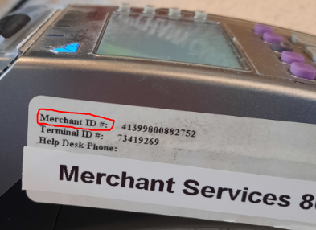
Merchant IDs
Merchant Identification numbers (MID’s) are used by GlobalPay to differentiate between departments.
UM’s MID’s start with 413998….
This number is tied to your equipment or Transaction Express
processing and is included in the Banking information when
the payment comes in.
Merchant ID | DBA | Detail Code
41399800882760 | UM COLLEGE OF FORESTRY | CCFO
41399800883644 | U OF MONTANA | CCBL
41399800885490 | GRIZ CARD CENTER | CCGW

Slide 5
Detail Codes
A detail code is a shortcut for an accounting string.
Every MID is assigned a detail code that begins with “CC”
The accounting associated with the detail code will be a department index and account code 50287 – the credit card clearing account code
Example: CCFO – Forestry CrCd Clearing.
The accounting where the payment will post when it comes into the Bank is a credit to MFR823 50287

Slide 6
A Credit Card Payment is taken

Slide 7
Settlement Report
A Settlement Report should be run at the end of every day if you collect $500 or more in payments.
If you do not collect $500, you should run a Settlement Report at least once a week.

Slide 8
Deposit
If your department takes credit card payments, you must make a credit card deposit in Treasury.
The Settlement Report is used as the back-up documentation to support your deposit amount.
Using the detail code associated with your MID in the bottom portion of the deposit card will post a debit to your 50287 credit card clearing account.

Slide 9
Deposit Card Example

Slide 10
Payment>Bank>Banner
Daily Singlepoint Report from US Bank shows transactions entering the bank.
An automated process builds a file from a Portfolio Report downloaded from Global Pay to post the payment as a credit to the corresponding accounting associated with the detail code in Banner.

Slide 11
Bank to Banner Reconciliation
Business Services does a reconciliation to make sure that payments in the Bank match the postings in Banner.

Slide 12
Reconciliation of 50287 Account
Someone in the department should be completing a reconciliation of the 50287 account code monthly. This is a clearing account and should have equal debits and credits and should net to 0.
Reconciling your 50287 account will be easier if you settle every day because the payments from Global Pay will match your deposit as most of the MID’s auto-close at the end of the day.

Slide 13
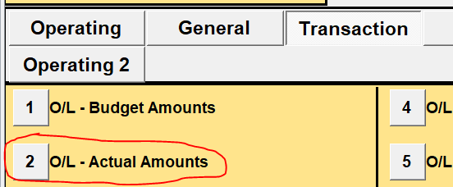
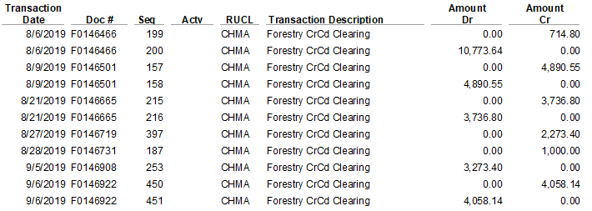
Reconciling Using UMDW
Transaction Tab with the index and account code 50287 as the Chart Elements Report #2 This can also export as an Excel spreadsheet.
Debits should equal credits except for timing differences

Slide 14
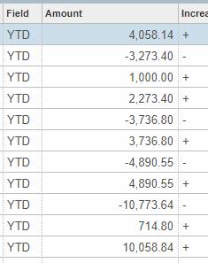
Reconciling Using Banner
FGIBDST Screen with the index and account code 50287 as parameters
Go
Related – Transaction Detail Information [FGITRND]
Tools – Export – this will give you an Excel spreadsheet you can manipulate if you like Excel and Banner
Debits should equal Credits except for timing differences

Slide 15
Fiscal Year End
The 50287 account code must be zeroed out at fiscal year end.
Departments should make a final credit card deposit at Treasury before it closes for the fiscal year. Treasury’s hours are usually advertised on the Campus Cut-off Schedule. The deposit will ensure that the information at FYE is as up-to-date as possible.
If the debits and credits do not zero out, Business Services will make an entry to force the clearing of 50287. The entry will be reversed in the new fiscal year so department processes remain constant.

Slide 16
Fees
7 cents per transaction, regardless of how payment was processed.
$2 Monthly minimum

Slide 17
Chargebacks
Departments are responsible for responding to any chargebacks - if possible. Business Services does not take care of this task.
Departments with outdated machines are more likely to be liable for chargebacks if they do not have a chip reader.

Slide 18
Merchant Services Help #
Merchant Services Help phone number is:
800 – 654 – 9256
This number can also likely be found next to the Merchant ID on your credit card machine.

Slide 19
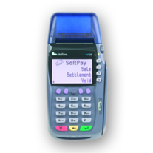
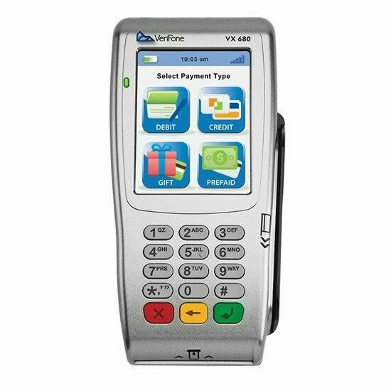
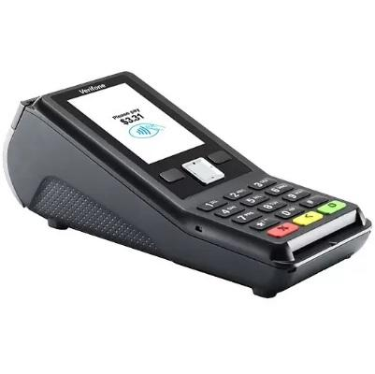
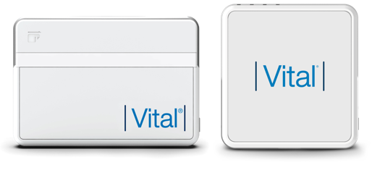
Credit Card Machines
Consider replacing
New – works with contactless pay
Vx570
Vx680
Vx520
V400c
Vital POS

Slide 20
Questions

