Slide 1
October Scholarship Forum
With the Financial Aid Office, UM Foundation, and Business Service.
October 6, 2023
Notes:
Raven presents
Complete.

Slide 2
August Scholarship Forum Recap
Topics covered in the last Forum:
Award Summary Sheet Instructions
Correction Award Summary Sheet Instructions
Responsible Party/ Signer Approval
Notes:
Raven presents
Complete.

Slide 3
Financial aid office updates and reminders
Important Dates and Deadlines:​
NEW! Opportunity Administrator Request Form
If you need to request access for an individual to be an Opportunity Administrator in the Scholarship Portal. Please have your Dean/Director fill out the following webform. https://www.umt.edu/finaid/scholarships/opportunity-admin-request.php
A link to this form has been added to the Department Resources Webpage.
Please make sure to include the individuals’ NetID as this will allow us to grant them access.
Beginning October 1st: The Portal is currently going through Cycle Management to archive all 2023-2024 scholarships and copying them for the 2024-2025 year. ​
It is now CLOSED for this process​
All administrators and students can no longer access the Portal for any reason.
November 1st: The Scholarship Portal will open for the 2024-2025 academic year.
December 1st: Last day to submit 2023-2024 Fall only awards via an award summary sheet.
Note: 2024-2025 FAFSA will not be available for students to fill out until December.
Reminder: Please allow at least 10 business days for processing. The Financial Aid Office is currently shorthanded.
Notes:
FAO Presents
Complete.

Slide 4
UM Foundation Reminders and Updates
Scholarship Budget and Criteria Reminders
All pertain to donor or department funds​
Awarding departments must make every effort to fully utilize all scholarship funds available.
Please continue to use the Scholarship Budget (Excel) included in your department’s Box folder in your process of tracking and reconciling awards to prevent over awards.
Awarding departments must adhere to documented criteria and donor intent​. There is a legal obligation to follow donor intent, whether the donor is living or deceased.​
Please continue to use the Scholarship Criteria Report (PDF) included in your department’s Box folder to ensure the awarded students meet the donor criteria.
If Financial Need is a scholarship criterion, it must be verified with the Financial Aid Office​.
Scholarship awards that are made to students who do not meet donor criteria will not be paid by the Foundation. Your department will be asked to find an alternate appropriate source of funding for the award​.
A message from our Stewardship team:
Scholarship Thank You Letters for academic year 2023-2024 are being reviewed, edited, and mailed.
If your unit plans to publish content regarding privately funded scholarships, please consult with the UM Foundation to ensure donors are appropriately featured and/or informed. Your partnership helps the UM Foundation honor formal media and stewardship agreements with generous supporters who invest in scholarships.
Scholarship Administrator Contact Email Listserv
Please send the Foundation and Financial Aid Office any new contacts (and their info including their umontana employee email address) who are assisting with Scholarship Administration in your unit/department or program
Notes:
Raven Presents:
Ask Emily for updates.

Slide 5
2023 – 2024 Academic year timeline & Monthly to Do List
Processing Times:​​
Please keep in mind that the Financial Aid Office is shorthanded currently, processing times are taking at least 10 business days.
October 1st – Cycle Management began, administrators and students currently cannot access the Portal.
Any remaining awards for the 2023-2024 academic year must be made using an Award Summary Sheet. Email to fascholarships@mso.umt.edu and umfawardsummarysheets@supportum.org.
To download a copy of the 2023-2024 AY Award Summary Sheet or Correction Sheet please visit the Department Resources Website.
Students can submit thank you letters to thankyou@supportum.org. Contact Emily Shankle, UM Foundation - Donor Stewardship Manager at (emily.shankle@supportum.org) if you have any questions.
October 31st – Last day of Cycle management.
November 1st – Scholarship Portal opens for the 2024-2025 scholarship cycle.
Begin reviewing scholarship qualifications in the Scholarship Portal​
Set open and close dates​
DO NOT enter an Archive Date. The FAO archives automatically through Cycle Management. ​
DO NOT enter budgets, UM Foundation will do this once they know the budget.
November 10th – Veterans Day – No Classes, Offices Closed
November 22nd – Non-instructional travel day for students.
November 23rd - 24th – Thanksgiving Holiday (UM Closed)
December 1st – Last day to submit 2023-2024 Fall Only scholarship awards.
Please ensure your Scholarship Committee is properly set up with the Scholarship Portal if they plan to use it to review scholarships.
Reconcile your 2023-2024 scholarship budgets against what had paid/disbursed to ensure students have received payment.
Make all Spring 2024 only awards.
December 8th – Last day of Regular Classes
December 11th – 15th – Final Exams
December 15th – Fall Commencement
October
November
December
Notes:
FAO presents
Complete.

Slide 6
TOPICS:
Tracking and Reconciling
UM Foundation FAQ
Notes:
Raven Presents:
Complete

Slide 7
Notes:
Raven Presents:
Complete

Slide 8
Tracking and Reconciling
Reminders:
It is the unit/departments sole responsibility to:​
Track recipient names​
Track award amounts​
Track and reconcile available budget balances throughout the award cycle​​
Differentiate between how scholarships are made (Portal v. AWSS). This may be helpful especially if you have multiple administrators making awards.
Processing and Disbursement​
UMF does not have access to campus resources, such as Banner (includes Finance) or UMDW. ​
Foundation payment to Business Services to reimburse scholarship expenses
Is limited and not in real-time​
Only occurs monthly through the Scholarship Billing Process​​
Questions regarding processing, or why students have not received money should be directed to the Financial Aid Office.
Notes:
FAO Presents:
Complete.

Slide 9
UM Foundation Trivia!
Notes:
Raven presents
Complete.

Slide 10
WHO DETERMINES HOW GIFTS ARE USED? AND WHO SETS THE FUNDRAISING PRIORITIES?
The Finacial Aid Office
Professors & Students
The UM President
Monte
Notes:
Raven Presents:
Complete.

Slide 11
WHO DETERMINES HOW GIFTS ARE USED? AND WHO SETS THE FUNDRAISING PRIORITIES?
The Finacial Aid Office
Professors & Students
The UM President
Monte
Explanation:
The UM President communicates the University’s fundraising priorities to the UM Foundation. In turn, the UM Foundation provides guidance to the President on what projects or purposes are most likely to appeal to donors. The UM Foundation invites donors to learn about and invest in the priorities identified by the UM President.
Notes:
Raven Presents:
Complete.

Slide 12
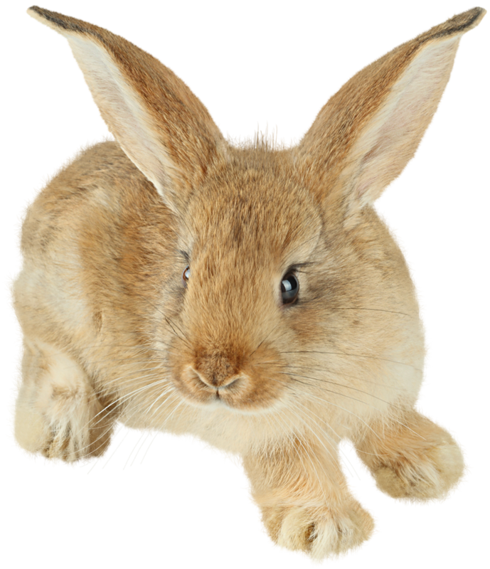
What is one way the UM FOUNDATION BENEFITs UM?
Provides UM with a critical and significant source of private support that augments other University revenue sources.
Ensures a steady source of financial support to the University that is not subject to fluctuations in state revenues or changing priorities of state lawmakers.
Enhances achievement of the UM mission through philanthropic gifts that do not reduce or replace state support.
All of the above.
Notes:
Raven Presents:
Complete.

Slide 13
What is one way the UM FOUNDATION BENEFITs UM?
D. All of the above
Explanation: ​
The UM Foundation serves individuals, families, businesses and private foundations that aim to support UM with philanthropic gifts in areas which match their interests, passions or criteria for philanthropic giving. The UM Foundation offers specific benefits to UM and donors alike.
Additional Benefits to UM
Offers investment of a privately funded endowment beyond the low-risk, low-return strategies often mandated by states, thereby increasing the opportunity for greater investment return and revenue available to UM.
Notes:
Raven Presents:
Complete.

Slide 14
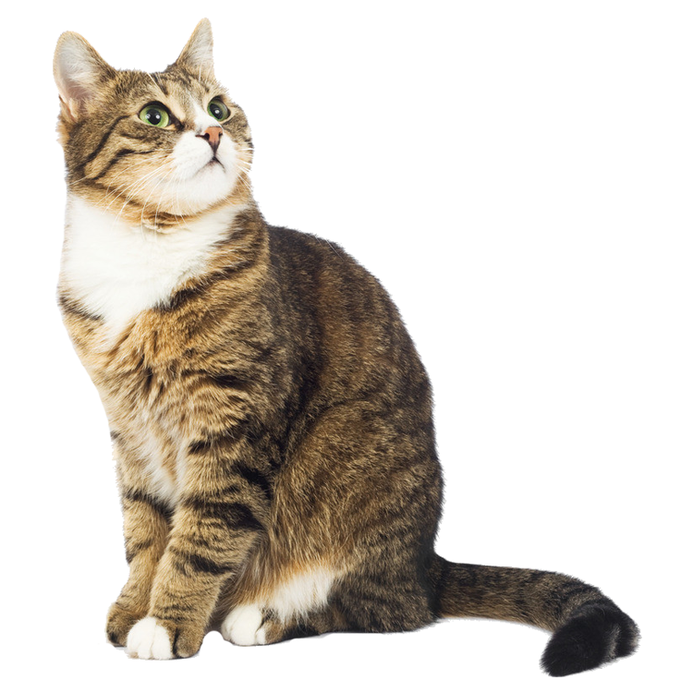
What is one way the UM FOUNDATION BENEFITs Donors?
Assists donors in understanding the University’s mission, and also supports engagement and evaluation of opportunities for philanthropic giving.
Facilitates philanthropic gifts from donors who feel more secure giving to a separate nonprofit organization like the UM Foundation, knowing their gifts are held separate from state funds and will be used in accordance with their wishes.
Safeguards the privacy of donors who may not want the details of their personal finances to become a matter of public record and ensures confidentiality or anonymity when requested.
All of the above.
Notes:
Raven Presents:
Complete.

Slide 15
What is one way THE UM FOUNDATION BENEFITs DONORS?
D. All of the above
Explanation:
Additional Benefits to Donors​
Provides appropriate acknowledgement and recognition, informs donors of the impact of their giving, and helps donors experience the joy of philanthropic giving.​
Offers engagement with professional staff who are passionate about delivering exceptional donor experiences.​
Ensures oversight by an independent governing Board of Trustees committed to fulfill their fiduciary responsibility, act with diligence and make good-faith decisions consistent with the UM Foundation mission.​
Fosters opportunities for individuals to engage through their volunteer service and financial contributions (gifts) to help advance the UM mission.​
Adheres to federal and Montana law pertaining to private corporations and nonprofit organizations. The UM Foundation has been extended tax-exempt 501(c)(3) status enabling donors to deduct their gifts to the extent allowed by law; files an IRS Form 990 annually; operates under an agreement with UM that is reviewed and approved by the Montana University System Board of Regents; annually shares independently audited financial statements; adheres to bylaws; and publishes an annual report.
Notes:
Raven Presents:
Complete.

Slide 16
IN TIMES WHEN THE UNIVERSITY OF MONTANA EXPERIENCES BUDGET CHALLENGES, WHY DOESN'T PHILANTHROPIC GIVING OFFSET THOSE CHALLENGES?
Because UM does not accept philanthropic gifts.
Because the majority of philanthropic gifts are designated for a specific purpose.
Because not enough philanthropic gifts have been received.
Because philanthropic gifts are used only for student scholarships.
Notes:
Raven Presents:
Complete.

Slide 17
IN TIMES WHEN THE UNIVERSITY OF MONTANA EXPERIENCES BUDGET CHALLENGES, WHY DOESN'T PHILANTHROPIC GIVING OFFSET THOSE CHALLENGES?
Explanation:
The vast majority of philanthropic gifts received by the UM Foundation are designated by donors for a specific purpose.
The philanthropic gifts extended by donors and accepted by the UM Foundation are tremendously impactful for UM and the constituents it serves. The gifts are often designated toward scholarships and other student support, faculty support and campus innovation. In times of campus budget constraints, philanthropic giving is not expected to offset budget challenges, but it does fuel student success and innovations that drive budget recovery more quickly.
Because UM does not accept philanthropic gifts
Because the majority of philanthropic gifts are designated for a specific purpose.
Because not enough philanthropic gifts have been received
Because philanthropic gifts are used only for student scholarships
Notes:
Raven Presents:
Complete.

Slide 18
How much money has disbursed to students as of the September Scholarship Billing?
$500,000
$850,000
$1 Million
Over $2 Million
Notes:
Raven Presents:
Complete.

Slide 19
HOW MUCH MONEY HAS DISBURSED TO STUDENTS AS OF THE SEPTEMBER SCHOLARSHIP BILLING?
Explanation:
Approximately $2,379,660 have disbursed to students as of the September Scholarship Billing.
$500,000
$850,000
$1 Million
Over $2 Million
Thank you!
Thank you to all who have made their awards and are continuing to do so. Your efforts are greatly appreciated!
Notes:
Raven Presents:
Complete.

Slide 20
Questions?
Notes:
Raven Presents:
Complete.

Slide 21
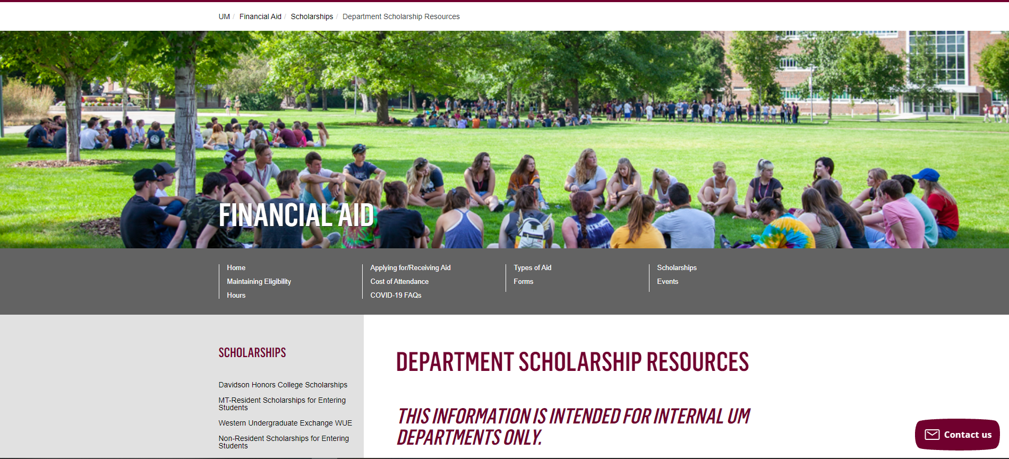
Department Scholarship Resource Webpage
Who is this for? ​
YOU! As a scholarship administrator/contact, these resources are for you, to use throughout the year as you go through your scholarship process.​
​
What can I find there? ​
Portal Administrator Request Form
Award Summary Sheet and Correction​
UM Portal Handouts/Instructions ​
Past Presentation Materials ​
Thank You letter information ​
FAO, UMF and Business Service Contact Information ​
How do I access this webpage?​
Please SAVE/Bookmark this link https://www.umt.edu/finaid/scholarships/department-use-resources.php. This link is “hidden” to reduce access from students.​
​
Notes:
Raven Presents:
Complete.

Slide 22
Looks LIKE SOUNDS Like
Financial Aid Contacts | UM Foundation Contacts
Christina Peltier Financial Aid Specialist II- Scholarship Manager christina.peltier@mso.umt.edu (406)243-4810 | Korla McAlpine Scholarship Administrator Korla.mcalpine@supportum.org (406) 243-4260
Nicole Krause Financial Aid Specialist I – Scholarship Coordinator nicole.krause@mso.umt.edu (406)243-4930 | Sarah Wade Assistant Director of Fund Administration Sarah.wade@supportum.org (406) 243-5592
Department Scholarship Resources Webpage: https://www.umt.edu/finaid/scholarships/department-use-resources.php | Nancy Randazzo Director of Gift and Fund Administration Nancy.Randazzo@supportum.org (406) 243-4739
 | Emily Shankle Donor Stewardship Manager Emily.shankle@supportum.org (406) 243-2506
To contact the Financial Aid Office main line please call (406) 243-5373 | Raven Clark Fund Administration Coordinator raven.clark@supportum.org (406)243-2407
Location: Aber Hall, 5th floor | Location: Gilkey Building, 2nd Floor. Our team is in office Monday-Tuesday, working remotely Wednesday-Friday.
Financial Aid Office Email: fascholarships@mso.umt.edu (Use to submit award summary/award summary correction sheets and any award questions) | UM Foundation Email: umfawardsummarysheets@supportum.org (for scholarship department questions)
Business Services Contact
Barb Bybee (406) 243-6261 Barb.bybee@mso.umt.edu
Notes:
Raven Presents:
Complete.

Slide 23
Thank you for joining!
Stay tuned for October Communication that will include important
scholarship information and deadlines.
Notes:
Raven Presents:
Complete.

