Slide 1
Montana World Affairs Council
“Virtually Fantastic”
Montana International Educators Conference
June 18 – 19, 2020

Slide 2
Who Are We?
Chris Hyslop
Nonpartisan, nonprofit organization dedicated to fostering global awareness and understanding in Montana’s classrooms and communities.
Resource and partner of choice for understanding global issues and how they affect Montana and Montanans.

Slide 3
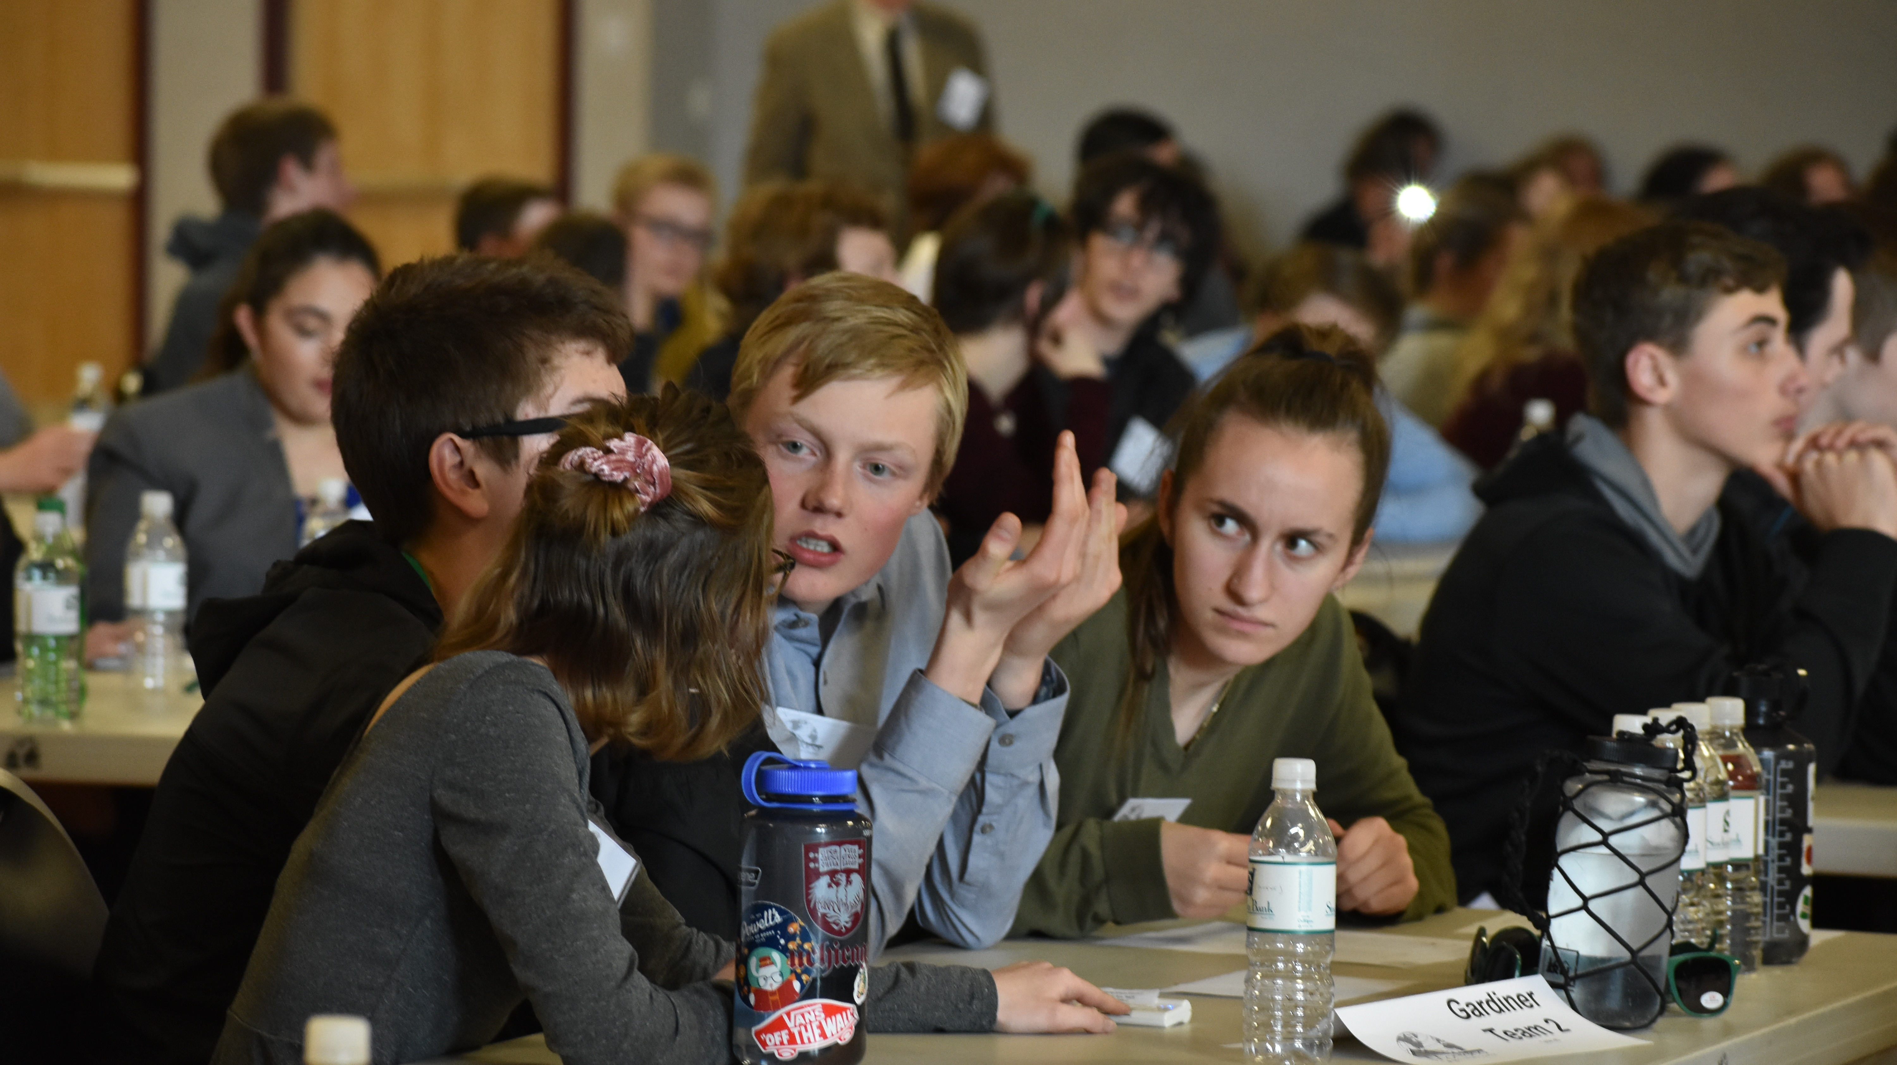
Why This? Why Now?
Unprecedented opportunities to understand and influence global events.
Global issues impacting directly and more immediately.
Montana is involved in these issues and want to shape policy.
Montana’s students are preparing to enter an unparalleled era of global engagement.

Slide 4
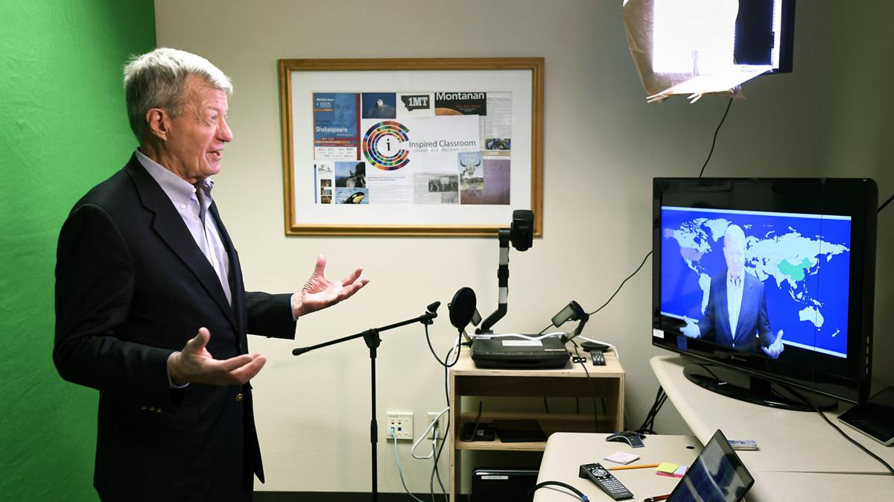
Programs
Student to Student Global Exchange
Council in the Classroom/GeoQuest
Connect Montana
Council on the Radio

Slide 5
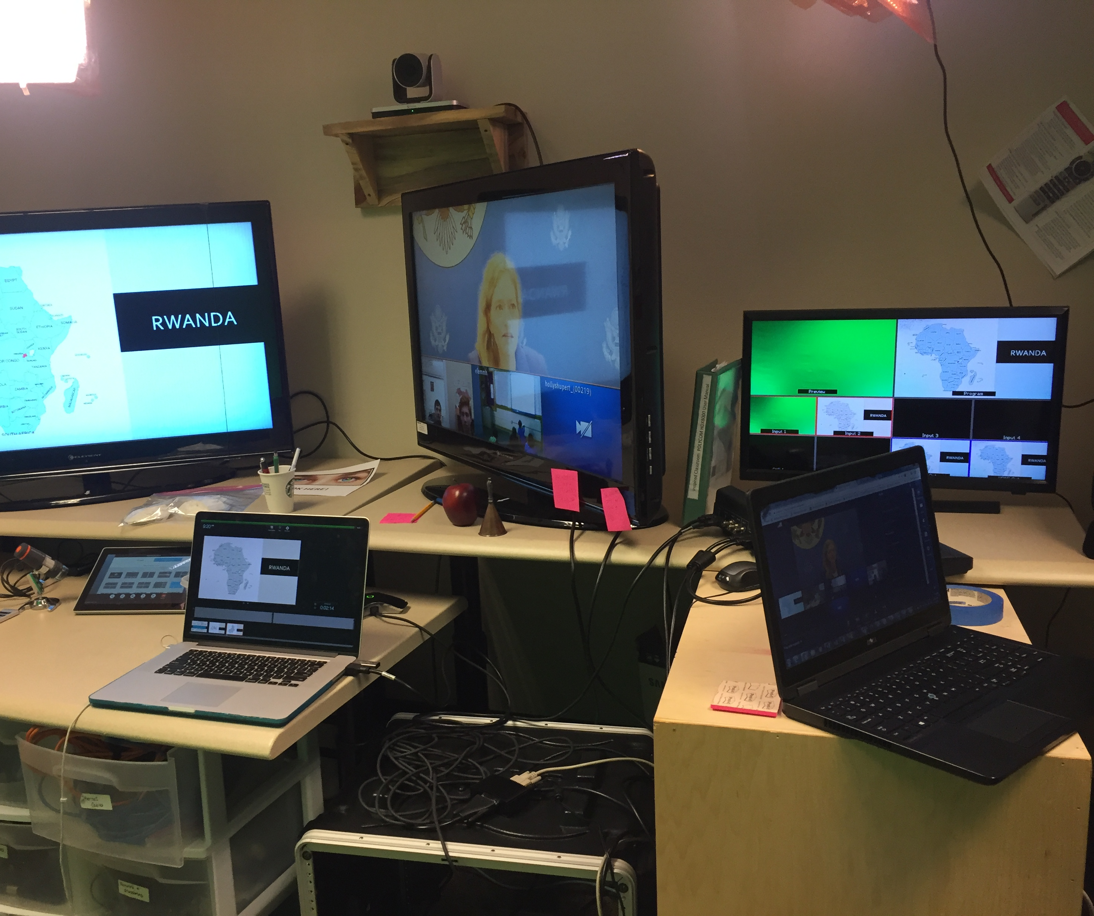
Why and How?
Montana’s geography
Limited opportunities
State-wide internet access
Partnering with Inspired Classroom
Off-the–shelf tools
Human contact

Slide 6
What Needs Are We Meeting?
Schools facing constraints
Prepare the next generation of citizens
Foster awareness of critical and timely global issues
Education and technology go hand in hand
21st Century Skills
Better citizens and learners
Students: self-initiated learning, actively seek to satisfy curiosities.

Slide 7
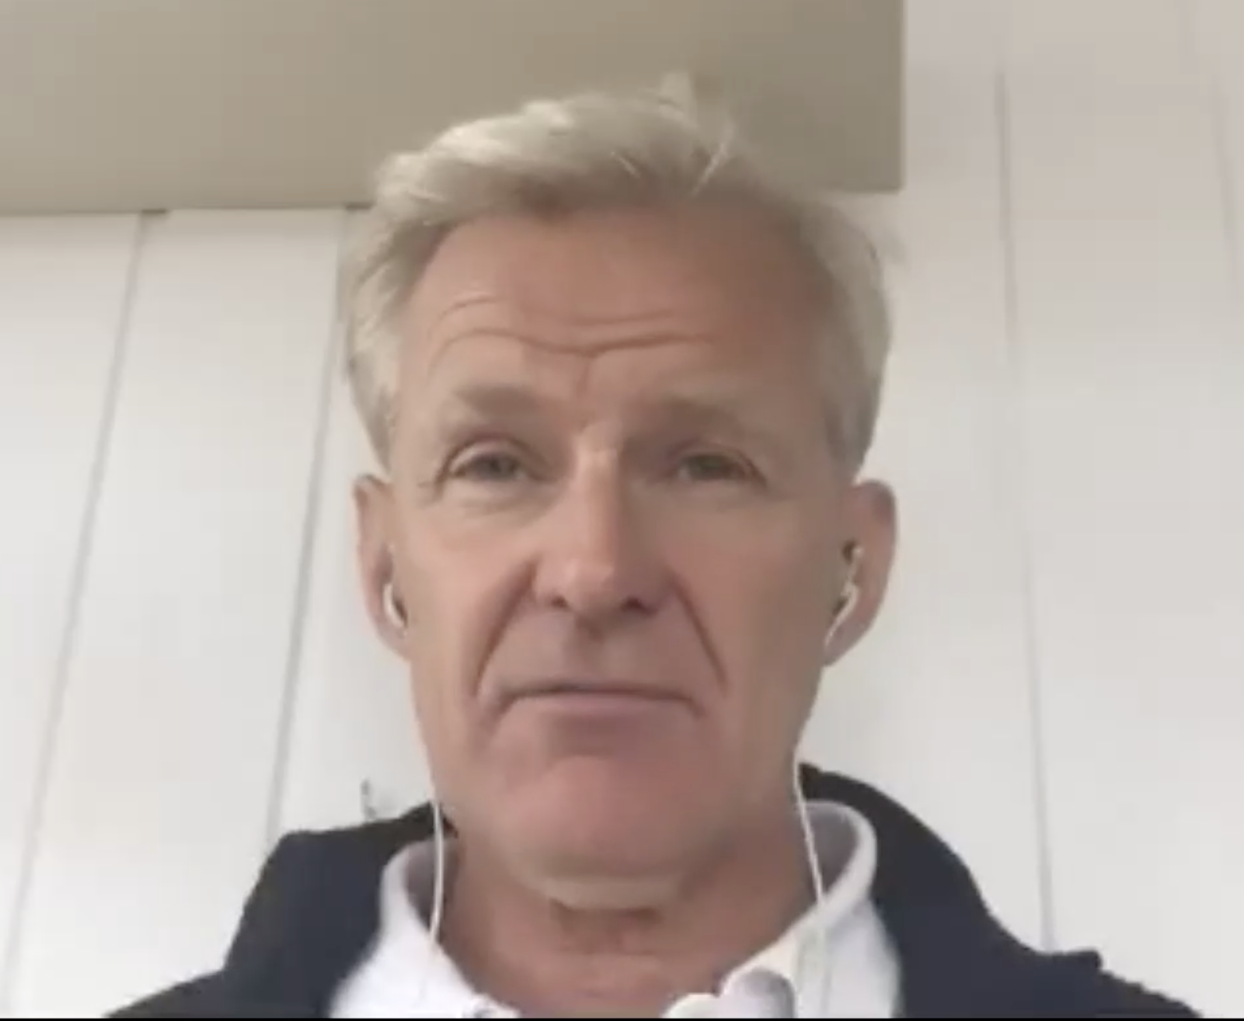
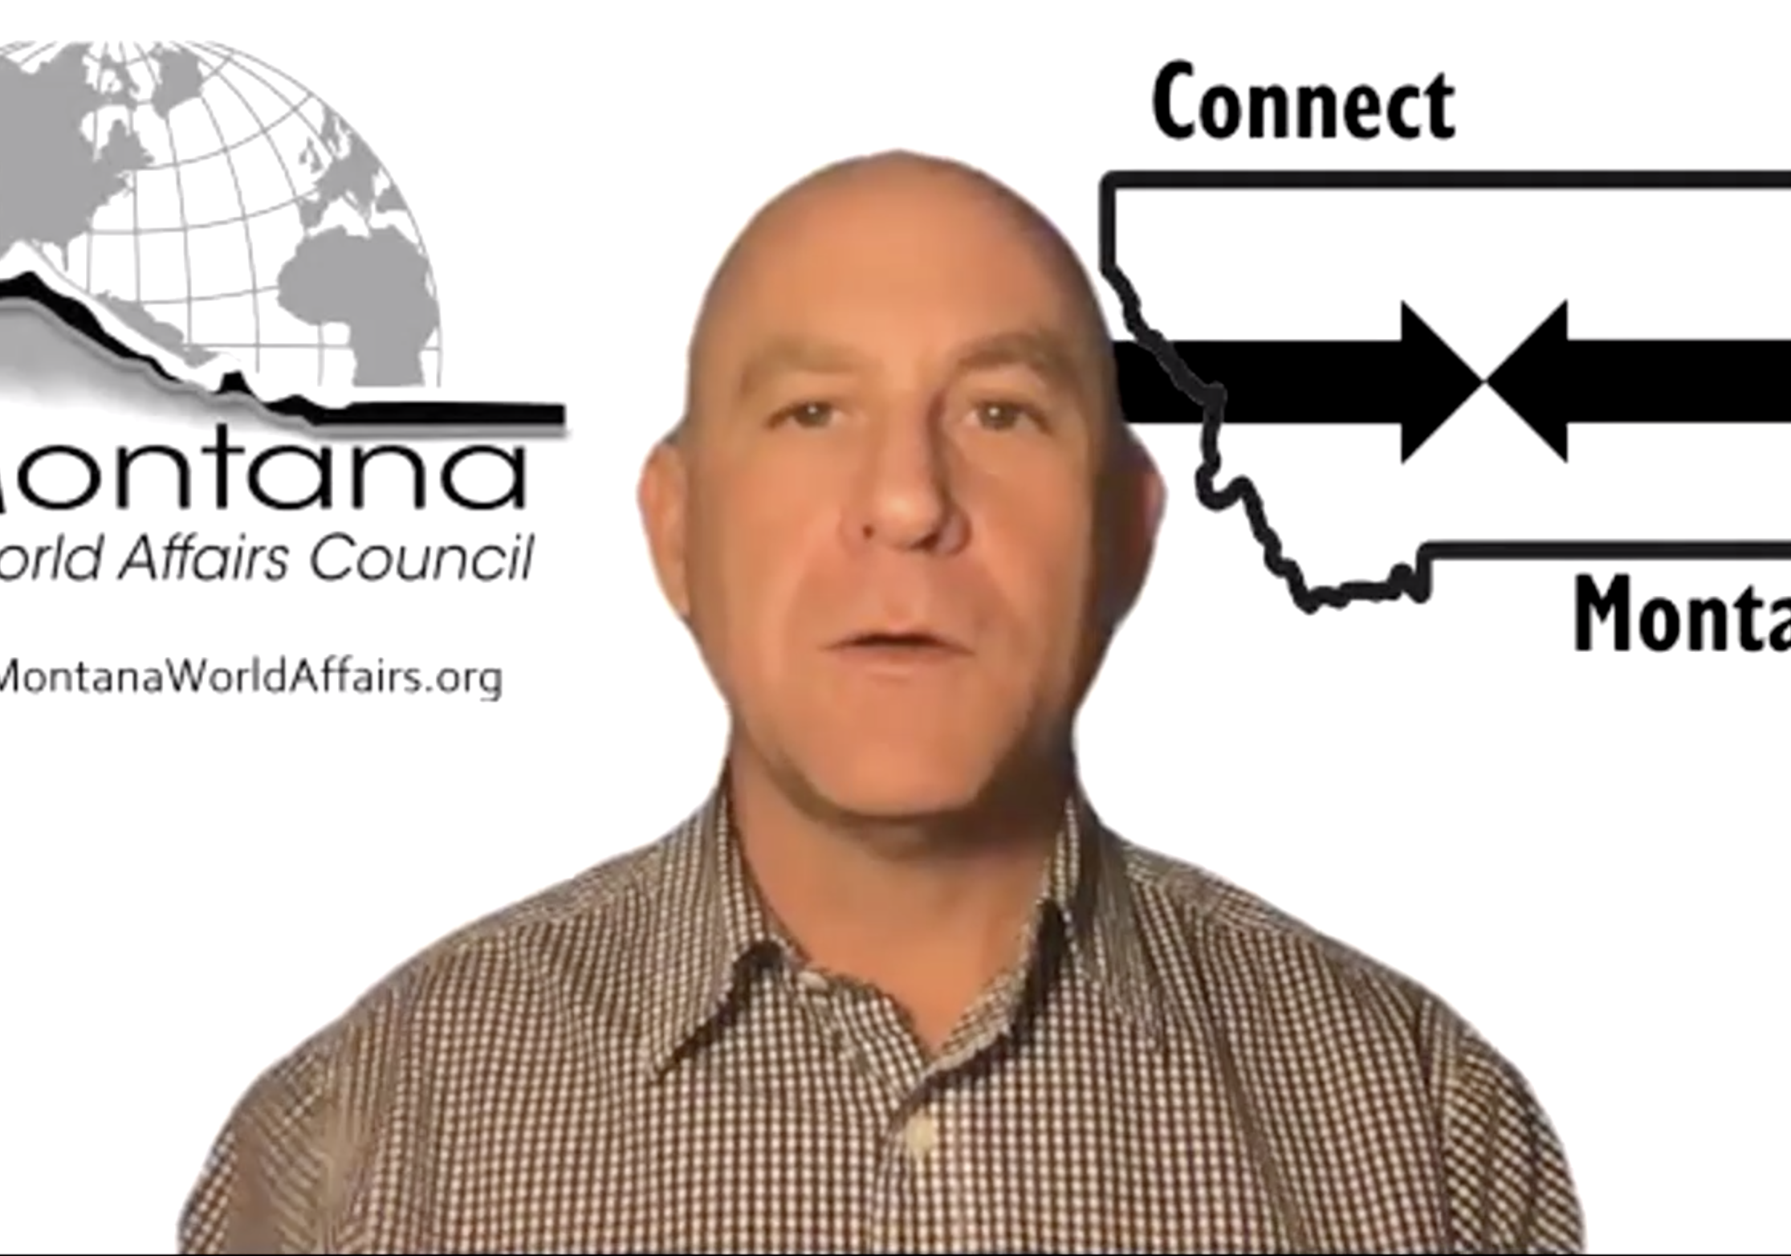
Outcomes
Develop globally competent students who can examine local, global and intercultural issues,
Understand and appreciate different perspectives, interact successfully and respectfully with others,
Take responsible action toward sustainability and collective well-being.

Slide 8
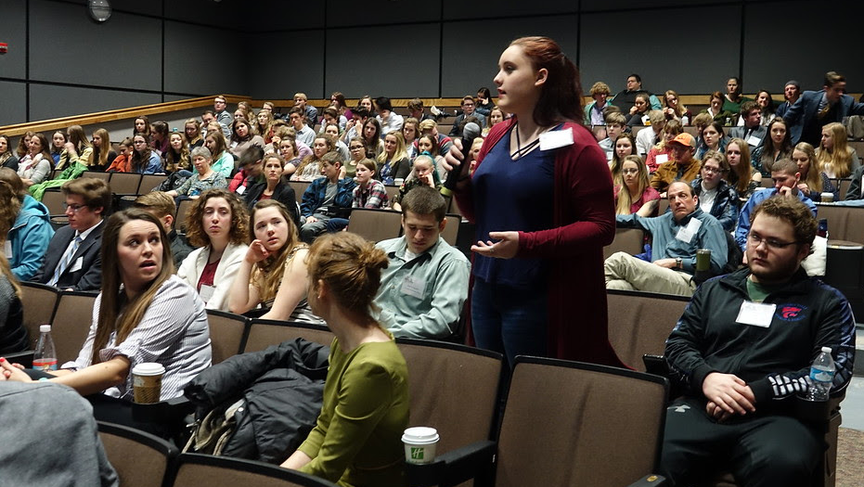
Thanks Any Questions?
Email: info@montanaworldaffairs.org
Facebook @montanaworldaffairscouncil
Instagram: montana_worldaffairs
Web: www.montanaworldaffairs.org

