Slide 1
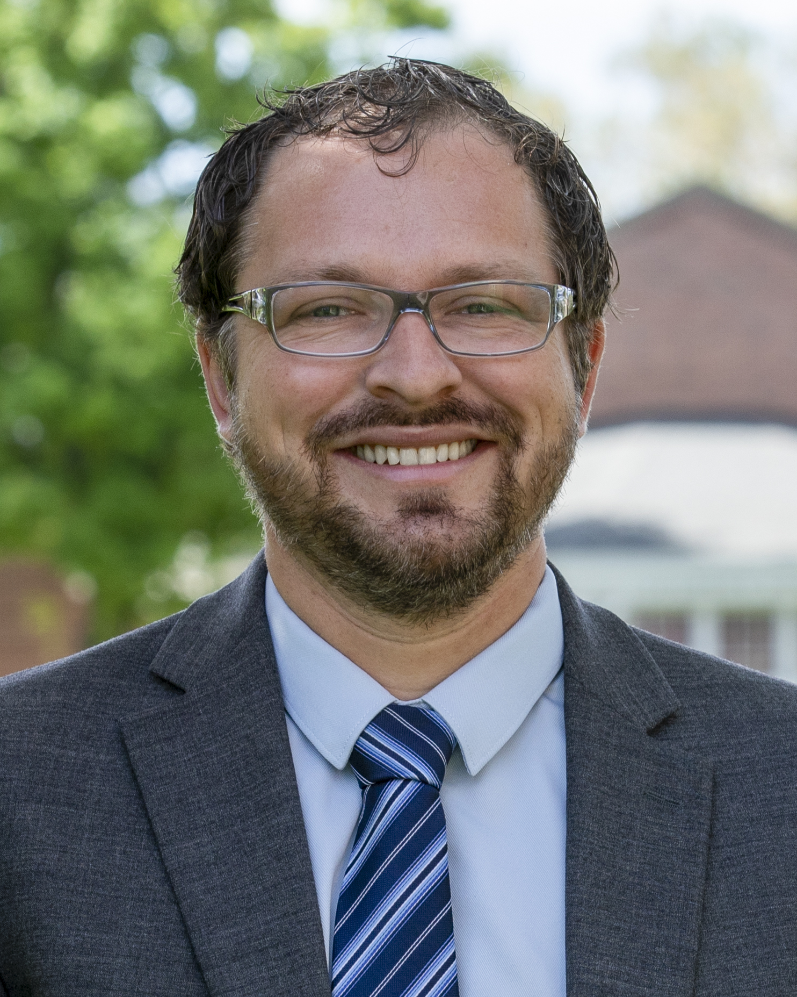
Recruitment Post Covid
Phillip VanDenBrink

Slide 2
Qualifications
Bachelor’s Degree in International Business, German, minor in French, TESOL though Aquinas College
Master’s in Foreign Language Education from Middlebury College
Master’s in Educational Leadership from the University of Cincinnati
International Educational Leadership PhD Student through the University of Montana.

Slide 3
International Experience
Exchange Student in Germany
Internship and semester abroad in Germany
Teaching in France
Teaching at an International Boarding School in Utah
Administration in China
Administration in Switzerland
Administration in Montana
Admissions in at an international boarding school in Utah

Slide 4
Current Issues in International Education
Covid-19
Race, Riots and Discrimination
Economic Uncertainty
Other?

Slide 5
Covid-19 and International Relations
新冠肺炎疫情凸显“美式人权”危机
2020年06月12日10:18 来源：人民日报客户端
Translation: The Covid-19 highlights the crisis of American Style Human Rights
Link: http://usa.people.com.cn/n1/2020/0612/c241376-31744808.html

Slide 6
Education and Media
美媒：美计划驱逐3000名中国研究生 专家：还是在“甩锅”转嫁责任
American Media: The US plans to expel 3,000 Chinese graduate students; Expert: shirk responsibility and shift the blame onto others June 2nd 2020
http://usa.people.com.cn/n1/2020/0602/c241376-31732721.html

Slide 7
Racism
“我透不上气”——黑人枉死再揭美国种族痼疾
"I can't breathe" -- a black man's death reprising America's racial ills
June 1st 2020
http://usa.people.com.cn/n1/2020/0601/c241376-31731517.html
Notes:
Image Link: https://www.aljazeera.com/news/2020/05/remembering-george-floyd-devoted-father-gentle-giant-200531070908430.html

Slide 8
Economic Uncertainty
The Global Economic Outlook During the COVID-19 Pandemic: A Changed World
June 8, 2020
Notes:
Link: https://www.worldbank.org/en/news/feature/2020/06/08/the-global-economic-outlook-during-the-covid-19-pandemic-a-changed-world

Slide 9
"Teachers open the doors, but you must enter by yourself. Chinese Proverb
The Pandemic led to the fastest changes in education the world has ever seen
Families see the power of education
New methods and pedagogy were implemented with outstanding creativity
New approaches will continue
Notes:
Quote Link: https://www.motivatingquotes.com/opportunity.htm
Article referenced: https://www.nytimes.com/2020/03/17/technology/china-schools-coronavirus.html

Slide 10
Proactive
Offer Hope. We may not have all the answers, but our team is meeting weekly to discuss these concerns. Please allow me some time to get back with you.
Example: Parents worried that there are some differences between online and school courses, and they want to know how to ensure the quality of online courses? We have continued to have high quality. Even our science experiments online this last part of the school year used items that are common in homes. For example, testing Ph levels, students had to find cleaning products and fruits and it was done in a safe way, but students were still able to learn about Ph levels and what different levels do. In addition, there were some more creative assignments from art teachers and English teachers. They were quite fun to watch.

Slide 11
Personal
Parents want to know their children are safe. We have more parent meetings now than in normal cases.
Example: If students need to be self-quarantined 14 days after arriving in the United States, is there any arrangement in the school? will the school provide accommodation and catering? Yes, we have planned for extra homes and nurses to work for the school if this would happen. We have all safety measures in place. We will provide for all the needs of the student including online meetings with the teacher for help. We will video all classes if this would happen so students can be live in the classroom even if they are quarantined in another are of the campus. Our quarantine areas also have outdoor spaces as we feel it will help students to heal faster if they are outdoors but away from other students.

Slide 12
Public
Be open with changes. Post updates on website and social media more frequently.
If students can arrive to start school on time, what kind of preventive measures will be provided by the school? (e.g. accommodation, catering, campus, transportation, extracurricular activities) We will change the rec trips to be fun, but in less populated areas. We are also doing a “staggered entry” with all students being tested for Covid upon arrival. We also have extra homes set up in case there is an outbreak. We also are close to a hospital in case a student has the Covid. We do not expect this, but we have a lot of safety in place. Our cafeteria also has options for “takeaway meals” We are also spacing and limiting class sizes and number of students on transportation. We have a mask policy for everyone and extra time between classes so tables and classrooms can be sanitized. We will have a lot of extracurricular, but it will be safe and fun at the same time.

Slide 13
Payment Policy
We are all facing economic uncertainty but working with families in these new circumstances helps to reassure.
Example: Due to the COVID-19 and other objective reasons (such as travel bans, visa denial, etc.), students can’t enter in the 2020-2021 academic year, what is the refund policy? We do have a refund policy or deferment. If there is a travel ban, we offer 100% refund policy. There is more information on this link: https://wasatchacademy.org/coronavirus-update

Slide 14
Policy Statement for Unity
Meeting the Challenges—Together
Thursday, June 4, 2020
Dear Wasatch Community,
The world is at a turning point. In the wake of these last few months, the country and the globe have witnessed a variety of tragedies. From the scourge of pandemic to the horrific, senseless deaths of Ahmaud Arbery, Breonna Taylor, George Floyd, and others at the hands of brutality and prejudice, recent events have exposed many daunting rifts within core tenets of our society.
Rarely throughout history do we experience moments like these that demand so much. Moments that demand some of our most visceral emotions—loss, anger, frustration, sorrow—but also our most powerful responsibilities. Our responsibilities to act and to lead.
Community lies at the heart of the Wasatch Academy Mission Statement. Whether it is fostering lifelong relationships between classmates or bringing students from across the world to engage in scholarship, we are dedicated to bridging divides and shaping the future, together.
Wasatch Academy itself operates from a unique vantage point. Located more than 100 miles from any civil unrest or violence and in a well-equipped city with zero cases of COVID-19, our school is fortunate to function in extraordinary safety. And while we, unlike many other locations across the country, may enjoy this luxury, it comes with responsibility.
As our staff, faculty, and students continue to pursue the ideals of a prosperous and equitable society, we are charged with taking full advantage of doing so under an umbrella of protection. It is our duty to raise the next generation of global citizens and leaders who will affect the change and reforms that are desperately needed today from a place of refuge and security.
We do not yet know what the rest of the 21st century holds. But it is certain our students will number greatly among the people who construct the rest of history—a history built by the compassionate, the strong, and the unified; a future designed for equality and the dignity of every human life. Wasatch Academy pledges its full support, one student at a time.
Sincerely,
Joseph Loftin Head of School

Slide 15
Results
Reassurance is the key
American Education continues to value each student
We must help build a better future for all.
Unified hopeful attitudes and working as a community will help
Recruitment can go up in these times

Slide 16
Discussion
What was one new method, tool or technique you have learned from the online classroom experience?
What has been one thought-provoking message you have learned from the recent movements?
What impact will it have on international education in the United States?
How would you create hope in uncertain times for students and families?

