Slide 1
Navigate: Getting started
TRAINING FOR ALL ROLES

Slide 2
Help center
For links in this lesson to the Navigate Help Center, you MUST be logged into Navigate to access the url.
Take a moment now to log into Navigate, click on the question mark in the upper right of your screen, and browse to the Help Center.
Try this link to test if you are ready to continue.
GIF (must download this PowerPoint to watch) →

Slide 3
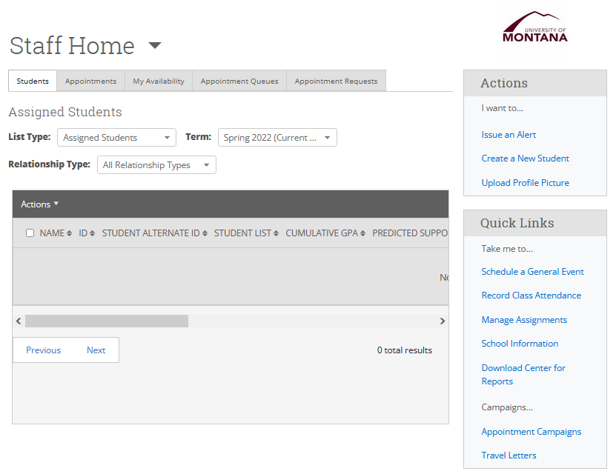
Your home screen
When you first log in, you will be shown a home screen labeled as either Staff Home or Professor Home or even Student Home.
Some features are only available depending on what roles you have been assigned.
For example, to submit progress reports on the Professor home screen, you must be in the faculty role.

Slide 4
Switching home screens
If you do have more than one home screen, you will sometimes need to switch between them.
To switch home screens, click on the triangle to the right of the “Staff Home” or “Professor Home” or whatever home label is displayed near the top.
Use that dropdown to select one of your other home screens.
GIF (must download this PowerPoint to watch) →

Slide 5
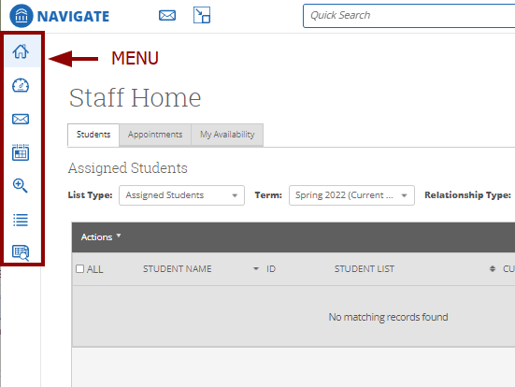
Menu overview
On the left side of the screen will be the menu as a vertical list of icons.
What icons you see depends on your role. You may have up to ten menu items.

Slide 6
Menu overview
You can click on the links below each menu item to learn more. However, for this lesson this is not required.
Availability depends on what role you have been assigned.
Home
Varies according to role
Staff Home
Professor Home
Dashboard
At-a-glance recent activity
Learn more
Conversations
Messages and reminders
Learn more
Calendar
Appointments, events, courses, and busy times
Learn more
Cases
List of open cases
Learn more
Campaigns
Create and view campaigns you created
Appointment Campaigns
Having trouble with links? Review the Help Center slide at the beginning of this lesson.

Slide 7
Menu overview
You can click on the links below each menu item to learn more. However, for this lesson this is not required.
Availability depends on what role you have been assigned.
To-Do
Upcoming and overdue todos
Learn more
Advanced Search
Find students using a ton of filtering options
Learn more
Lists and Saved Items
Student Lists
Saved Searches
Saved Reports
Analytics
Limited availability
Learn more
Reports
Varies according to role
Learn more
Admin
Not available
Having trouble with links? Review the Help Center slide at the beginning of this lesson.

Slide 8
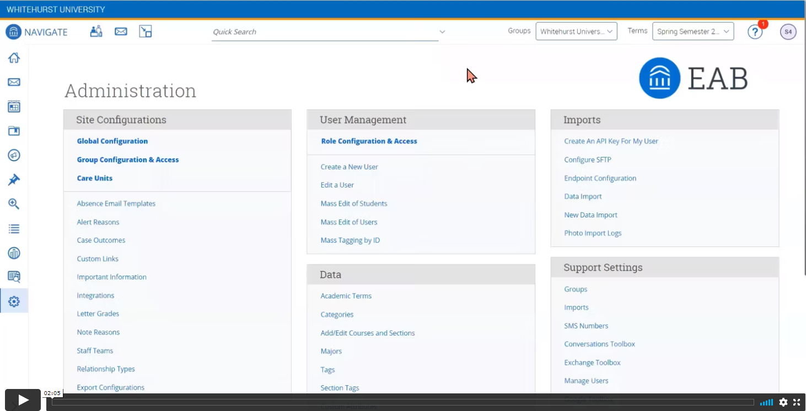
Search for a student
The fastest way to find a student is to enter their 790 number in the quick search at the top of every page.
You can also type in the student’s name, but because it is possible for some students to share the same first and last name it is best to use the 790 number.
Depending on your role, you may also have the ability to use the advanced search to find a student by major, advisor, category, course enrollment or many other details.
Click the image above to view a video about using search.
Note that the video is for an older version, but the functionality is about the same.

Slide 9
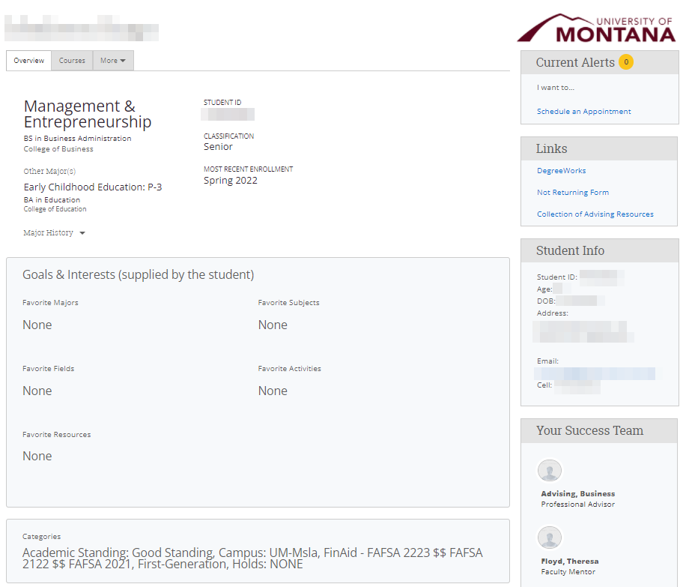
Student: Overview tab
Monte Bear
When you select a student, the first tab you see is the Overview tab. You may have other tabs available depending on your role.
On the Overview tab, you will be able to view a student’s major, classification, goals and interests, categories and other info.
If you advise current students, you will also see a 30-second gut check pane with current GPA, total credits, repeated course count, and other metrics (not shown at right).

Slide 10
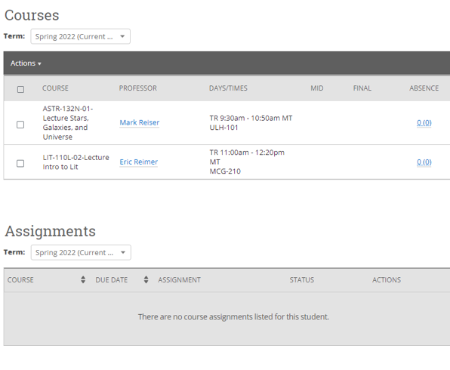
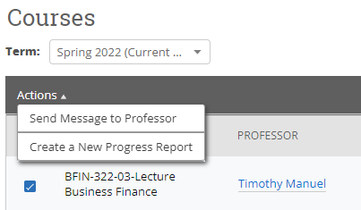
Student: Courses tab
Under the Courses tab, you can view the student’s current registration or select a term to view past registration.
If you select a course in this list, you can optionally perform other actions if your permissions allow it.
← This is not used at all.

Slide 11
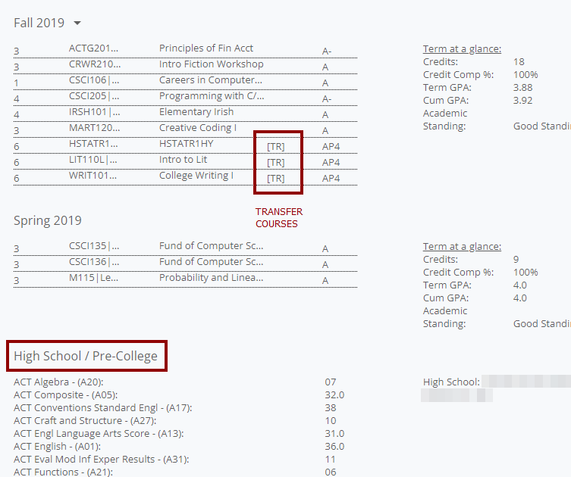
Student: Courses (history)
Towards the bottom of the page will be any coursework at UM including transfer courses.
If the student has any test scores recorded in Banner, they will appear in the High School / Pre-College section.

Slide 12
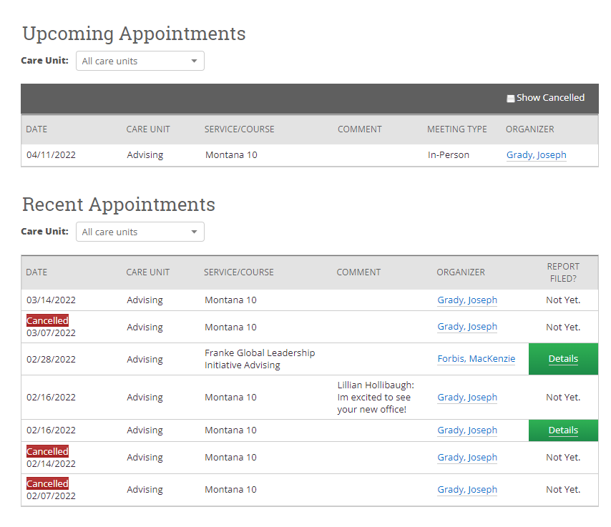
Student: appointments tab
You can find the Appointments tab under the More menu.
All appointments are listed in either Upcoming, Recent, or No Show tables (the No Show table is not shown in the image).
You can view the cancelled status as well as the service and the organizer (usually this is the advisor).
Depending on your permissions, you may be able to view the appointment summary notes by clicking the green Details button.

Slide 13
You have finished the lesson!
Questions on content?
Suggestions for improvements?
Any other thoughts?
For all of these, please email us at osstech@mso.umt.edu.
We would love to hear from you!

