Slide 1
Navigate: Setting up availability
Training for Faculty

Slide 2
Availabilities drive what students see
When scheduling an appointment, students are asked what type of appointment to schedule.
This is internally called the care unit.
Each care unit will have multiple possible services. However, the student will only see the services that have been configured in staff members availabilities.

Slide 3
Availabilities drive what students see
After also selecting a date, the students will be able to see all the people who offer the service.
In this example, the staff member who allowed both Drop-In and Appointments in their availability has times for the student to choose while the staff member who has open availability for Drop-Ins only just has the link.
In this lesson, you will learn how to set up your own availabilities.

Slide 4
Calendar Sync
Before setting up availabilities, you will want to sync your Outlook calendar.
Outlook plays a pivotal role in the function of Navigate.
Navigate relies on Outlook calendar sync for availability and campaigns to function inside of Navigate.
Have an unexpected meeting during your normal availability? It will be automatically blocked for any scheduling by students if your Outlook is synced.
Outlook Sync is a very simple process and will only take a few minutes once the sync has been activated

Slide 5
My availability- Home screen
You can view your current and past available times under the My Availability tab.
From this homepage, you can view/edit and create new availabilities
You can also copy your Personal Availability Link or more commonly know as PAL’s. This link can be used in communications with students.
TIP: Add your PAL to your email signature so students can more easily schedule appointments with you.

Slide 6
Multiple available times
You will likely have multiple available times.
In this example, a special collaboration with admissions (Bear Tracks Advising) for incoming students has a specific date range.
Different days of the week and times are set aside for most of the other scheduling.
The pink/red availabilities are those with date ranges that have passed (you can delete these if you want or keep them for reference to copy for a new semester).

Slide 7
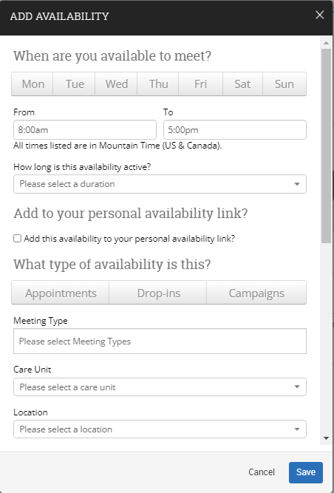
My availability setup
The Actions menu is where you can add, copy, delete time, and add to Personal Link.
Choose “Add Time” to start creating an availability.
After clicking Add Time a new window populates which is the Add Availability window.
From here you get a whole host of options to customize how you want our availability to be set up.

Slide 8
Add availability
Allows you to select specific days you are available.
Select the time range each day you are available
Active availability will allow you to select ranges of dates, or forever, or by term.
You can select which availability if you have more than that you want added to your PAL’s link
Here we can choose between Appointments, Drop-ins or Campaigns. You can select one or all three.
Modality which allows you to select in-person, virtual or phone
Care unit selection
Location selection

Slide 9
PAL
A PAL is your personal link that will allow you to enhance communication with students when using outlook.
Your PAL will direct students to Navigate’s appointment scheduler
Each PAL is unique to each staff member and will not change over time
A PAL link can be accessed by students through email, URL, website and SMS (text).

Slide 10
Appointment Types
Appointments: This is the most common type of availability where students will use the student scheduler and select you through location and care unit.
Drop-Ins: This is setup for when you have office hours and allow students stop by using a range of time based on the days you have selected.
Campaigns: This appointment type is for the appointment campaigns that faculty will utilize the most. This appointment type must be selected for use of Appointment campaigns.

Slide 11
Outlook TIPS
Outlook Calendar Sync is a must have!
When creating meetings in Outlook:, the following will create issues with the sync:
An end date of Forever for your Outlook meeting.
An Outlook meeting that runs all day will mean that Navigate will also block the entire day.
Have a vacation coming up?
Block out your calendar on Outlook. Navigate and Outlook work in conjunction back and forth.

Slide 12
other TIPS
Special instructions are also a viable way to communicate too students when setting up availability. This feature is available at the end of add availability.
A “Virtual location” was created for flexibility during Covid and will be discontinued at the end of spring semester. Use meeting types instead. If you do not see a location that works for you, contact osstech@mso.umt.edu.
An “Instructor’s Office” location is available for faculty.

Slide 13
You have finished the lesson!
Questions on content?
Suggestions for improvements?
Any other thoughts?
For all of these, please email us at osstech@mso.umt.edu.
We would love to hear from you!

