Slide 1
Success Markers Overview
Prepared for the University of Montana
Student Success Collaborative

Slide 2
Introduction to Success Markers
Developing Success Markers
Review Next Steps & Discussion

Slide 3
What Are Success Markers?
Critical Courses that Help Keep Students On the Right Path
Definition of a Success Marker
A critical course or group of required, predictive courses that are key to student success within a major. They are frequently first and second year courses, which are entered into the Navigate platform so that advisors can identify and intervene with students who are not completing the markers.
The time by which students must complete the course and the recommended grade threshold students should achieve are also required to enter the success markers.
Note: Success markers are not intended to replace degree audits.

Slide 4
Anatomy of Success Markers
Example Major: Chemistry
Success Marker #1 (Completed)
Success Marker #2 (Completed)
Success Marker #3 (Missed)
Success Marker #4 (In Progress)
Success Marker #5 (Upcoming)
Anatomy of a Success Marker
Required milestone course for the major (e.g., CHEM 101)
Minimum recommended grade (e.g., B-)
Appropriate timing (e.g., 0 – 30 credits)
Success Marker Statuses
Success markers already completed
Success markers missed due to grade or timing
Success markers that are upcoming
Platform Application of a Success Marker
Advising Campaigns based on specific course performance
Individual student advising conversations
Request Early Alerts from faculty in predictive courses

Slide 5
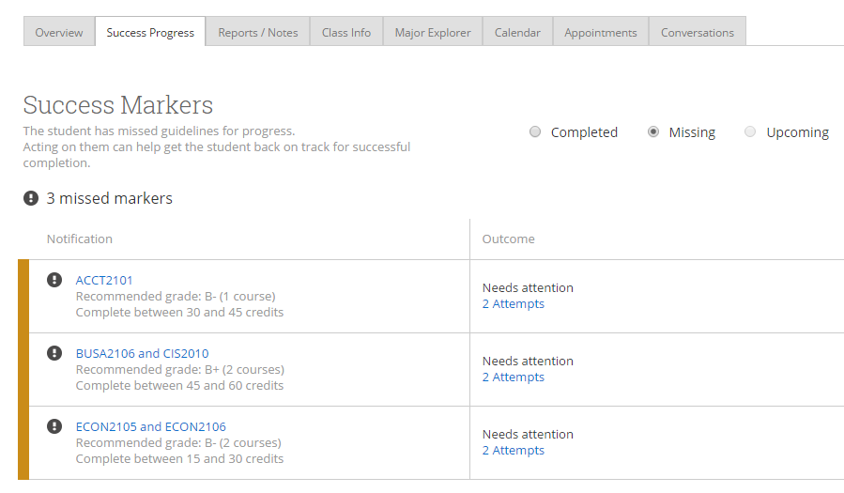
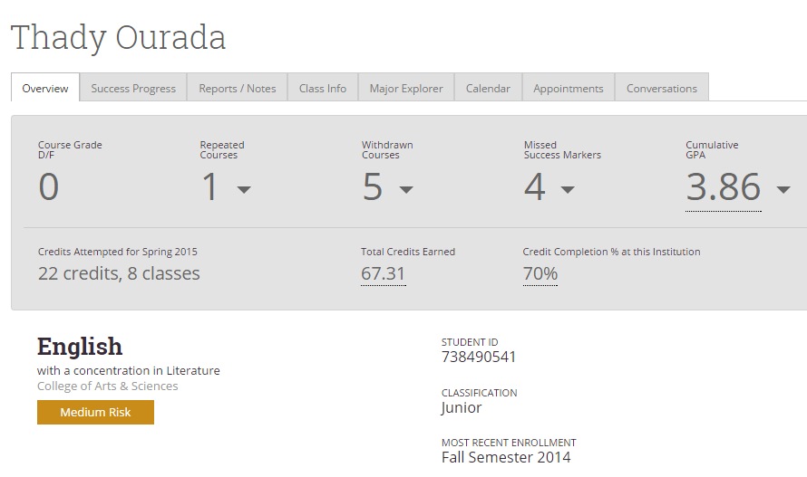
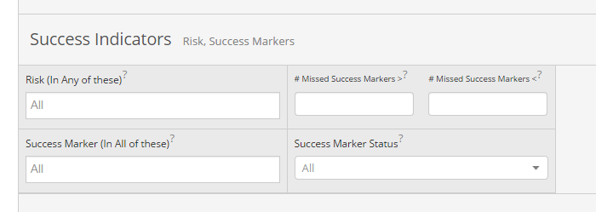
Success Markers in the Platform
Summary of All Success Markers in the Success Progress Tab
Number of Missed Success Markers on a Student’s Overview Page
Success Markers and Number of Missed Success Markers as Filters in the Advanced Search
An Ongoing Process Success Markers will not necessarily be available for all programs. As Success Marker development progresses, additional programs will see Success Markers become available in the platform.

Slide 6
How are Success Markers Used?
Centralized communication for students who are missing key success markers
Tutoring campaigns to bring potentially vulnerable students in based on courses they’re in/have taken
High-need proactive student advising campaigns
Training advisors and other support staff to understand these academic requirements and advise students accordingly
Training how to find/communicate success markers
Sharing these recommendations with students for transparency and motivation
Supporting Proactive Advising

Slide 7
Introduction to Success Markers
Developing Success Markers
Review Next Steps & Discussion

Slide 8
Developing Success Markers
Using Data to Drive the Success Marker Creation Process
Process for Success Marker Development
Resources for Success Markers
Locate predictive courses and recommended grade thresholds in Institution Reports
Identify courses desired as Success Markers and exclude courses not required of all students in the major
Confirm or Edit grade threshold based on Institution Reports and knowledge of curriculum and students
Determine appropriate timing based on Institution Reports, degree maps, and knowledge of curriculum and students
Deliver course number, timing, and grade threshold by completing Success Marker template form & sending to EAB for entry into Navigate
Inform EAB of Success Marker revisions annually as curriculum changes take effect
1
Program Knowledge and Institutional Research
2
Degree Maps or Plans of Study
3
Insights from Institution Reports
4
Consider Title V STEM Courses
Notes:
Now let’s spend some time talking about how to develop success markers. Using a variety of the data available to you at HBU to inform the creation of your success markers is crucial to ensuring you get value out of them in practice. There are a few resources from which you can use in developing success markers from your own program knowledge and institution research, historical trends from Institutions reports, and I know there was interest in this group to consider Title V courses (perhaps in stem majors/courses) when building success markers as well. I will be showcasing how Institution Reports can be helpful here in the next few slides.
The process for success marker development is fairly straight forward. (read from slide)

Slide 9
Where Do They Come From?
Analysis of Historical Records Identifies Highly-Predictive Courses and Grades
Two Required Courses for a Chemistry Major
✓
✘
Predictive
Not Predictive

Slide 10
Success Marker Overview
Developing Success Markers
Review Next Steps & Discussion

Slide 11
Getting Started
Collect the Resources You Will Need and Learn Initial Tips for Successful Success Markers
Helpful Tips for Creating Success Markers
Timing of Critical Courses: Select required courses with suggested completion in the earlier terms
Number of Courses: Identify between 3-5 predictive courses for each major, but this will differ depending on the program
General Education Requirements: Determine whether you want general education requirements to be included in your success markers
Elective Options: Steer away from markers that include a large number of courses a student can choose from
Substitutions or Course Code Changes: Indicate an “or” if there are relevant course substitutions or old course codes that meet the success markers
Necessary Resources
Success Marker Template
Degree map and/or major requirements
Institution Reports
Timing Considerations
After submission, success markers can take up to one week to appear in the platform
Success markers can be updated at any time
Due Date:
Submission to: EMAIL CONTACT

