Slide 1


Bloodborne Pathogens Training
2023
Kathy Heivilin
Biosafety Officer
University of Montana
243-6395

Slide 2
OSHA’S Bloodborne Pathogen Standard
29CFR 1910.1030
Employers must:
  Develop an Exposure Control Plan (ECP) that details their Bloodborne Pathogens (BBP) Program
  Use engineering controls and enforce work practice controls
  Supply and maintain personal protective equipment
  Provide employees at risk with Hepatitis B virus vaccination
  Provide post-exposure evaluation and follow-up to employees who have an exposure incident
  Use labels and signs to communicate hazards
  Provide initial and annual information and training that covers dangers of BBP, preventive practices, and post-exposure procedures
  Maintain employee medical and training records

Slide 3
Who is Covered by the BBP Standard?
  Any employee who has occupational exposure to human blood or other potentially infectious materials within the scope of the standard.
    Occupational exposure : reasonably anticipated skin, eye, mucous membrane or parenteral (through the skin) contact with blood or other potentially infectious material (OPIM) that may result from the performance of an employee’s duties.
  Employees trained in first aid and CPR designated by the employer as responsible for rendering medical assistance as part of their job duties.

Slide 4
Topics to be Covered
UM Exposure Control Plan
What are bloodborne pathogens?
Safe work practices
Employee Training
HBV vaccinations
Decontamination and cleanup
Proper actions to take in the event of an accidental exposure

Slide 5
UM Bloodborne Pathogens
Exposure Control Plan
Any employer with employees covered by the standard must have a written exposure control plan that includes:
  Universal precautions
  Work practice controls
  Personal protective equipment
  Training
  Hepatitis B vaccine
  Post exposure procedures and evaluation
  Communication of hazards to staff
  Medical records and record keeping
Access this document at umt.edu/research/compliance/IBC/bbp.php

Slide 6
Human Bloodborne Pathogens
Human bloodborne pathogens are microorganisms present
in human blood and other human body fluids* that can
infect and cause disease in people who are exposed to these pathogens
  * Other Potentially Infectious Materials (OPIM) include
      Saliva
      Semen
      Cerebrospinal fluid
      Any body fluid visibly contaminated with blood
      Unfixed human tissue or organs
      All cultures and culture fluids of human bloodborne pathogens

Slide 7
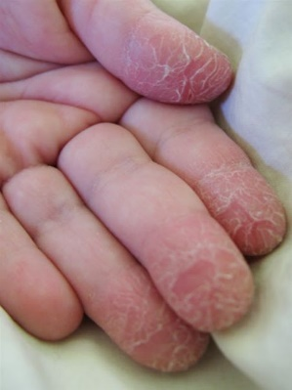

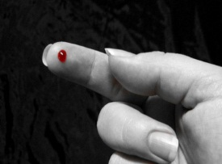
How Are Bloodborne Pathogens Transmitted?
Accidental puncture with needle, glass, scalpel or other sharps contaminated with the pathogen
Contact between broken or damaged skin and infected body fluids
Contact between mucous membrane (eyes, nose, mouth) and infected body fluids

Slide 8
Examples of Bloodborne Pathogens
Viruses:
  Hepatitis B Virus (HBV)
  Hepatitis C Virus (HCV)
  Human Immunodeficiency Virus (HIV)
Other bloodborne pathogens may include:
  Syphilis
  Malaria

Slide 9
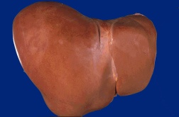
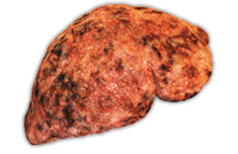
Hepatitis B Virus (HBV)
Risk factor: contact with infected blood or OPIM
HBV can survive outside of the body up to 7 days in dried blood
Approximately 20,000 people are infected annually as reported by Centers for Disease Control and Prevention (CDC) (2019)
An extimated 860,000 Americans are chronically infected with HBV
There is no cure for HBV and it causes inflammation of the liver
2/3 of infected people become symptomatic
Symptoms may include:
  Fatigue
  Stomach pain
  Loss of appetite
  Nausea, vomiting
  Jaundice (yellowing of skin)

Slide 10
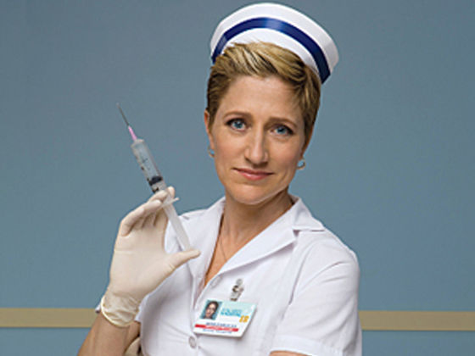
An Effective Hepatitis B Vaccine is Available and Highly Recommended
HEPLISAV-B is the first new hepatitis B vaccine approved in the U.S. in more than 25 years, and is the only two-dose HBV vaccine approved for adults.
  2 doses
  Can be completed in 1 month
Possible side effects of vaccination
  Pain, itching, swelling at site of injection
  Flu-like symptoms
  Allergic reaction to the yeast component of the vaccine
  Becoming infected with hepatitis B virus is much more dangerous to
  your health than receiving this vaccine

Slide 11
Hepatitis C Virus (HCV)
HCV causes liver inflammation
Risk factor: Direct blood-to-blood contact
An estimated 17,000 Americans are infected annually (2019)
HCV is the most common chronic bloodborne infection in the United States with an estimated 2 million people infected
Only 20 % of people infected with HCV become symptomatic
  All the symptoms of HBV, plus
  Dark urine
  Chronic HCV infection can lead to either cirrhosis or cancer of the liver
There is no vaccine against HCV
New antiviral drug treatments are now available. They are effective, but expensive ($84,000 - $168,000 per treatment)

Slide 12
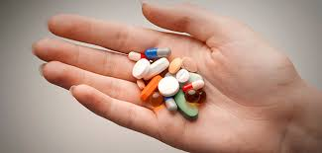
Human Immunodeficiency Virus (HIV)
Causes AIDS
Direct blood-to-blood contact and sexual contact
An estimated 1.2 million Americans are living with HIV (2019)
Approximately 36,500 Americans are infected annually (2019)
HIV is not as easily contracted as HBV
Approximately 1 in 250 people exposed will become infected
Nearly 25% of HIV positive people also have HCV
There is no vaccine for HIV
Antiviral drug treatments are available (@$35,000 per year for life), but relapse occurs if drug treatment is withdrawn

Slide 13
SAFE WORK PRACTICES

Slide 14
Universal Precautions
Refers to a method of bloodborne disease control which requires that all human blood and OPIM be treated as if known to be infectious with HIV, HBV or other bloodborne pathogens regardless of the perceived low risk of the patient or patient population.

Slide 15
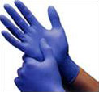
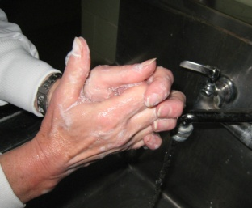
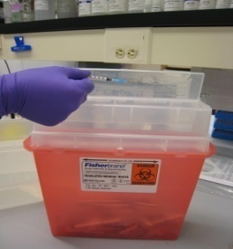
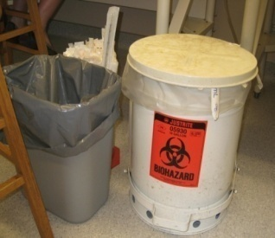
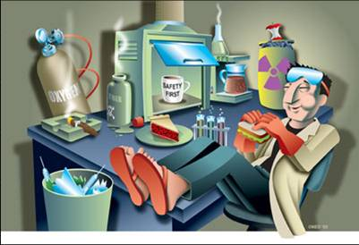
Use Universal Precautions
When Handling Blood or
Other Potentially Infectious Material (OPIM)
Wear gloves and other appropriate personal protective equipment (PPE)
Wash hands after removing gloves
Use sharps containers for all sharps. DO NOT RECAP NEEDLES
Dispose of all waste materials properly
Do not pipette
by mouth
Do not apply cosmetics or handle contact lenses
Use mechanical pipetting devices
Do not eat or drink in the area

Slide 16

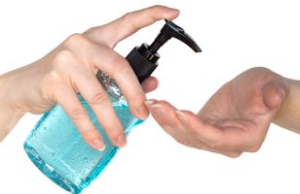
Wash Your Hands!
  Wash hands with soap for 15-20 seconds after removing gloves
  Use antiseptic towelettes or hand wash (if no facilities)

Slide 17
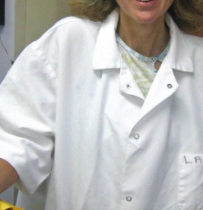
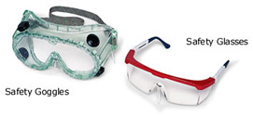
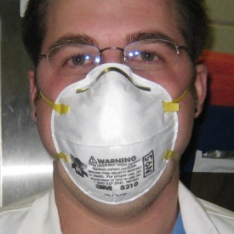
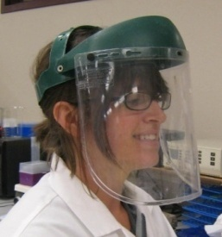
Personal Protective Equipment (PPE)
PPE includes, but is not limited to, disposable gloves, eye protection, face masks and lab coat
Always use PPE when there is the potential for exposure to bloodborne pathogens
Examine PPE to ensure that it is in good condition
Damaged PPE must be thrown away

Slide 18
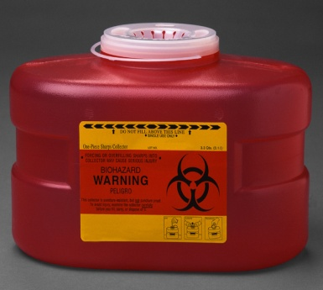

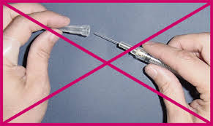
Sharps Disposal
Place all sharp objects in puncture resistant containers (sharps container)
  Needles
  Scalpel blades
  Glass slides
DO NOT break, bend or RECAP needles!
Do not handle broken glass with your hands; use a broom and dust pan and put glass into puncture resistant container for proper disposal

Slide 19
Biohazard Labels
Orange or red with biohazard symbol and lettering in a contrasting color
Labels must be affixed to containers of regulated waste, refrigerators and freezers containing blood or other potentially infectious material, and containers used to store, transport, or ship blood or other potentially infectious materials.

Slide 20
TRAINING and
HEPATITIS B VACCINATION

Slide 21
BBP Training
BBP training must be conducted before beginning work with human blood and OPIM and annually thereafter.
All BBP training and annual refresher training must be documented by PI or supervisor and records maintained for 3 years.
Different training venues are available at UM
  UM IBC web site presentation and quiz, umt.edu/research/compliance/IBC/bbp/php
  Formal classroom presentation (call the Biosafety Officer to arrange, 243-6395)

Slide 22
Hepatitis B Vaccination
HBV vaccination series must be offered free of charge to all employees who are determined to have occupational exposure
  HBV vaccination must be offered to such employees within 10 working days of initial assignment
  Previous vaccination must be documented by the original health care giver
  If written verification is not available, a blood titer may be taken at Curry Health Center (CHC)
Students who are determined to be at risk of exposure, are vaccinated at their own expense. Curry Health Center charges a nominal fee.
Although you can decline to be vaccinated, we strongly encourage you to be vaccinated against HBV for which there is no cure.
  An official letter of declination must be signed and maintained by the PI or supervisor (form is available from the UM Biosafety Officer)

Slide 23
Hepatitis B Vaccination (continued)
HBV vaccination is a series of 2 injections given over 1 month
Employees of UM
  Vaccination for employees is provided at Curry Health Center (CHC). Call for an appointment at 243-2122.
  There is no charge to the employee. CHC will charge-back the cost to the employee’s Principal Investigator or Department.
  Post-series titer (antibody) testing, and if necessary, a second hepatitis B vaccine series will be given free to the employee.
Students at UM
  Students are responsible for the cost of the HBV vaccination series.
  Vaccination for a small fee is available at CHC or vaccination may be administered through the student’s private physician.

Slide 24
DECONTAMINATION
AND
CLEANUP

Slide 25
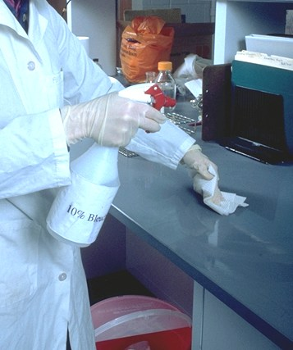
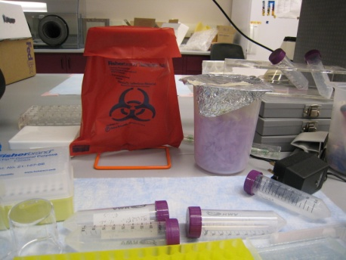
Disinfecting Work Area
Before beginning work, wipe down the work area with 70% ethanol (EtOH) or freshly made 10% bleach
Always wear gloves when working with blood or OPIM
Wear additional PPE as warranted for the situation (lab coat, eye protection, etc.)
At the end of work session, wipe down the work area with 70% ethanol or freshly made 10% bleach
Dispose of gloves and contaminated materials properly into biohazard bags (bags will be autoclaved to decontaminate)

Slide 26
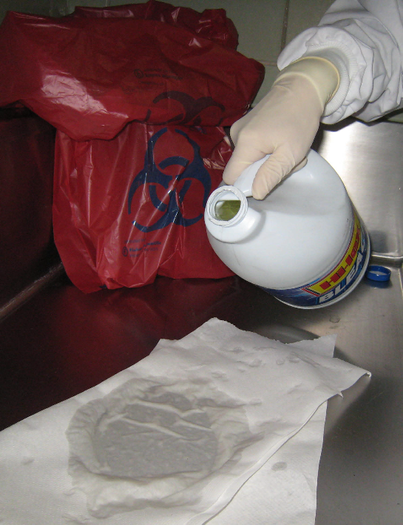
Accidental Spill Cleanup of Blood or OPIM
Isolate the spill area
Put on disposable gloves and other PPE as warranted
Place paper towels over the spill
Small spills: saturate the paper towels with disinfectant (e.g., 10% fresh bleach solution) for 10 minutes minimum
Large spills: saturate towels with concentrated bleach for 15-30 minutes
Gather all waste and dispose into biohazard bags
Clean area again with 10% bleach, soap & water
Autoclave biohazard bags to decontaminate

Slide 27
IN THE EVENT OF AN
EXPOSURE

Slide 28
WHAT IS AN
EXPOSURE INCIDENT?
An exposure incident is a specific eye, mouth, other mucous membrane, non-intact skin or parenteral contact with blood or other potentially infectious materials that results from the performance of an employee’s duties.
  Accidental puncture with needle, glass, scalpel or other sharp contaminated with the pathogen
  Contact between broken or damaged skin and infected body fluids
  Contact between mucous membrane (eyes, nose, mouth) and infected body fluids

Slide 29
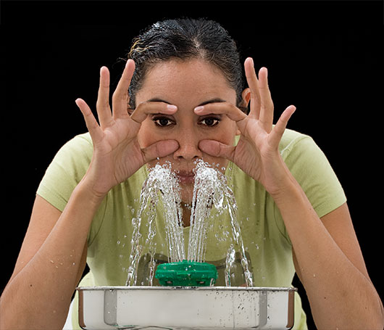
If You Are Exposed to
Human Blood or OPIM
Cleanse all exposed skin with soap and water for 15 minutes
Rinse mucous membranes or eyes with water for 15 minutes
Record the location and time of incident
Report the incident to your supervisor
Seek evaluation at a emergency care facility within 2 hours of exposure.
Staff and paid student workers fill out a UM accident report within 24 hours (mandatory)

Slide 30
Contact Information
Biosafety Officer, Kathy Heivilin, 243-6395
  For additional biosafety information
  For one-on-one meeting to answer questions or to discuss concerns
Curry Health Center, 243-2122
  Hepatitis B vaccinations and titers
  Needle sticks, pathogen exposure, etc.
Environmental Health, 243-4503
  Sharps disposal
Workman’s Compensation and Accident Reports, 243-2842

Slide 31
You have completed the BBP presentation.
Return to umt.edu/research/compliance/IBC/bbp.php
and take the quiz.
  You may review the slides while taking the quiz.
  Give the completed quiz to your supervisor for grading.

Slide 32


QUESTIONS?
Call the Biosafety Officer at 243-6395
Do I really have to do BBP training every year?
YES!

