Slide 1
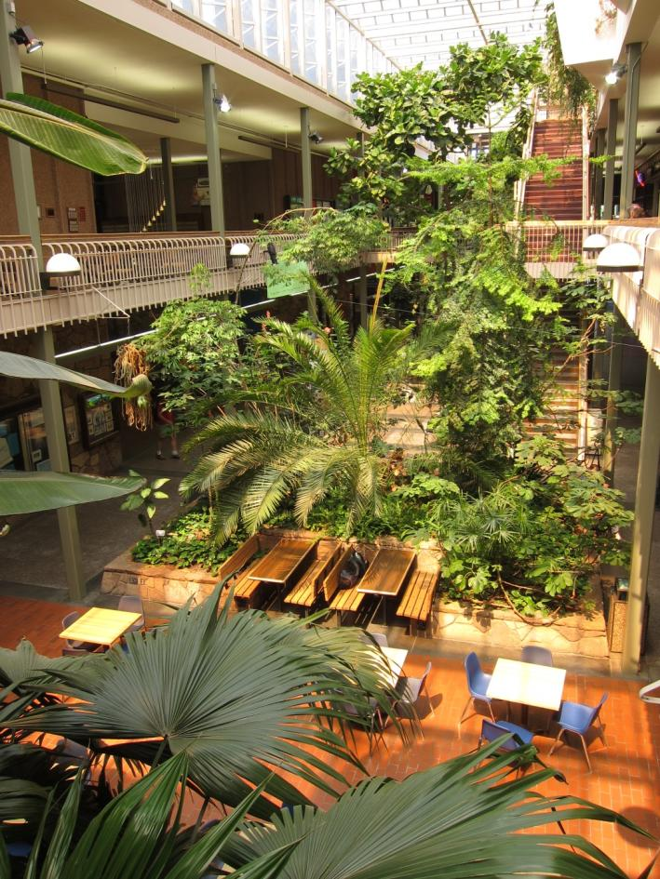
A Very Long Event Title
10:00 am – 2:00 pm
January 4th 2012
UC Ballroom
Free event, open to the public

