Slide 2
Who We Are
Director: Jen Fowler (0.55 FTE)
Assistant Director: Jaylene Naylor (0.3 FTE)
Chief Pilot: Bart Bauer (.6 FTE)
Research Assistant: Carl Spangrude (.25 FTE)
Research Assistant: Katherine Derry (.25 FTE)
Part of Broader Impacts Group (BIG) – in VP Research Scott Whittenburg’s office
Funding from UM and 3-4 grants/year

Slide 3
Why does UM have a UAS office?
The Autonomous Aerial Systems Office (AASO) mission is
to coordinate and guide faculty, staff, and students for understanding and decision-making regarding implementation of UAS in a changing research and regulatory environment
to establish the infrastructure and resources in order to create sustainable autonomous aerial research
to stimulate UAS-related innovation, entrepreneurship and workforce development in the state of Montana
Notes:
AASO also conducts feasibility studies that utilize UAS observations in innovative applications to demonstrate use case processes that provide efficiencies and cost savings.

Slide 4
Additional Aerial Platforms
Large Scientific Balloons – “heavy payloads”
Sounding Balloons – Radiosondes
Tethered/Moored Balloons
Rockets
UAVs

Slide 5
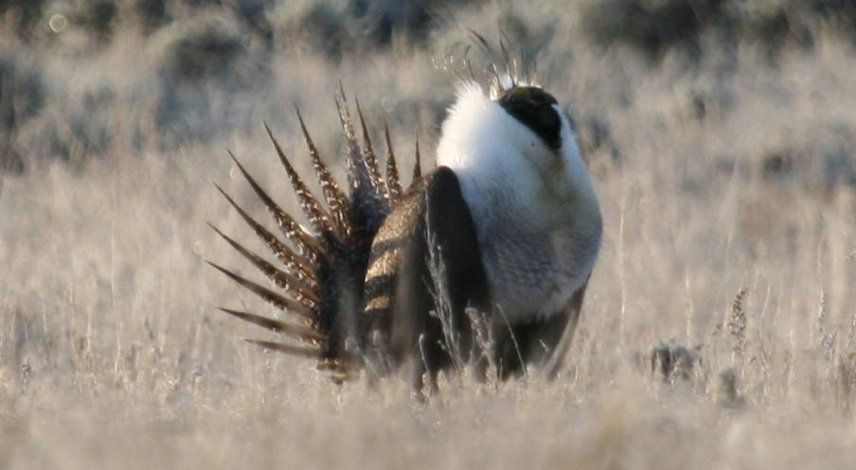
AASO Projects - Wildlife
https://www.sagegrouseinitiative.com/a-lek-trek/
Collaboration with The Nature Conservancy to improve sage grouse population counts. These counts are traditionally done visually with spotting scopes and only count males on a lek during mating season.
Notes:
How many of you know what a Sage Grouse Lek is? Have you seen them “dance”? Leks hold 25-30 males defending a few meter square area. Lek size is only ~40’ by 40’ or so with the breeding are of about 750-875 acres. Females will range up to 20 miles. Population numbers are difficult to estimate due to the large range of the species, physical difficulty in accessing some areas of habitat, and past inconsistent sampling of leks across states. Additionally, estimating population sizes using lek data is difficult as the relationship of those data to actual population size (e.g., ratio of males to females,) is unknown. Males may also attend multiple leks in a morning. The use of harvest data for estimating population numbers also is of limited value since both harvest and the population size on which harvest is based are estimates.
Partnership with TNC – Matador Ranch, MT Fish, Wildlife, and Parks
Show link in box of IR video: TNC - Sage Grouse (14:50, 4_22, 20170422_063209_H264)

Slide 6
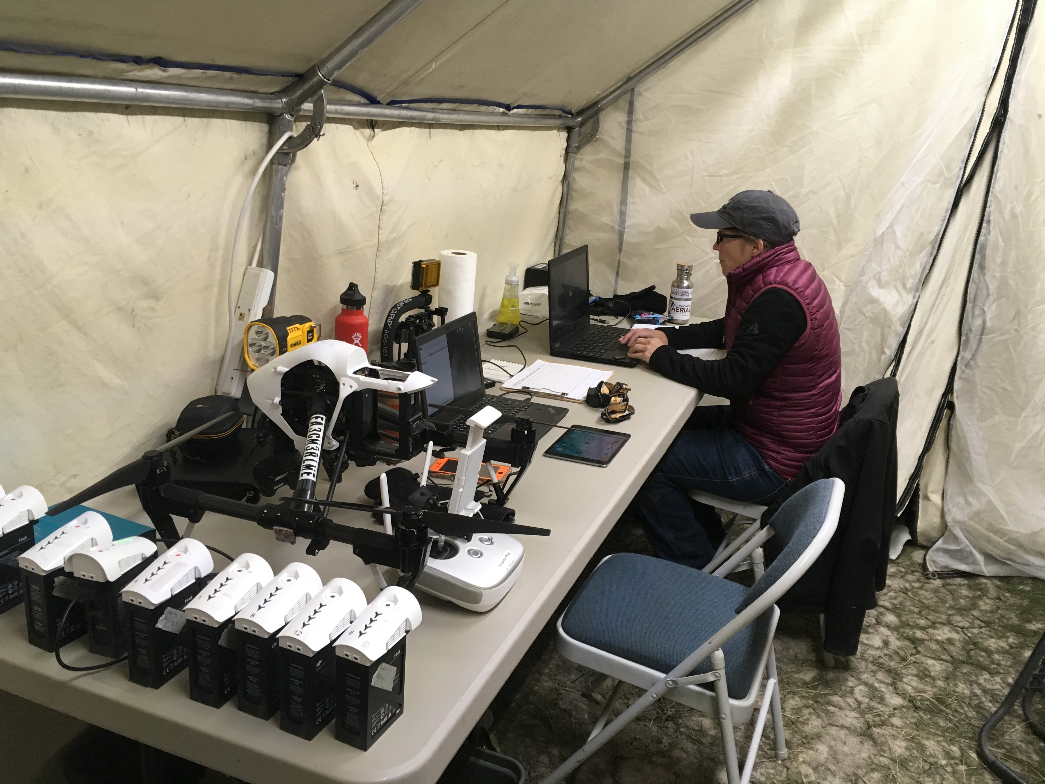
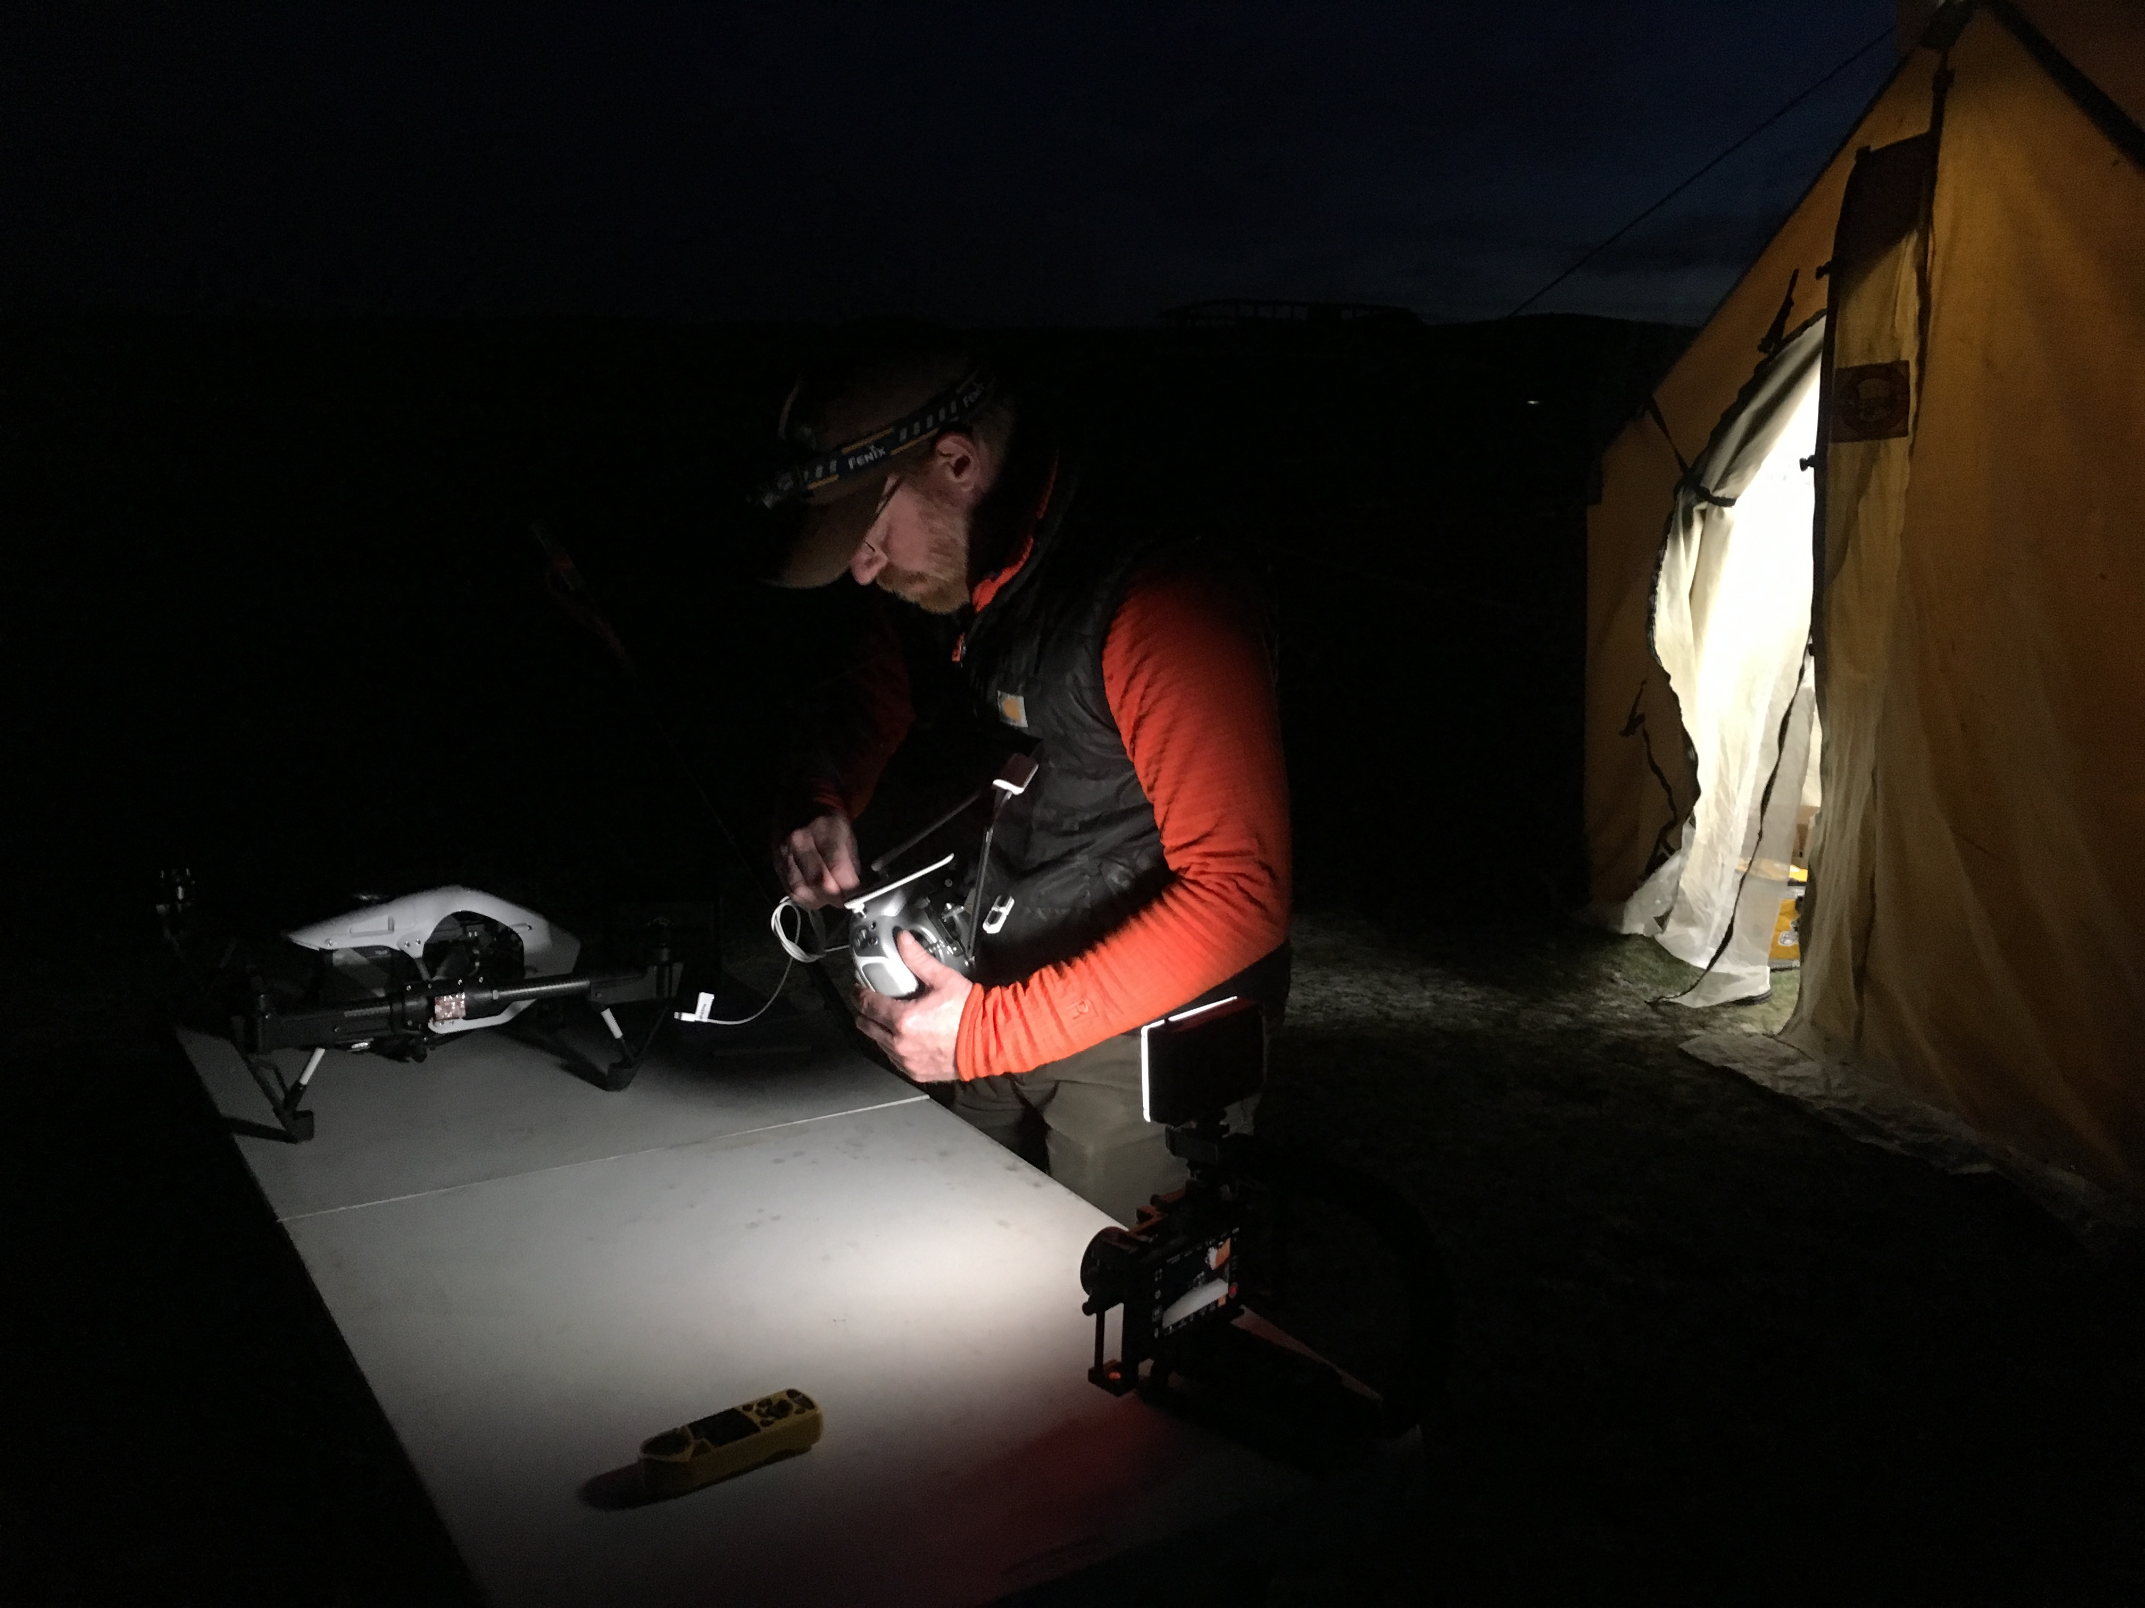
AASO used nighttime IR imagery to detect both males and female sage grouse.
Notes:
The more sun light, the more the image “blows out” and more wind. This flight is with an “auto” mission (~150’ altitude).

Slide 7
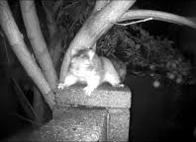
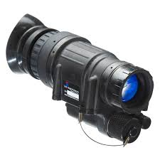
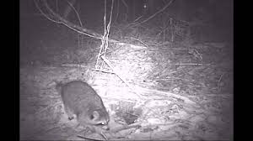
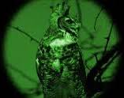
Next field campaign with sage grouse will involve night vision imagery to assist with gender differentiation.
PVS-14 A

Slide 8
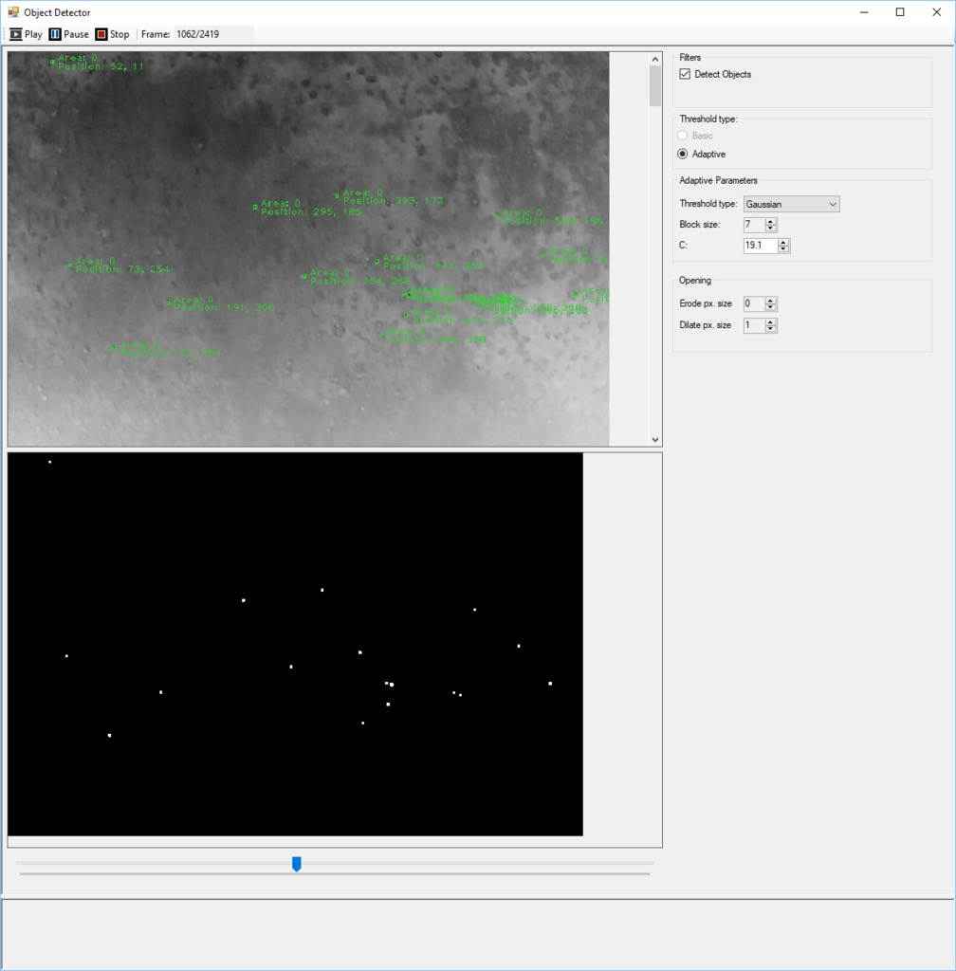
Preliminary work with machine learning algorithms are being done to detect the grouse automatically from the aerial imagery.
Notes:
This is visible camera of the area.
Future work with Deep Learning algorithms, safety specifications for UAS flights over Sage Grouse, and Prairie Dogs

Slide 9
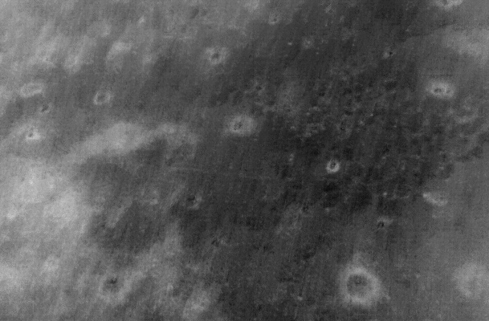
IR imagery can also be used for prairie dog town assessment, i.e. growth and collapse of colonies
Notes:
All the holes are prairie dogs so this is a good option for mapping with less impact.
Future work with Deep Learning algorithms, safety specifications for UAS flights over Sage Grouse, and Prairie Dogs

Slide 10
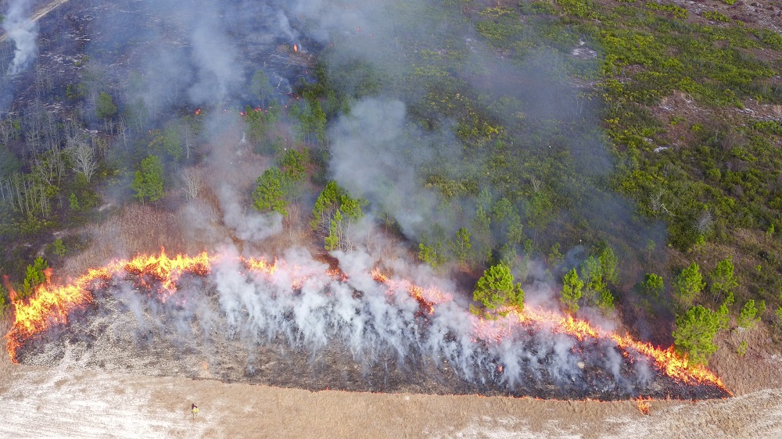
Development of workflows and algorithms to increase fire management effectiveness.
https://www.umt.edu/aaso/DroneFire/default.php
Notes:
http://www.umt.edu/aaso/DroneFire/DroneFire%20Stories/default.php
Images and videos were gathered in both true-color and thermal infrared to characterize a myriad of fuel conditions and combustions. DroneFire team members light off a patch of fuel near on-the-ground heat flux packages, which are designed to characterize heat change through time as the fire's flaming front advances through vegetation. DroneFire scientists, such as PhD student Dan Jimenez, hope to correlate data from the heat flux packages with aerial images of the fire.

Slide 11
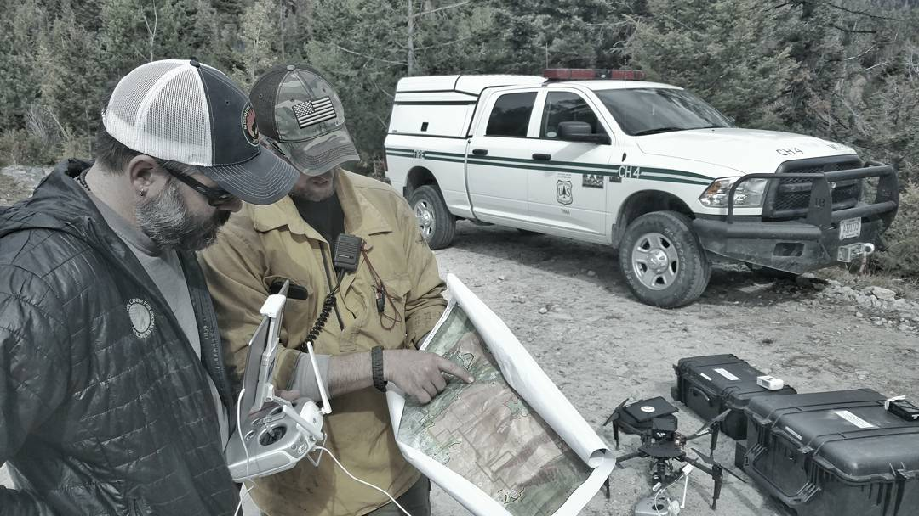
Roaring Lion Fire, MT 2016
Post burn assessment

Slide 12
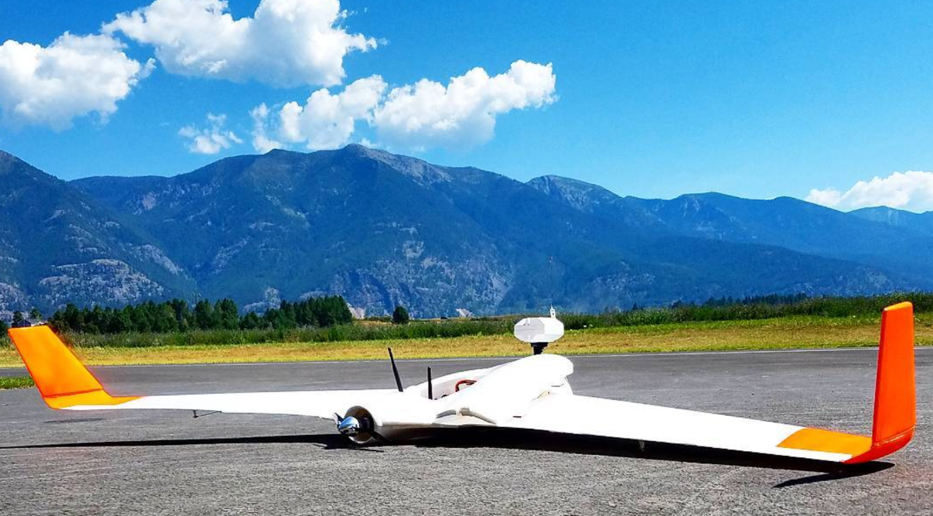
Atmospheric Sounding Studies using multiple platforms
Notes:
Note the weather sensor at the top of the aircraft.

Slide 13
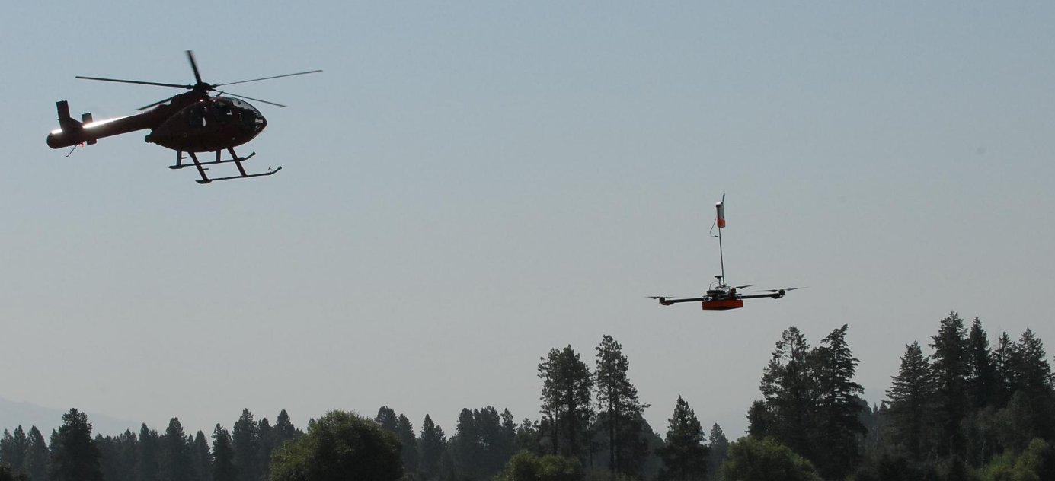
This flight went to 9,500’ MSL in a comparison test with balloon-borne radiosondes.
Notes:
Why steep lapse rate at beginning of flights? Time delay between balloon and drone?
Pseudo Code
BEGIN
filter := Extended Kalman Filter tuned for use case
# values is the set of values recorded at a time t
FOR values IN data:
gx := get x accelerometer reading from values
gy := get y accelerometer reading from values
gz := get z accelerometer reading
yaw := get yaw value from values in degrees
# Filter values
gx, gy, gz, yaw = filter.update(gx, gy, gz, yaw)
# degrees simply converts from radians to degrees
tilt_angle = degrees( arctan2(sqrt(gx^2 + gy^2) / abs(gz)) )
tilt_direction = degrees( arctan2(-gx, -gy) )
wind_direction = yaw + tilt_direction
# Experimentally determined relation
wind_speed = (0.4292 * tilt_direction) - 0.0524
Now output wind_speed and wind_direction at this time, t
END FOR
END

Slide 14
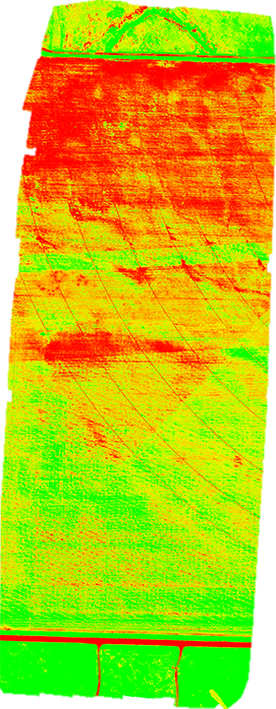
Agriculture Studies
These images come from a multispectral camera analysis of the effectiveness of different irrigation practices in collaboration with the Montana State Prison.
NDVI
Red
NIR
(NIR-Red)
(NIR+Red)
Normalized Difference Vegetation Index
NDVI=
Notes:
Field uses a different algorithm for mapping. Mapper is needed is want more professional 3-D model.
Pix4Dfields uses a direct-to-orthomosaic photogrammetry pipeline optimized for fast processing of mostly flat terrain from drone imagery. By focusing on this specific domain we can provide high quality maps processed in a fraction of the time, allowing immediate analysis while still on site using a laptop computer.

Slide 15
Time Series Analysis

Slide 16
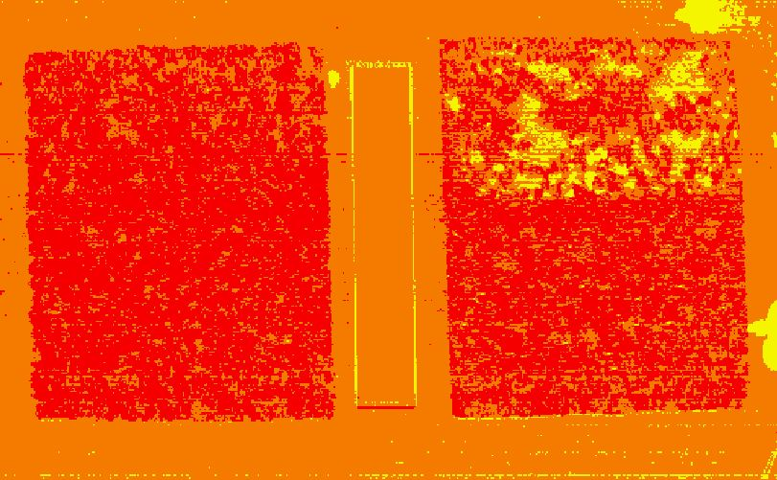
Hyperspectral Studies
This work is to assess the presence of ice on a roadway under a grant with the Montana Department of Transportation.
Ice Index - https://www.mdt.mt.gov/research/projects/safety/icy-road-rwis.shtml

Slide 17
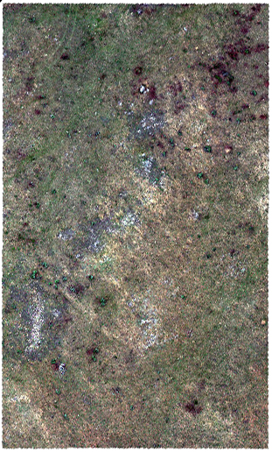
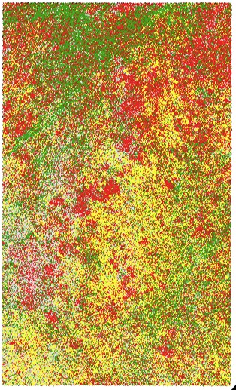
Classification Projects - Vegetation
UAS: Matric 100
Sensor: RedEdge-M
Study Sites: 10
Images: 17,850
Mapped Acres: 48.7 acres
GTP: 1,200 per site
GSD: 2 cm/pixel
Altitude: 30 meters
Maps Produced: 30
Accuracy Assessment: 96%
RGB Composite
Classification

Slide 18
Classification Projects - Fire
Collected Data from actively piloted aircraft
EO/RGB
Short Wave IR
Mid Wave IR
AIMMS-20 (weather data)
Infrared
RGB
Notes:
Aircraft-Integrated Meteorological Measurement System
EO = electro-optical imagery (visible wavelengths)

Slide 19
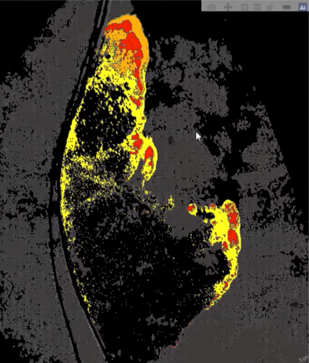
Classification Projects - Fire
Active Burning (orange)
Intense Heat (red)
Smoldering (yellow)
Burnt (black)

Slide 20
100m resolution, terrain following wind simulation/forecast to couple with or overlay on fire classification.
Weather Forecasting and Simulation
Notes:
- Comparisons are being done to optimize speed of producing forecasts of meteorological variables.
- Data matches with rate of spread to the north at 1900 local time

Slide 21
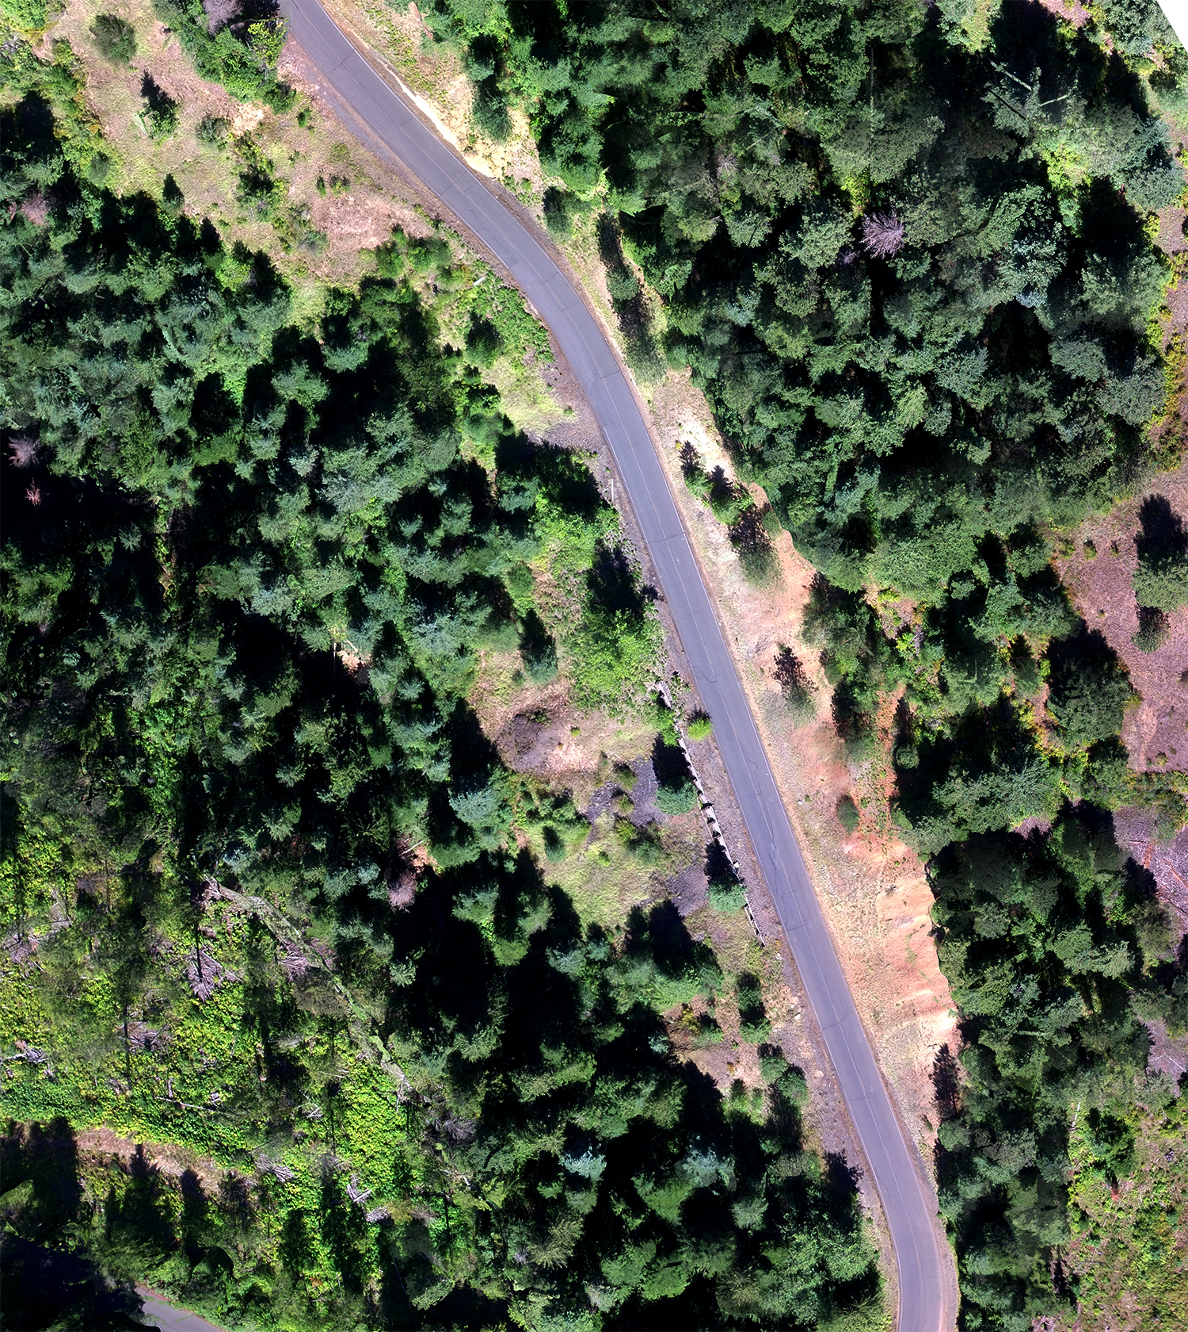
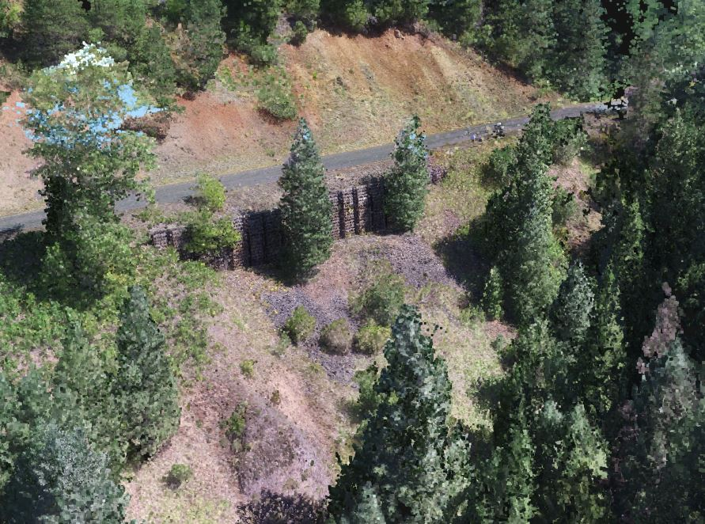
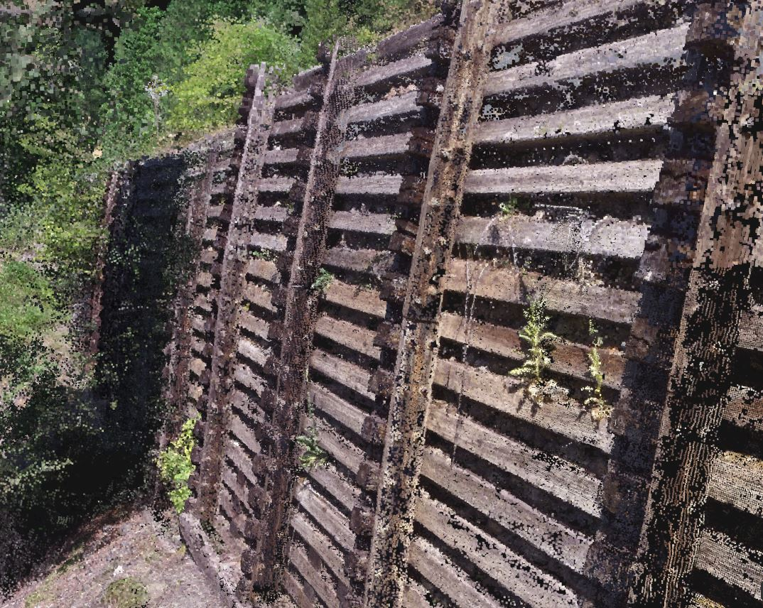
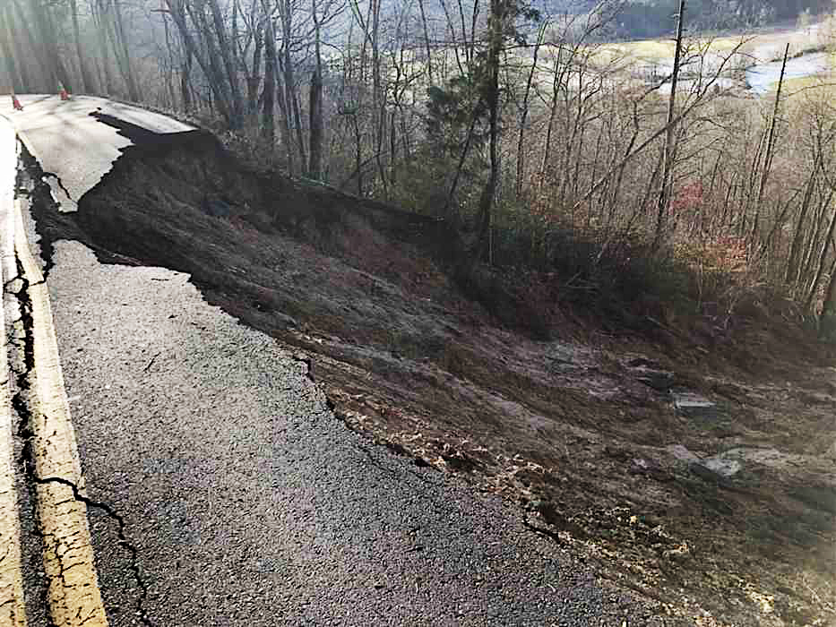
Landslide Monitoring
3D point cloud imagery to define weaknesses in retaining wall. This project led to over $1 million in funding for infrastructure repair.
Notes:
Evaluation of safety and mitigation actions.
Missions: 24
Images: 7050
Mapped Acres: 105 acres
GSD: 5-23cm/pixel
Study Sites: 5
UAS: Matric 100
Inspire 1
Sensor: RedEdge-M
x3 RGB
XT Thermal

Slide 22
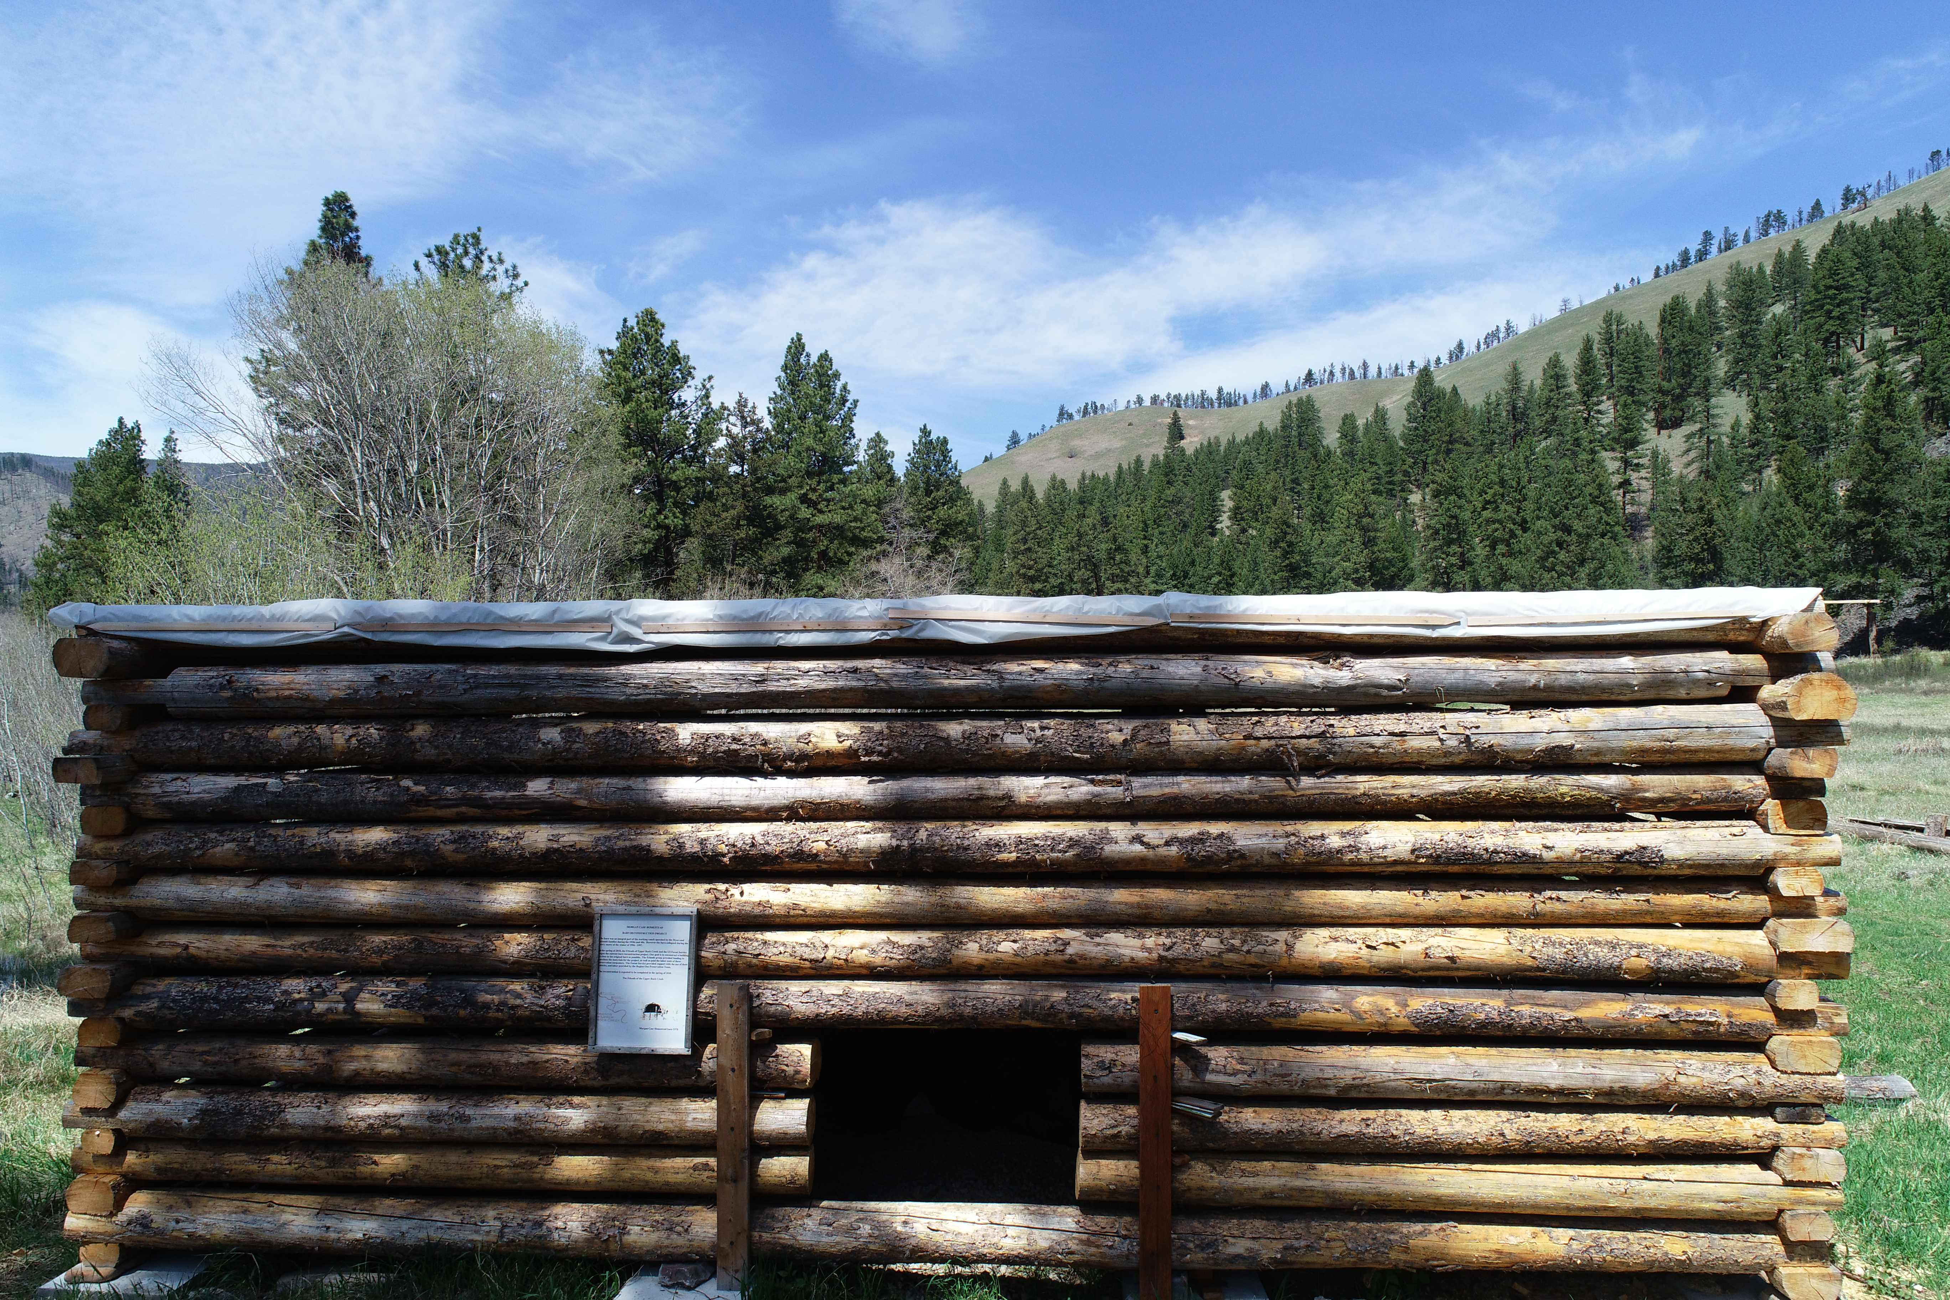
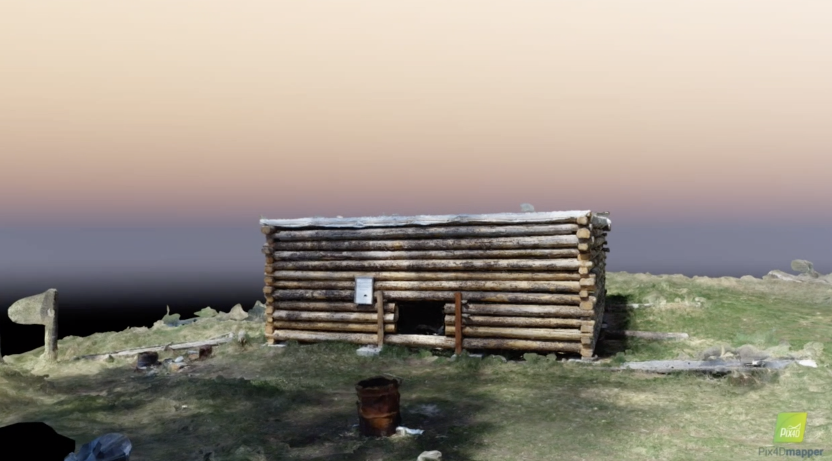
3D Modeling of US Forest Service Historic Structures
These projects help maintain forest service inventory of historic structures and lay the ground work for 3D printing of the models.

Slide 23
Adelos Inc. Autonomous Drone Surveillance
Objectives
Technical Approach
Send a message to an Unmanned Aircraft System (UAS) and direct the UAS to a lat/long coordinate derived from the Adelos fiber optic array, the Phosonic system
While in ground-mode, UAS to receive message, autonomously launch, and fly to an observation point
UAS to autonomously hover, broadcast video back to ground station, and return
Use custom-built UAS with open source flight controller and software
Develop Python code using DroneKit libraries to automate flights
Develop user-friendly Graphical User Interface (GUI) to monitor UAS while executing mission
Accomplishments
DoD Benefits
Demonstration of automated UAS flight based on lat/long coordinate of suspicious activity received from simulated Phosonic system at Polson, MT
Video transmitted from UAS via 5.8 GHz link to monitor near Phosonic system
Monitoring of UAS via GUI during flight testing
UAV launches and returns to launch point autonomously
Rapid deployment after Phosonic alert for target acquisition
Useful in complex terrain
https://www.adelosinc.com/sensor-systems/

Slide 24
Future Projects
Assessment of USFS dams structure and flow with underwater vehicle imagery combined with aerial imagery.
Assessment of airport runway conditions with hyper-spectral sensor.
Wildland fire smoke plume prediction with Missoula National Weather Service.
Integrate autonomous terrestrial vehicle with aerial data towards the goal of a vertical, tactical platform stack.

