Slide 1
University Budget Committee
October 13, 2015

Slide 2
Agenda
Recap of the 2017 allocation methodology – address any questions
Review of the peer institutions
Review of the aspirational peer institutions
Understanding IPEDS data
Discussion of other category targets
Committee structure revision and implementation

Slide 3
Programmatic Budgeting
Incorporating Strategic Planning into the Budget Process
http://www.umt.edu/planningassessmentcontinuum/Budget/budgetdocs/meeting%20documents/9.22.15/UBCPresentation9.22.15.pptx

Slide 4
Institutional Peers

Slide 5
Institutional Peers
-Continued-

Slide 6
Aspirational Peers

Slide 7
Aspirational Peers -Continued-

Slide 8
Understanding IPEDS data
Dawn Ressel
Associate Vice President
Office of Planning Budget and Analysis

Slide 9
Other Benchmarks / Targets
Goal: Instruction + Academic Support + Student Services above 70%

Slide 10
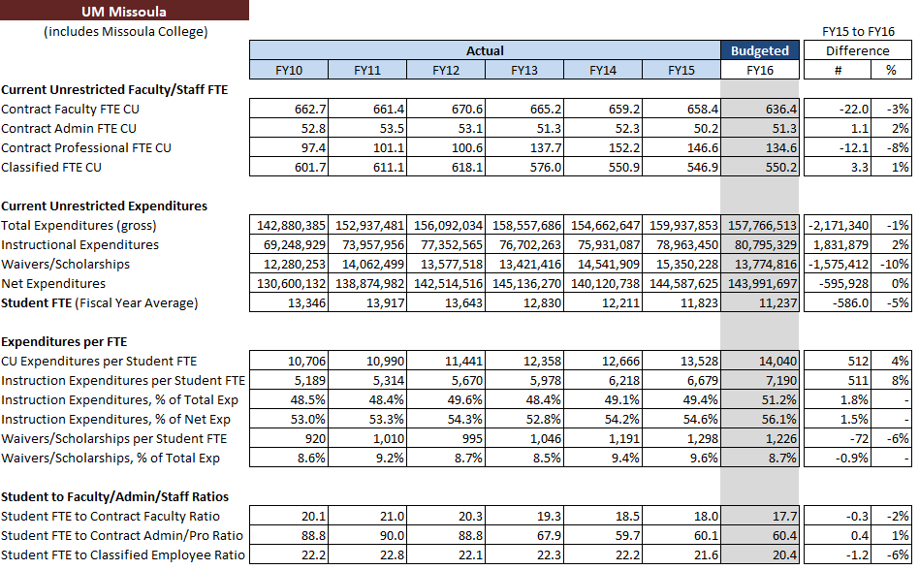
Other Benchmarks / Targets

Slide 11
University Budget Committee
Two Vice Presidents
Two Deans
Two Sector Budget Directors (rotating alternating years)
Representative from Faculty Senate
Representative from ASUM
Representative from Staff Senate
Representative from University Faculty Association
Representative from Auxiliary Enterprises
Representative from FAM
Facilitator – AVP OPBA

