Slide 1
University Budget Committee
Agenda
January 24, 2017
2:00 – 3:00 PM
University Center 330/331
Brief Overview of President’s State of University Address
Committee Members: Responsibility Changes, Commitments & Membership
Additional level of obligation and time commitment
Committee membership
Reaffirm current member commitments and/or identify new members
Outline Sub-structure and Establish Membership for Workgroups
1. Budget Mechanics
2. Budget Benchmarks, Metrics and Standards
3. Budget Timeline and Deadlines
4. Budget Communication Plan
Management and Controls for Budget and Fiscal Planning
Establish process and procedural changes
Outcomes:
Establish weekly meetings and committee responsibilities
Identify sub-structure, charge for each and related membership
Notes:
If we had hit Ratio Target for the FY17 Budget: Have ~58 less Faculty FTE and 51 less non Faculty FTE. Possible Salary savings from the $4M - $8M.
A Fall 11,000 headcount figure results in~ 9,300 ANNUALIZED FTE. For that size FTE need ~116 less Faculty FTE and ~130 less non faculty FTE from the FY17 starting budget. This could result in ~$10M - $17M in SALARY ONLY

Slide 2
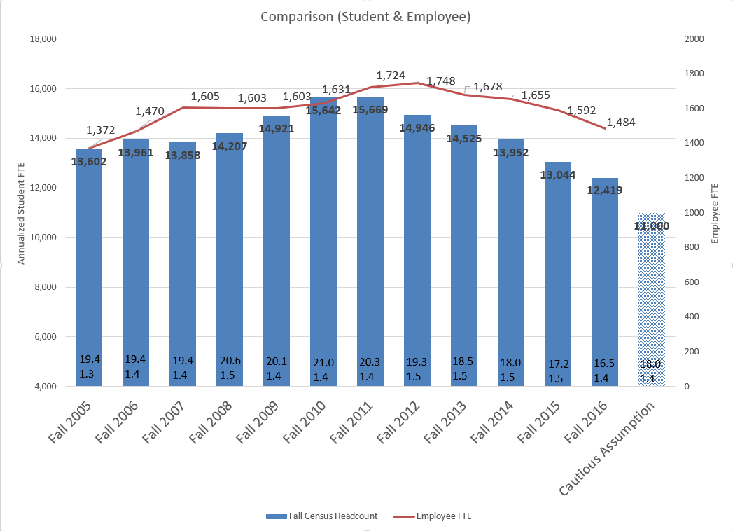
Notes:
If we had hit Ratio Target for the FY17 Budget: Have ~58 less Faculty FTE and 51 less non Faculty FTE. Possible Salary savings from the $4M - $8M.
A Fall 11,000 headcount figure results in~ 9,300 ANNUALIZED FTE. For that size FTE need ~116 less Faculty FTE and ~130 less non faculty FTE from the FY17 starting budget. This could result in ~$10M - $17M in SALARY ONLY

Slide 5
Committee Charge:
Recommend a budget to the President, by mid-April, for submission to the Board of Regent’s May meeting.
Budget based on 11,000 student headcount
Recommend appropriate/sustainable employee levels
Reevaluate the current budget allocation methodology and make recommendations for improvement.

Slide 6
Proposed Schedule (for discussion)
Meet weekly until April budget submission is complete
1st Thursday = formal Committee as a whole
2nd Thursday = subgroups working on assigned responsibilities
3rd Thursday = informal report/feedback on subgroup progress
4th Thursday = subgroups working on assigned responsibilities
5th Thursday = subgroups working on assigned responsibilities

Slide 7
UBC Subgroups and Responsibilities
Evaluate budget model and develop structural changes for improvement
Develop standards/benchmarks to be used in the allocation of resources
Establish a timeline (with key deadlines) for the budget process
Develop a communication plan for the budget process

Slide 8
Budget Controls and Future Implementation
Overview of fiscal rules/procedures to ensure budgetary controls

