Slide 1
How Enrollment and Retention Affect the University’s Budget
January 17, 2019
UM Budget Committee

Slide 2
Budgeted Tuition Revenue equals:
A projected headcount of new students
plus
A projected headcount of continuing students (those who are “retained” or “persist”)
less
A projected headcount of students who will graduate or attrite
Even a slight decline in enrollment impacts the balance of the university’s budget.
Budgeting Challenges:
Every student is not equal revenue.
Not every student receives a tuition waiver.
The latest retention and persistence information is not always available for budgeting.
Project based upon single year historical information and future predictions.

Slide 5
UNIVERSITY OF MONTANA
Headcount

Slide 7
UNIVERSITY OF MONTANA
Gross Tuition Revenue
Tuition revenue only – Does not include mandatory or non-mandatory student fees, program tuition, course fees, room and board, etc. or the cost to recruit.

Slide 8
$ (534,700) Gross Tuition Lost
X 18.32% =
$ 97,957 Discount
$ (436,743) Net Tuition Revenue from 100 Resident Undergraduates Per Year

Slide 9
UNIVERSITY OF MONTANA

Slide 10
Performance Funding Model Desired Properties
Non-competitive between institutions
Recognizes “noisy” (random or non-statistically sig. variation in) data
Sliding scale: partial gain/loss (in extreme, includes bonus for exceeding goal)
Straightforward (and non-duplicative or compounding) weights across metrics
Pre-defined target values
Opportunity to make up lost funds
Plan for reallocation of residual
Regular model review/assessment

Slide 11
3 – Steps to Performance Funding
Determine the maximum amount of performance funding an institution can receive.
Measure the institutional performance on a define set of metrics
Allow for grant application to gain back up to 50% of the lost revenue

Slide 12
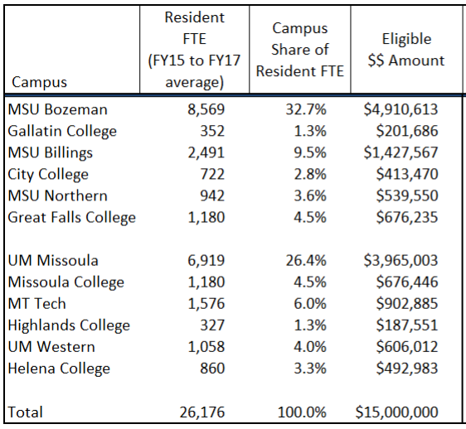
STEP 1 - Determine the maximum amount of performance funding an institution can receive
Eligible amount is based on the three-year average of RESIDENT FTE.
Institutional percentage of the system average resident FTE is the dollar share of the performance funding pool
Note: There is a timing lag
FY15, FY16, FY17 average FTE is used to determine eligible funding for FY18 and FY19

Slide 13
STEP 2 - Measure the institutional performance on a define set of metrics
Performance funding metrics are mission specific.
Mountain Campus
Number of undergraduate degrees awarded (30%)
Retention Rate (performance funding defined cohort tracked) (30%)
Number of graduate degrees awarded (20%)
Research expenditures (20%)
Missoula College
Number of degrees/certificates awarded (30%)
Retention Rates (30%)
Dual Enrollment (15%)
Remedial Success (12.5%)
Credit Accumulation (12.5%)
Calculation:
Scores are indexed to a 1,000 point scale
Growth Target is determined by regents. Institutions are scored and compared to the needed growth target
Most recent year of data must show improvement from the 3-year average

Slide 14
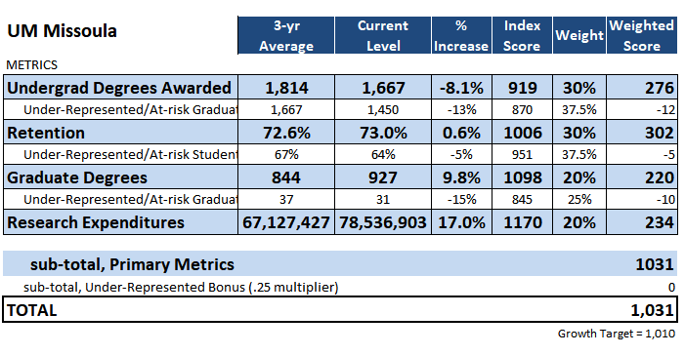
STEP 2 - Measure the institutional performance on a define set of metrics
FY19 Mountain Campus Allocation
Received full eligible amount

Slide 15
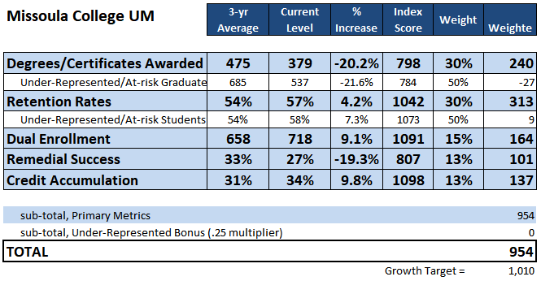
STEP 2 - Measure the institutional performance on a define set of metrics
FY19 Missoula College Allocation
Lost allocation because awards and remedial success did not show improvement and other areas did not improve enough to make up their loss

Slide 16
STEP 3 - Allow for grant application to gain back up to 50% of the lost revenue
What happens if institution does not gain enough points to hit the growth target?
Eligible amount is pro-rated based on a standard deviation of the last 5-years of total points scored by the institution.
Missoula College updated standard deviation = 96.9
Regents allow for some funding as long as total score is within two standard deviations of the growth target.
96.9 * 2 = 193.8
1010 – 193.8 = 816.2 (minimum score MC needed to get any performance funding
The score of 954 is 71% of the distance between the minimum score and growth target; MC receives 71% of the eligible target
$\frac{954 −816.3}{1010 −816.3}=\frac{137.7}{193.7}=71.1\%$
Missoula College applied for a grant addressing how they would improve their performance funding metrics and received a portion of the last performance funding back

