Slide 1
University of Montana Budget Committee
November 29, 2018

Slide 2
Fiscal Year 2019 Status

Slide 3
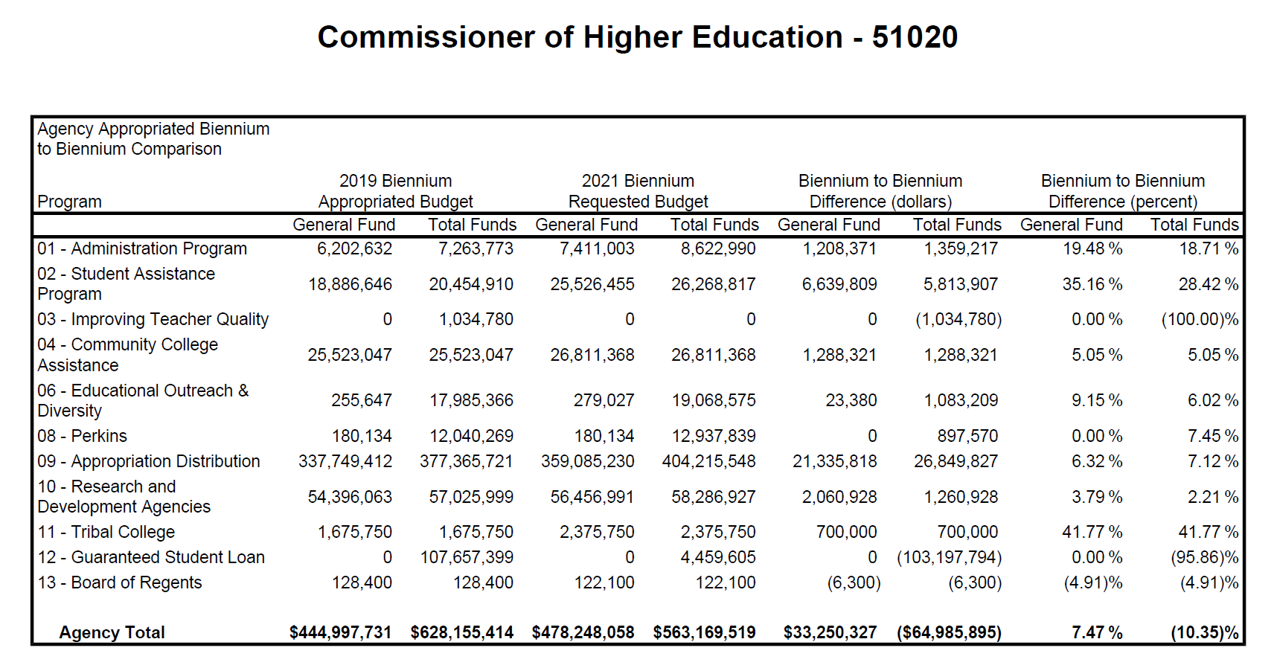
Governor’s Proposed Budget Increased Appropriation

Slide 4
Governor’s Proposed Budget

Slide 6
Program Tuition
MONTANA BOARD OF REGENTS OF HIGHER EDUCATION
SUBJECT: FINANCIAL AFFAIRS
Policy 940.12.1 – Tuition and fee approval; Disclosure of total cost of attendance
Adopted: May 21, 1973; Revised: May 22, 2015; Revised May 24, 2018
Definitions
TUITION
1. General tuition – Tuition rate assessed to all students on a per credit basis, deposited in the current unrestricted fund at each campus.
2. Program tuition – Additional tuition assessed to students in certain academic programs whereby the elements of cost are significantly higher and (unique) to the program. Program tuition is not intended to cover costs typically covered by general tuition.

Slide 7
MONTANA BOARD OF REGENTS OF HIGHER EDUCATION
SUBJECT: FINANCIAL AFFAIRS
Policy 940.31 – Policy Statement on Tuition
Adopted: March 20, 2003; Revised: November 19, 2010
Introduction
Funding for higher education is a shared responsibility of the state, students, and campuses. The state assumes its share of that responsibility through state general fund appropriations and millage; students, through tuition and fees; and campuses, through management efficiencies in innovative and creative thinking and the generation of additional revenue.

Slide 8
II. The General Goals of Tuition Policy
Tuition should be set at a level that enables a campus to maintain high quality programs and services.
Tuition levels should not be so high as to make postsecondary education unaffordable for Montanans of modest means.
Access is a more important consideration at introductory levels of postsecondary education since this is the gateway to all subsequent achievement. Thus tuition will generally increase as educational level increases.
Campuses will have the flexibility to differentiate tuition by program, sector and method of delivery to reflect the cost of providing education.
As far as practicable, tuition levels should be predictable. This helps students and their families plan for college expenses. It also helps campus administrators develop plans and goals within a realistic time frame.
Tuition levels should be competitive with other comparable public institutions.
The issue of competitiveness is especially crucial in setting tuition levels for courses where access to the course is independent of a student’s location (e.g., on-line courses).
The proliferation of fees should be avoided, and the incorporation of mandatory general fees into tuition levels should be more commonplace.

Slide 9
III. Consideration of the Cost and Value of Education in Setting Tuition Levels
Tuition levels will bear a relationship to the costs incurred by the campus in providing the education to the student. Tuition levels for resident students will bear a relation to the cost of education and the level of state support. Campuses have the flexibility to set non-resident tuition at 150% of resident tuition and set non-resident tuition for graduate research and teaching assistants at 100% of resident tuition.
The economic benefits of higher education that accrue to the individual will be taken into account when tuition levels are established or when proposals for program- or institution-specific exceptions to tuition levels are considered. This factor will often complement the practice of scaling tuition to the cost of programs. The social, intellectual, cultural and economic benefits that accrue to society from having a well-educated citizenry and skilled workforce will also be considered when tuition levels are established.
A practical manifestation of these two factors is the tiering of tuition by level of institution and by the degree progression of students and the corresponding allocation of state appropriations to assure students affordable access to postsecondary education.

