Slide 1
University of Montana
FYE 2025 Training
May 22nd
Business Operations & Finance
5/19/2025
1

Slide 2
Agenda
Introduction
Staff
What’s New
Procurement
Accounts Payable
Payroll
UM Foundation
Accounting Procedures
JV Reminders
5/19/2025
2

Slide 3
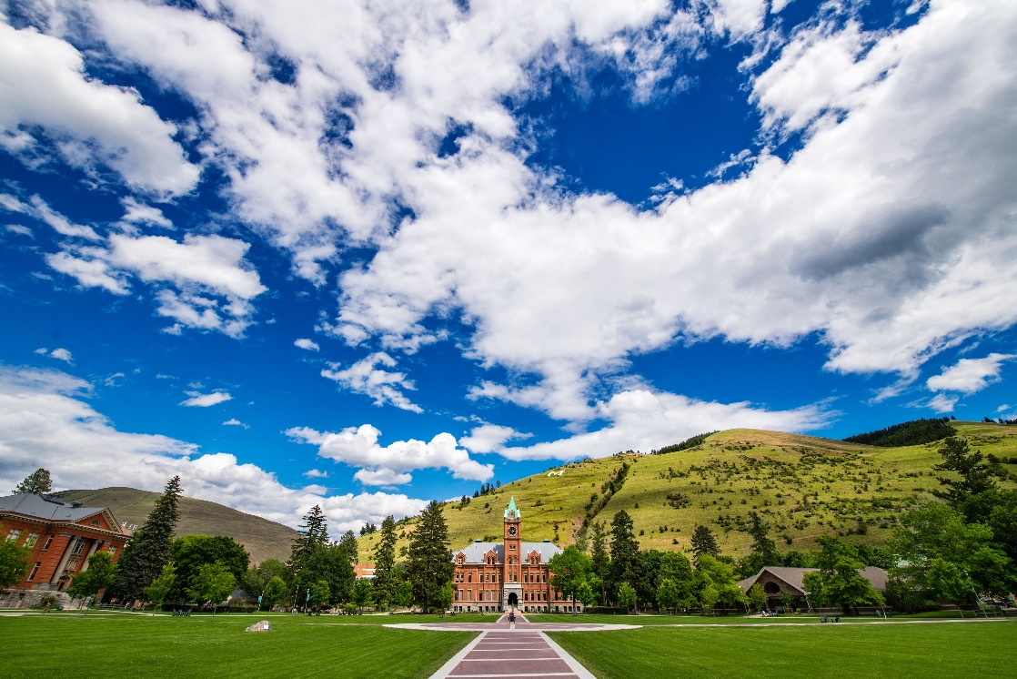
Staff Updates
Derek Kelly– PATH Desk Associate Director
Suzanne Ranger – Associate Director of Accounts Payable
Matt Hill – PATH Desk Team Lead
Michelle Wunder – Procurement Officer
Gabriel Earle – Accounts Payable Auditor
Interns
  Christopher Dietrich

Slide 4
Changes for FYE 25
Hard cutoff deadlines
Banner will be down July 11th at noon and July 25th at noon.
  Roll will happen on Friday, July 11th.
  GrizMart will be down for the weekend following July 11th and the weekend following July 25th.
Payroll redistribution deadlines
Administrative Assessment Schedule
  Preliminary run July 9th
  Final Assessment July 18th
Procurement and AP open for processing on July 1 for FY26

Slide 5
Changes for FY 26
Chrome River/Emburse
Check printing
InstantCards
PATH Desk
Vendor onboarding switching to GrizMart from Payment Works (Fall/Winter)

Slide 6
Business Operations & Finance Contact List
Accounting Services
Rachel Buswell, Controller Ext 2294
Tara Scott, Assistant Controller Ext 5802
Jennifer Dahl, Accounting Manager Ext 5983
Connor Smith, Accounting Compliance Coordinator Ext 6628
Barb Bybee, Accounting Analyst Ext 6261
Teddi Reinholz, Accounting Analyst Ext 2077
Kris Krause, Accounting Analyst Ext 6696
Accounts Payable
Suzanne Ranger, Associate Director of Accounts Payable Ext 2113
Gabriel Earle, Accounts Payable Auditor Ext 6618
Carol Walton, AP Specialist Ext 2516
Procurement
Bob Hlynosky, Director Procurement/AP Ext 2494
Jody Parrow, Associate Director Procurement Ext 4064
Christopher Newlon, Procurement Officer Ext 2510
Michelle Wunder, Procurement Officer Ext 2054
Systems
Scott Klanecky, Finance Systems Manager Ext 5558
Frank Grady, Banner Finance Production Manager Ext 2940
Todd Herman, Systems Analyst Ext 4979
PATH Desk
Derek Kelly, PATH Desk Associate Director Ext 2509
Matt Hill, PATH Desk Team Leader Ext 2390

Slide 7
FAQ's
Q: Is this presentation recorded?
A: No – please plan to take notes.

Slide 8
Procurement

Slide 9
Procurement
Purchase timing
  Critical cutoff dates
  PO’s must be set up before, NOT after purchase.
Multi year encumbrance

Slide 10
Accounts Payable

Slide 11
Accounts Payable
Friday June 13th by 5:00 PM
  All check requests forms must be completed
  Travel Processing for FY25 must be entered
  Grizmart Non PO FY25 invoices must be entered
  Warrant Cancellation requests for FY25 must be completed
FY 26 opens for processing on Tuesday, July 1st

Slide 12
PATH DESK

Slide 13
PATH Desk
Only Procard charges through 6/30/2025 will appear in FY 25
  All spending needs to be done by this date
6/30 – Procard Cycle 12 closes at 5:00pm

Slide 14
Payroll

Slide 15
Staff Updates
Payroll
Chelsea Chirinos: Director of Payroll Operations & Financial Compliance
  Pam Anderson: Personnel Associate
Austin Duncan: Associate Director of Payroll
  Danielle Goddard: Accounting Associate IV
  Clara Moore: Accounting Associate IV
Tatiana Salimova: Payroll Manager
  Austin Hughes: Payroll Tech
  Sharie McDonald: Payroll Tech

Slide 16
FY 25/26 Expenses
No payroll split or accrual for FY25
Last Payroll of FY 25 is Bi-Weekly 14; posts June 27th and pays July 9th
First Payroll of FY 26 Bi-Weekly 15; posts July 11th and pays July 23rd
New Rates for FY 26
  Health Insurance $1,080.00/month
  Unemployment .35%
  PERS 9.17%
  TRS 11.85%
  TIAA-CREF 10.676%
  Workers Comp
    Low Reg .00265% OT .00177%
    High Reg 1.895% OT 1.263%

Slide 17
FYE Payroll Redistributions
Department Responsibility:
Do not include benefits in the amount you are moving.
If partial move, please indicate the full wage amount with the funding sources that need to be used on the correcting redistribution.
JV / U-Approve is not appropriate for moving wages/benefits.
Permanent fund moves require RPT (Request for Personnel Transaction).
Deadlines –all requests requiring payroll must be submitted by 6/30/2025
  <30 Days = No justification, no approval
  >30 Days = Justification and Payroll Director approval
  >90 Days = Not allowed
IMPORTANT Bi-Weekly 14 Reminder:
Review your GTO reports carefully upon completion. If there is an error – contact your payroll by July 2rdat noon. There will be no payroll redistributions for Bi-Weekly/Student Payroll 14 for FY 25.

Slide 18
FY26 Changes
Redistributions
Updated form
Submit all requests (except grants) to Payroll
  umpayroll@mso.umt.edu
Working on Self Service redistribution requests
Payroll Split
HRA’s: handle everything before being paid, Payroll: handles everything after
New website, procedures, timelines, forms, teams HUB coming soon!
Transactional payroll email: umpayroll@mso.umt.edu
  Example: Additional hours (retros), redistributions, hours (when you run into errors)

Slide 19
UM Foundation

Slide 20
Receivables
  Submit all posted FY 25 expenses – Wednesday, July 2nd
  Submit final payroll and any clean up expenses – Friday, July 11th
  Do not request a miscellaneous receivable related to any Foundation payments as it will double up the receivable

Slide 21
Activity Codes
  Activity Codes are encouraged!
  Must be set up in advance with Business Operations & Finance
  Best if activity code mirrors UMF fund number (Example: MHC100 – 2XU)
  When pulling UMDW reports, you can use the activity code as a filter
  Please use one activity code per check request

Slide 22
FAQ's
Q: When is the last day to submit to the Foundation for cash reimbursement?
A: July 2nd for FY25 Reimbursement
A: July 11th for payroll and clean up

Slide 23
Fiscal Year End Procedures
Accounting

Slide 24
Prepay Expense
In Short:
  You’re paying for an item or service in the current fiscal year that you won’t receive until the next fiscal year.
Prepaids are not different at fiscal year end but deserve increased awareness.

Slide 25
Prepaid Expense Checklist
Step 1
Grant Expense?
STOP
No Prepay
YES
NO
Step 2
Other than 62xxx expense?
STOP
No Prepay
YES
NO
Step 3
> $500?
STOP
No Prepay
NO
YES
Step 4
Paid Monthly?
STOP
No Prepay
YES
NO
Step 5
Cross Fiscal Yrs?
STOP
No Prepay
NO
YES
Step 6
Calculate Months Prepaid
Step 7
Proceed to Grizmart

Slide 26
Additional Prepaid Guidelines/Tips/Updates
Updates/Reminders:
GRIZMART: Use the activity code PREPAY
1905 account invalid in GrizMart
PROCARD: Appropriate to use 1905 account
Do NOT use PREPAY activity code
Department Responsibility:
  For all Procard prepaids, send all supporting documentation to Teddi Reinholz no later than 7/8/2025 ( Teddi.Reinholz@mso.umt.edu )

Slide 27
FAQ's
Q: When does the Prepay Reversal Happen?
A: Expect to see an expense once July is closed

Slide 28

Miscellaneous Accounts Receivable
In Short:
Some departments on UM campus, use their own invoicing system. When this happens, those transactions are not on UM books (meaning: they are not recorded in BANNER).

Slide 29
Miscellaneous Receivables
DEPARTMENT RESPONSIBILITY:
We cannot see your invoicing system; we need you to:
  Provide Business Operations & Finance with appropriate documentation support.
  Keep a copy of that documentation support.
  Do not include receivables from other UM Departments or the UM Foundation.

Slide 30
Miscellaneous Receivables
  DEADLINE:
  7/11/25 by noon: Kris Krause
  Supporting Documentation Includes:
      Invoices
      Miscellaneous A/R reports

Slide 31
FAQ's
Q: Do I include receivables from the Foundation?
A: No

Slide 32
Expenditure Accruals

Slide 33
Expenditure Accruals
In Short:
  If a department has an expense that won’t be paid until the next fiscal year, we may need to record this.
Department Responsibility:
  Inform Business Operations & Finance
Departments must submit requests for expenditure accruals to Business Operations & Finance on or before July 8th at noon.
The Following information along with the backup documentation must be provided to Business Operations & Finance:
  Explanation and supporting documentation.
  Identify vendor (If vendor is another state agency, special accrual accounting is required).
  Department contact person and phone number.

Slide 34
Expenditure Accruals
  Only items $500.00 or more will be accrued.
  Remember: An accrual may be necessary for Procard purchases made during the last days of June if the vendor does not process them in a timely manner.
  Make sure to get supporting documentation to Tara Scott (Ext 5802) before noon on Tuesday 7/8/25.

Slide 35
FAQ's
Q: What documentation do you need?
A: Invoice (preferred) or similar documentation

Slide 36
Deferred Revenue
In Short:
  Deferred revenue is the result of receiving money that should not be recorded as revenue until next fiscal year
Departments that record deferred revenue include, but are not limited to:
  Continuing Education
  Bio Station
  Dining Services
  Athletics
  Campus Recreation
  Residence Life

Slide 37
Deferred Revenue
Department Responsibility:
  Complete Banner Online Departmental Deposit Form.
  Please use a separate deposit card for each deferred revenue transaction.
  Deferred revenue must be recorded with an activity code.
    The activity code is the revenue account code with the ‘5’ replaced by an ‘R’ (ie; 50404 – Campus Recreation Trip Fee income activity code would be R0404)
  Use account number 2505 – Deferred Revenue.

Slide 38
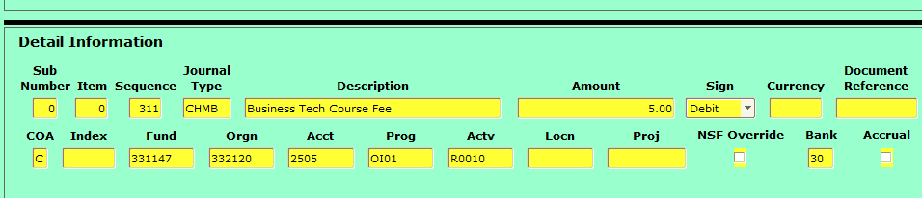
Trial Balance Report-Detail

Slide 39
FAQ's
Q: When will revenue appear in next Fiscal Year?
A: No later than the close of July

Slide 40
Credit Card Processing

Slide 41
Fiscal Year End
Department Responsibility:
The 50287 credit card clearing account should be reconciled on a regular basis throughout the year.
Departments should make a final credit card deposit at Treasury before it closes for the fiscal year. Treasury will close on Monday, June 30th at 11am.

Slide 42
How Money is Received
Most money (other than student account payments) coming into UM from state agencies will be received electronically via:
  SABHRS IUJ (Kris) or
  SABHRS Wire (Jennifer) or
  Deposit into Bank Account (Barb)
  Department Responsibility:
    Contact appropriate person and inform Business Operations & Finance of initiating entity, amount, and anticipated date.

Slide 43
U-Approve
  All FY 25 U-Approve JV’s must be completed and approved by 12:00pm on Thursday, July 10th.
  Any JV’s not completed by 12:00pm on Thursday, July 10th will be deleted.
  Late JV’s will not be allowed. They will need to be resubmitted in next fiscal year.

Slide 44
Helpful Tips
Please reference the Banner document number in your JV document text when correcting an entry along with a description of why the correction is being made.
Correction involving a grant fund must include an Accounting Analyst as an approver.
Please monitor all deadlines and notify Business Operations & Finance right away if unable to meet a deadline.

Slide 45
Helpful Tips
Please monitor your accounts and submit your requests to the Foundation for Gift accounts by their deadline.
Dates on JV’s are critical; you must use 6/30/25 if you want it to post in FY 25.

Slide 46
FAQ's
Q: Will there be communication on deadlines throughout FYE?
A: Yes! Plan to see frequent email communication throughout June and July

Slide 47
Tools for Monitoring FYE Activity

Slide 48
Tools for Monitoring FYE Activity
Banner Finance
  FGIBDST – Org Budget Status
  FGITBSR – Trial Balance Summary
  UMDW
  Operating Statement
  Trial Balance
  Payroll
UMDW Access Contact: Business Operations & Finance Systems

Slide 49
Fiscal Year End Webpage
Documentation
Cutoff Schedules
Presentation Slides
Contact Information
Fiscal Year End Webpage

Slide 50
Questions?
5/19/2025
50

Slide 51
Thank You
5/19/2025
51

