Slide 1
Brand Strategy
Initiative
GOAL
UM’s Brand Strategy Task Force works to build awareness and recognition of UM’s attributes by developing a comprehensive brand strategy and marketing plan. Goals are to increase alumni engagement, receive more philanthropic and legislative support, and enhance faculty, staff, and student recruitment and retention through effective brand management and marketing.

Slide 2
Scope of Project
Three phases
Research, positioning & message development
Creative work
Marketing plan
Notes:
Through research and discovery, develop a positioning statement and messaging platform for the University.
3.2.1.1 Review findings of the UM communications audit conducted in 2010.
3.2.1.2 Review UM’s graphics standards manual.
3.2.1.3 Review UM website.
3.2.1.4 Review the messaging of key competitors.
3.2.1.5 Conduct a series of research and discovery sessions including focus groups with all key stakeholders, one-on-one interviews and phone interviews.
3.2.1.6 Lead a one-day consensus building retreat with the UM Brand Strategy Task Force, President’s Cabinet and Academic Officers.
3.2.1.7 Deliver a report on this phase of the project to UM that includes a positioning statement, a list of key attributes and messaging platform.
3.2.2 Develop a unified brand that highlights the University’s distinct attributes and transcends differences in missions of its various units.
3.2.2.1 Recommend a comprehensive brand strategy and direction for creative collateral that includes a brand statement, creative (brand) concepts, messaging, visual approach, visual identity refinement and representative creative. Include:
Nomenclature development
Voice and Messaging
Brand Identity Design
Design System Look and Feel
Stationery System
Print Literature System
Presentation templates
Vehicle Graphics
Signage System
Visual and Verbal Brand Identity Guidelines
3.2.2.2 Provide original artwork and layout designs for all materials.
3.2.2.3 Provide camera ready originals for all print materials.
3.2.3 Develop an integrated marketing communications plan to roll out the brand and manage its use across UM’s units and affiliates, including schools, colleges, programs, centers and the UM Foundation.

Slide 3
Preliminary Timeline
Nov. 7 Proposals due
Nov. 23 Contract to be awarded
Jan./Feb. Research & discovery,
positioning statement creation
March Message development
April Messaging platform delivered
May Creative development
June Marketing plan development

Slide 4
TASK FORCE MEMBERS
Co-Chairs:
  Provost Perry Brown and Beth Hammock, UM Foundation Vice President, Strategic Communications and Marketing
Campus Representatives:
  Jen Gursky, President, ASUM
  Rick Hughes, Chair, Department of Media Arts
  Bill Johnston, Director, Office of Alumni Relations
  Rosi Keller, Associate Vice President for Administration and Finance
  Peggy Kuhr, Dean, School of Journalism
  Jed Liston, Assistant Vice President for Enrollment Services
  Jakki Mohr, Regents Professor, Department of Management and Marketing
  Jim O’Day, Director, Intercollegiate Athletics
  Sharon O’Hare, Executive Director, Office for Student Success
  Cary Shimek, Senior News Editor, University Relations
  Allison Squires, Staff Senate
  Bill Woessner, Regents Professor, Department of Geosciences
  Kim Zupan, Carpentry Program, Department of Industrial Technology
Community/Alumni Representatives:
  Mike McDonough, Retired Telecommunications Executive, UM Foundation Trustee
  Ginny Merriam, Public Information/Communications Director, City of Missoula
  Tim O’Leary, Co-Founder and CEO, R2C Group, UM Foundation Trustee
  Jeremy Sauter, Marketing Consultant

Slide 5
The Challenge
Average Alumni Annual Giving Rate: National Universities
Source: U.S. News & World Report, 2010 Best Colleges Rankings
9.1% The University of Montana
Notes:
National average in 2010 for public research/doctoral universities was 9.4% in 2010. This is a drop from 11.5% in 2002. We want to be above average.
5

Slide 6
Source of Gifts to UM
Notes:
UM is fortunate to have a significant level of contributions from non-alumni. This chart shows the source of gifts since 2002. Last year, non-alumni contributed $8.4 million, the same amount alumni gave. During the Invest in Discovery campaign alumni giving was higher: almost 18% of alumni made a gift in 2002. Other campaign years alumni giving was 13 to 16 percent. This shows the impact of targeted messaging.

Slide 7

The University of Texas at Austin
“What Starts Here Changes the World”
Source: Carnegie Communications

Slide 8
UNIVERSITY OF TEXAS:
Why We Need a Brand
A brand is a set of associations evoked by UT that should be:
  A short cut description of the actual experience
  Tied to UT’s mission, vision, and objectives
  Positive and motivational
Why we need a brand:
  Prospective Students: Creates an “easy choice”
  Alumni: Generates loyalty and word-of-mouth recommendations
  Parents: Results in payment of higher prices
  Media: Insulates from negative situations
  Internal Audiences: Directs behavior
  Everyone: Enhances UT’s reputation over time
Source: Carnegie Communications

Slide 9
The UNIVERSITY OF TEXAS
Brand Positioning Idea
The University of Texas at Austin is leading the future of higher education.
As a unified community, UT is creating a new vision of the public university for the next generation that will have more impact on changing the world than any institution of its kind.
Source: Carnegie Communications

Slide 10
Return on Investment: Brand Value
Enrollment Metrics (applications, inquiries, visits, matriculants, etc.)
Student Quality Metrics (average test scores, GPA)
Development Metrics (annual giving, campaign goals, alumni participation)
Academic/ Research Quality Metrics (faculty/ admin recruiting, research funding, publishing)
Operational efficiencies (unified/ centralized marketing materials, resources)
Soft Assets (spirit, loyalty, pride, motivation, state and national prestige)
Source: Carnegie Communications

Slide 11
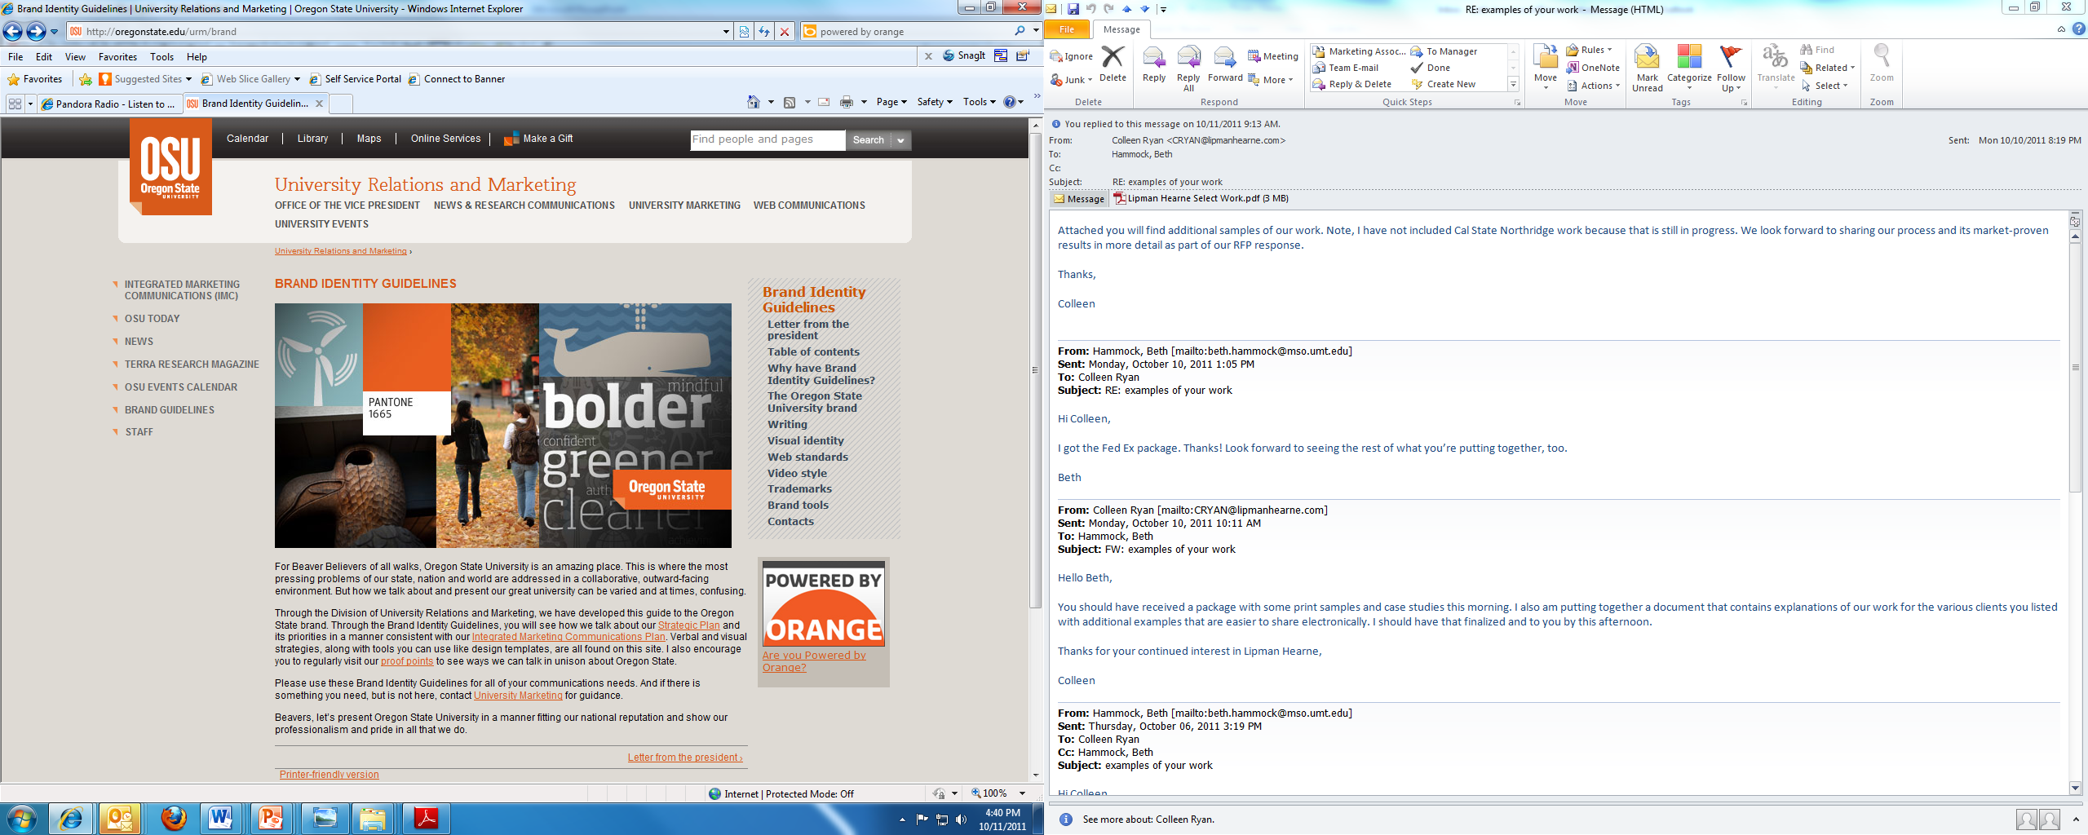

Slide 12
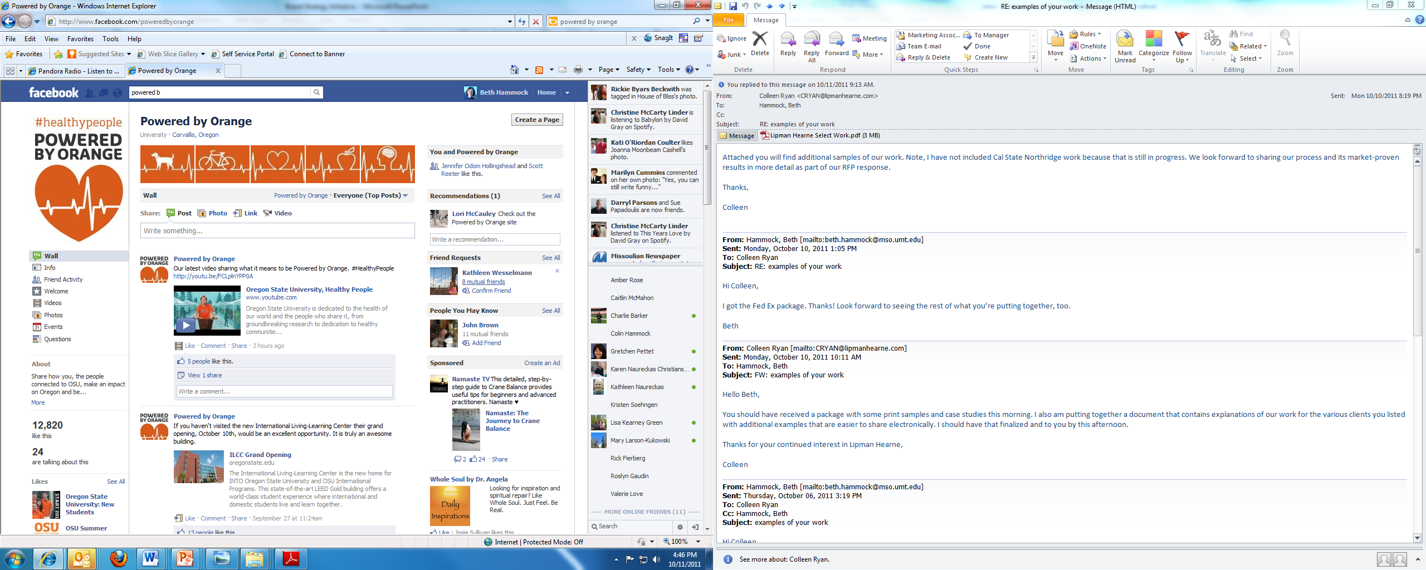

Slide 13
It’s Montana’s Turn
Questions? Comments?
Contact me:
beth.hammock@mso.umt.edu or 243-4609

