Slide 1

Department
of Intercollegiate
Athletics

Slide 2
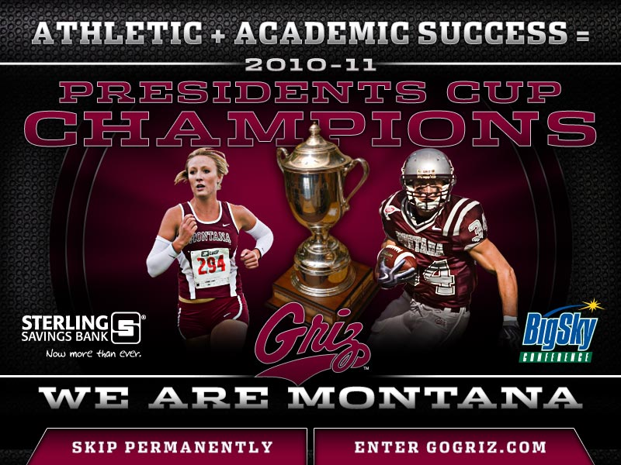

Slide 3

By the numbers
UM Athletics Budget
1988 1992 2005 2010 2011 2013
$1.8 million $4 million $9.2 million $12.8 million $11.8 million $15.2 million
$4.5 million – 2012 Football Ticket Sales Revenue
$100,000 Television Revenue
19,000 + Season Football Ticket Sales
$6.5 million – Cost to run a Football Program; Revenue directly associated with football
54, UM’s Place on Collegiate Licensing Listing of apparel sales

Slide 4
Recent Accomplishments
Athletic & Academic Success
Department Internal Study By NACDA Consulting
Master Plan to Address Title IX
WAC Discussions & Big Sky Conference Expansion
Facility Improvements Needs Re-Defined
5-Year Department Funding Plan
NCAA Cycle III Certification Process

Slide 5
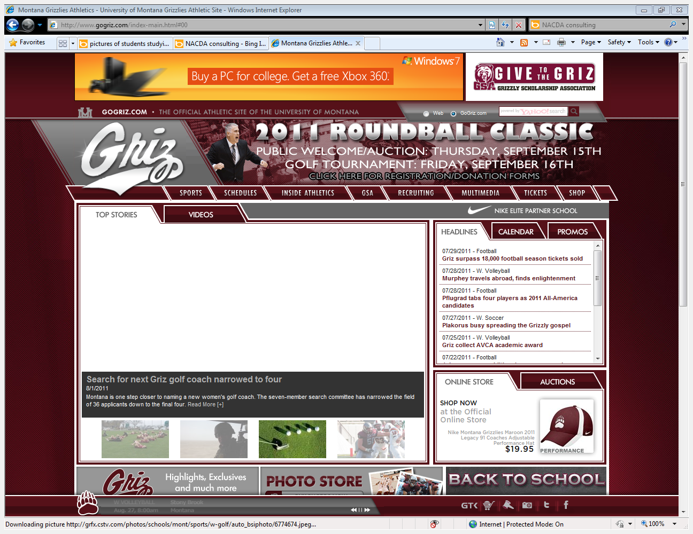
Website Changes (gogriz.com)

Slide 6
2020
Building A University
For The
Global Century

Slide 7
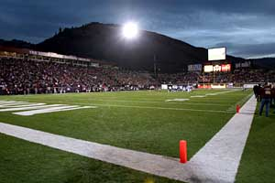
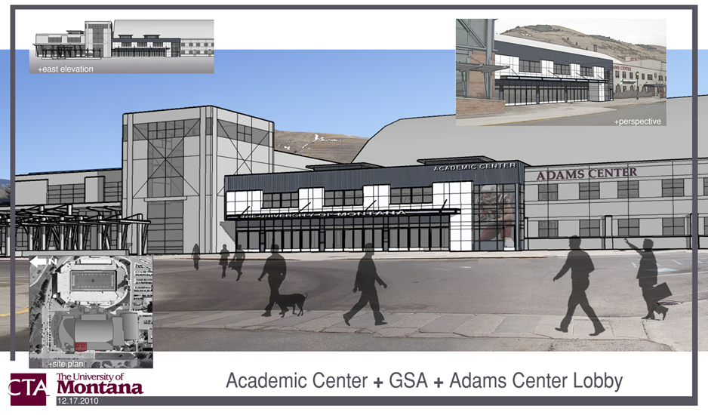
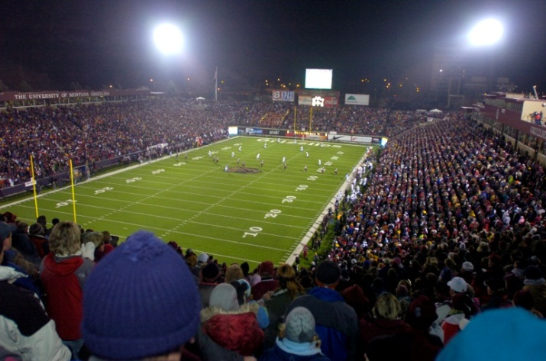
Partnering for
Student Success
Fund-Raising for a Student-Athlete Academic Center
Washington-Grizzly Stadium Lights

Slide 8
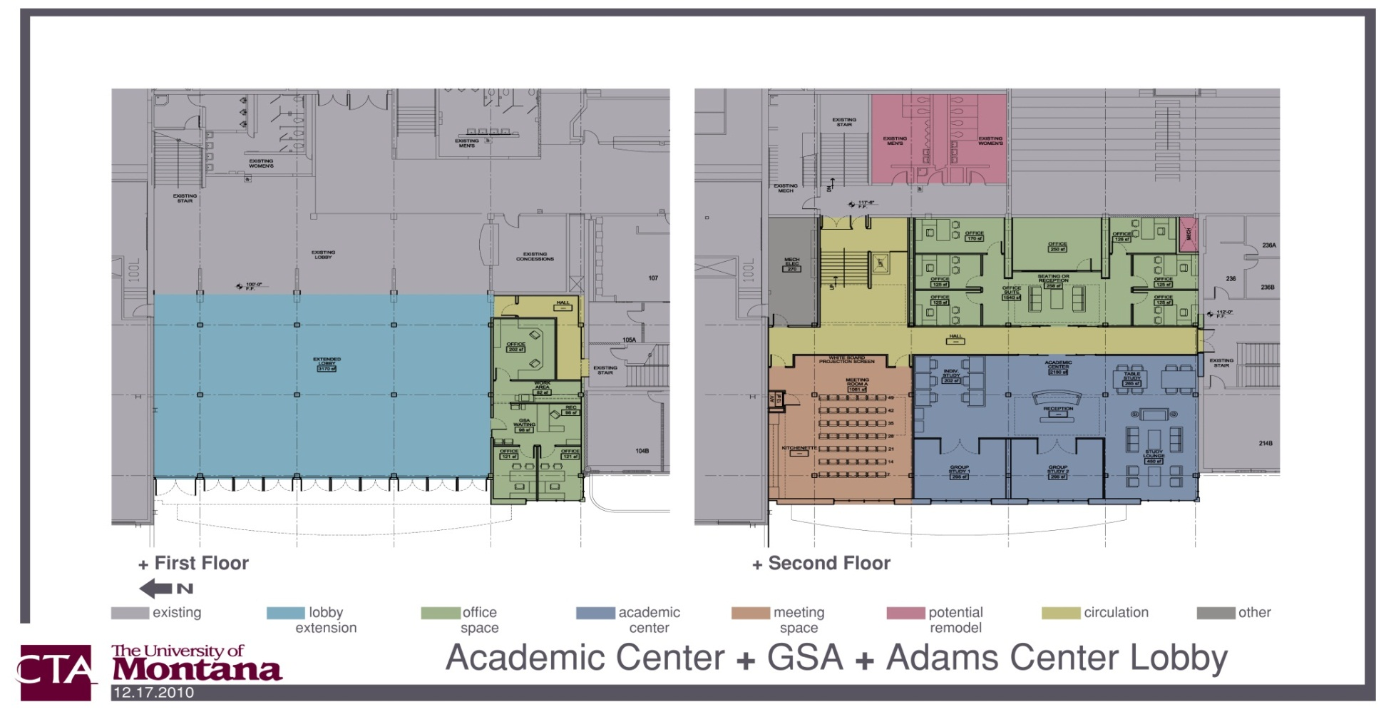
Provide a Dynamic Learning
Environment

Slide 9
Fundraising
for Improved…
Strength & Conditioning Center
Locker Rooms
Meeting Rooms

Slide 10
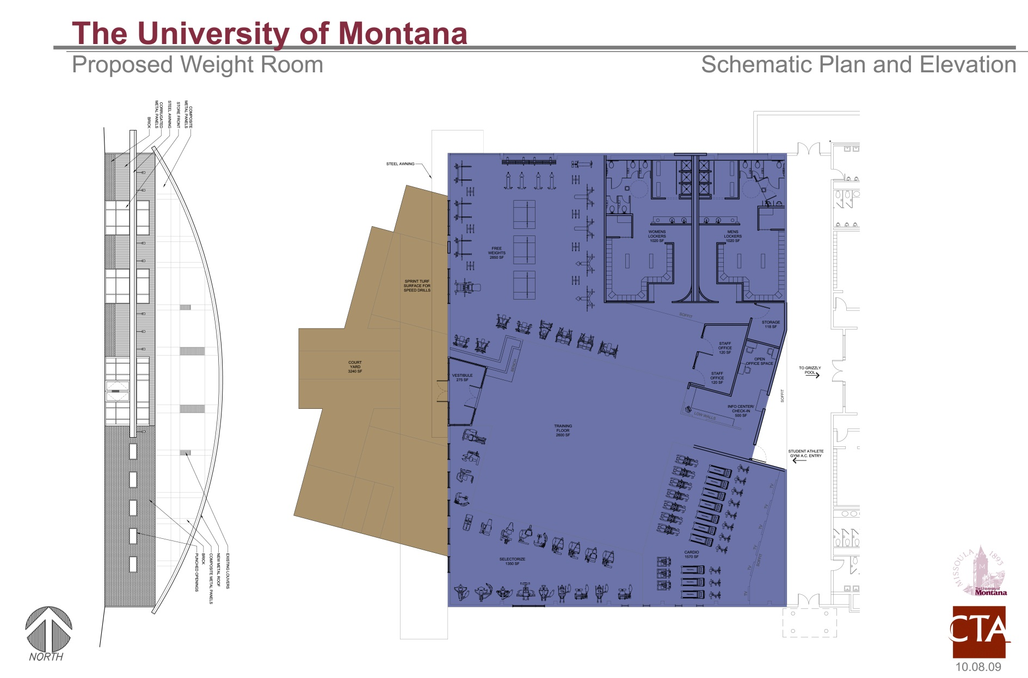

Strength & Conditioning
Center

Slide 11
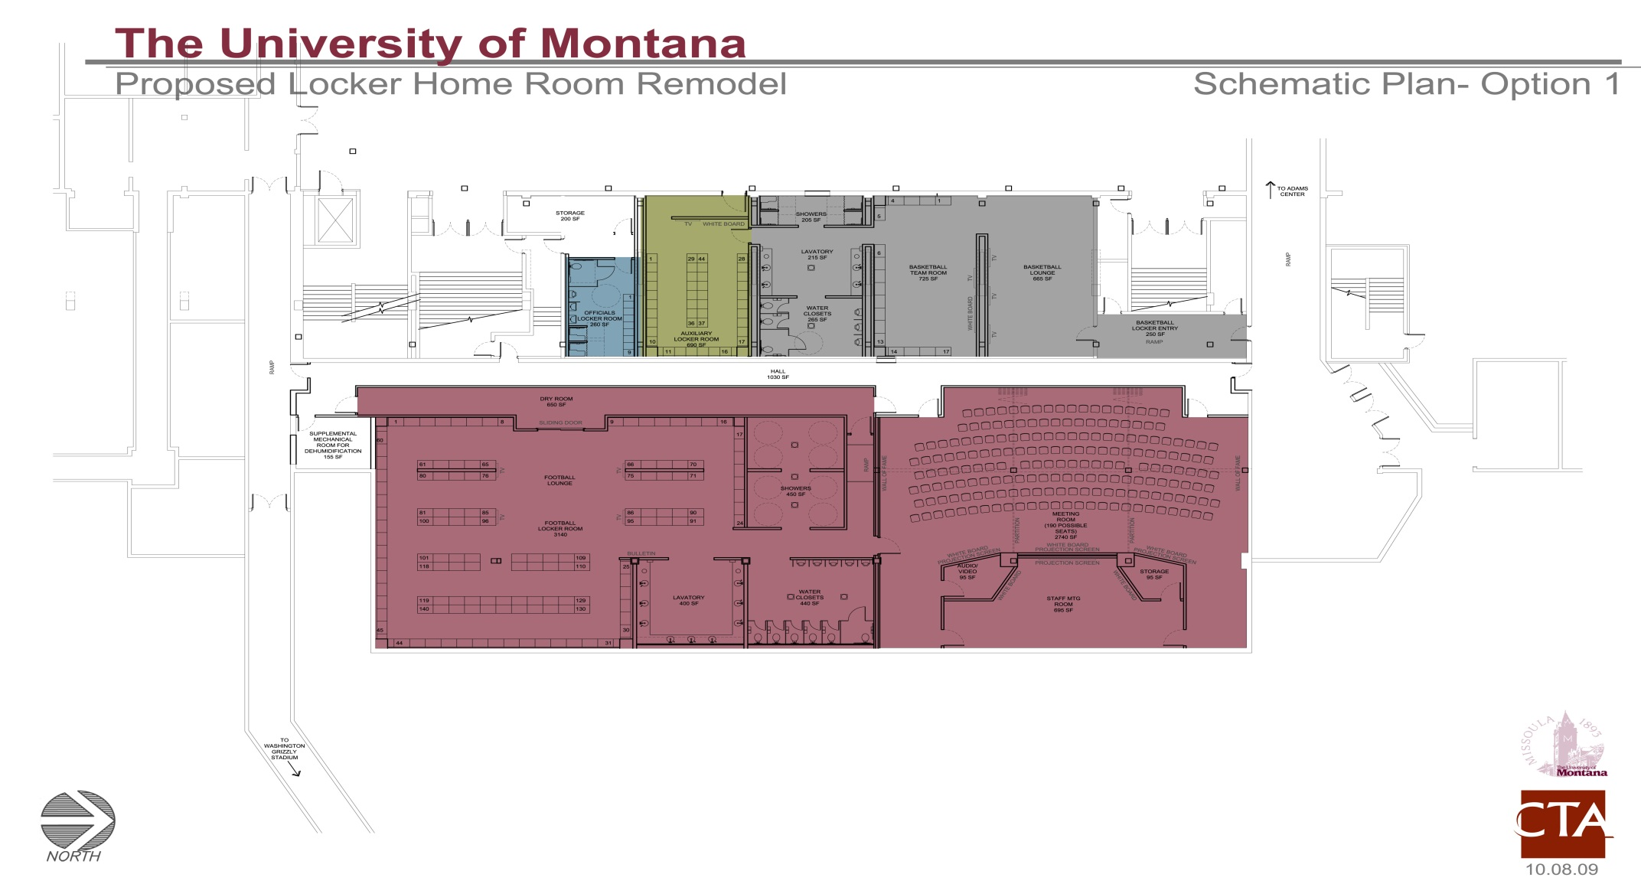

Locker Room
& Meeting Rooms

Slide 12


Expanding the Scope
of Social Media/Television
– Above and Beyond -

Slide 13


Create a Master Plan
for Women’s Softball Program

Slide 14
Build a Stronger Partnership with Campus Affiliates

Slide 15


Brand Awareness Campaign
Consistent Messaging/Use
of Trademarked Logos, etc.

Slide 16
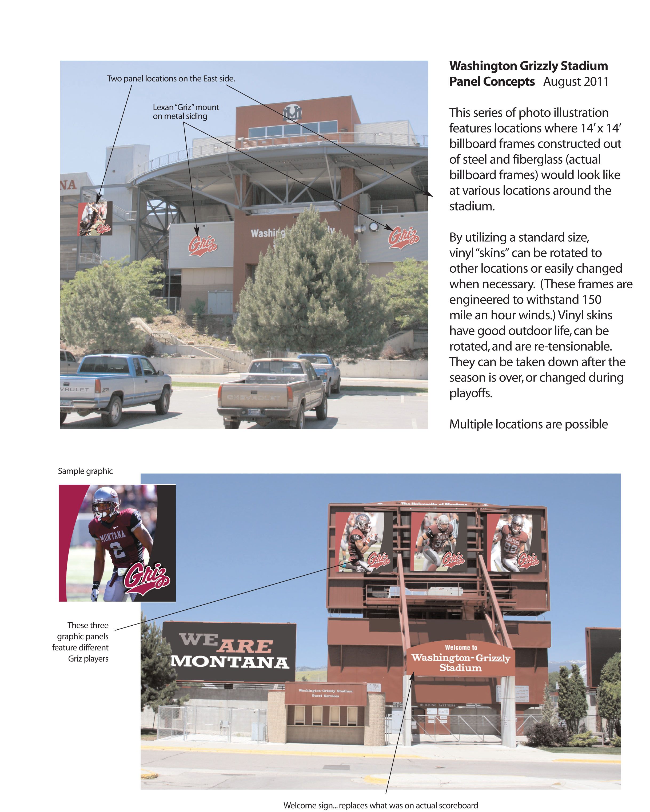

Slide 18
Re-visit Department Strategic Plan and Updates

Slide 19
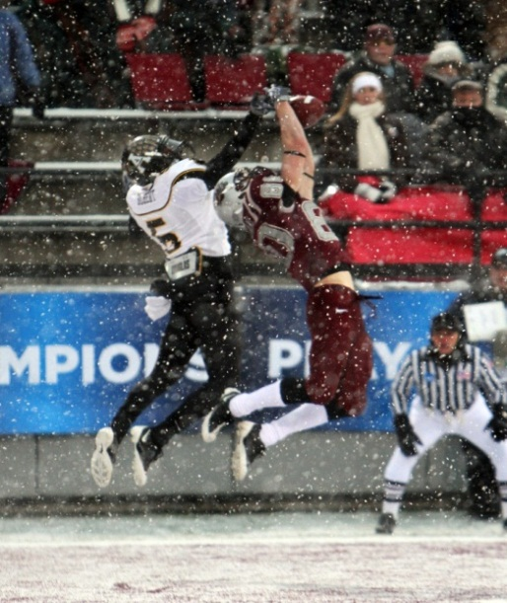
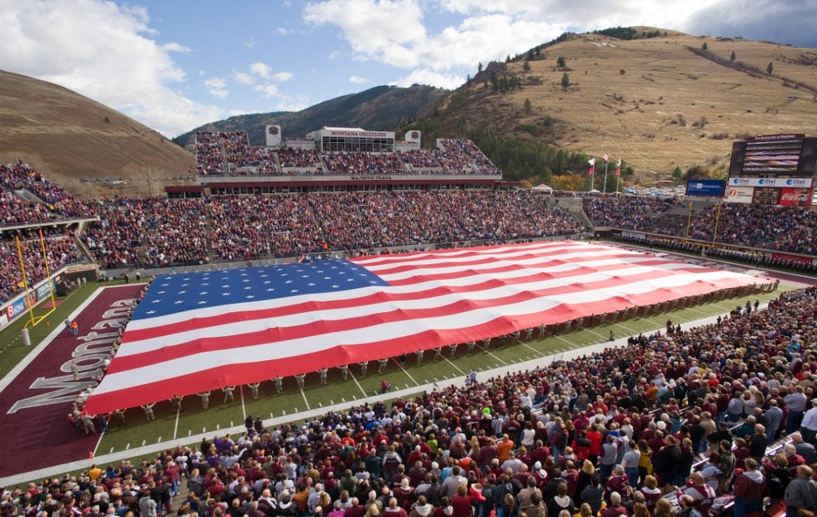
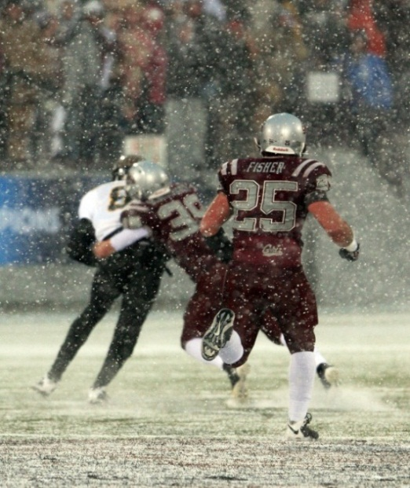
Aspire to Remain “Relevant” Across Montana, the Country and the World
UM vs. App State
Dec. 12, 2009
ESPN2
Military Appreciation Day
Oct. 31, 2009

Slide 20
Jean Gee
Senior Associate Athletic Director
Senior Woman Administrator
Compliance/Academics

Slide 21
Student-Athlete
Welfare Programs

Slide 22
Athletic Performance Center
Strength & conditioning instruction from certified strength coaches
Injury rehabilitation (in consultation with Rhinehart Athletic Training Center)
Nutritional supplements (chocolate milk, granola bars, and fruit)
Strength training equipment

Slide 23
Rhinehart Athletic Training Center
(RATC)
Injury treatment and care by certified athletic trainers
Injury prevention
Drug Testing (NCAA & Institutional)
Collaboration with Athletic Training program within the College of Education and Human Resources

Slide 24
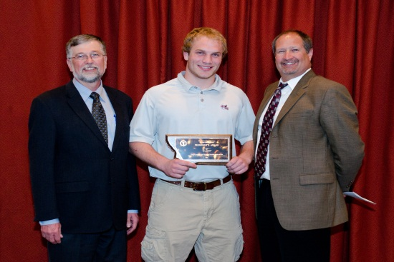
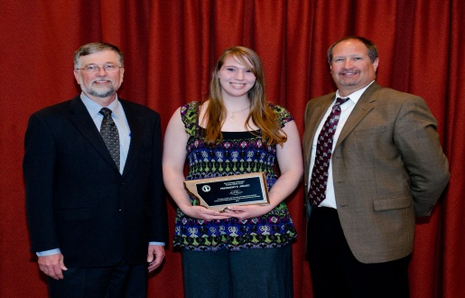

Academic Support Programs for Student-Athletes
Tutoring
At-risk Academic Mentoring Program
Academic Course Advising
NCAA Academic Eligibility Requirements advising and monitoring
Freshman student-athlete orientation course in the fall
Various workshops during the year
Career counseling and mentoring programs
Various guest speakers throughout the academic year
NCAA-mandated exit interviews

Slide 25
The Academic Recruiting Process
Official Visit
Academic Evaluation
Recruiting Advisory Board (RAB)

Slide 26

Fruits, Nuts and Bagels:
NCAA Rules 101

Slide 27

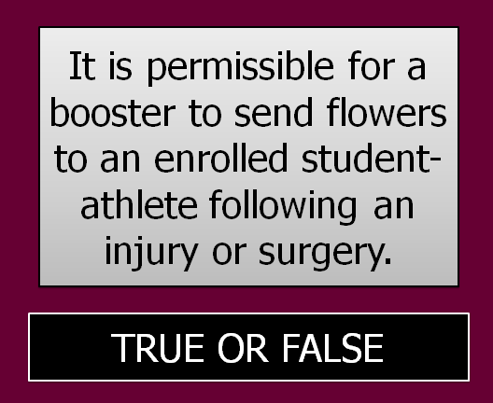

Slide 28



Slide 29
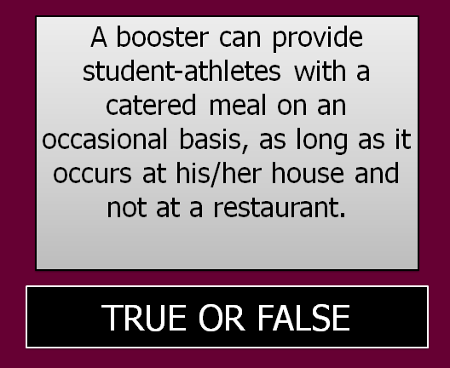

Slide 30


Slide 31

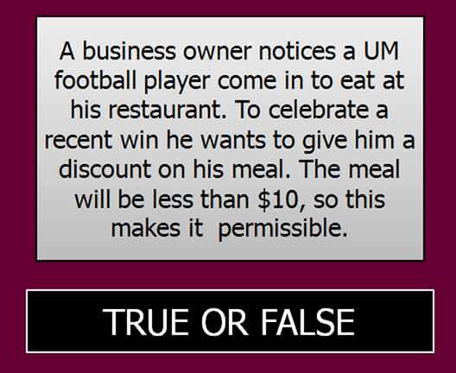

Slide 32



Slide 33
Greg Sundberg
Assistant Athletic Director
Executive Director, Grizzly Scholarship Association

Slide 34

Grizzly
Scholarship Association

Slide 35
What is the Grizzly Scholarship Association (GSA)?
501(c)3 non-profit
Primary goal to raise funds for student-athlete scholarships
Scholarship costs UM $4.1 million
Raised $2 million + in each of the last four years

Slide 36
How does the GSA operate?
GSA has four employees:
Director
Assistant Director
Business Manager
Administrative Assistant – part time
Governed by Board of Directors
13 Chapters from across the state and Washington

Slide 37
Fundraising
Memberships
Special Events

Slide 38
Two Types of Memberships
Priority Seating
Club Members
Access to better seat
Donation is based per seat and location
Gold - $420
Silver - $260
Copper - $120
80% Tax Deductible
Support the academic pursuits of Grizzly Student-Athletes
100% tax deductible
$50-$5,000
Annual membership

Slide 39




Special Events
Golf Tournaments
Spring Tour
Wine Festival
Poker Tournament
Auction
Tailgates
Smaller socials

Slide 40


Slide 41

Scholarship Costs
1987-88 1998-99 2011-12
IN-STATE
Tuition/Fees $1,329 $2,880 $5,775
Full Scholarship $5,700 $10,160 $14,075
OUT OF STATE
Tuition/Fees $3,147 $7,930 $19,612
Full Scholarship $7,518 $15,210 $27,912

Slide 42
Kent Haslam
Associate Athletic Director
For Development

Slide 43
Fundraising Priorities
Facility Improvements
Scholarships
Opportunity Funds
Hall of Champions

Slide 44
Facility Improvements
Student-Athlete Academic Center
Relocation & Renovation of Weight Room
Renovation of Men’s Locker Room

Slide 45
Fundraising Goal:
$6 Million
Fundraising To Date:
$2.7 Million

Slide 46


Scholarships
41 Named Scholarships in Athletics (only 17 6 years ago)
$25,000 to Endow a Scholarship or
$1,000 Per Year For Five Years
Degree Completion

Slide 47
Opportunity Funds
Provides Flexibility for Greatest Need
13 Named Funds
Sport Specific Opportunity Funds

Slide 48
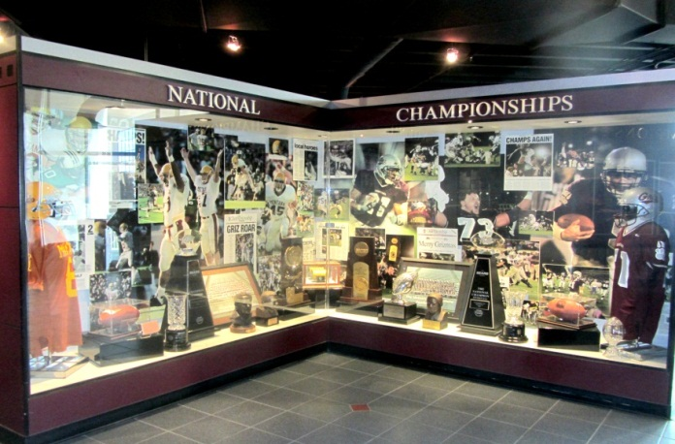
Hall of Champions
Project taken on by National Advisory Board for Grizzly Athletics (NABGA)
Celebrates History of Grizzly Athletics
Always Needs to be Updated
Supported by Endowed Funds & Annual Funds

Slide 49
Athletics Fundraising
Charitable Amounts Only
Processed & Receipted by UM Foundation
FY2011- $3.46 million 17.3% of total
FY2010- $3.23 million 23% of total

Slide 50
GOAL:
Give the Student-Athletes the College Experience They Deserve

Slide 51
Challenges/Initiatives/ Complexities
Academic Reform
Partnering for Student-Athlete Success
Title IX
Including Transgender Student-Athletes
Budgeting to Success

Slide 52
Addressing Violence and Behavioral Issues
We all spend too much time chasing fires vs. getting down to the root of the problem
Sending too many mixed messages
Cleaning up language, control alcohol abuse
More leadership across the board – and our student-athletes need to take leadership roles
“There are not simple answers or magical programs”

Slide 53
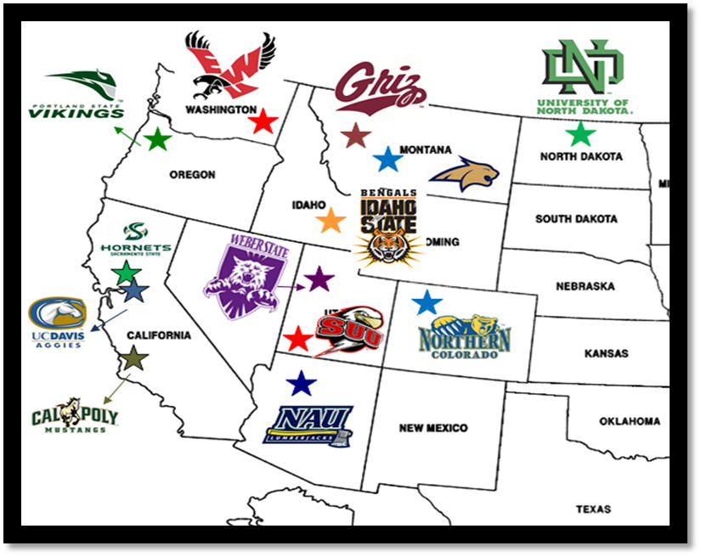

Slide 54
WE
ARE
MONTANA

