Slide 1

Smooth Travels
Savoring as a Self-Regulation Strategy
Grade 6–8
Health / SEL Lesson
60 Minutes

Slide 2

Welcome Aboard!
Please have your journal and a pen or pencil ready to use.
Learning Objectives (Pay attention to these things!)
By the end of today’s lesson, you will be able to:
Define savoring in your own words
Discuss ways savoring could help regulate emotions
Practice at least one savoring technique
Identify when you could use savoring

Slide 3
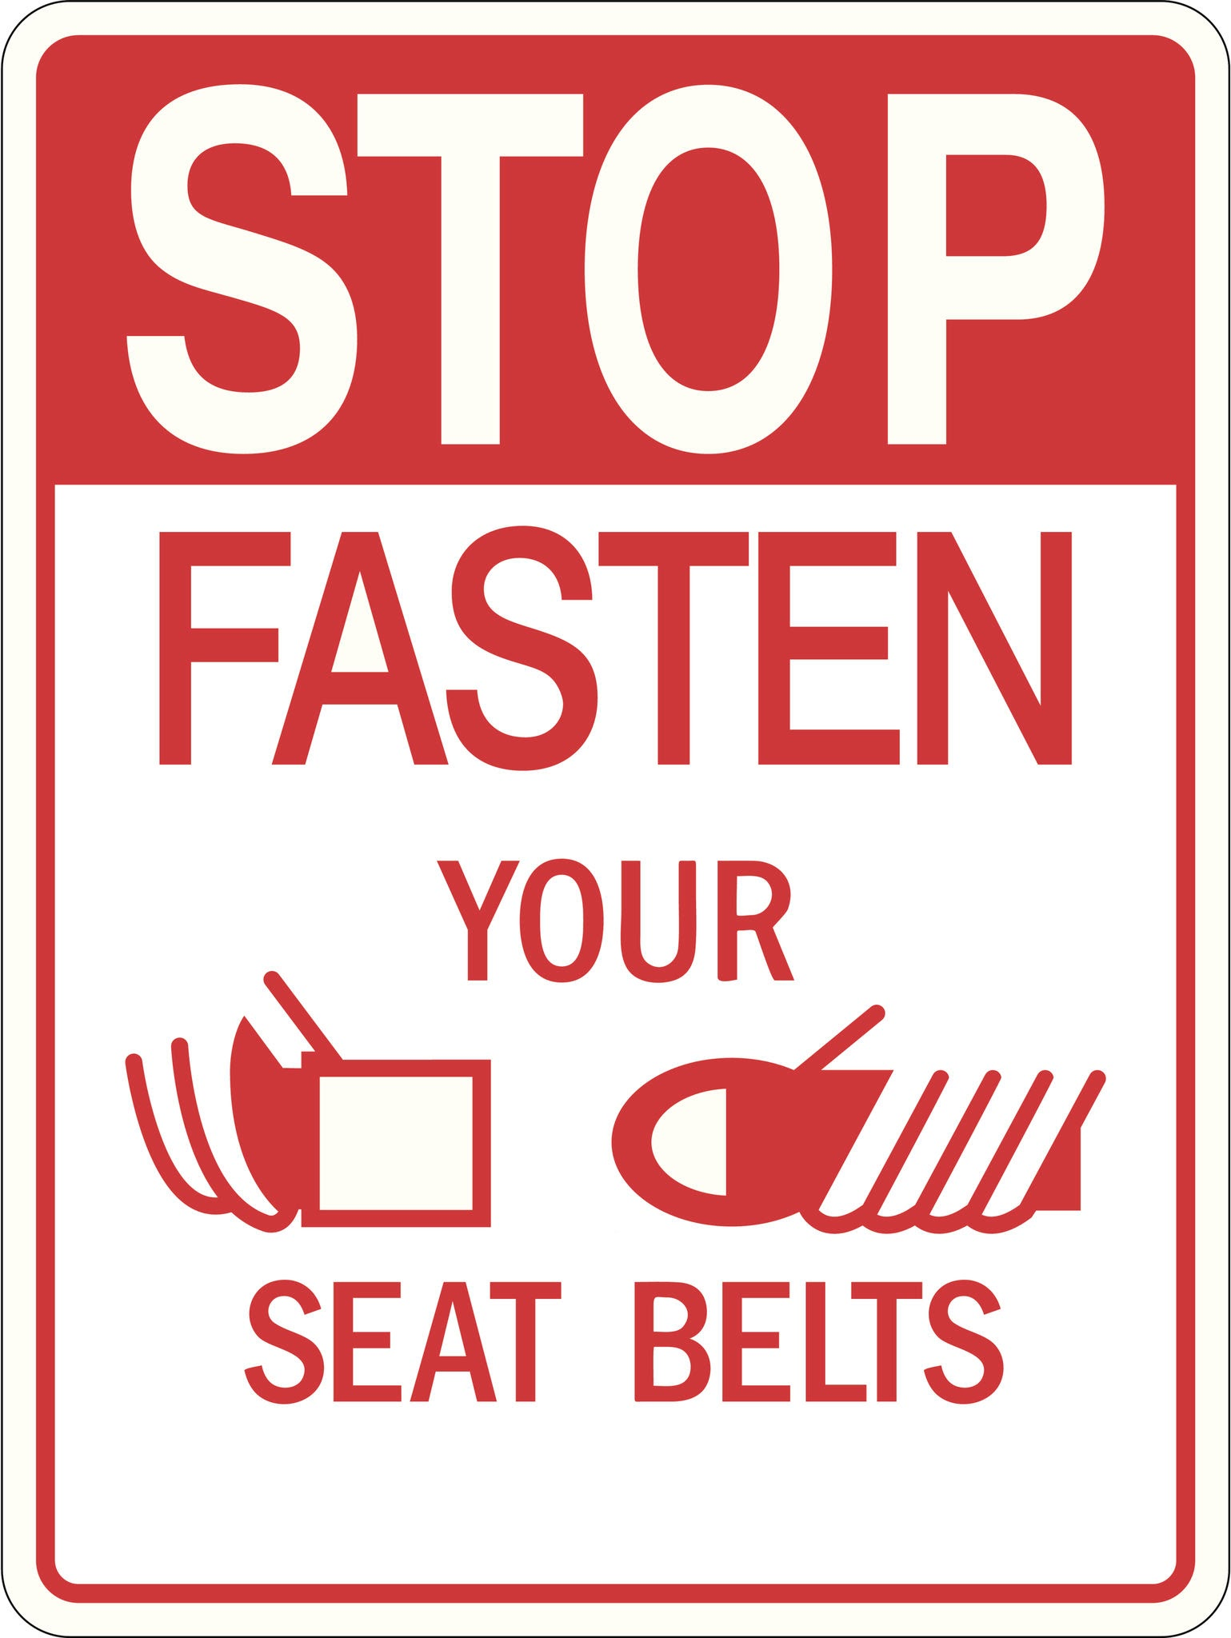
Fasten Your Seatbelt!
What do you usually do when you feel:
Stressed?
Upset?
Overwhelmed?
Do you have strategy? Several strategies?
Write quietly for 2–3 minutes.

Slide 4
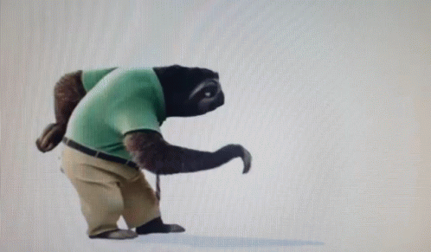
Strategy Recap +
What is a strategy we have already covered here?
What are some other calming strategies?
What about slowing down?
Has anyone ever heard the word SAVOR?
Does it make you think of anything?
Today’s Strategy is… SAVORING!!!

Slide 5

This is Your Captain Speaking
What is Savoring?
Savor: To notice and appreciate a positive experience.
Savoring: Noticing, enjoying and extending our positive experiences.
Notes:
Ways to engage in savoring - senses-paying attention-being fully present in the moment

Slide 6

Put on your Oxygen Mask! https://www.youtube.com/watch?v=taKdfDHwzqU

Slide 7
Why Try Savoring?
Your brain has:
An alarm system called the amygdala
A thinking/regulating system called the prefrontal cortex
Sometimes the amygdala works overtime and we can feel stress or even “flip our lid”
Practicing savoring can help the prefrontal cortex do its work to help us stay regulated
Savoring can help to:
Slow your breathing
Relax your muscles
Improve your memory
Shift your focus
Activate the calming part of your brain!

Slide 8
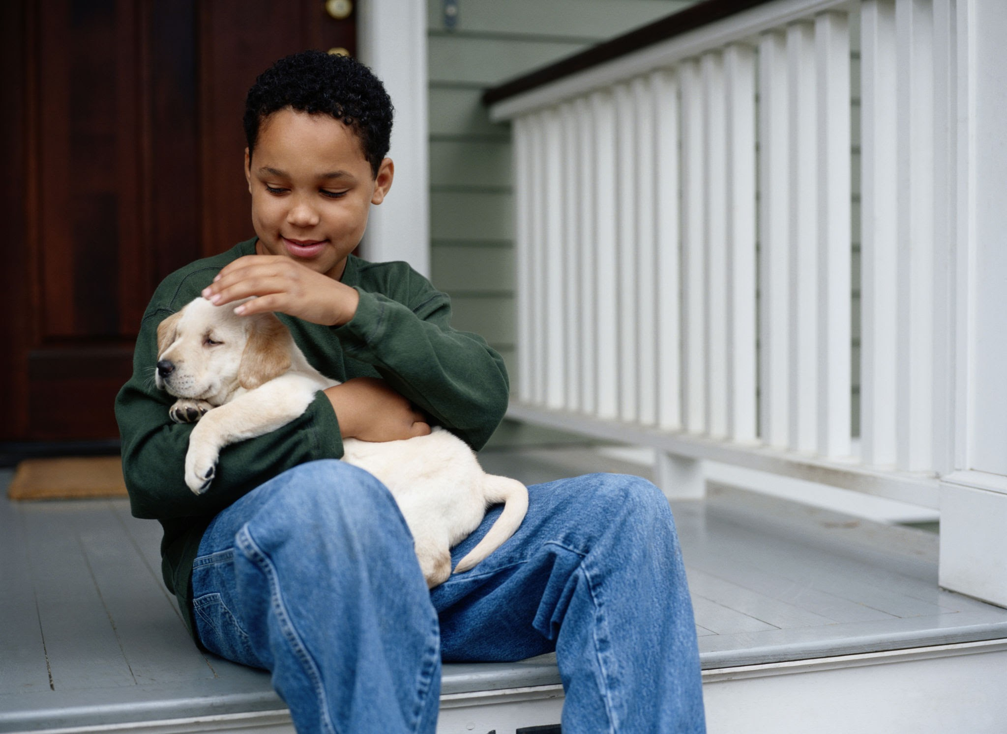
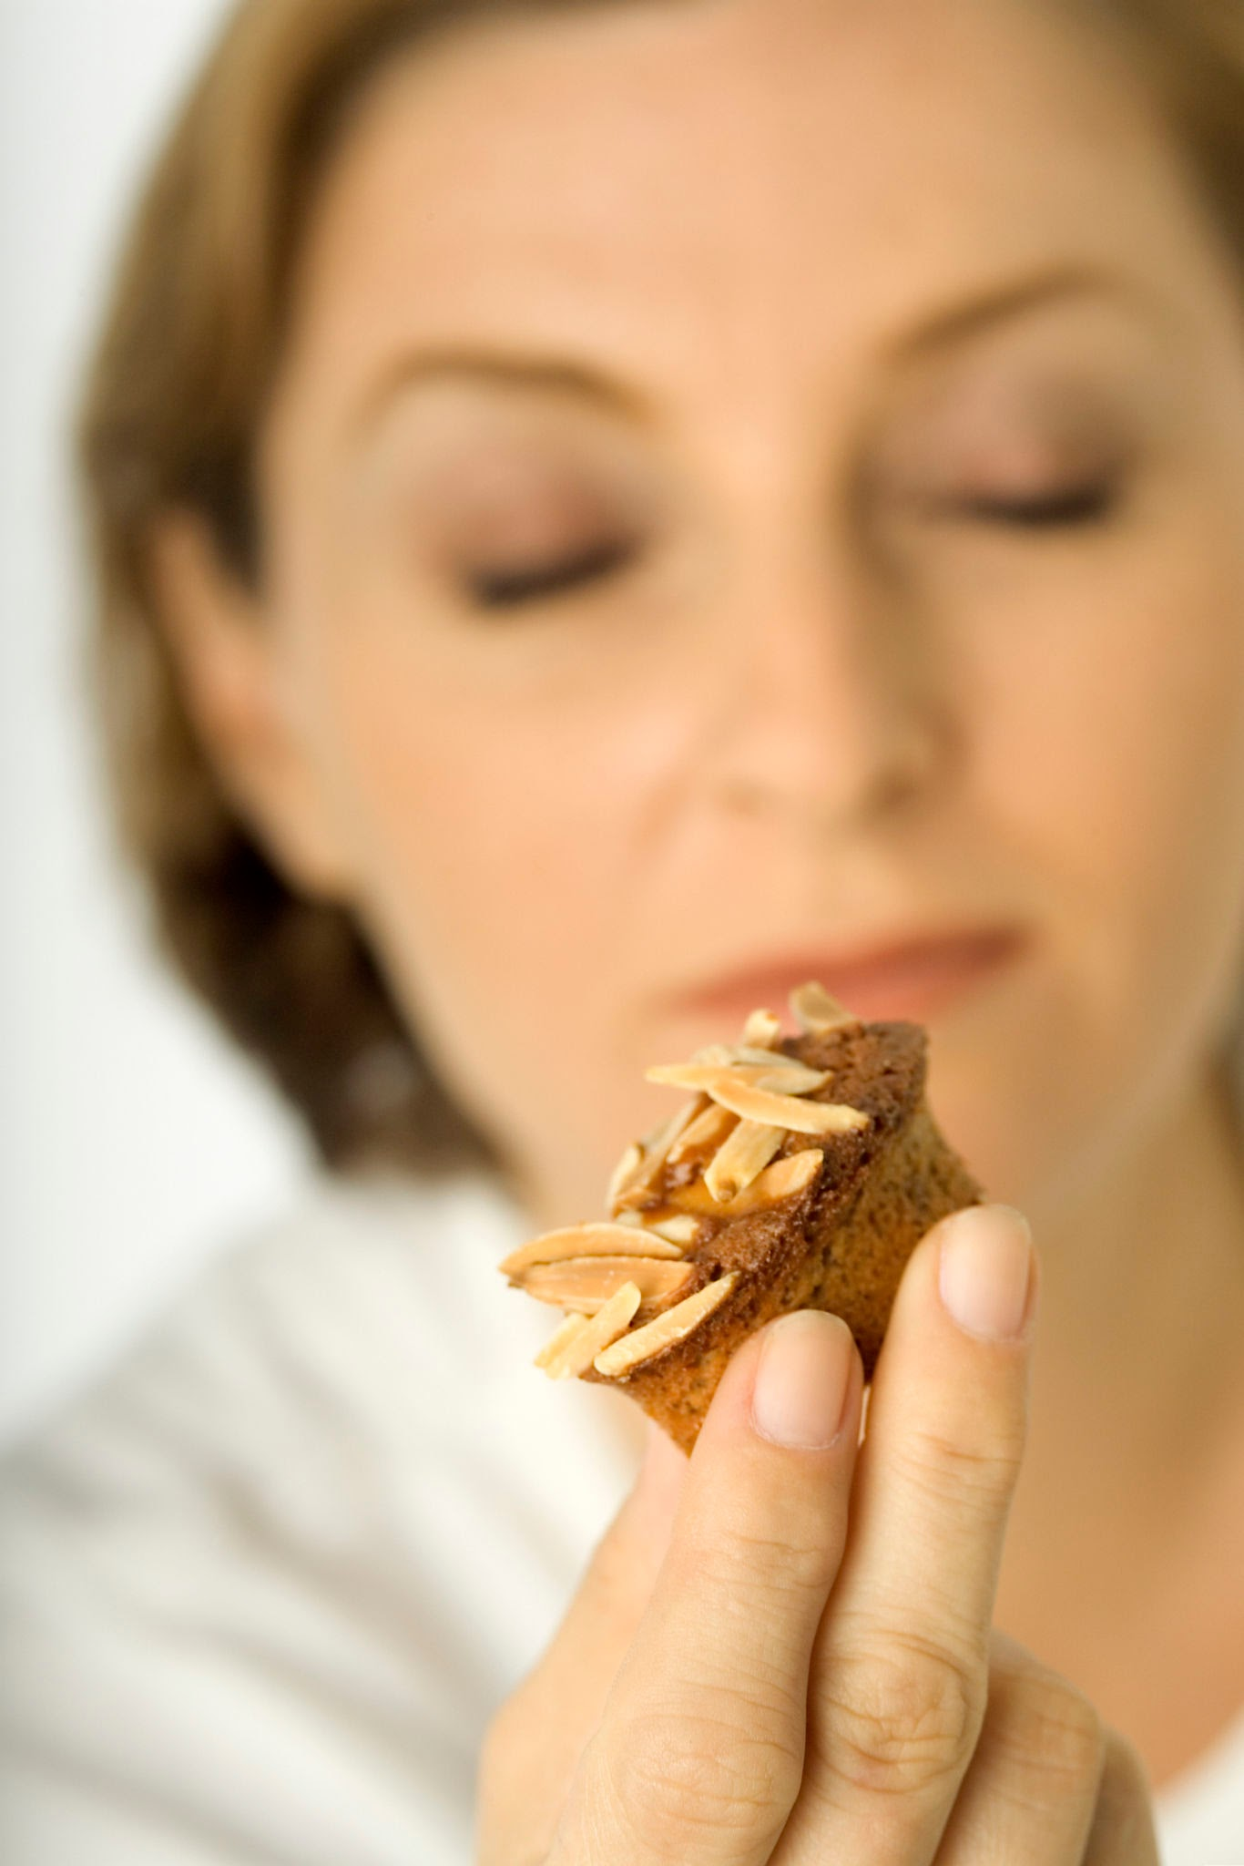




Examples of Savoring
Listening to a favorite song
Watching a sunset
Slowly enjoying your favorite snack
Remembering a fun moment in detail
Paying close attention to something beautiful
Petting a dog

Slide 9
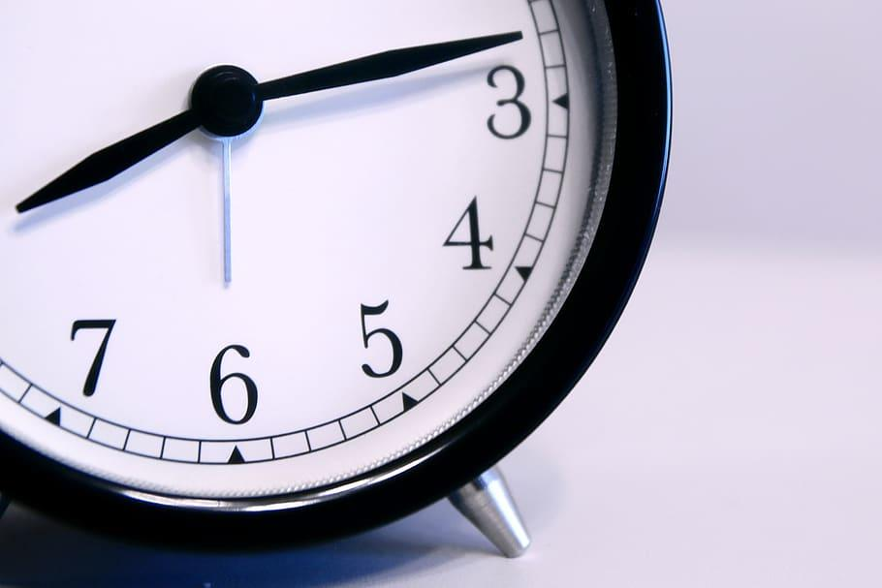
Hey! Listen up, it’s Decision Time!
Notes:
Outline next four steps of the process- “You will be given two options for this activity. We will listen to each option and the directions for how to approach each before we begin the activity. I will make sure you have what you need to get started. Then you will have the opportunity to practice savoring for a few minutes. When the timer goes off, please immediately begin journaling about the experience without discussion. There will be prompts up here if you need help getting started. We will have time to talk and discuss after journaling.

Slide 10

Option 1: Savor a Food Item
Use your senses. Sight-Smell-Touch-Taste to notice and experience more.
Take a slow deep breath to help you get started
LOOK Notice the color.
LOOK Notice the shape.
TOUCH Feel the texture.
BREATHE Smell the aroma.
TASTE Take a slow bite.
Notice the flavor and texture.
Slow down between each step.
Notes:
Use your senses. SLow your roll. So much of our food intake (especially as Americans) is thoughtless.. A snack in the car, dinner with the TV etc… THe point of this is to slow down and use your senses to NOTICE and experience the food. See if/how that changes eating it for you.

Slide 11

Option 2: Savor a Memory
Close your eyes (it helps!). Take a deep breath.
Think of a happy or peaceful moment.
Things you can ask yourself: Who-What-When-Where-How-Why
WHAT did I see?
WHEN was it?
WHAT sounds were there?
WHERE was I?
WHO was with me?
HOW did I feel?
WHY was it impactful? Stay with the memory slowly.

Slide 12
TAKE OFF on your Guided Savoring Practice
Independently make your decision and choose one option below.
Option 1
A Food Item.
Option 2.
A Positive Memory.

Slide 13

NOW you can
use the next few minutes to
independently and silently
engage in savoring option 1 or 2.

Slide 14

Independent Reflection Transition
Use your Journal to record your thoughts and experience. (5-10 minutes)
Sample Prompts:
What did you notice?
Did you feel different after the exercise vs. before?
Did pausing to notice or reflect slow you down?
Would this be a strategy you could use to focus or reset?
Was this a positive experience for you or not? Why?
Where else might savoring be a tool you could utilize?

Slide 15

Flight Plan (Group Think Talk)
What do you think? Why?
Did you notice if you slowed down during the exercise?
Why might that be a good thing sometimes?
Were you able to engage today?
Is savoring different from distraction?
When Might Savoring be Helpful? Why? How?
Before a test
After an argument
When feeling anxious
Before bed
When overwhelmed
As a reset
When I need to

Slide 16
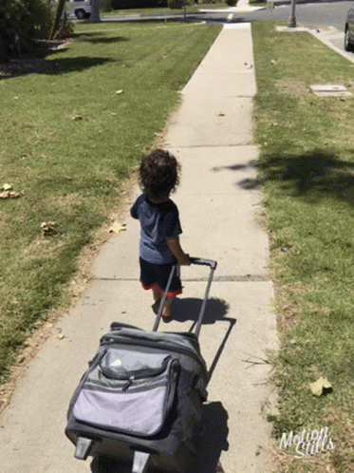
Remember your Baggage
(Key Takeaways)
Savoring
Is FREE
Can be done anywhere
Gets easier with practice
Is independent
Does not make problems go away
Helps your brain reset so you can deal with them
Souvenirs (optional)
Practice 2x a week
Combine it with gratitudes
Create a bulletin board with savoring images and ideas

Slide 17
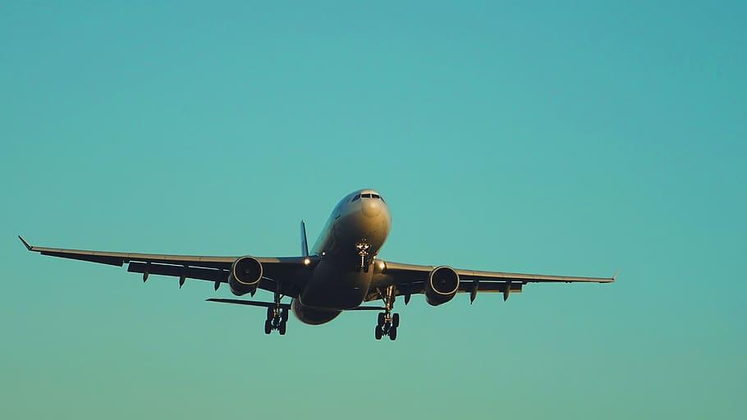
Departure Ticket/Check Out
Complete this sentence:
“One time I could try savoring this week is_____.”
Yes, you can answer verbally OR in writing on your ticket.
Yes, you have to tell me directly or turn in your answer to me before you leave

