Slide 1
Laboratory Safety
Environmental Health & Safety
Aber Hall 6th Floor

Slide 2
Ben Mason
Occupational Safety Health Specialist / Radiation Safety Officer
Aber Hall 610
x4503
ben.mason@mso.umt.edu

Slide 3
Trent Drinkwalter
Occupational Health & Safety Officer
Aber Hall 605
x4508
Trent.drinkwalter@mso.umt.edu

Slide 4
Hazard Awareness
Introduction
Regulatory Background
Hazard Communication (HazCom)
Chemical, Physical, and Biological Hazards
Hazardous Wastes

Slide 5
Regulations
Introduction
Solid Waste Disposal Act - 1965
National Environmental Policy Act – 1970
Resource Conservation and Recovery Act - 1976
Comprehensive Environmental Response, Compensation, and Liability Act - 1980

Slide 6
HazCom
Hazard Awareness
Right to Know (RTK)
Globally Harmonized System (GHS)

Slide 7
RTK Program Essential Elements
Right to Know (RTK)
Safety Awareness
Chemical Inventory
Labeling
Safety Data Sheets
Written Program
Training

Slide 8
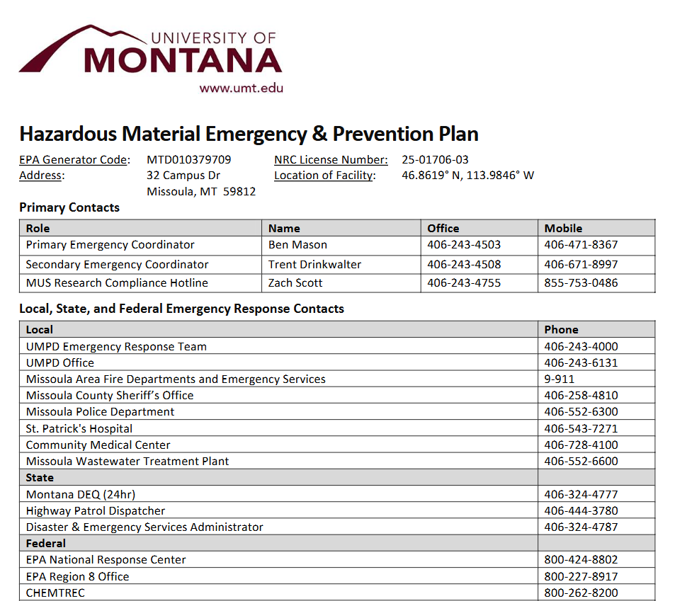
RCRA Posting
Safety Awareness

Slide 9
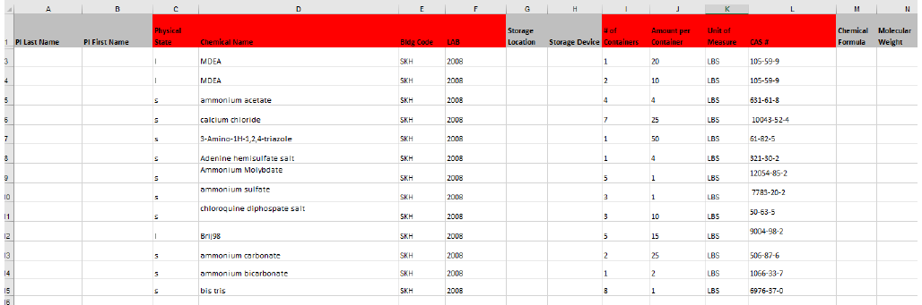
Chemical Inventory
RTK Program Essential Elements
Each lab must have an inventory list of all chemicals present in the lab

Slide 10
Labeling
RTK Program Essential Elements
Container labels should have the following:
Signal Word (Danger or Warning)
Product Name or Identifier
Hazard Pictograms
Precautionary Statements
Hazard Statements
Manufacturer Information
This information must be provided by the manufacturer under current regulations
Older chemicals may not have complete information

Slide 11
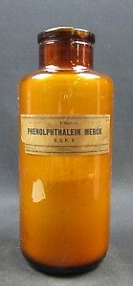
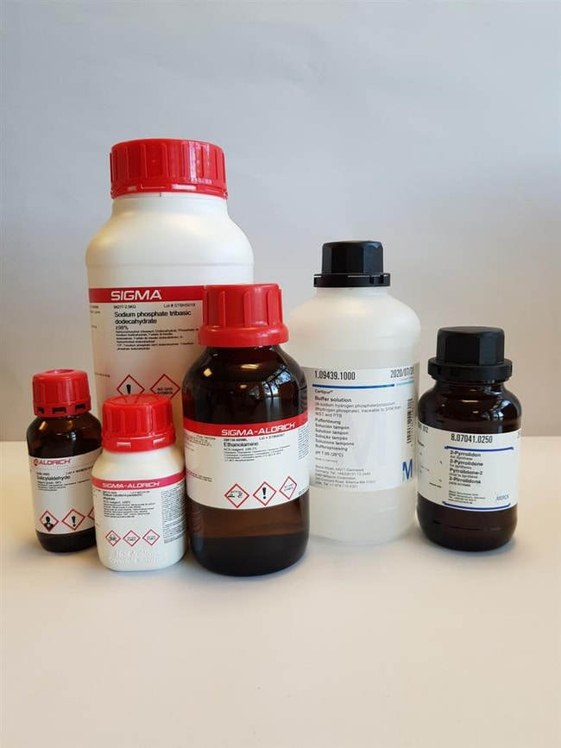
Manufacturer Labels
Labeling
Notes:
Ebay, Sigma

Slide 12
Secondary Container Labels
Labeling
All chemicals, including prepared solutions and chemicals transferred from their original containers, should be labeled with
Name
Concentration(s)
Hazard Warning(s)
Additional information
Initials of staff responsible
Date Received
Date Opened
Expiration Date

Slide 13
Labeling Systems in Use
Labeling
National Fire Protection Association (NFPA)
Hazardous Material Identification System (HMIS)
Globally Harmonized System (GHS)

Slide 14
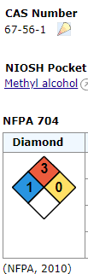
NFPA Hazard Labels
Labeling Systems
Color-coded by hazard type
Blue – Health Hazards
Red – Flammability Hazards
Yellow – Reactivity Hazards
White – Special Hazards
Number indicates severity of hazard
0 is minimal, while 4 is severe

Slide 15
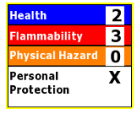
HMIS Hazard Labels
Labeling Systems
Color-coded by hazard type
Blue – Health Hazards
Red – Flammability Hazards
Yellow – Reactivity Hazards
White – Personal Protection
Number indicates severity of hazard
0 is minimal, while 4 is severe

Slide 16
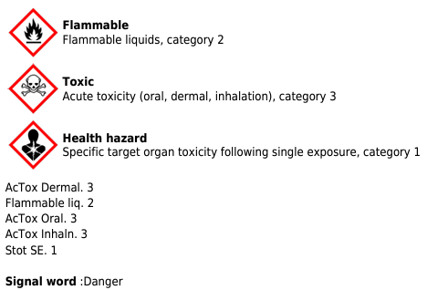
GHS Hazard Labels
Labeling Systems
Utilizes 9 main pictograms chosen for universal interpretability
Corresponding transport labels used for shipping
Severity numbered from 4 (least severe) to 1 (most severe)

Slide 17
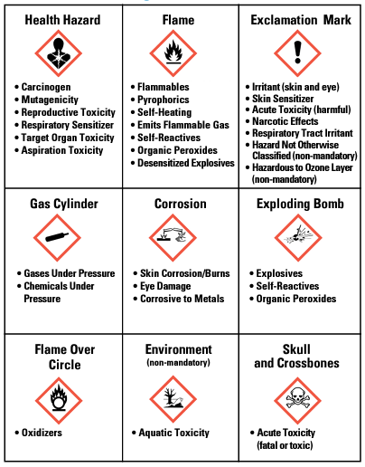
GHS Pictograms
Labeling Systems

Slide 18
Safety Data Sheets (SDS)
RTK Program Essential Elements
Formerly known as a Material Safety Data Sheet
Each chemical used in the laboratory must have an accompanying SDS that is accessible to staff in either physical or digital form
An SDS provides important data known about the chemical at the time of publication

Slide 19
Required SDS Components
Safety Data Sheets (SDS)
Identification of the substance or mixture and of the supplier
Hazards Identification
Composition Information on Ingredients
First Aid Measures
Firefighting Measures
Accidental Release Measures
Handling and Storage
Exposure Controls and Personal Protection
Physical and Chemical Properties
Stability and Reactivity
Toxicological Information
Ecological Information
Disposal Considerations
Transport Information
Regulatory Information
Other Information

Slide 20
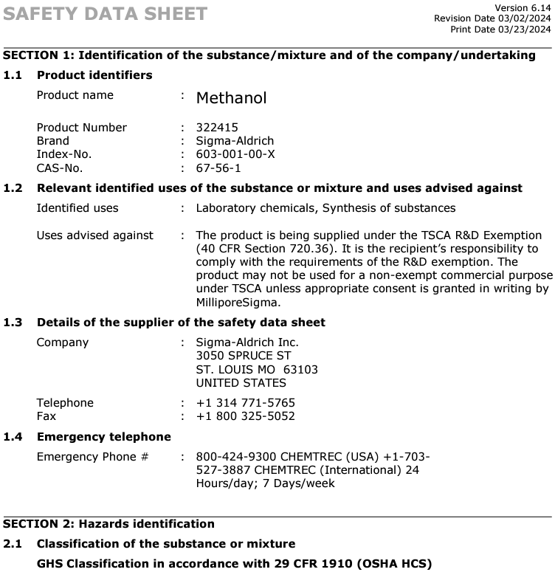
Example SDS
Safety Data Sheets (SDS)

Slide 21
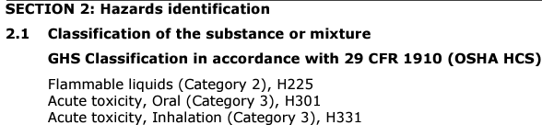
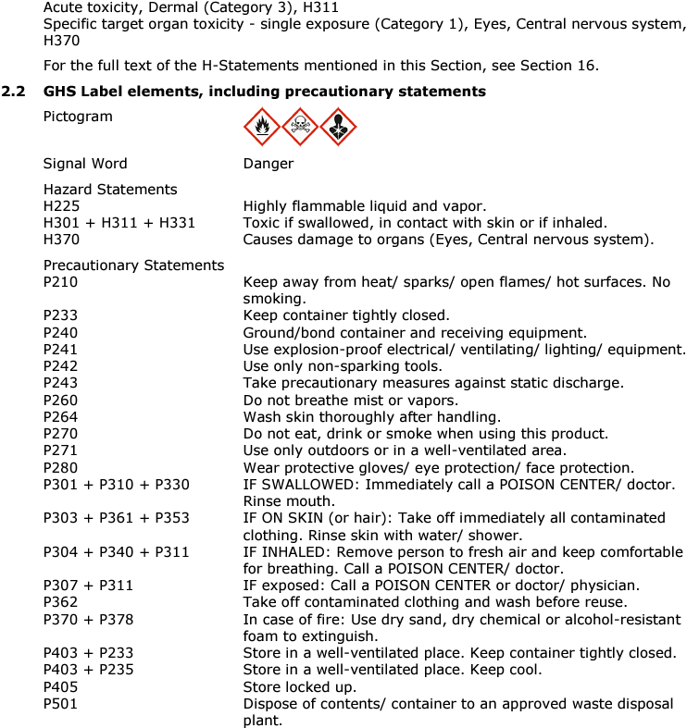
Example SDS
SDS

Slide 22
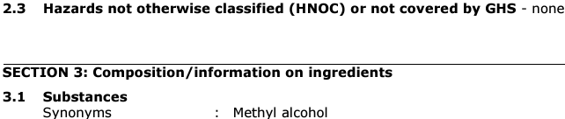
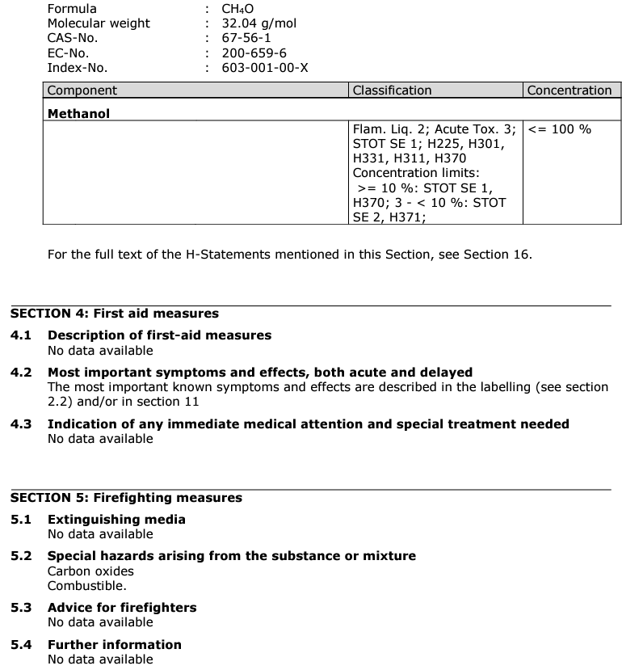
Example SDS
SDS

Slide 23
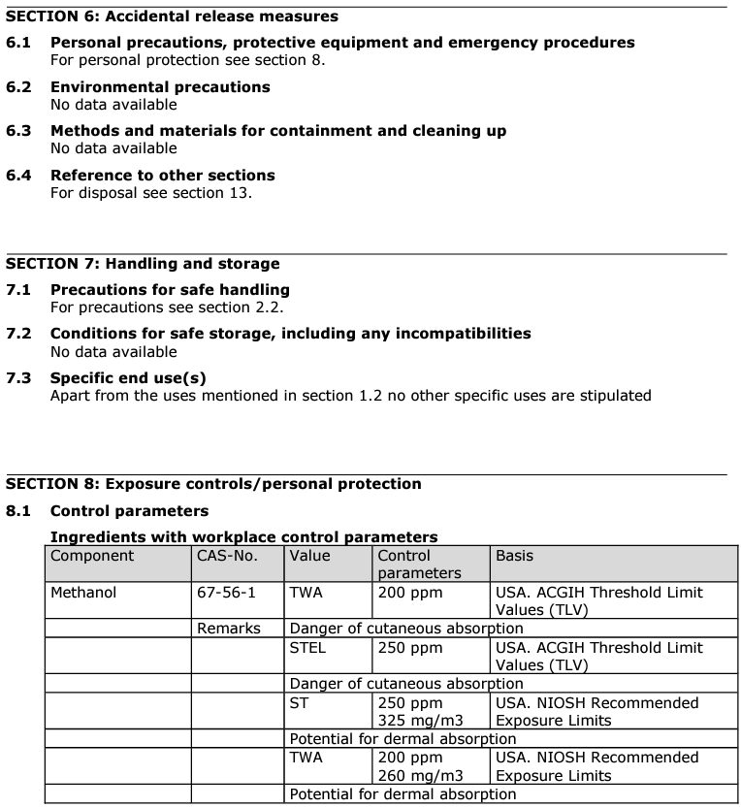
Example SDS
SDS

Slide 24
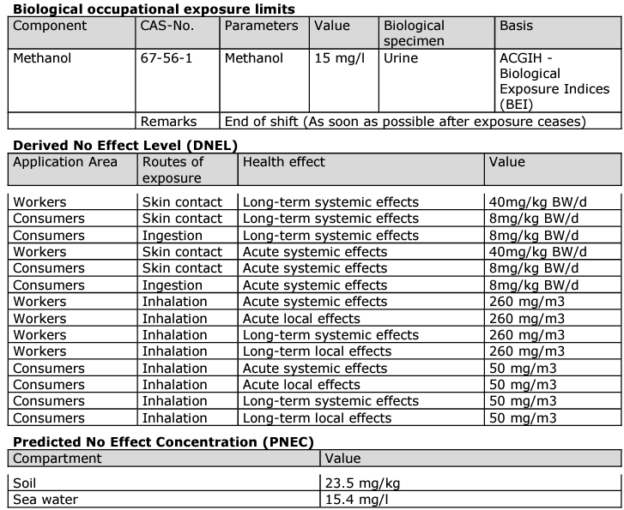
Example SDS
SDS

Slide 25
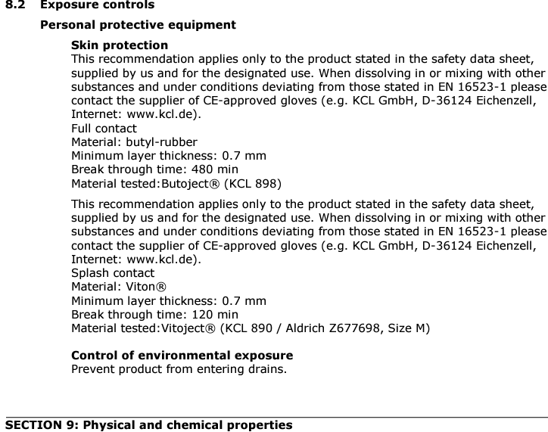
Example SDS
SDS

Slide 26
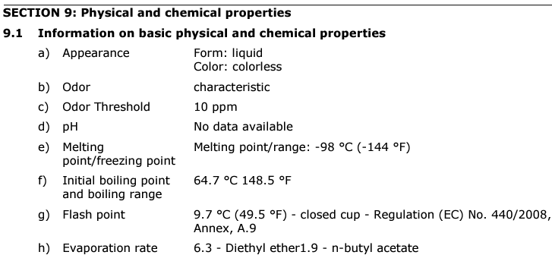
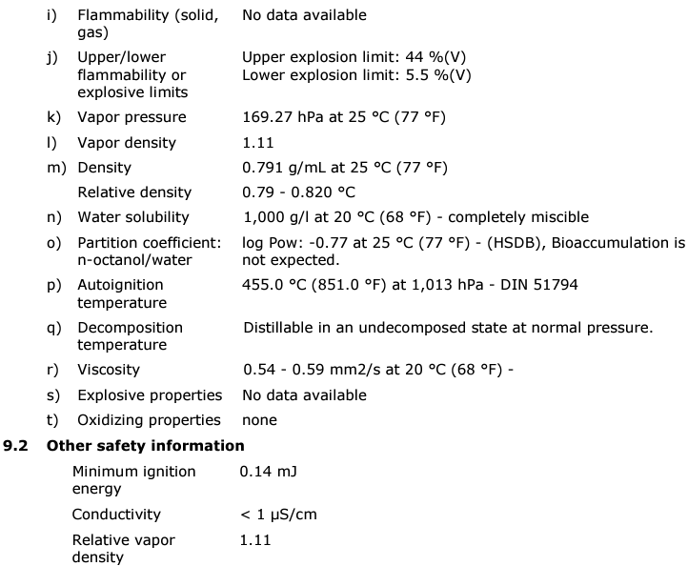
Example SDS
SDS

Slide 27
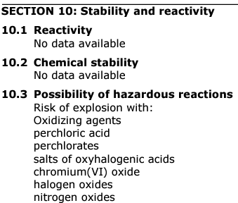
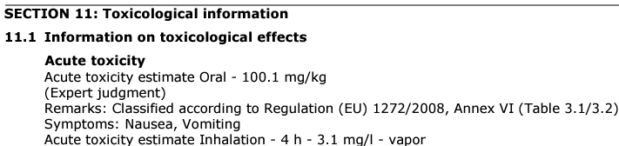
Example SDS
SDS

Slide 28
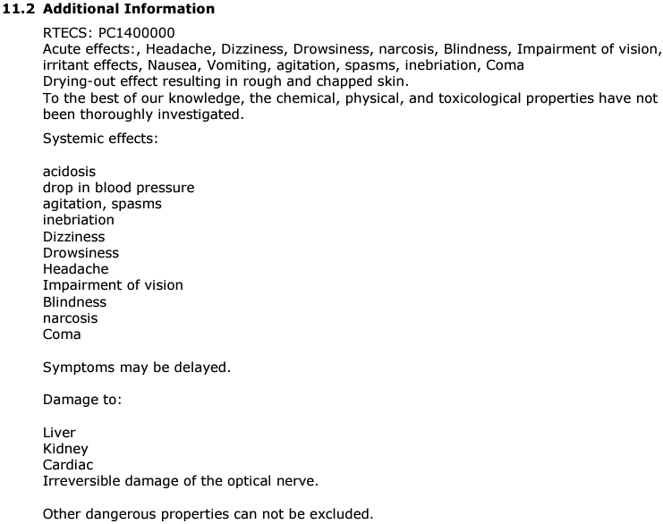
Example SDS
SDS

Slide 29
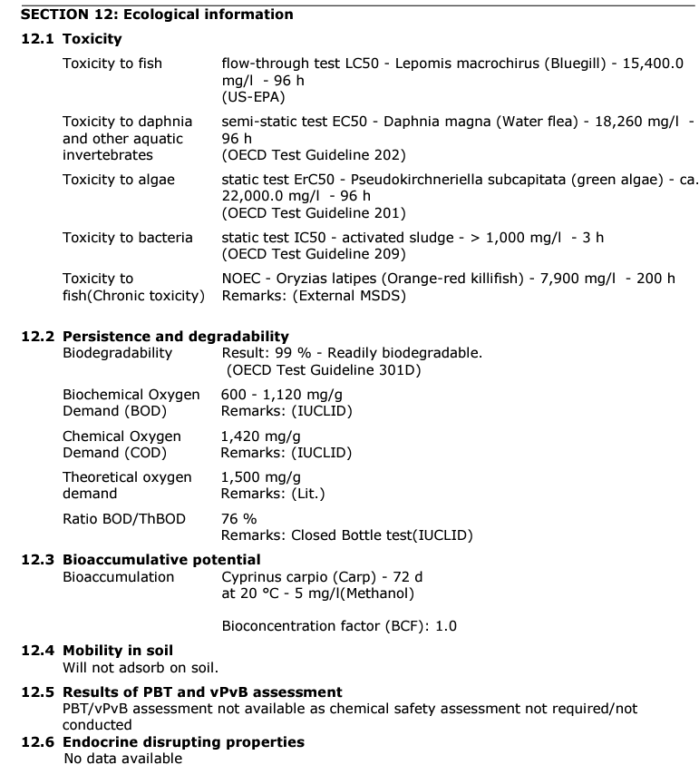
Example SDS
SDS

Slide 30
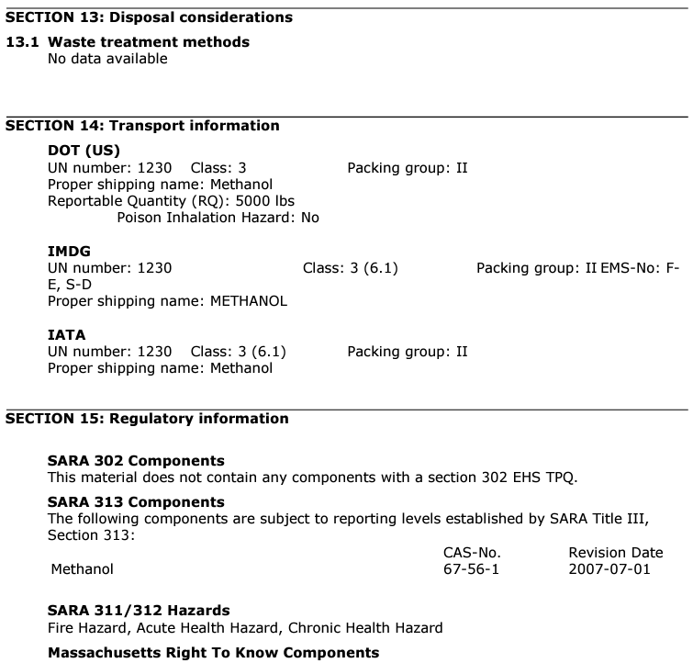
Example SDS
SDS

Slide 31
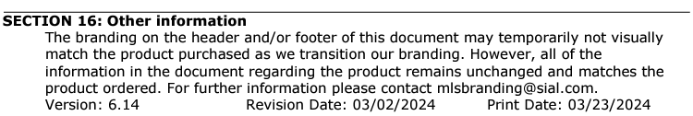
Example SDS
SDS

Slide 32
Chemical Hygiene Plan (CHP)
Written Program
A written program including policies and procedures intended to prevent contamination and personnel exposure
Each lab must develop a CHP appropriate to their work
Each employee must review and sign the acknowledgement page prior to working in the lab
The CHP must be updated annually

Slide 33
Background
CHP
The Chemical Hygiene Plan is part of the University’s compliance with the regulations promulgated in 1990 by OSHA
The Standard entitled “Occupational Exposures to Hazardous Chemicals in Laboratories" is hereafter referred to as the Lab Standard

Slide 34
Components of CHP
CHP
Standard operating procedures relevant to safety & health considerations to be followed when laboratory work involves the use of hazardous chemicals
Criteria to determine and implement specific control measures, such as engineering controls and personal protective equipment.
A program that ensures fume hoods and other engineering controls are functioning properly.
Information and training requirements.
When a lab will require “Prior approval”.
Provisions for medical consultations and medical exams.
Designation of the Chemical Hygiene Officer.
Additional precautions for select carcinogens, reproductive toxins and extremely toxic substances.

Slide 35
Training Requirements
Training
Before commencement of lab duties, all lab workers must read the Chemical Hygiene Plan.
Training records should be kept with the Principal Investigator (PI) or the lab supervisor with the CHP.
The CHP must be reviewed annually by the lab’s Chemical Hygiene Officer (CHO) and the “revised/review date must be listed on the front page of the CHP.
Lab safety presentation and quiz.
If biological or radiological agents are present, training must be conducted in these areas as well.

Slide 36
Lab Worker Responsibilities
Responsibilities
Follow all health and safety standards and rules.
Report al hazardous conditions to the lab supervisor.
Wear or use prescribed Protective equipment.
Report any suspected job-related injuries or illnesses to the lab supervisor and seek treatment immediately.
Refrain from the operation of any equipment or instrumentation without proper instruction or authorization.
Request information and training when unsure how to handle a hazardous chemical.

Slide 37
Standard Operating Procedures
SOP’s
The Lab Standard requires operating procedures relevant to safety and health consideration to be followed when lab work involves the use of hazardous chemicals.
Examples of SOP’s include authorized access to labs, minors in labs, container integrity, compressed gas cylinder handling, lab equipment use procedures, waste disposal, food, drink, cosmetics in lab, working alone, required PPE, fume hood use, chemical spills, etc.

Slide 38
Fume Hoods
Fume hoods
Chemical fume hoods are the most common engineering control in labs.
Others include Bio safety cabinets, glove boxes, etc.
All fume hoods at UM should have face velocities between 80 -100 feet per minute with the sash at the proper working height.
A fume hood does not provide absolute containment or absolute protection from the materials in the hood.
Keep all apparatus at least 6 inches back from the face of the hood.
Excessive storage of chemical or any apparatus in the hood will impair the performance of the hood.
Do not place electrical receptacles or other spark sources inside the hood when flammable gases or liquids are present.

Slide 39
Information and Training
Information and Training
All individuals who work in labs who may be exposed to hazardous chemicals must be apprised of the hazards of chemicals present in their work area.
Information and training must be provided before initial assignment and before new exposure situations.
It is the responsibility of the PI to ensure that all lab workers have been properly trained.

Slide 40
Prior Approval
Prior Approval
The responsibility for approval of the acquisition and use of toxic chemical agents rests with the lab supervisor.
Some materials including radioactive materials, recombinant DNA, radioactive materials and biohazards require internal (UM) or external approval at various levels.

Slide 41
Medical Consultation and Exams
medical
If an employee develops any symptoms thought to arise from chemical overexposure
After an event such as a major spill, leak or explosion which may have resulted in an overexposure.
Employee accidents, injuries or illness should be reported immediately by the employees supervisor.

Slide 42
Chemical Hygiene Officer
CHO
The PI or lab supervisor shall serve as the CHO for his/hers labs.
The designated CHO has the primary responsibility for safety and health within the lab.
The CHO is also responsible for conducting an annual review of the CHPs that apply to their labs.

Slide 43
Additional Precautions
Precautions
Special provisions for additional employee protection for work with particularly hazardous substances.
These include
Select carcinogens
Reproductive toxins
Substances that have a high degree of acute toxicity
The following provisions must be included:
Establishment of designated area
Use of containment devices such as fume hoods or glove boxes
Procedures for safe removal of contaminated waste
Decontamination procedures

Slide 44
Additional Precautions
Precautions
Work with reproductive toxins, and acutely toxic chemicals must be performed within a certified functioning fume hood, biological safety cabinet, ventilated glove box or other systems designed to minimize exposure to the substances.
The ventilation efficiency of the fume hoods, bio safety cabinets or glove boxes should be evaluated periodically at determined intervals.
Each laboratory using these substances must designate an area for this purpose.
The designated area could be an entire lab, a fume hood, or bio safety cabinet.

Slide 45
Additional Precautions
Precautions
All lab workers who work in a lab which has a designated area, must be trained on the following:
Deleterious effects
Signs and symptoms
Safe handling and storage
Appropriate PPE and trained on its use
The designated area must be thoroughly decontaminated and cleaned at regular intervals

Slide 46
Individuals of Childbearing Potential
Precautions
Individuals of childbearing potential should be warned to be especially cautious when working with chemicals known to be reproductive toxins.
Some examples are:
Benzene
Cadmium compounds
Mercury compounds
Toluene
Formamide
Pregnant lab staff may choose to disclose status to CHO
Not appropriate for workplace setting to guess at pregnancy

Slide 47

Routes of Entry
Laboratory Health Hazards
Eyes
Skin
Inhalation
Ingestion
Injection

Slide 48
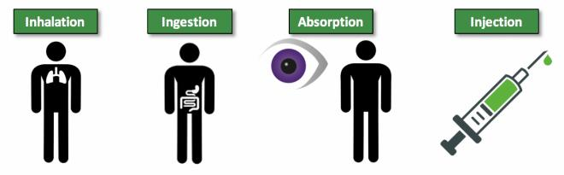
Routes of Entry
Laboratory Health Hazards
Inhalation: The major route of entry when working with solvents. Great rapidity of absorption
Ingestion: Usually accidental or due to poor hygiene practices.
Absorption: May produce systemic poisoning. Condition of skin determines rate of entry.
Examples: organic lead, solvents, (xylene, methylene chloride) organo phosphate pesticides, cyanides
Injection: Introducing a foreign substance into body forcefully e.i. hypodermic needle.

Slide 49
Lab First Aid
Training and Safety Awareness
Burns
Chemical
Thermal
Wounds causing significant bleeding

Slide 50
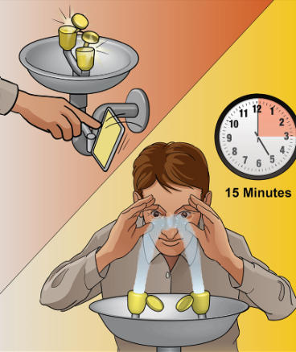
Chemical Burns - Eyes
Laboratory First Aid
Forcibly open eyelids to ensure effective washing behind eyelid
Wash from nose out to ear to avoid washing chemicals back into eye or into an unaffected eye
Flood eyes and eyelids with water/eye solution for minimum of 15 minutes

Slide 51

Chemical Burns - Eyes continued..
Laboratory First Aid
Remove contact lenses immediately to rinse eyes of harmful chemicals
Cover eyes with clean or sterile gauze
Call 911 or 243-4000 and proceed directly to the Emergency Room
* Make sure you know the location of the nearest eyewash station *

Slide 52

Eye Wash Maintenance
Laboratory First Aid
Eyewashes and emergency showers are periodically checked by EHS
A responsible party in each lab should be designated to flush the eyewash for one minute each week

Slide 53

Chemical Burns- Skin
Laboratory First Aid
Remove any contaminated clothing.
Other lab staff should ensure privacy for the affected worker
Chemicals may collect in shoes, remove shoes, if appropriate.
Rinse area with large quantities of water for at least 15 minutes (sink, shower or hose).

Slide 54

Chemical Burns- Skin
Laboratory First Aid
For large affected body areas, call 911 or 243-4000
DO NOT apply burn ointments/spray to affected areas
Cover with dry clean or sterile material
If possible, bring the name of the chemical and/or its SDS along with you to the evaluating medical facility.
Report all injuries, no matter how small (investigations of near misses lead to fewer future injuries)

Slide 55
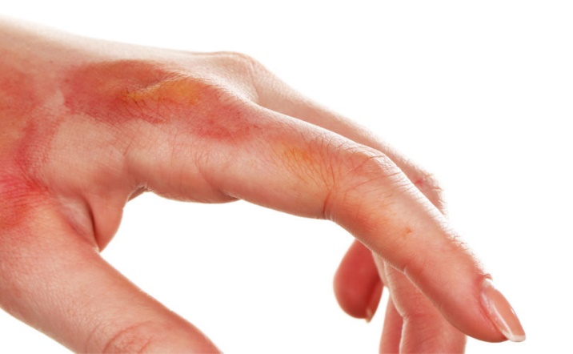
First Degree Thermal Burns
Laboratory First Aid
In general first degree burns have redness only, no blister or more extensive tissue damage.
Run cool water over area of burn or soak in cool water for at least 5 minutes.
Cover burn with a sterile bandage or clean cloth.
DO NOT APPLY ANY OINTMENTS, SPRAYS OR SALVES.
Note: Burns can at first appear to be first degree, but blisters may develop over the next several hours. When in doubt, seek medical attention.

Slide 56
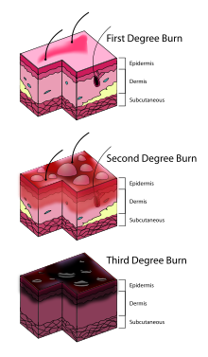
Second & Third Degree Thermal Burns
Laboratory First Aid
Second and Third Degree burns are burns that have blisters or more extensive tissue damage.
If victim is on fire, put fire out.
Call 911 or 243-4000
Do not remove any burnt clothing unless it comes off easily.
Cover burns with dry sterile or clean bandaging.
DO NOT APPLY ANY OINTMENTS, SPRAYS OR SALVES.
Do not run under COLD water.

Slide 57
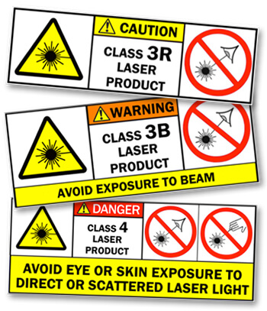
Laser Injuries
Laboratory First Aid
LASER is an acronym for “ Light Amplification by Stimulated Emission of Radiation.”
Laser light is a form of non-ionizing radiation
Laser equipment produces and amplifies light that has unique properties that cannot be produced in any other way
The light that it produces is monochromatic – it is composed of one single color at a specific wave length.

Slide 58
Laser Classification
Laboratory First Aid
Class 1: Low energy levels, not hazardous to skin or eyes. Safe during normal operations.
Ex. CD/ DVD player
Class 1M: Safe during normal operation, but may cause eye injury if viewed with optical instruments
Class 2: Visible wave length only blink response will provide eye safety. Will not burn skin.
Ex. Barcode reader
Class 2M: Visible wavelength only , blink response provides eye safety for unaided viewing but can be hazardous if viewed through optical instruments. Will not burn skin

Slide 59
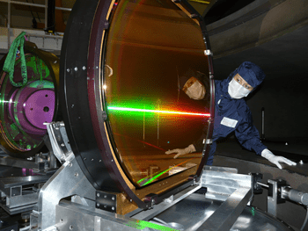
Laser Classification continued…
Laboratory First Aid
Class 3R: Transitional zone between safe and hazardous laser products. Direct viewing of beam may be hazardous as well as certain specular reflections.
Ex. Measuring and target devices
Class 3B: Direct viewing and specular reflections can cause eye injury. Diffuse reflections are usually safe.
Ex. High Power/ lab laser products for professional use.
Class 4: Can cause severe skin and eye injury through and direct exposure., specular reflections and sometimes from diffuse reflections. Often fire hazard as well.
Ex. Medical lasers, Industrial cutting, laser light show equipment.
* Know what class of laser you will be working with before you start *

Slide 60
Safety Precautions with Lasers
Laboratory First Aid
Never intentionally look directly into laser light.
Eyewear will only protect your eyes for short time periods, depending on the laser power. Therefore do not look directly into laser even with laser eye protection on.
Eyewear must be of the correct optical density and offer protection at the wavelength(s) of the laser(s) being used.
Periodically inspect and replace damaged or defective eyewear.
Exposure to direct or diffuse reflections from ultraviolet lasers can result in short and long term skin hazards. Cover your exposed skin areas when working near these lasers (use long sleeve shirts or lab coats, cloth gloves, etc. as necessary).
Do not fight the eye’s blink or aversion response.
Never direct the beam toward people or doors.
Never allow a laser beam to escape from its designated area of use.
Remove all unnecessary reflective objects from the area near the beam path. This may include watches, jewelry or tools.
Position the laser so that it is well above or below eye level (both standing and sitting).
When not in use, a laser should be stored to prevent unauthorized use.

Slide 61
Laser Injury Emergency Procedures
Laboratory First Aid
Stop all work in the lab
Shut down all lasers in the lab (do not resume until EHS approves)
Seek Medical Attention as soon as possible.
Have a co-worker call for help and give assistance.
Severe injuries such as total loss of vision, bleeding from eye, 2nd or 3rd degree burns to the eye area or face CALL 911 to request transport to the nearest hospital or emergency room.
Never rub the affected eye.
If injury to the eye or around the orbits occurs cover BOTH eyes with sterile dry dressing. Covering both eyes will reduce movement of the affected eye.
Avoid applying pressure, ice pack may be used to relieve pain once sterile dressing in place
Exposures not resulting in severe injury, contact Environmental Health & Safety Program to determine your next steps for medical treatment.
Do not alter the laser setup (this allows analysis to find the cause of the accident, and to take corrective action to prevent a re-occurrence)
Note: Not all eye injuries will have pain; laser retinal burns may be painless while laser burns to the cornea or sclera may have burning pain at the site of exposure

Slide 62

Wound Care- Significant Bleeding
Laboratory First Aid
Call 911 or 243-4000
Calm and reassure victim
Lay victim down. (Reduces chance of fainting)
DO NOT remove any objects impaled in victim
Put direct pressure on wound with a sterile bandage or clean cloth
If direct pressure does not control bleeding, elevate wound above the heart if possible.
Once pressure applied do not remove the bandaging. If bleeding soaks through apply more bandaging. Removing bandages will affect the clotting process.
If bleeding is severe elevate victims legs about 12 inches, and cover victim with a blanket to avoid shock
Use bleeding control pack if trained

Slide 63

When to Wear Eye Protection
PPE
Glassware under reduced pressure
Cryogenic materials
Glassware under elevated pressure
Explosives
Caustics, Irritants or Corrosives
Biohazards
Radioactive Materials
UV Light
Toxic Chemicals
Carcinogens
Flammable Materials
Lasers

Slide 64


Eye Protection
PPE
* Wear goggles when using acids or whenever there is potential for a splash hazard
* Wear safety glasses at other times when chemicals are present and when handling glassware

Slide 65
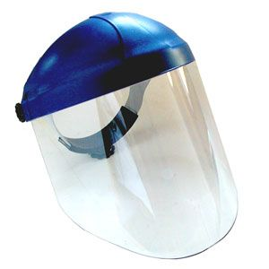

Face Protection
PPE
Face protection should be worn when there is a possibility of a chemical splash to the face. A face shield is not a substitute for eye protection…..safety glasses or goggles must be worn in conjunction with a face shield.

Slide 66







Gloves
PPE
Gloves
Cotton
Leather
Latex
Viton
Butyl
Neoprene
PVC
Nitrile
Other

Slide 67
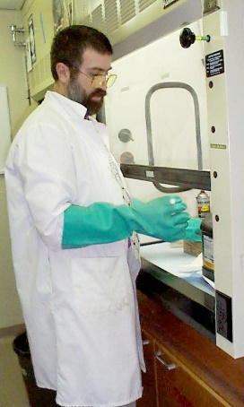
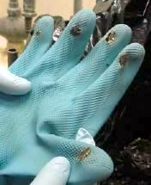
Gloves
PPE
Be sure you know which type of glove is appropriate for the chemical you are using.
Avoid Latex gloves when possible.
Many people are unaware of a latex allergy or it may develop later in life.
Always try to avoid using latex even if you are not allergic, others may be.
Was this the appropriate gloves to use for these chemicals?

Slide 68
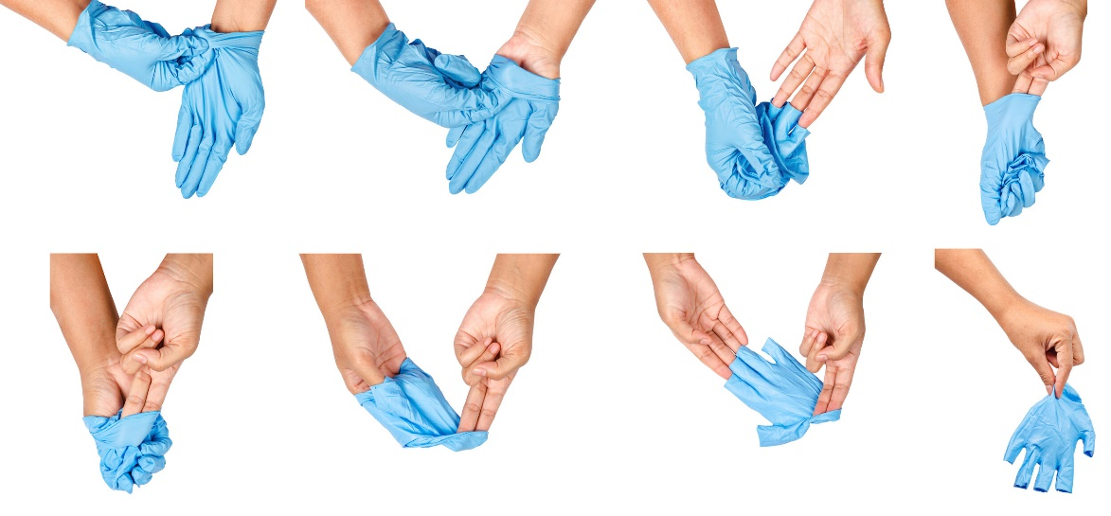
Gloves
PPE
Remove soiled gloves. If gloves become soiled or contaminated
during experiment, stop, and remove carefully.
Wash your hands and put on new pair of gloves. If you double-glove, remove soiled glove, replace outer glove with new one, and continue your work.

Slide 69

Gloves
PPE
Gloves can be ordered through any vendor. If using Grizmart, Fisher Supplies is the most commonly used.
Fisher Scientific “Safety Manual” also includes information on:
Choosing size
Proper removal
Care and handling

Slide 70
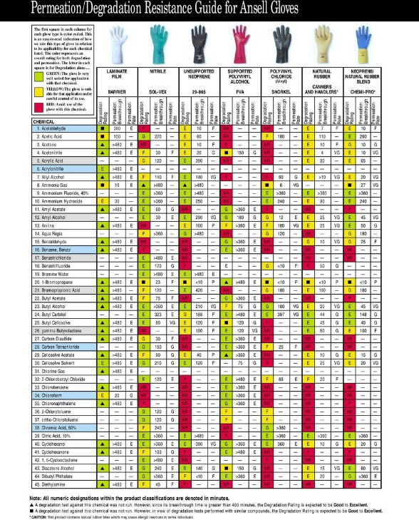
Gloves
PPE
Check “Chemical Resistance Guide” in safety catalog for degradation rating and permeation breakthrough information for various chemicals.
Xylenes: Nitrile
Perchloric Acid: Nitrile, or PVC
Neoprene

Slide 71
Physical Hazards
Training and Safety Awareness
Centrifuges
Pressurized Cylinders
Electrical
Microwaves
Radiation
Vacuums and Ventilation
Thermal Devices
Autoclaves, ovens, incubators, cold storage, hot plates
Sound
Ergonomics
Housekeeping
OSHA General Duty
Sharps

Slide 72
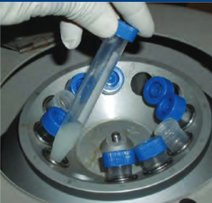
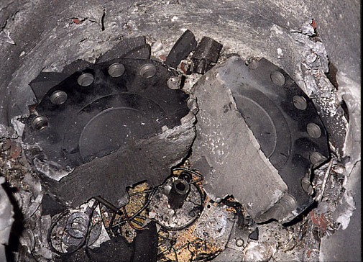
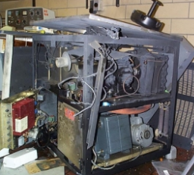
Centrifuges
Physical Hazards
Most accidents result from user error
Unbalanced or overfull loads
Inadequate maintenance
Follow manufacturer's operating instructions
Do not exceed max speed
Keep the lid closed while in motion
Centrifuge explosions can be expensive and potentially deadly

Slide 73
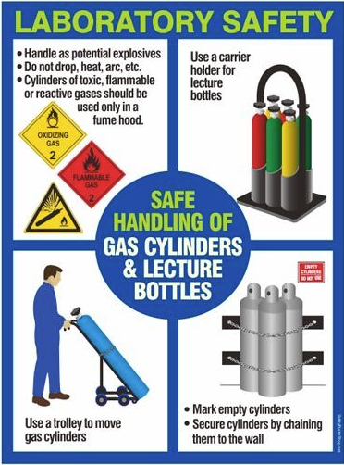
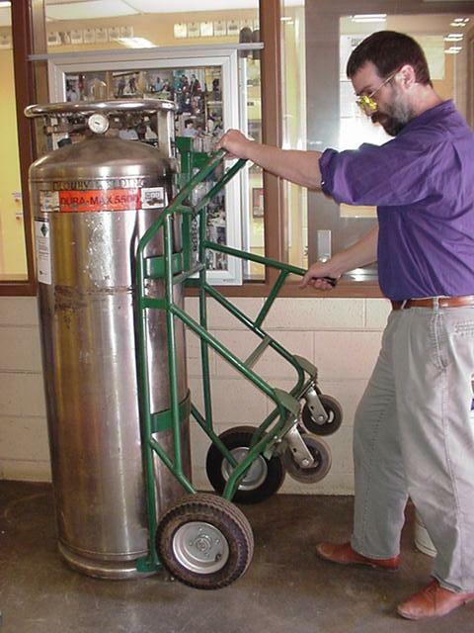
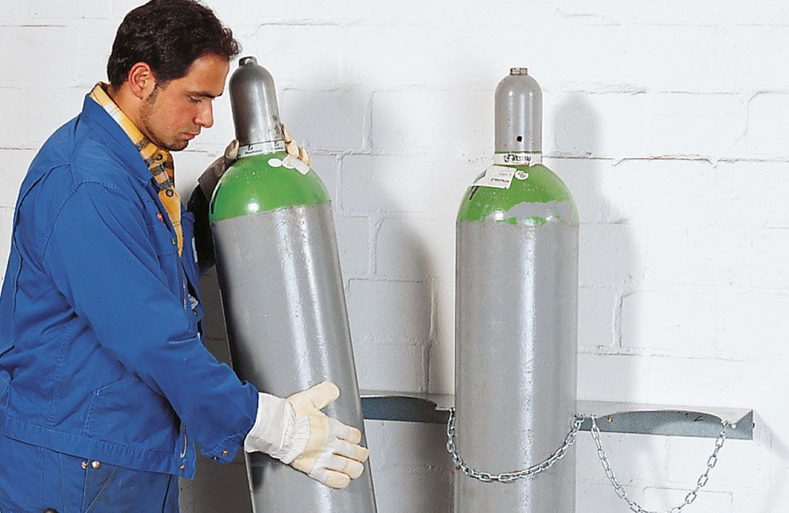
Pressurized Cylinders
Physical Hazards
Always inspect cylinders before use for any damages or noticeable defects.
Do not locate where objects may strike or fall on cylinders
Secure in upright position except hoisting or carrying
Do not place where cylinder may become part of an electrical circuit
Use cylinder truck, chain, and/or other steadying device to keep cylinders from being knocked over while in storage or use.
Cylinders are not to be transported up or down flights of stairs at anytime.

Slide 74
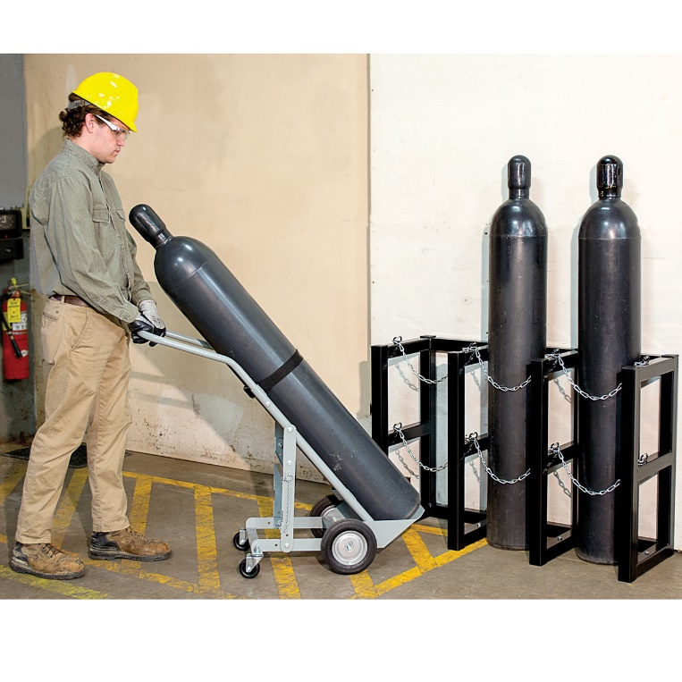
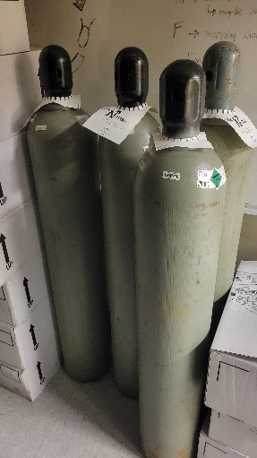
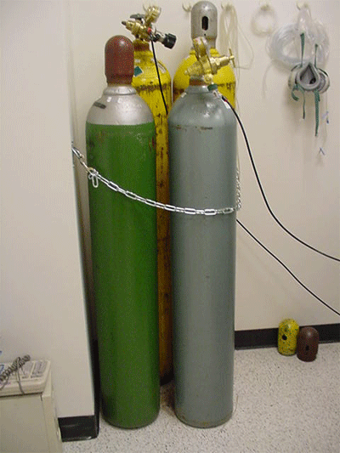
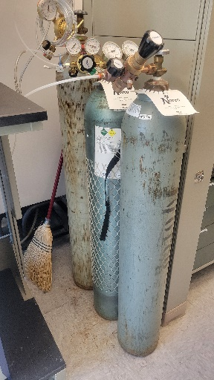
Transport & Storage
Pressurized Cylinders
Secure cylinders with a strap or chain. Regulators shall be removed and valve protection caps put in place when not in use.
Always move cylinders with a cylinder cart and with the cap attached.

Slide 75
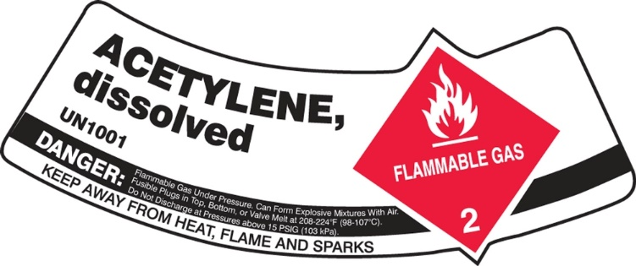
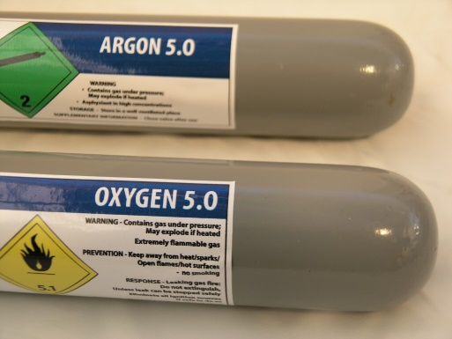
Lecture Bottle Labels
Pressurized Cylinders
Lecture Bottle Labels:
Flammable: flame on red label
Non-flammable: gas canister on green background
Poisonous: skull and crossbones
Oxygen-containing: flaming letter “O”
Chlorine: labels distinctly marked

Slide 76

Lab Fires
Fire Safety
Small Lab Fire (extinguishable immediately):
Cover fire with inverted beaker or wet paper towels.
If this fails use fire extinguisher if properly trained and are familiar with hazardous decomposition products:
When using the fire extinguisher remember the P.A.S.S. process.
P - Pull the pin
A - Aim hose at base of fire
S - Squeeze the handle
S - Sweep hose back and forth
* If the fire is beyond the incipient stage, larger then a small office trash can, evacuate and allow the fire department to address*

Slide 77
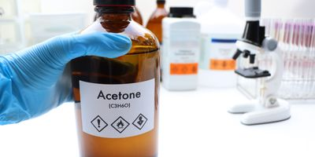
Flash Points
Fire Safety
Keep in mind that liquids with low flash points may ignite if they are near heat sources such as hot plates, steam lines or lab equipment which might produce a spark or heat.
Acetone = Flash point 0° F

Slide 78
Fatal Shocks
Electrical Safety
QUESTION: At 100 volts what current level is sufficient to deliver a lethal shock?
25 mA
250 mA
2.5 amps
25 amps
ANSWER: 25 mA can be life threatening. Make sure power is off before making connections. Beware of loose connections. If you feel a “tingle” when you touch the unit, stop using until it is repaired.

Slide 79
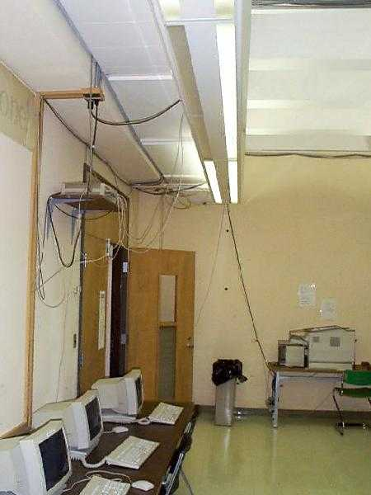
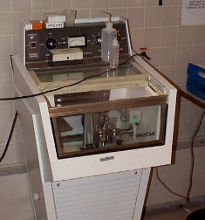
Electrical Safety Tips
Electrical Safety
Eliminate frayed or worn wiring
Never stretch wires across floor or other equipment.
Staff should know location of circuit breakers
Match size of extension cord to appliance power cord to prevent cord overheating.
Extension cords are not intended for "permanent" installations -- appliances shall be connected to permanently wired receptacles.
Replace damaged wires
Use only 15 amp fused power strips.

Slide 80

Electrical Safety Tips
Electrical Safety
Electrical "octopuses" can result in overloaded circuits and fire.
Match appliance power requirements to circuit power.
Use GFCIs when working with electrical equipment near water
Only use extension cords with three prongs
Tape down on floor or cover with rubber channels to eliminate tripping hazard

Slide 81


Electrical Safety Tips
Electrical Safety
Avoid use with high temperature, over sharp edges, or in traffic areas
Inspect and test cords and outlets regularly
Use with GFCIs, outdoors and in wet or damp areas, and in construction
Maintain 3’ clearance in front of circuit breaker panels.

Slide 82

Clean Workspace
Housekeeping
Keep your work area neat at all times.
Clean & organized = decreased likelihood of injuries or accidents
OSHA Lab Standard

Slide 83


Laboratory Glass
Housekeeping
Do not force a rubber stopper onto glass tubing or thermometers.
Lubricate the tubing and the stopper with glycerol or water.
Use paper or cloth toweling to protect your hands.
Grasp the glass close to the stopper.
Clean laboratory glassware at the conclusion of your experiment. Make sure glassware racks do not interfere with eye wash station access.
Do not sweep up glass using the palm or your hand.

Slide 84

Broken Glass
Housekeeping
Broken, contaminated glassware can cause chemical exposure
Do not use broken, chipped, starred or cracked glassware.
Broken glass must be placed in a separate container.
Take special precautions when handling contaminated glassware

Slide 85

Broken Glass
Housekeeping
Do not pick up broken glass with bare hands
Dispose in a sealed container.
Separate sharps:
scalpel blades
razor blades
needles

Slide 86
Medical Conditions
Training and Safety Awareness
Workplace chemical exposures can result in the development of a new medical condition, however, the more common consequence is a worsening of a pre-existing condition.
Be extra cautious when working in a lab setting if you have any of the following past/current medical history:
Pregnancy
Respiratory (asthma, COPD)
Cardiac (hypertension, arrythmias, angina)
Cancers
Neurological (photosensitivity, epilepsy, migraines)
Muscular skeletal
Heat/ cold sensitivity
Diabetes
Allergies (food, pollen, LATEX, chemical, bees)

Slide 87
Medical Conditions Exacerbated Examples
Training and Safety Awareness
Musculoskeletal conditions – Arthritis, back pain, or joint disorders are among the most common pre-existing conditions that can be reaggravated at work. Repetitive motions, heavy lifting, or prolonged standing can trigger the symptoms of these conditions to flare up, leading to increased pain and discomfort.
Respiratory conditions – Employees with pre-existing respiratory conditions, such as asthma or chronic obstructive pulmonary disease (COPD), are vulnerable to reaggravation in certain work environments. Exposure to various irritants, such as dust, chemicals, or fumes, can trigger respiratory symptoms and potentially worsen the condition.
Cardiovascular conditions – Cardiovascular conditions, such as hypertension, heart disease, or arrhythmias, can be affected by workplace stressors. High-stress jobs, long work hours, or physically demanding tasks can increase the risk of aggravating these conditions. Employers should ensure that employees with preexisting cardiovascular conditions have access to reasonable work accommodations and a less stressful work environment. Certain chemicals can also cause chemical imbalances within the blood adding additional stressors on the heart
Neurological conditions – Employees with pre-existing neurological conditions, such as epilepsy or migraines, may be susceptible to reaggravation at work. Factors such as exposure to bright lights, loud noises, or stressful situations can trigger seizures or severe headaches.

Slide 88
Medical Conditions
Training and Safety Awareness
Remember to be your own advocate for safety and health, you know your body better than anyone.
You do not have to disclose your medical history to lab personnel, but if it is something of concern take all the precautions you need.
If you become pregnant be sure to review ALL activities that you will be performing and with what chemicals.
Consult with PCP about the environment and chemicals with which you will work.
Acquire all PPE needed if planning to work with any chemicals.
Review SDS for any chemicals you are not sure of that could cause reproductive harm.
Discuss with PI any accommodations that may be needed
Remind others of current pregnancy to be sure certain chemicals or activities are not done in your presence.
Be sure to keep the lab clean to avoid accidental exposure.
If at any time you feel pre-existing medical conditions are exacerbated by work, report to your Lab Manager and follow up with PCP

Slide 89
Emergency Procedures
Training and Safety Awareness
There is an emergency team for each building on campus.
The five main categories of a UM emergency alert are:
Hold
Secure
Lockdown
Evacuate
Shelter
Call x4000 for UMPD or 911 for a medical emergency.

Slide 90
Chemical Storage
Training and Safety Awareness
Segregate incompatible chemicals.
No storage of liquid chemicals on floor without secondary containment.
All flammables need to be stored in an approved fire cabinet (door closed).
Do not double stack chemical containers on shelves.
Properly manage time-sensitive chemicals

Slide 91
Leaks and Spills
Training and Safety Awareness
Small spills or leaks of non-toxic or non-hazardous materials can be cleaned up according to the procedures in the SDS. Inform EHS.
Contact EHS for larger spills or leaks.
If necessary, alert others and evacuate the area.

Slide 92
Hazardous Waste Disposal
Training and Safety Awareness
Contact Environmental Health & Safety for any questions on chemical disposal.
All waste containers must be closed at all times unless adding waste
Approved sharp containers must be used for all syringes, needles, etc.
Waste containers must be properly labeled.
No chemicals (including empty bottles) should be placed in the trash or flushed down the sink.

Slide 93
Hazmat Shipping
Training and Safety Awareness
Various entities regulate the logistics (DOT, IATA, States)
Those shipping hazmat must be properly trained and certified
UM: Ben Mason
x4503
ben.mason@mso.umt.edu

Slide 94

Environmental Safety
Training and Safety Awareness
UM encourages responsible campus stewardship through Priorities for Advancement and other directives
Specific mention of natural environment and broader impacts
Topics to consider
Reduction of waste streams by operational controls, treatment of waste, etc.
Ensuring minimal impacts when working in the field
Stormwater management and local water quality
Sustainable purchasing practices
Minimizing hazards where practicable, e.g., toxic substances
Try to use products which do not have persistent environmental effects

Slide 95
Stormwater & Water Quality
Training and Safety Awareness
Montana has suffered and currently suffers from impaired waters
Clark Fork (furans, dioxins, PCBs, heavy metals)
Berkeley Pit in Butte (heavy metals, pH)
Sinks drain to the sewer and end up at the treatment plant
Storm drains end up in the river or in the Missoula aquifer
Much higher volume which the treatment plant can't handle
Stormwater is relatively much less treated than sewer water
Implications:
Any illicit discharge to storm drains must be prevented
Accidental releases must be reported
Shared impact on drinking water merits broad participation

Slide 96
Quiz
Conclusion
18 questions, must pass with 70%
Keep completed quizzes with training records

Slide 97
Thank You and Have a Safe Day

