Slide 1
April Scholarship Forum
With the Financial Aid Office, UM Foundation and Business Services
April 7, 2023

Slide 2
February Scholarship Forum Recap
Topics covered in the last Forum:
Academic Year Timelines and Monthly To Do Lists
Summer 2023 Scholarship Awarding
How to offer scholarships to students via the scholarship Portal
Reviewer Groups and Rubrics

Slide 3
SUMMER 2023 SCHOLARSHIP AWARDING REVIEW
Submitting Summer Award Summary Sheets
Requests for Summer 2023 AWSS should be sent to the UM Foundation email (umfawardsummarysheets@supportum.org).
Please follow the instructions below to submit your Summer 2023 Award Summary Sheet:
Fill out ALL information asked on the Summer 2023 Award Summary Sheet.
Review fund and student information to ensure ALL information is accurate.
Collect the signature of your dean, director, or other specified “responsible party” who can approve awards. If you are unable to collect a signature, please be sure the specified “responsible party” can include the Summer Award Summary Sheet attachment with their email approval.
Send the Summer Award Summary Sheet attachment (that includes the signature) by email to the Financial Aid Office for processing fascholarships@mso.umt.edu AND CC the Foundation umfawardsummarysheets@supportum.org.
The email SUBJECT LINE should include: SUMMER 2023 Award Summary Sheet – Dept/Unit Name.
For Foundation Scholarship funds, please confirm the following:
Check your scholarship box folder to review budget amounts AND criteria
Check if you have already submitted a 2023-2024 AWSS
Check if you have already offered a scholarship in the Portal
Additional Information:
For Scholarships, the 2023-2024 AY budgets includes summer awards (if any)
Disbursements in Banner or UMDW will not display until a week or two prior to the first day of the semester, therefore, it is important to track how you are awarding scholarships.
For Foundation Programmatic funds, confirm the following:
Check that you have a sufficient cash balance in the fund
Review your accounting report or discuss with your fiscal administrator
Check the funds’ purpose/criteria
Key Take Aways
Summer awards cannot be made in the Portal.
By submitting your Summer Award Summary Sheet you acknowledge the above has been reviewed AND your department will be responsible for any over-awards made.
Please send Summer 2023 AWSS separately, do not mix with new 2023-2024 awards.

Slide 4
Financial aid office updates and reminders
2022-2023
2023-2024
Scholarship Awarding Update:​
After the last day of Spring semester, changes to students’ aid for fall 2023/spring 2024 may be limited.​
July 1st – 2023-2024 Award Summary Sheets are due for processing to ensure credits are applied to student accounts prior to the start of the Fall semester, beginning August 28th.
Reminders:
Remember to check qualifications in each of your opportunities to match criteria provided by the UM Foundation.
Please make sure you are using the correct academic year AWSS and Correction AWSS.
Correction sheets are only used to cancel or modify awards. If you would like to re-award to a new student, you will need to fill out a new AWSS. Do not include re-award in Correction AWSS.
Summer 2023
Important Dates and Deadlines:​
May 18th – Summer awards are due for processing to ensure credits are applied to student accounts prior to the start of Summer courses beginning on May 22nd. (we can still process Summer AWSS after this date).
May 22nd – Summer 2023 Payment deadline to avoid $80 late fee
June 12th – Summer 2023 Final Payment deadline to avoid cancellation of classes.

Slide 5
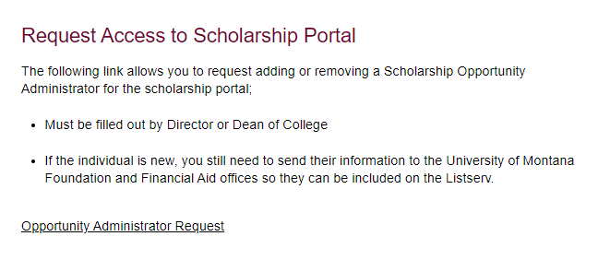
Financial aid office updates and reminders Cont.
*New* Opportunity Administrator Request Form
If you are needing to set request access for an individual to be an opportunity Administrator. Please have your Dean/Director fill out the following webform. https://www.umt.edu/finaid/scholarships/opportunity-admin-request.php
A link to this form is located on the Department Scholarship Resource webpage.

Slide 6
Um foundation Updates and Reminders
Following Criteria and Donor’s Intent​
Reviewer Committees should be given a copy of the criteria prior to recipient selection. The Portal and BOX hold the criteria description. ​
There is a legal obligation to follow donor intent when distributing funds. This applies whether the donor is living or deceased. In accordance with the donor’s wishes, the criteria produced must be followed, without exception.
Scholarship Budget Updates
The Foundation continues to make 2023-2024 revisions/updates to scholarship budgets, please be sure your Box notifications are turned on, so you receive notice.
Reminders:
For Department Funds, administrators, please review your 2022-2023 budgets and expenditures to inform UMF (Korla) on what you would like to budget for the 2023-2024 academic year.
The Foundation updates scholarship budgets in Box as money is received, processed, and reviewed. Please allow a few business days once money is received.
If you have scholarship budget questions or updates, please contact our Scholarship Administrator, Korla McAlpine at korla.mcalpine@supportum.org.
A message from our Stewardship team:
UMF is currently processing scholarship donor contact lists for AY23-24 for those units who have already requested them. Please contact Emily Shankle (emily.shankle@supportum.org) if you would like to learn more about these lists.
Scholarship Administrator Contact Email Listserv
Please send the Foundation and Financial Aid Office any new contacts (and their info including their umontana employee email address) who are assisting with Scholarship Administration in your unit/department or program

Slide 7
Questions & Suggestions

Slide 8
Question 1
Is there a way to allow for Banner-pulled student records to auto-update even after an application has been submitted? Many incoming students complete the SP app in December/January but then adjust their majors in February/March ...
FAO ANSWER: The Banner feed updates the Scholarship Portal information daily for student’s as it may change, examples are majors, need, etc. The only time that you may still see an applicant that no longer meets your opportunity criteria is because it has closed/ended.

Slide 9
2022 – 2023 Academic year timeline & Monthly To Do List
April 1st – Was the last day to submit Spring only and Full Year 2022 – 2023.
Exceptions for graduation awards or awards that are dependent on end of term/year criteria.
All final 2022 – 2023 awards must be made using an Award Summary Sheet.
Complete reconciliation of all funds.
UM Scholarship funds should have a $0 fund balance at fiscal year-end.
You can view your fund balance in Banner in FGITBSR (you will need the fund number) and in UMDW in the "General" tab > Trial Balance.
Last student scholarship letters for 2022-2023 mailed to donors.
May 5th – Last Day of Regular Classes
Continue working on completing reconciliation of all funds.
May 8th – May 12th – Final Exams
May 13th – Spring Commencement
June 1st - Due to the upcoming fiscal year end, any last minute Award Summary sheets must be submitted by June 1st. This allows for processing time.
Reconciliation of funds should be complete.
April
May
June

Slide 10
2023 – 2024 Academic year timeline & Monthly to Do List
Processing Times:​​
Please keep in mind that the Financial Aid Office is shorthanded currently, processing times are taking up to 10 business days.
April 3rd – Summer 2023 Registration Bills are available via Cyberbear
Continue awarding for Summer 2023 and academic year 2023-2024.
Continue awarding for Summer 2023 and academic year 2023-2024.
May 18th – Summer awards are due for processing to ensure credits are applied to student accounts prior to the start of Summer courses.
May 22nd – Classes Begin for 10-week Session and 5-week Session I.
Summer 2023 Payment deadline to avoid $80 late fee
May 29th – Memorial Day, No Classes, Offices Closed
Continue awarding for academic year 2023-2024.
June 12th – Final Payment Deadline to avoid cancellation of Classes for Summer 2023.
June 23rd – Last Day of Classes for 5-week Session I
June 26th – Classes Begin for 5-week Session II
April
May
June

Slide 11
UM Scholarship Portal
TOPICS:
How to Decline Awards in the Portal
How to View Student Thank You Letters in the Portal
Post-Acceptance End Date Update

Slide 12
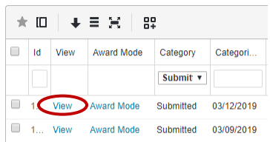
Declining/Canceling A Scholarship Award In the Portal
See online handout for more in-depth graphics and info > How to Cancel or Decline Awards in the Scholarship Portal
Steps:
Locate the applicant by opportunity
Opportunity > Portfolios > All > Click on Applications
Click on “View”
3. Click on “Submitted”
Notes:
FAO Presents
Complete

Slide 13
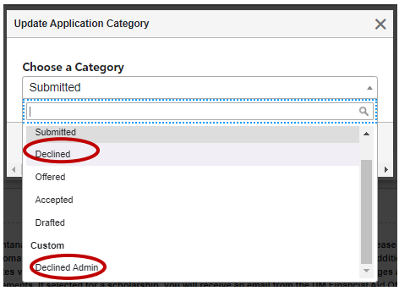
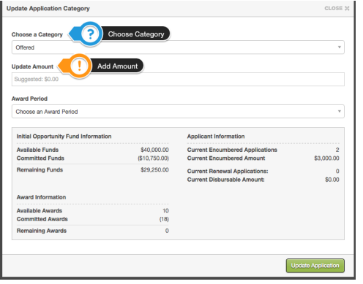
Declining/Canceling A Scholarship Award In the Portal CONT.
Continued Steps:
4. Update Category to “Declined” or
“Declined Admin”
> Update Application Category
box will appear, click
“Update Application”.
Please note, the system will take a few minutes to process and update.
Last STEP: Submit a Correction Award Summary Sheet
Reminder: A Correction Awards Summary sheet is still needed even if the student is no longer attending.
Notes:
FAO Presents
Shall we add more explanation to the reminder that a CAWSS is still needed if student is not attending?

Slide 14
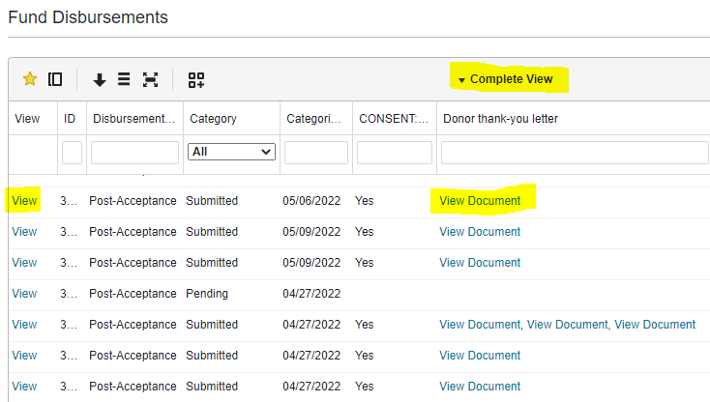
How to: view student thank you letters on the Portal
There are two options to view student thank you letters on the Scholarship Portal:
First Option > If you want to review all thank you letters for your unit/department:
Opportunity > Portfolios > Fund Disbursements > Complete View or Select Custom View
You can move columns around and save the information
you want to see first by creating a custom view.
​Click on “View” under View column, OR
“View Document” under Donor thank-you letter column.
Using “View” will show you the recipients' responses
and link to the thank you letter.
Using “View Document” will download the document.

Slide 15
How to: view student thank you letters on the Portal CONT.
Second Option > If you want to view thank you letters for a specific scholarship:
Opportunity > Portfolios > All > Click on Award

Slide 16
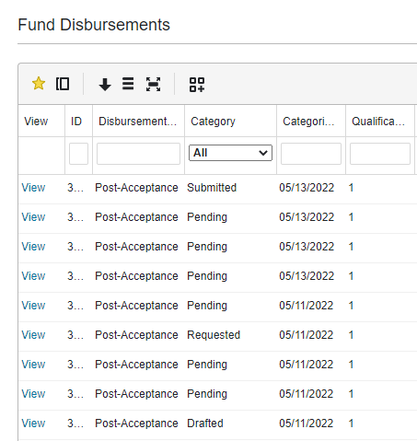
How to: view student thank you letters on the Portal CONT.
Fund Disbursements > Category Status:
Pending = Award offer has been extended to the applicant, but they have not “accepted” or “declined” the offer.
Requested = Award offer has been “accepted”, but the applicant has not yet completed their “Post-Acceptance”.
*Drafted = Applicant started to respond to the “Post-Acceptance” but has not yet completed it.
*Submitted = Post-Acceptance is complete.
*Awarded = Financial Aid has reviewed the award.
*This does not hold up the award from being transmitted to the student’s financial profile (Banner).

Slide 17
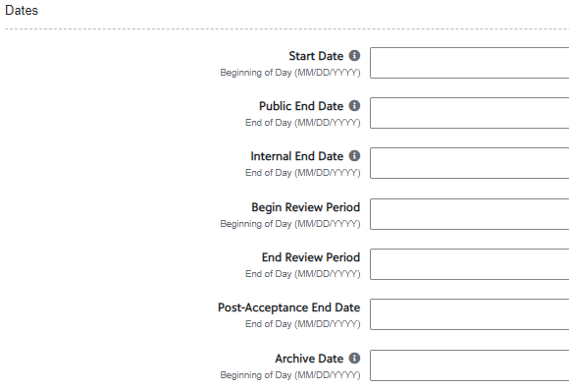
Post-Acceptance End Date
The “Post- Acceptance End Date” field is located in the funds Opportunity under the “Dates” section.
If a date is added to the “Post – Acceptance End Date” field students will not be able to answer any Post- Acceptance Questions or upload their Thank you Letters to the Portal.
This may cause confusion for students, as they may try to upload and won't be able to complete the Post Acceptance requirements.
If you have entered a Post-Acceptance End Date, please connect with Emily Shankle, UM Foundation Donor Stewardship Manager.
Details Tab - Opportunity

Slide 18
Questions?

Slide 19
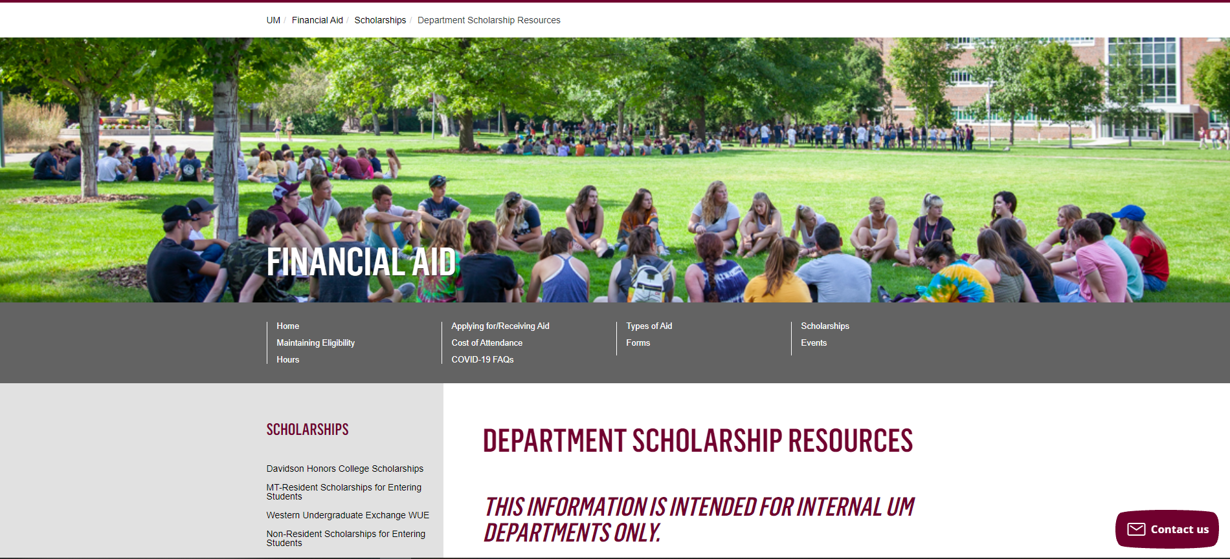
Department Scholarship Resource Webpage
Who is this for? ​
YOU! As a scholarship administrator/contact, these resources are for you, to use throughout the year as you go through your scholarship process.​
​
What can I find there? ​
Award Summary Sheet and Correction​
UM Portal Handouts/Instructions ​
Past Presentation Materials ​
Thank You letter information ​
FAO, UMF and Business Service Contact Information ​
How do I access this webpage?​
Please SAVE/Bookmark this link https://www.umt.edu/finaid/scholarships/department-use-resources.php. This link is “hidden” to reduce access from students.​
​

Slide 20
Looks LIKE SOUNDS Like
Financial Aid Contacts | UM Foundation Contacts
Christina Peltier Financial Aid Specialist II- Scholarship Manager christina.peltier@mso.umt.edu (406)243-4810 | Korla McAlpine Scholarship Administrator Korla.mcalpine@supportum.org (406) 243-4260
Department Scholarship Resources Webpage: https://www.umt.edu/finaid/scholarships/department-use-resources.php | Sarah Wade Assistant Director of Fund Administration Sarah.wade@supportum.org (406) 243-5592
 | Nancy Randazzo Director of Gift and Fund Administration Nancy.Randazzo@supportum.org (406) 243-4739
 | Emily Shankle Donor Stewardship Manager Emily.shankle@supportum.org (406) 243-2506
To contact the Financial Aid Office main line please call (406) 243-5373 | Raven Clark Fund Administration Coordinator raven.clark@supportum.org (406)243-2407
Location: Aber Hall, 5th floor | Location: Gilkey Building, 2nd Floor. Our team is in office Monday-Tuesday, working remotely Wednesday-Friday.
Financial Aid Office Email: fascholarships@mso.umt.edu (for scholarship department questions) | UM Foundation Email: umfawardsummarysheets@supportum.org (for scholarship department questions)
Business Services Contact
Barb Bybee (406) 243-6261 Barb.bybee@mso.umt.edu

Slide 21
Thank you for joining!
Please note we will not be hosting Scholarship Forums in May, June, or July.
Stay tuned for monthly communications that will include important
scholarship information and dates of upcoming forums.

