Slide 1
December Scholarship Forum
With the UM Foundation, Financial Aid Office, and Barb Bybee

Slide 2
Financial Aid Office
2021-2022
​
No More Fall Only Scholarships​
​
2022-2023
Remember to check qualifications in each of your opportunities to match criteria provided by the UM Foundation.
Email fascholarships@mso.umt.edu if you are interested in using the Reviewer Groups feature to select scholarship recipients in the Portal! More in-depth info to come in later slides.

Slide 3
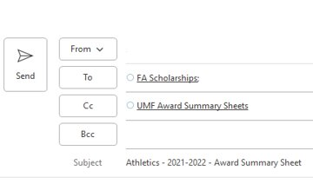
UM Foundation
2021-2022
2022-2023
Reminders:​
Track and reconcile: Check to ensure all FALL expenditures have paid. ​
UMDW​
Banner - FGIBDST​
Collect Thank You letters​
Students can email their letters to thankyou@supportum.org. ​
Questions, please contact Emily Shankle.​
Activity Code in the Award Summary Sheet​
Do NOT add the index code or Foundation Fund Number in this section. Leave blank unless you have an Activity Code to use. ​
Email “subject” lines:
Please include department name – award year- type of document (award summary sheet or correction)
NEW Scholarship Budgets​
BOLO – For email from UMF to schedule upcoming budget meeting.​
Scholarship Budgeting Timeframe: December – March​
If you have questions, contact Korla, UMF Scholarship Administrator.
Help Us!
If you want to receive communications from the Foundation or Financial Aid Office, please send the department name, staff full name, and UM email address to the Foundation

Slide 4
Survey Questions

Slide 5
Question
Can scholarships be awarded for summer? It's not an option on the award summary sheet.
UMF Answer: Yes, scholarships can be awarded for summer but not at this time. It is not an option on the Award Summary Sheet because it has its own sheet, specifically for summer. This helps Financial Aid, Foundation and Business Services distinguish between award and fiscal years.

Slide 6
Awarding on the Scholarship Portal for 2022 - 2023
Table of Contents
What do students see?
How to Add Dates at the Conditional Level
How to Add Dates at the Opportunity Level
Reviewer Groups and Scoring Rubrics

Slide 7
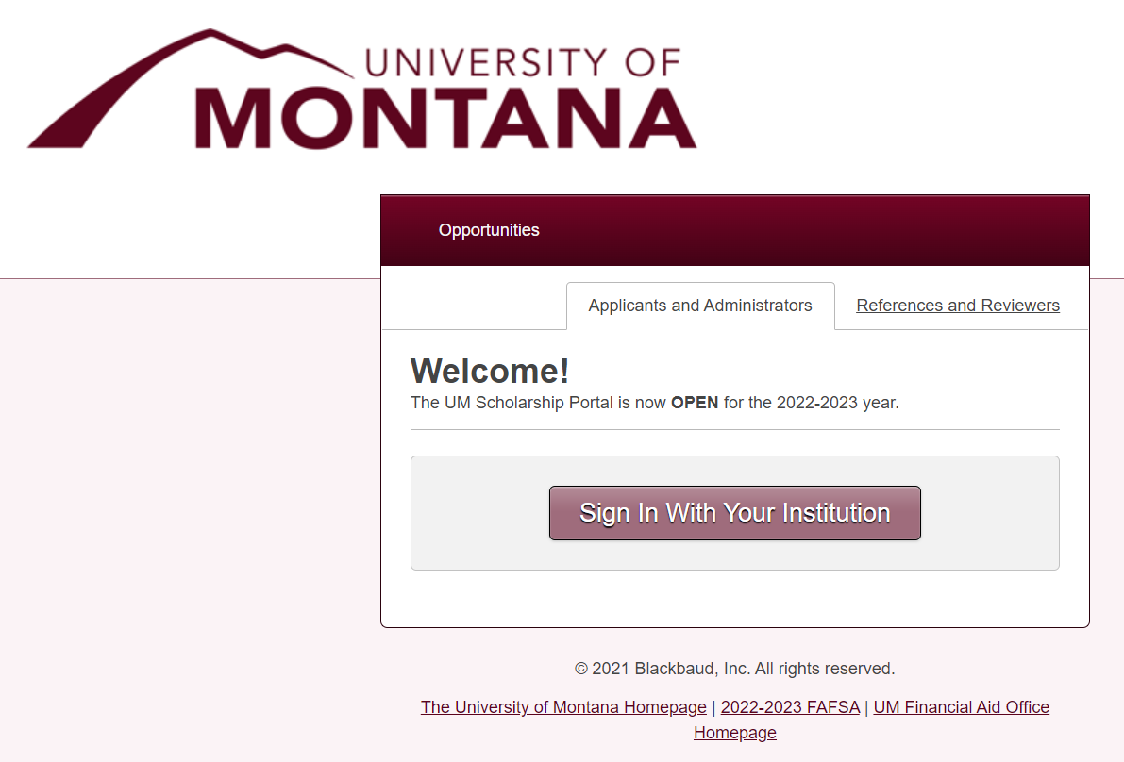
What do students see?
Scholarship Portal Landing Page​
Opportunities – lists all open opportunities in the Portal ​​
Applicants and Administrators – For students and administrators to log in to the Portal (using NetID and password)​​
References and reviewers should not use this to sign in ​
References and Reviewers – For References or Reviewers to log in to the Portal​
Students and administrators should not use this to sign in ​​
Sign In With Your Institution – Click to sign in using NetID and password. ​​
Quick Links – Helpful links provided for quick access to umt.edu, the 2022-2023 FAFSA , and the UM FAO webpage
1
2
3
4
5

Slide 8
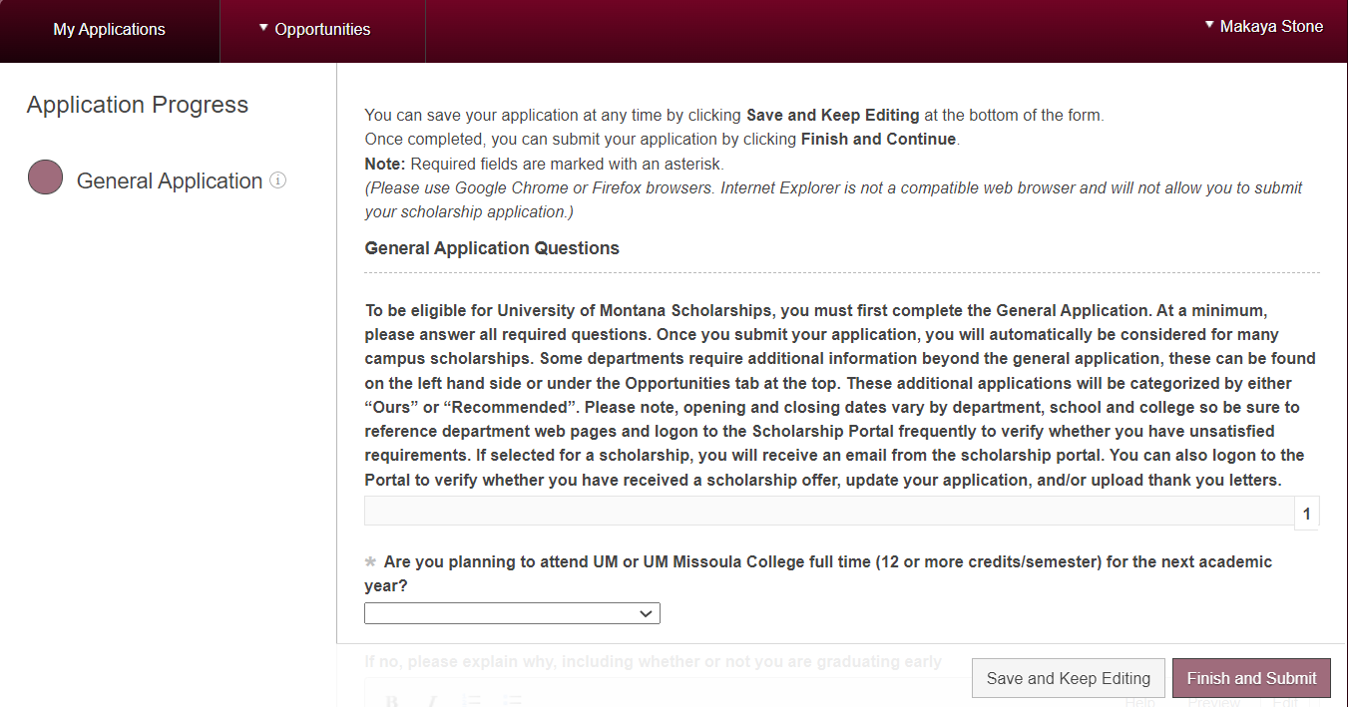
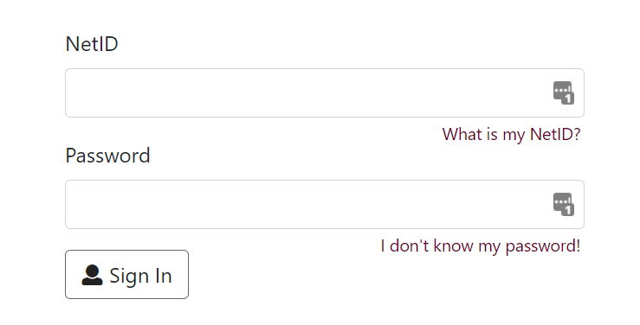
What do students see?
My Applications – General Application will display. If the applicant is eligible to apply for other units/departments that have a conditional application, another icon will appear. The General Application must be submitted first. ​
Opportunities – Students can search for scholarships by typing in keywords but are signed in.​
Recommended: These are Apply-To opportunities that the student may meet qualifications for. “Recommended” does not constitute qualified. If a student does not believe they qualify for consideration after reading the opportunity description, they should not apply. ​
Ours: lists all open opportunities in the Portal ​
Save and Keep Editing or Finish and Submit ​
* Asterisk questions are REQUIRED
1
2
NET ID Login
3

Slide 9
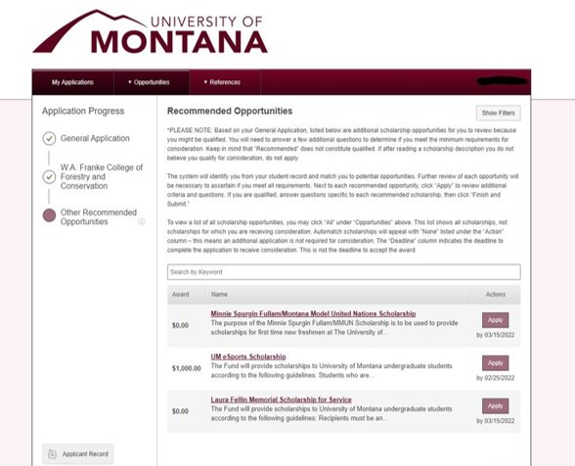
What do students see?
When a student completes the General Application, a conditional application will automatically populate under Application Progress if the student meets the qualifications. ​
Nearly all conditional applications require the student to have a specific major/minor. This info is pulled from Banner.​
Please note - a Conditional Application will not populate until after the student submits the General Application
Other Recommended Opportunities will populate with Apply-To opportunities that the student meets qualifications for.​
We do not recommend that students use the "search" function to find opportunities. Most opportunities are Auto-Match and students often get confused when they can't find a specific scholarship.

Slide 10
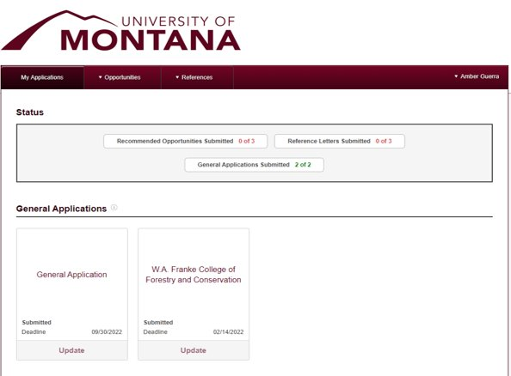
What do students see?
Under My Applications, students can view details of all applications they have submitted (General Application, Conditional Application, and any Apply-To opportunities)​
Select "Update" to make changes to an application

Slide 11
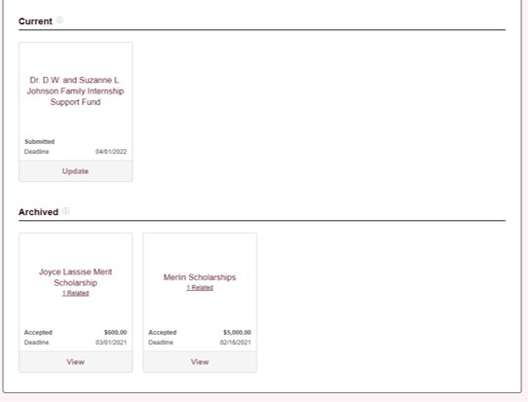
What do students see?
Scroll down under the My Applications tab to see:​
​
Current Apply-To opportunities that the student has started​
Select "Update" to make changes to an application​
This will say “Finish” if the General Application is not yet completed
​
Archived awards the student has been offered in previous years

Slide 12
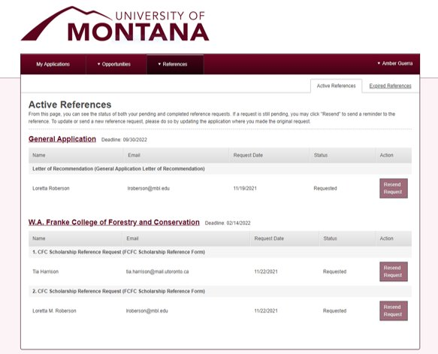
What do students see?
Students can view their references for their active applications and see the status of their request​
Select References -> Active References​​
Students can also view their references used for previous year's applications​
Select References -> Expired References

Slide 13
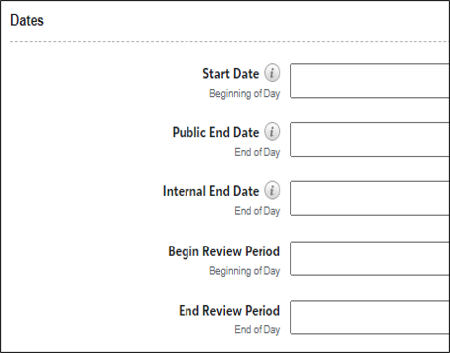
How to add Start and End Dates at the Opportunity Level
Opportunity Portfolios ALL​
​
If no date has been entered, the default is “Future”, click on “Future”.​
Start Date – If left blank, the opportunity will be closed for applicants. You can back date to “November 1st” even if it past that date when you add in the Portal. ​​
Public End Date – The deadline date that is visible to applicants. After this date, the opportunity will no longer be published.​​
Internal End Date – The deadline date for matching applications to the opportunity. Only qualified applications that were submitted prior to/on this date will match to the opportunity. Applicant answers submitted after this date will not be reflected on the opportunity applications.​​
Begin Review Period and End Review Period Dates – You may add when you open, however, please be sure you have updated your committee members and it is recommended the Begin Review Period is a week or so after the End Date. The time between will allow you to review your applicant pool and organize your list for your review committee whether you are using the Review functionality in the Portal or not.

Slide 14
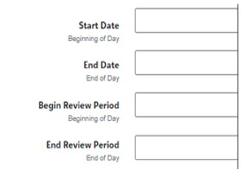
How to add Start and End Dates at the Conditional Level
Opportunity General Applications Conditional​
​
Click on “Conditional Application Details” ​
​
Start Date – If left blank, the conditional application will be closed for applicants. You can back date to “November 1st” even if it past that date when you add in the Portal. ​​
End Date – The last date the conditional application will accept applications.​
Begin Review Period and End Review Period Dates
Recommendations:​
Update your committee members and reviewer group.​
Set review period a week or so after the End Date. The time will allow you to review your applicant pool and organize your list for your review committee whether you are using the Review functionality in the Portal or not.

Slide 15
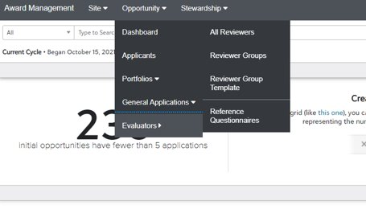
Reviewer Groups and Scoring Rubrics
What are Review Groups?​
A feature in the Portal that allows administrators to assign your department Scholarship Committee members to review and select recipients for opportunities/scholarships​
Notable features​
Reviewers can use a "Rubric" to rate each student's qualifications​
No need to meet in-person​
Reduces miscommunications and chance of losing paperwork​
Each Reviewer can go into the Portal and review applicants at their leisure during the Review Period (instructions in later slide)
Click Reviewer Groups
Go to Reviewer Groups to view the list of groups already created for your department/scope​
You could have one group for all opportunities/scholarships or multiple groups and assign them to specific opportunities, depending on your department's awarding process

Slide 16
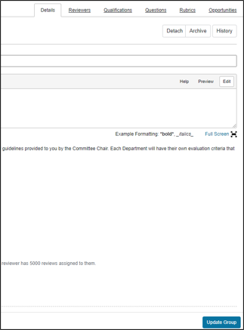
Reviewer Groups and Scoring Rubrics
Click group name
Select tabs to review group info
We will go over each tab in separate slides. ​
​
Please DO NOT edit this information. Email fascholarships@mso.umt.edu to work with FAO on updating/creating your Reviewer Groups and Rubrics. This is to ensure that student applications are not missed.

Slide 17
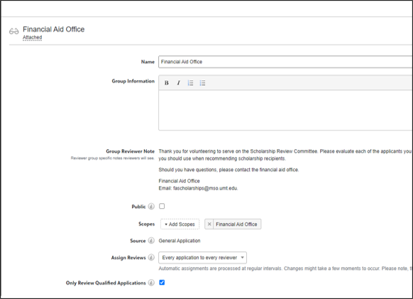
Reviewer Groups and Scoring Rubrics – Details Tab
Name​
Can be name of Department or opportunity/scholarship​
Group Information​
Is usually left blank
Group Reviewer Note​
A note to your reviewers​
Scope​
Your department/college name​
Source​
General Application and/or a Conditional Application​
Assign Reviewers​
The number of people that review each application (typically all reviewers look at all applications
1
2
3
4
5
6

Slide 18
Reviewer Groups and Scoring Rubrics – Reviewers Tab
3
4
1
2
1. Current Reviewers​
People assigned to the Reviewer Group​
​
2. Role​
Member, Chair, or None
3. Reviewed/Assigned - This Group​
Number of opportunities reviewed by the group and assigned to the group​
4. Reviewed/Assigned - All Groups
Number of opportunities reviewed by all your groups and opportunities assigned to the groups

Slide 19
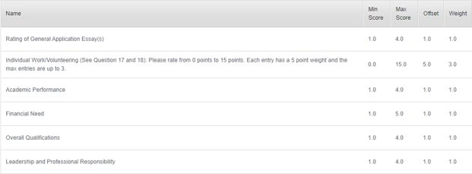
Reviewer Groups and Scoring Rubrics - Rubrics
Reviewer Groups are typically created using a template, which has a standard Group Reviewer Note, Questions, and Rubric.​
​
Above is an example of Rubrics used in the template. ​
Minimum Score, Maximum Score​
Offset​
Weight
Rubrics can be customized to fit your department's needs. ​
​
Please DO NOT create new or make changes to any Reviewer Groups or Rubrics. Email fascholarships@mso.umt.edu to work with FAO in making these changes.

Slide 20
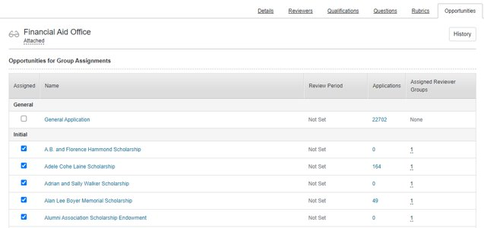
Reviewer Groups and Scoring Rubrics - Opportunities
Specific opportunities/scholarships can be assigned to each Reviewer Group.
Assigned​
Is the opportunity assigned to the Reviewer Group you are currently looking at?​
Name (of the opportunity)​
Review Period ​
Set in each individual opportunity
Applications​
Number of apps that meet one or more of the qualifications​
Reviewer Groups ​
Number of groups assigned to the opportunity, hover curser over number to see name of group

Slide 21
Reviewer Groups and Scoring Rubrics
Again, please email fascholarships@mso.umt.edu to create or update Reviewer Groups!​
In your email, please provide the following information:​
Number of Reviewer Groups needed​
Names of all Reviewers (members of your Scholarship Committee) and their role​
Rubric ideas​
Which opportunities the groups(s) will be assigned to
If your department already has functional Reviewer Groups set up, you can add various review settings in each opportunity (see next slide)

Slide 22
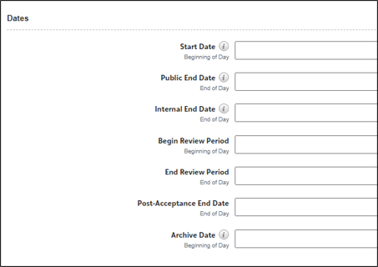
Reviewer Groups and Scoring Rubrics
On each opportunity, you can make the following adjustments for your reviewing process:​
Hide Applicant Name – if you would like a more unbiased review​
Opportunity Reviewer Note – administrators may enter any notes specific to the opportunity that the review group would need to see​
Begin Review Period – administrators will need to enter dates for the reviewers to complete their process
Don't forget to click "Update Opportunity" to save your changes!​

Slide 23
Trivia Break!
What year was the oldest active UMF scholarship established in?
1957! The A.B. and Florence Hammond Scholarship was established by Mrs. Frank B. King in memory of her father and mother. The grandiose Hotel Florence in Missoula, which now houses many offices, was named after Mrs. Hammond. As one of Missoula's founding families, the Hammonds are still remembered fondly by the community.

Slide 24
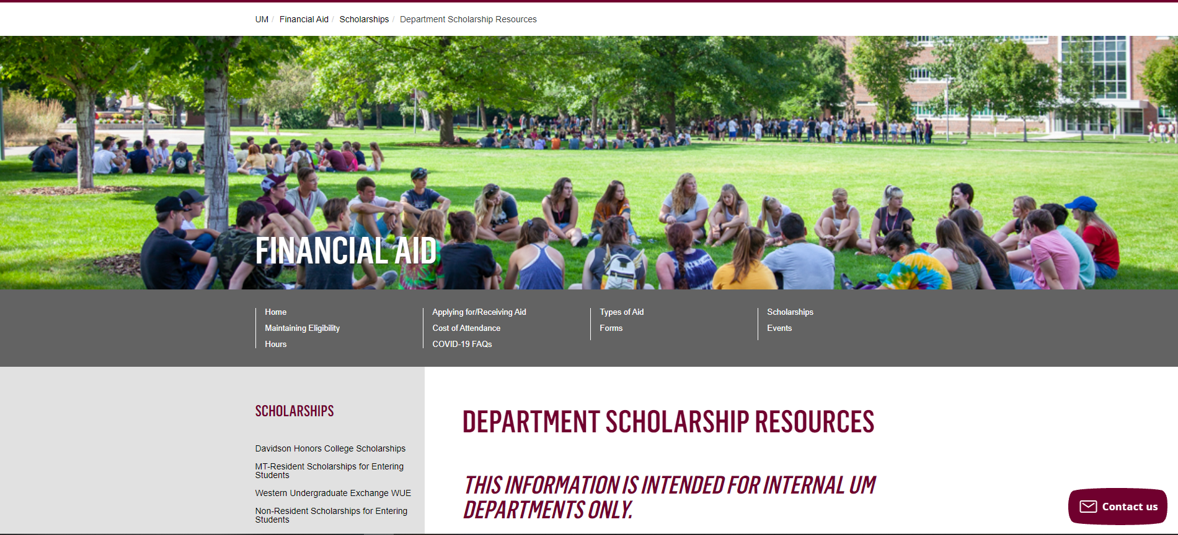
Department Scholarship Resource Webpage
Who is this for? ​
YOU! As a scholarship administrator/contact, these resources are for you, to use throughout the year as you go through your scholarship process.​
​
What can I find there? ​
Award Summary Sheet and Correction​
UM Portal Handouts/Instructions ​
Past Presentation Materials ​
Thank You letter information ​
FAO, UMF and Business Service Contact Information ​
How do I access this webpage?​
Please SAVE/Bookmark this link https://www.umt.edu/finaid/scholarships/department-use-resources.php. This link is “hidden” to reduce access from students.​
​

Slide 25
Looks LIKE SOUNDS Like
Financial Aid Contacts | UM Foundation Contacts
Maggie Lawton Scholarship Coordinator (406) 243 - 5510 | Korla McAlpine Scholarship Administrator Korla.mcalpine@supportum.org (406) 243 - 4260
Christina Peltier Financial Aid Evaluator II – Scholarship Manager (406) 243 - 4810 | Sarah Wade Manager of Fund Administration Sarah.wade@supportum.org (406) 243 - 5592
 | Nancy Randazzo Director of Gift and Fund Administration Nancy.Randazzo@supportum.org (406) 243 – 4739
Department Scholarship Resources Webpage: https://www.umt.edu/finaid/scholarships/department-use-resources.php | Emily Shankle Donor Stewardship Specialist Emily.shankle@supportum.org (406) 243 – 2506 www.supportum.org/thanks
Location: Lommasson 218 Until December 19th. After December 20th Aber Hall 5th floor, Room 522. | Location: Gilkey Building, 2nd Floor
Financial Aid Office Email: fascholarships@mso.umt.edu (for scholarship department questions) | UM Foundation Email: umfawardsummarysheets@supportum.org (for scholarship department questions)
Business Services Contact
Barb Bybee (406) 243- 6261 Barb.bybee@mso.umt.edu

Slide 26
Thank You for Joining Us!
There will be no January Scholarship Forum, but please stay Tuned more information on a February Scholarship Forum. Happy Holidays!

