Slide 1

December Scholarship Forum
With the UM Foundation, Financial Aid and Barb Bybee (Business Services)
Thursday, December 17th

Slide 2
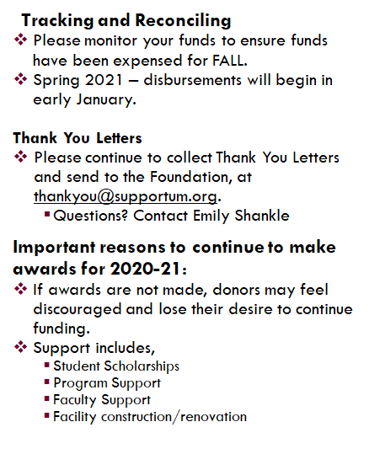
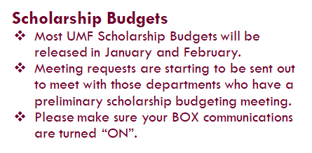

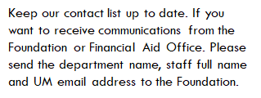
Foundation
2020-21
2021-22
Help Us!

Slide 3
Financial Aid Office
2020-21
Spring only and final full year awards due by April 1st.
We are still working in rotation, due to this it is causing some delay in processing.
Processing of award summary sheet’s remain at 5 to 10 business days.
2021-22
Portal is up and running. Opportunities should be open. Review Committee’s should be selected and updated in the portal.
Reminder:
Please use fascholarships@mso.umt.edu to submit award summary sheet, tuition waiver’s and portal questions. Using any other email address can cause a delay in processing.

Slide 4
Survey Questions

Slide 5
Question #1: We will be offering a scholarship to a graduate students that is fully funded. I understand that it will go onto the student account. How does she access scholarship amount?
FAO Answer: There are two ways that a scholarship get’s processed.
Awarded via Portal: When awarded through the portal the system pulls this information into Banner. When disbursement begins the scholarship then pays onto the student account, to cover the bill that they have. Please note the system defaults to 12+ credits for disbursement, if the student is enrolled in less you need to let us know so we can manually adjust it.
Award Via Award Summary sheet: A scholarship team member in the Financial Aid office manually enter’s these into Banner. When disbursement begins the scholarship then pays onto the student account, to cover the bill that they have.

Slide 6
Question #2: Why do we need to fill in hometown and state on award summary sheets if the award is for a programmatic fund that does not require this information? If we need to do this, what Banner report gives the hometown and state and can everyone access that report?
UMF Answer: The Foundation sends out Endowment and Recipient reports to donors on an annual basis (coming out soon) for scholarships and programmatic funds. The Endowment Report includes accounting information on how the fund is performing, as well as expenditures for the last fiscal year. The Recipient Report includes student name (first name only unless no consent), major, class level, hometown/city and state. The Recipient Report is only sent for scholarship funds. The Foundation does not have access to student information through Banner so we rely on information from the Award Summary Sheets and UM Portal (applies only if student and department use the Portal). To make it more complex, there are some programmatic funds that can still provide scholarships, for this reason reporting all information on the Award Summary Sheet is helpful. If the fund is programmatic and the criteria or purpose does not specify a city, county, state, etc. that the student must meet then, you do not have to include that information on the Award Summary Sheet.
You can find permanent city, state, county, in a Banner form called SPAIDEN. Please check that you have access to this form. There may be other forms or platforms that may also have this student information. Does anyone else have suggestions?

Slide 7
Question #3: We should have the Portal be able to handle spring only awards. We need to eliminate the use of award summary sheets as much as possible.
FAO Answer: We have worked closely with Blackbaud Award Management System who is the software company that houses our portal regarding this. Currently there is no ability to award two year’s consecutively. Instead, it can only handle one year at a time. Due to this spring only, awards must be awarded using the award summary sheet process.

Slide 8
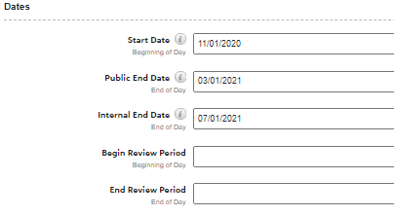
Question #4: I need to open up opportunities for the upcoming scholarship season. Our application due date will be March 5, 2021. I don't know what to enter for the many dates on the details tab for each opportunity. Thanks for addressing this!
FAO Answer: When opening your opportunities in the scholarship portal you only need to put dates for “start date” and “Public End date”. If your opportunity shows “Internal End Date” it is optional for you to enter a date, there.
For your review committee to access the applicants you would enter those dates in the “Begin Review Period” and “End Review Period”.

Slide 9
Question #5: How do you change questions or scoring for reviewing?
FAO Answer: At this time the Financial Aid Scholarship Team is the only group who are to make changes in scoring and reviewing.
If your department is wanting to make these changes you will need to send an email to fascholarships@mso.umt.edu with subject line : Updates to questions or Scoring for Review.
In the body of the email, you will need to provide us with what the new questions and scoring are. Please note this process will take a few days for us to do and we will email you back once it has been updated.
In addition, if you would like to use the reviewer component in the Portal for your committee, or if you need to update your committee members, please send the request to fascholarships@mso.umt.edu.

Slide 10
Question #6: When students get emails, what email address is it coming from? What do students see when they get correspondence from the Portal?
FAO Answer: It depends on what emails are being sent to a student. All general Financial Aid emails are sent from our general student account. These emails often let students know not to respond back to them and gives them our general student email address which is faid@mso.umt.edu.
All Scholarship Portal correspondence comes from fascholarships@mso.umt.edu. This email is primarily used for department correspondence but student’s on occasion do get emails from this as well. We do ask that students not be given this email address as it is specific to departments, but we are not able to have a separate email address listed in the portal for their correspondence.

Slide 11
Other Questions?

Slide 12


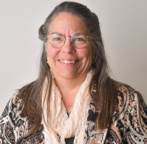
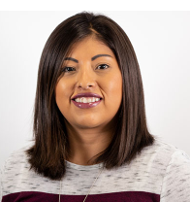
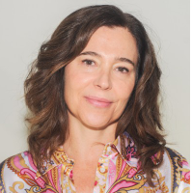

Contact Information
Financial Aid: | Foundation:
Shylar Wilson Financial Aid Evaluator (406) 243-5510 | Korla McAlpine Scholarship Administrator (406) 243-4260 Korla.mcalpine@supportum.org
Christina Peltier Financial Aid Evaluator (406) 243-4810 | Sarah Wade Manager of Fund Administration (406) 243-5592 Sarah.wade@supportum.org
Ginger Lowry Associate Director of Customer Care (406) 243-6802 | Nancy Randazzo Director of Fund Administration (406) 243-4739 Nancy.randazzo@supportum.org
 | Emily Shankle Donor Stewardship Specialist (406) 243-2506 Emily.shankle@supportum.org
Financial Aid Office Email: fascholarships@mso.umt.edu | UM Foundation Email: UMFAwardsummarysheets@supportum.org
Office Location: Lommasson Building | Office Location: Gilkey Building, 2nd Floor (Office is closed but if you need to get something to us, please let us know.)
Business Services Contact: Barb Bybee (406) 243-2303 Barb.bybee@mso.umt.edu
UM Scholarship Departmental Resource Page
Please save/bookmark this link as a Favorite
https://www.umt.edu/finaid/scholarships/department-use-resources.php

Slide 13
Thank you for joining us!
February Scholarship Forum To Be Announced!
NO January Scholarship Forum!

