Slide 1
March 18, 2022
MARCH SCHOLARSHIP FORUM
With Financial Aid, UM Foundation, and Barb Bybee

Slide 2
FINANCIAL AID OFFICE
2021-2022
2022-2023
April 1st - All award summary sheets and correction sheet for Spring 2022 Semester and Full year 2021-2022 are due
Awards for the 2022-2023 year can begin being made.
Reminders
Please make sure your applicants match donor criteria.
Please submit award summary sheets for Summer 2022 by June 1st
Please submit award summary sheets for the 2022-2023 year (Fall 2022-Spring 2023) by July 1st.
*Due to the Financial Aid Office being shorthanded, our processing time is taking 10 business days *

Slide 3
UM FOUNDATION
2021-2022
Please continue to encourage students to submit thank you letters, they can be sent to the Foundation at thankyou@supportum.org. If you have questions, please contact Emily Shankle, Donor Stewardship Manager.
Please make sure to track all 21-22 awards. Use the flowchart on the next slide while reviewing awards that have not disbursed.

Slide 4
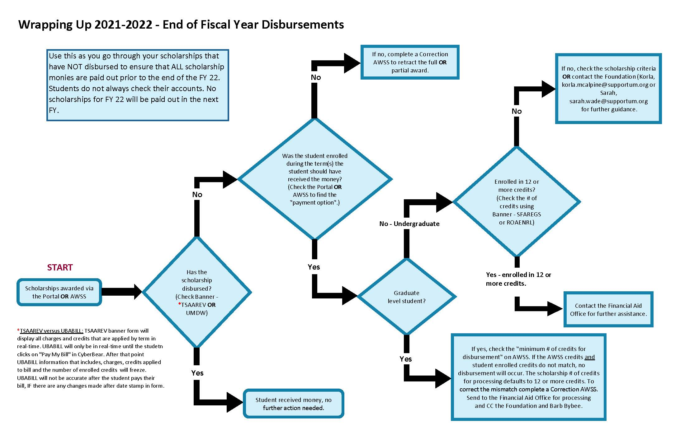
UM FOUNDATION
Tracking and Reconciling 2021-2022 awards

Slide 5
UM FOUNDATION
2022-2023
Scholarship Budgets and Criteria
All initial scholarship budgets have been distributed in Box
We are now working on updates/revisions
When an update or revision is made, we update the budget spreadsheet and add a comment on the right-hand side “activity” section
If you are using the Portal, the Portal will be updated after the excel and comment is added
Questions regarding budgets on the Portal, please contact Sarah
Please be sure you have your Box notifications turned on
Summer
Monday, April 4 – Summer Registration bills will be viewable via CyberBear
Tuesday, July 5 – Final Summer Payment Deadline to Avoid Cancellation of Classes
Reminders: Please request and submit your Summer AWSS at least 5-10 business days to allow for Foundation reply and Financial aid to process.

Slide 6
SUMMER 2022 SCHOLARSHIP AWARDING

Slide 7
SUMMER 2022 SCHOLARSHIP AWARDING​
Summer 2022 Award Summary Sheets (AWSS)
Summer awards cannot be made in the Portal
ALL requests for a Summer AWSS will need to be sent to the UM Foundation (umfawardsummarysheets@supportum.org).
Reminders for Administrators
For Foundation Scholarship funds, please confirm the following:
Check your scholarship box folder to review budget amounts AND criteria
Check if you have already submitted a 2022-2023 AWSS, OR
Check if you have already offered a scholarship in the Portal
Additional Information:
For Scholarships, the 2022-2023 AY budgets includes summer awards (if any)
Disbursements in Banner or UMDW will not display until a week or two prior to the first day of the semester, therefore, it is important to track how you are awarding scholarships.
For Foundation Programmatic funds, confirm the following:
Check that you have a sufficient cash balance in the fund
Review your accounting report or discuss with your fiscal administrator
Check the funds’ purpose/criteria
IF AN OVER-AWARD IS MADE
It is the departments’ SOLE responsibility to track recipient names, award amounts and available budget balances throughout the award cycle. The department will be responsible for covering over-awards made by the unit/department or program.

Slide 8
SUMMER 2022 SCHOLARSHIP AWARDING​
Submitting Summer Award Summary Sheets
Please follow the instructions below to submit your Summer 2022 Award Summary Sheet:
Fill out ALL information asked on the Summer 2022 Award Summary Sheet.
Review fund and student information to ensure ALL information is accurate.
Collect the signature of your dean, director, or other specified “responsible party” who can approve awards. If you are unable to collect a signature, please be sure the dean, director, or other specified “responsible party” can include the Summer Award Summary Sheet attachment with their email approval.
Send the Summer Award Summary Sheet attachment (that includes the signature) by email to the Financial Aid Office for processing fascholarships@mso.umt.edu AND CC the Foundation umfawardsummarysheets@supportum.org.
The email SUBJECT LINE should include: SUMMER 2022 Award Summary Sheet – Dept/Unit Name.
Key Take Aways
Send Summer AWSS request to the Foundation (umfawardsummarysheets@supportum.org).
By submitting your Summer Award Summary Sheet you acknowledge the above has been reviewed AND your department will be responsible for any over-awards made.
Please send Summer 2022 AWSS separately, do not mix with late year end/spring 2021-2022 OR new 2022-2023 awards.

Slide 9
SURVEY QUESTIONS

Slide 10
QUESTION 1
I would like to walk through the scholarship process from the student's perspective.
The December 2021 Scholarship Forum walked through the entire student experience. Those slides can be found on the Department Scholarship Resources page (https://www.umt.edu/finaid/scholarships/department-use-resources.php ).

Slide 11
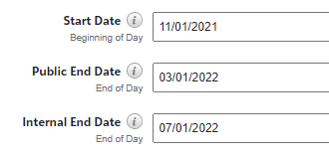
QUESTION 2
Why has our list of eligible applicants for a scholarship changed after our application closed? We checked and it was not because of the student changing majors or any other reason that they shouldn't have been listed as eligible in the first place.
If an opportunity has both a “Public End Date” and “Internal End Date” line, you will need to enter a date for both. Leaving the internal end date blank will allow applications submitted anytime to filter into your applicant list. Be sure to add this date to avoid late applicants from pulling into your applicant list.
For example, the Financial Aid Office uses the dates in the screenshot for auto-match opportunities. When an applicant is looking at the opportunity they will see a deadline of March 1st, but the auto-match feature will allow applications submitted before July 1st to filter into the applicant list.”

Slide 12
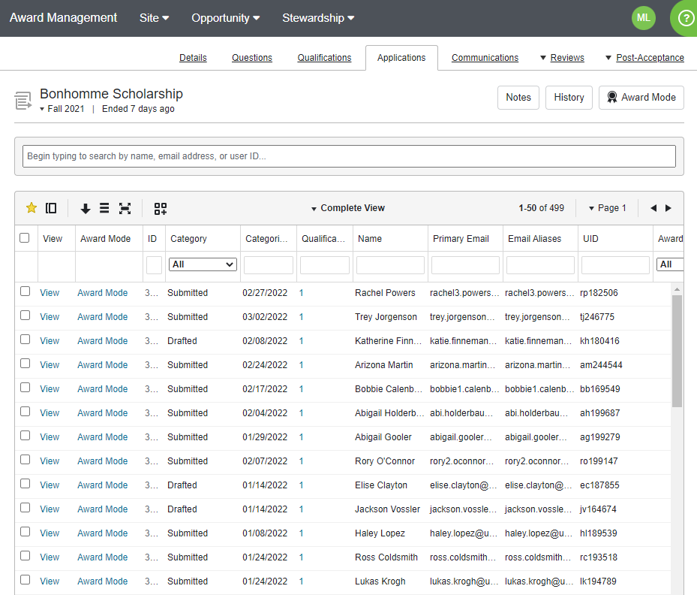
HOW TO CREATE AND SAVE A CUSTOM VIEW IN THE APPLICATION TAB
Select the “Applications” tab in the opportunity. Below is the “Complete View” for these applications. This means there is a column for each question on the General Application and for the data imported from Banner

Slide 13
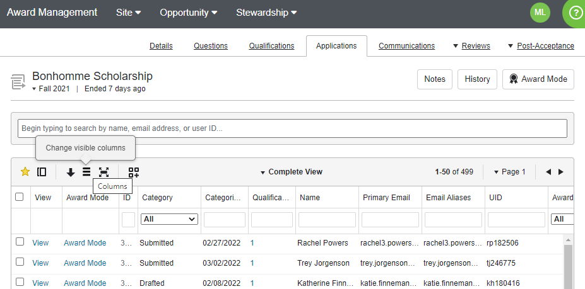
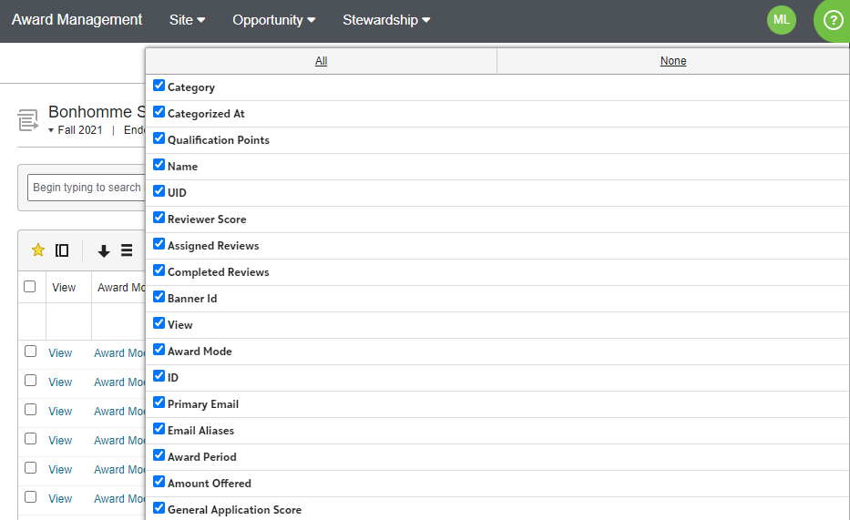
2. You can create a new, custom view that will show the information that you need by changing the visible columns. Select “Change visible columns” and you can select “All” columns or “None”, depending on what you need in our view.
3. Select the information points that you need. You can select as many or few as you need and each information point will be a column in your view.

Slide 14
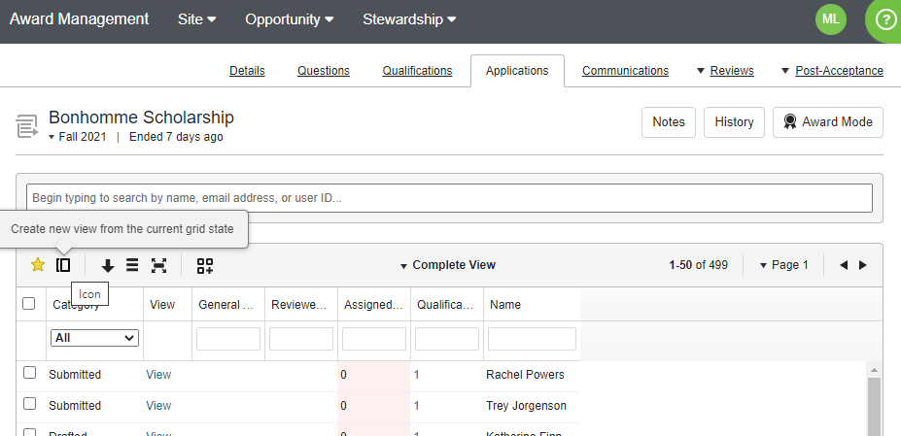
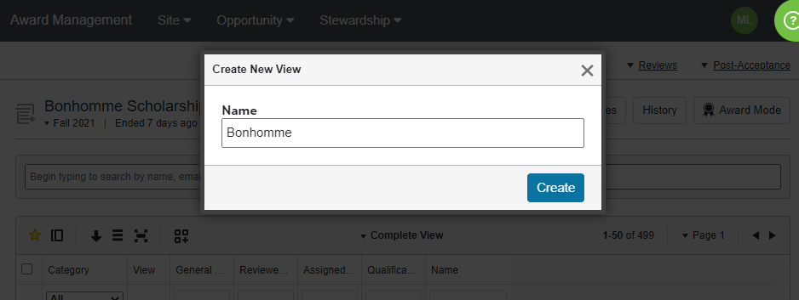
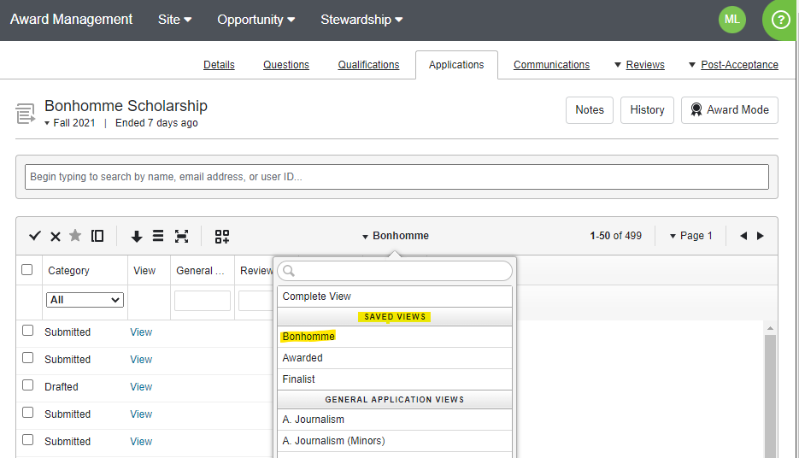
4. When you have selected all the information points that you need, click outside of the list of points. Select “Create new view from the current grid state” and create a name for your custom view.
5. You can then see and select your custom view under the list of “Saved Views.”

Slide 15
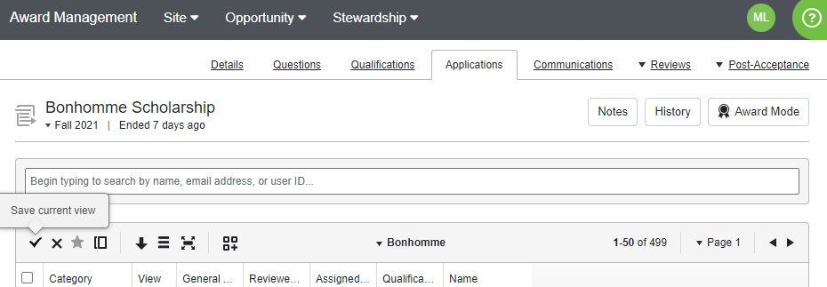
6. You can update your custom view at any time by selecting different information points and changing the columns in your view. You can then select “Save current view” to update your saved view. If you are no longer using a custom view, you can select “Delete saved view.”

Slide 16
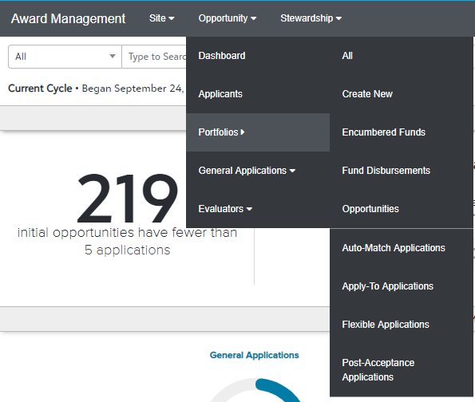
HOW TO OFFER SCHOLARSHIPS TO STUDENTS VIA THE SCHOLARSHIP PORTAL
Extending a Single Award Offer
1. While logged in as an opportunity administrator, go to the Opportunity section and select the Portfolios menu's "All" page and locate the desired opportunity.
1a. Click on the season time stamp to open the opportunity.

Slide 17
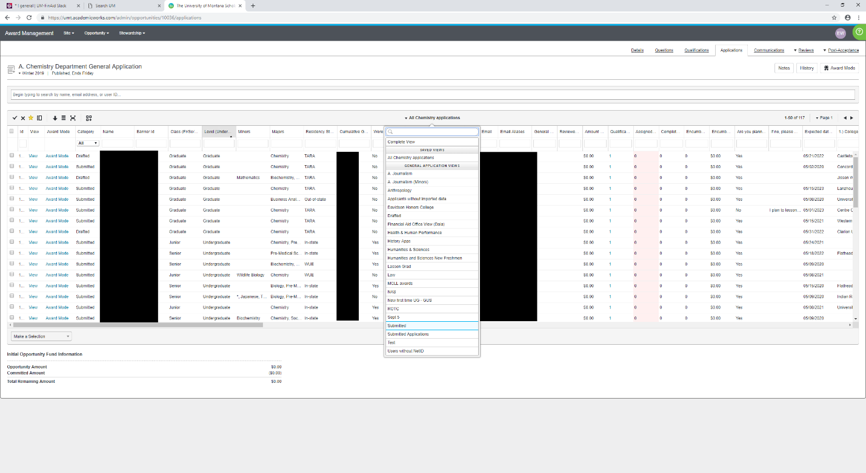
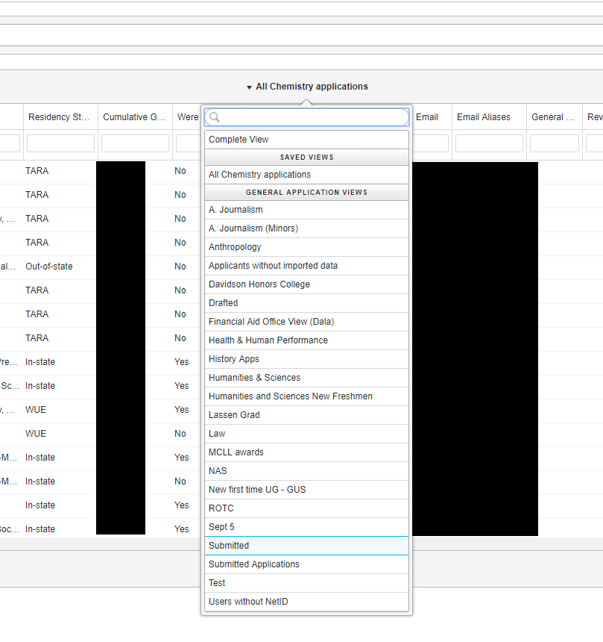
2. Next, click on the opportunity's Applications tab and a grid of all applications for the opportunity should appear.
2a. To ensure you are looking at submitted applications only, hover over the view function in the middle of the screen and select “Submitted”

Slide 18
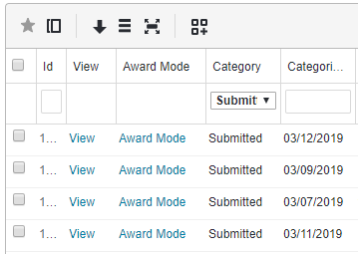
3. To locate the applicant(s) to whom you wish to make an offer and click the “View” link for that applicant. You may be interested in the values for Reviewer Score and Qualification Points columns, or in filtering the grid to locate particular applicants.
4. The page that opens up will display the user's application for that particular opportunity. You should see a button on the right side of the window that displays the current status or category of the application.

Slide 19
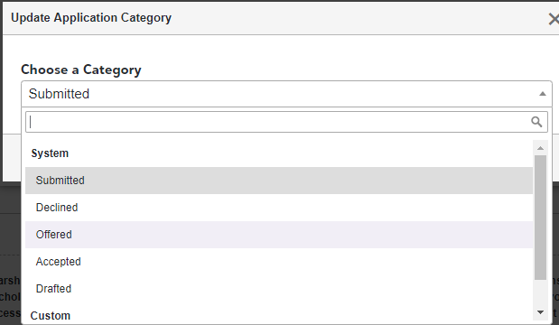
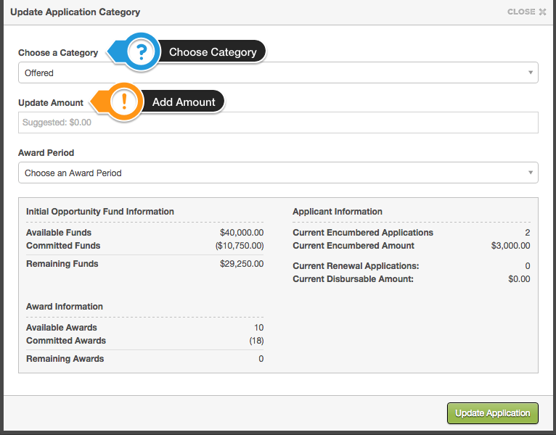
4a. Click on the category (i.e. Submitted) button to launch the category updating screen. When you select the "Offered" category from the drop-down menu, additional awarding information will appear. You may wish to review this information before making your decision:
4b. After selecting “Offered” category, an “update application category” box will display.

Slide 20
4b. Cont.
A. Initial Opportunity Fund Information: Based on the pre-set Total Award Amount for the opportunity, this area informs administrators of how much funding remains available.
Note: If the opportunity's award information has not been set, then this will likely show as 0. Additionally, when extending award offers administrators may encounter an "overextended funds" warning message.
B. Award Information: Based on the pre-set Total Award Amount for the opportunity, this area informs administrators of how awards remain available. (Note: If the opportunity's award information has not been set, then this will likely show as 0.)
You may see the following warning message in red when updating the Update Amount field: "Amount must be greater than or equal to $XXXX and less than or equal to $XXXX" depending on the minimum and maximum award amounts you have set at the portfolio level. If you are trying to enter an amount that is less than the minimum amount set or greater than the maximum amount set, you WILL NOT be able to complete the action. In either of these cases, please contact the UM Foundation for further assistance as the minimum or maximum award amount may be set by the criteria. Please do not edit yourself.
C. Applicant Information: This informs administrators of any other awards the applicant has already received this cycle, as well as the overall amount. For systems with the Renewal Management Module enabled, this area will also display available renewal award information for the applicant. When ready to extend an award offer to the applicant, type in the appropriate award amount (and select an Award Period tag, if your system uses custom Award Periods). When finished, click the green "Update" button.

Slide 21
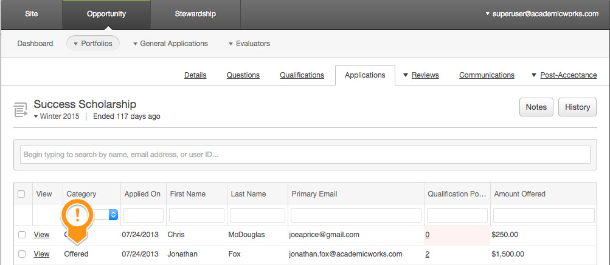
5. The category updating box will close and, in a few moments, the award offer will be extended to the applicant. After waiting a few moments, you may check the opportunity's Applications tab to confirm the award offer.

Slide 22
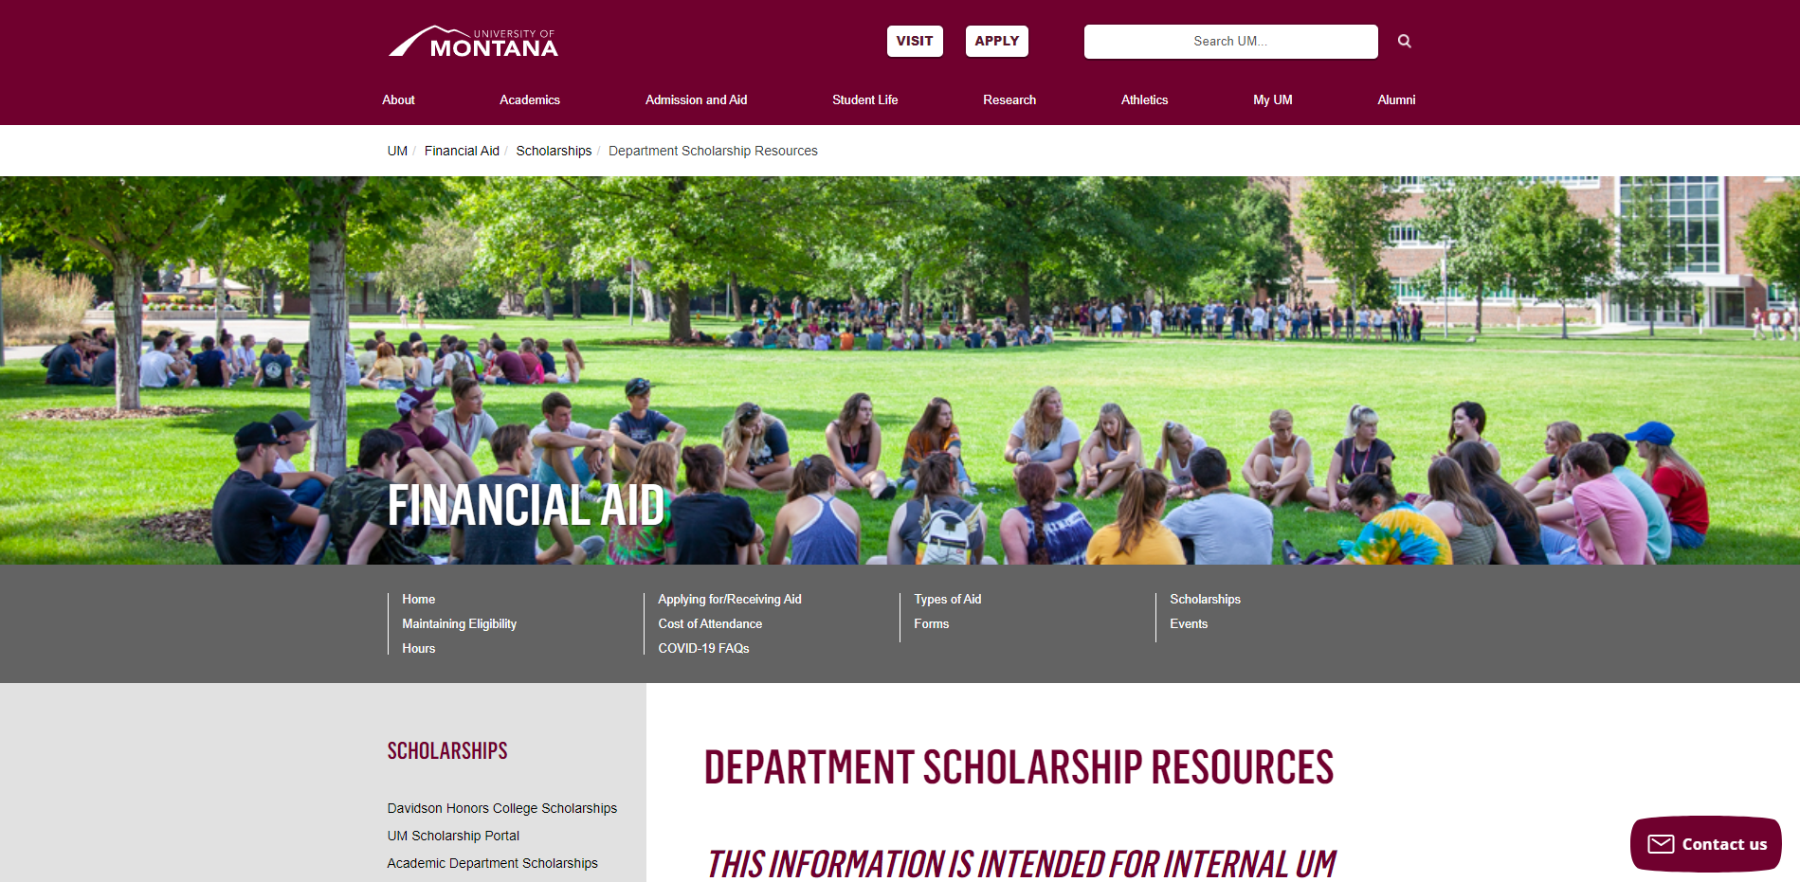
DEPARTMENT SCHOLARSHIP RESOURCE PAGE
Who is this for?
YOU! As a scholarship administrator/contact, these resources are for you, to use throughout the year as you go through your scholarship process.
What can I find there?
Award Summary Sheet and Correction
UM Portal Handouts/Instructions
Past Presentation Materials
Thank You letter information
FAO, UMF and Business Service Contact Information
How do I access this webpage?
Please SAVE/Bookmark this link https://www.umt.edu/finaid/scholarships/department-use-resources.php. This link is “hidden” to reduce access from students.

Slide 23
*Foundation:​​​ | Financial Aid:​​​
Korla McAlpine​​​​ Scholarship Administrator​​​​ (406) 243-4260​​​​ Korla.mcalpine@supportum.org​​​​ | ​Maggie Lawton Scholarship Coordinator (406) 243-5510 ​
Sarah Wade​​​​ Manager of Fund Administration​​​​ (406) 243-5592​​​​ Sarah.wade@supportum.org ​​​​ | Christina Peltier​​​​​ Financial Aid Evaluator​​​​ II- Scholarship Manager​ (406) 243-4810​​​​​ ​
Nancy Randazzo​​​​ Director of Fund Administration​​​​ (406) 243-4739​​​​ Nancy.randazzo@supportum.org ​​​​ | ​
Emily Shankle​​​​ Donor Stewardship Manager (406) 243-2506​​​​ Emily.shankle@supportum.org​​​​
UM Foundation Email:​​​​ UMFAwardsummarysheets@supportum.org​​​​ | Financial Aid Office Email:​​​​​ fascholarships@mso.umt.edu ​​​​​
Office Location: Gilkey Building, 2nd Floor | Office Location: The Financial Aid Office is now located on the 5th floor of Aber Hall
Business Services Contact: ​​​​ Barb Bybee​​​​ 406-243-6261​ Barb.bybee@mso.umt.edu​​​​
*The Foundation Scholarship Team will be on campus Mondays and Tuesdays. Remote working, Wednesday – Friday.

Slide 24
Thank You for Joining Us!
Please mark your calendars for our next forum on Friday, April 8th at 1pm. Calendar invite to follow!

