Slide 1
May Scholarship Forum
With the Financial Aid Office, UM Foundation and Business Services
May 13, 2022

Slide 2
Survey update and Raffle
Thank you to everyone who participated in our Scholarship Administrator survey! Our team will be reviewing the responses and working towards next steps in the upcoming months.
Our raffle winner is…
Melissa Reimann!

Slide 3
Who does That??
Which office processes scholarships (i.e., Award Summary Sheets, Correction Award Summary Sheet, oversees awards made in the Portal)?
Which office or entity on campus owns and manages functionality in the Scholarship Portal?
Which office distributes and oversees the scholarship budgets and scholarship criteria?
Which office updates the Scholarship Portal budget?
Which office collects student thank you letters?
Let’s find out!

Slide 4
Who does That?
Which office processes scholarships (i.e., Award Summary Sheets, Correction Award Summary Sheet, oversees awards made in the Portal)
UM Business Services
UM Financial Aid Office
UM Foundation
Monte
I am not sure

Slide 5
Who does That?
Which office or entity on campus owns and oversees the functionality in the Scholarship Portal?
UM Foundation
UM Business Services
Unit/Department
UM Financial Aid Office
Administration & Finance

Slide 6
Who processes Award Summary Sheets & oversees the UM Scholarship Portal?
The Financial Aid Office processes award summary sheets and oversees the UM Scholarship Portal.
To submit award summary sheets or correction sheets for processing:
Please send to the following email address:​ | Award Summary Sheet​ | Correction Award Summary Sheet​
 | fascholarships@mso.umt.edu​ | fascholarships@mso.umt.edu​
 | umfawardsummarysheets@supportum.org​ | umfawardsummarysheets@supportum.org​
 | ​ | Barb.bybee@mso.umt.edu​
For any questions regarding the overall UM Scholarship Portal system, please email fascholarships@mso.umt.edu

Slide 7
Who does That?
Which office distributes and oversees the scholarship budgets and scholarship criteria?
UM Business Services
UM Financial Aid Office
UM Foundation
Monte
I am not sure

Slide 8
Where To find Foundation scholarship criteria and budgets
 | Scholarship Criteria | Scholarship Budget
UM BOX | X | X
Scholarship Portal | X | X
What Information Is included?
UMF Fund Number | X | X
Index Code | X | X
Name of Scholarship | X | X
Current vs. Endowed |  | X
Fund Creation Date | X
Unit and Department Designation | X | X
Distribution of Annual Scholarship Criteria and Budgets
The Foundation distributes the mass scholarship criteria for units/departments once a year, starting in December – March for the upcoming award year.
If you need assistance or have questions, please contact, Korla and Sarah.

Slide 9
Who does That?
Which office updates the Scholarship Portal budget?
UM Business Services
UM Financial Aid Office
UM Foundation
Monte
I am not sure

Slide 10
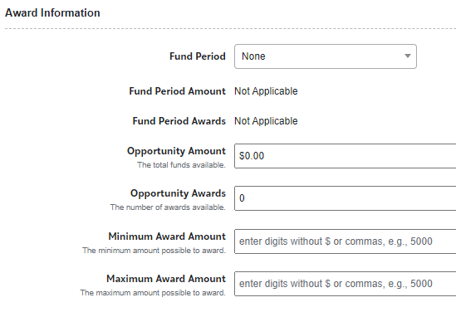
Updating Budgets in the Portal
The Foundation updates budgets in the Portal AFTER:
The Foundation has received and processed the gift, and
Updates are made in BOX
The Award Information section in each opportunity should only be updated by members of the Foundation scholarship team.
Please contact Sarah for assistance.

Slide 11
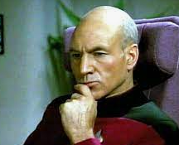
Who does That?
Which office collects students thank you letters, print (if needed) and mails?
UM Foundation
UM Business Services
Unit/Department
UM Financial Aid Office
Administration & Finance

Slide 12
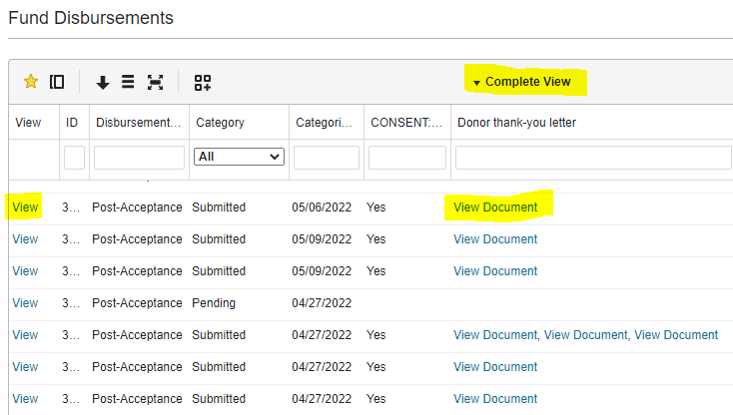
How to: view student thank you letters on the Portal
Two Options to view student thank you letters on the Scholarship Portal:
First Option > If you want to review all thank you letters for your unit/department:
Opportunity > Portfolios > Fund Disbursements > Complete View or Select Custom View
You can move columns around and save the information
you want to see first by creating a custom view.
​Click on “View” under View column, OR
“View Document” under Donor thank-you letter column.
> Using “View” will show you the recipients' responses and
link to the thank you letter.
> Using “View Document” will upload the document.

Slide 13
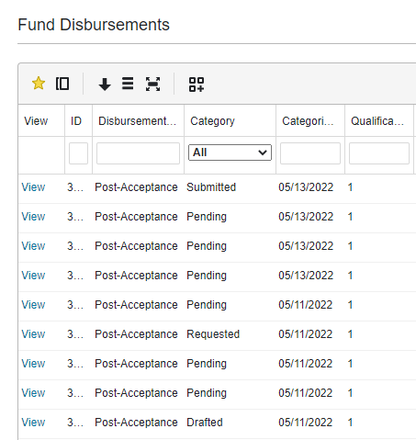
How to: view student thank you letters on the Portal
Fund Disbursements > Category Status:
Pending = Award offer has been extended to the applicant, but they have not “accepted” or “declined” the offer.
Requested = Award offer has been “accepted”, but the applicant has not yet completed their “Post-Acceptance”.
*Drafted = Applicant started to respond to the “Post-Acceptance” but has not yet completed it.
*Submitted = Post-Acceptance is complete.
*Awarded = Financial Aid has reviewed the award.
*This does not hold up the award from being transmitted to the student’s financial profile (Banner).

Slide 14
How to: view student thank you letters on the Portal
Second Option > If you want to view thank you letters for a specific scholarship:
Opportunity à Portfolios à All à Click on Award

Slide 15
Bonus Question
After you make an award on the Portal, what do you do when you need to relinquish or decline the award?
A) Panic
B) Administrator updates recipient to “decline” in Portal.
C) Administrator updates recipient to “decline” in Portal and calls Financial Aid.
D) Administrator updates recipient to “decline” and sends Correction Award Summary Sheet to ensure award is removed from Banner.

Slide 16
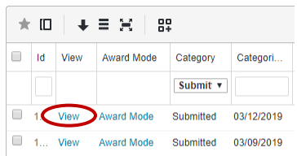
Declining/Canceling A Scholarship Award In the Portal
See online handout for more in-depth graphics and info > How to Cancel or Decline Awards in the Scholarship Portal
Steps:
Locate the applicant by opportunity
Opportunity à Portfolios à All à Click on Applications
Click on “View”
3. Click on “Submitted”

Slide 17
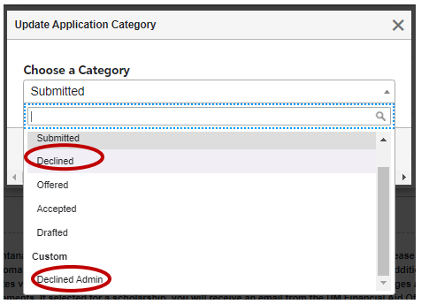
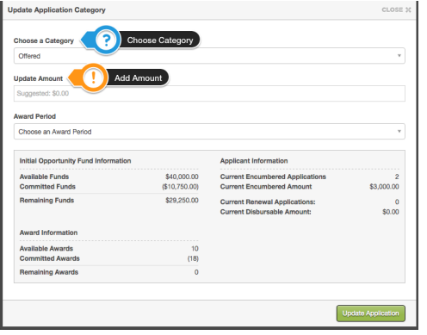
Declining/Canceling A Scholarship Award In the Portal
See online handout for more in-depth graphics and info > How to Cancel or Decline Awards in the Scholarship Portal
Continued Steps:
4. Update Category to “Declined” or
“Declined Admin”
> Update Application Category
box will appear, click
“Update Application”.
Please note, the system will take a few minutes to process and update.
Last STEP: Submit a Correction Award Summary Sheet

Slide 18
Financial aid office updates and reminders
2022-2023
Summer 2022 AWSS Processing and Deadlines
Processing will take 10 business days.
May 18^{th -} Summer AWSS are due for processing, to ensure credits are applied to student accounts prior to the start of Summer semester on May 23rd. ( We can still process Summer AWSS after this date).
2022-2023 AWSS Processing and Deadlines
Processing will take 10 business days.
July 1 – AWSS are due for processing, to ensure credits are applied to student accounts prior to the start of Fall semester.
Help Us With Processing
Please identify the Academic Year or Summer 2022 in the e-mail “Subject Line” with unit/dept name.
Send AWSS emails for 2022-2023 AY or Summer 2022 separately.

Slide 19
UM foundation updates and reminders
2022-2023
Help Us!
Please let us know if you have any staffing changes that affect scholarship administration in your unit/department/program. This will help our team with maintaining our scholarship contact list so we can introduce ourselves, get them access to BOX folders and other scholarship information.
Summer Awarding
Information and Instructions – see March 2022 Forum presentation
Requests can be sent to umfawardsummarysheets@supportum.org
Please allow 1-2 business days for review
Reminders
Summer awards cannot be made on the Portal
Check your 2022-2023 Box budgets to confirm the budget and criteria
Departments are solely responsible for any over awards made
Scholarship Donor Contact Lists
Currently, UMF is processing scholarship donor contact lists for units who have already requested them. Please contact Emily Shankle (emily.shankle@supportum.org) if you would like to learn more about these lists.
Please allow 10 business days for processing these requests
Scholarship Budgets That Depend on 2021-2022 Budget Allocations
Reconcile and contact Korla McAlpine (korla.mcalpine@supportum.org)
Scholarship Portal
Please be sure the recipients are meeting the scholarship criteria.

Slide 20
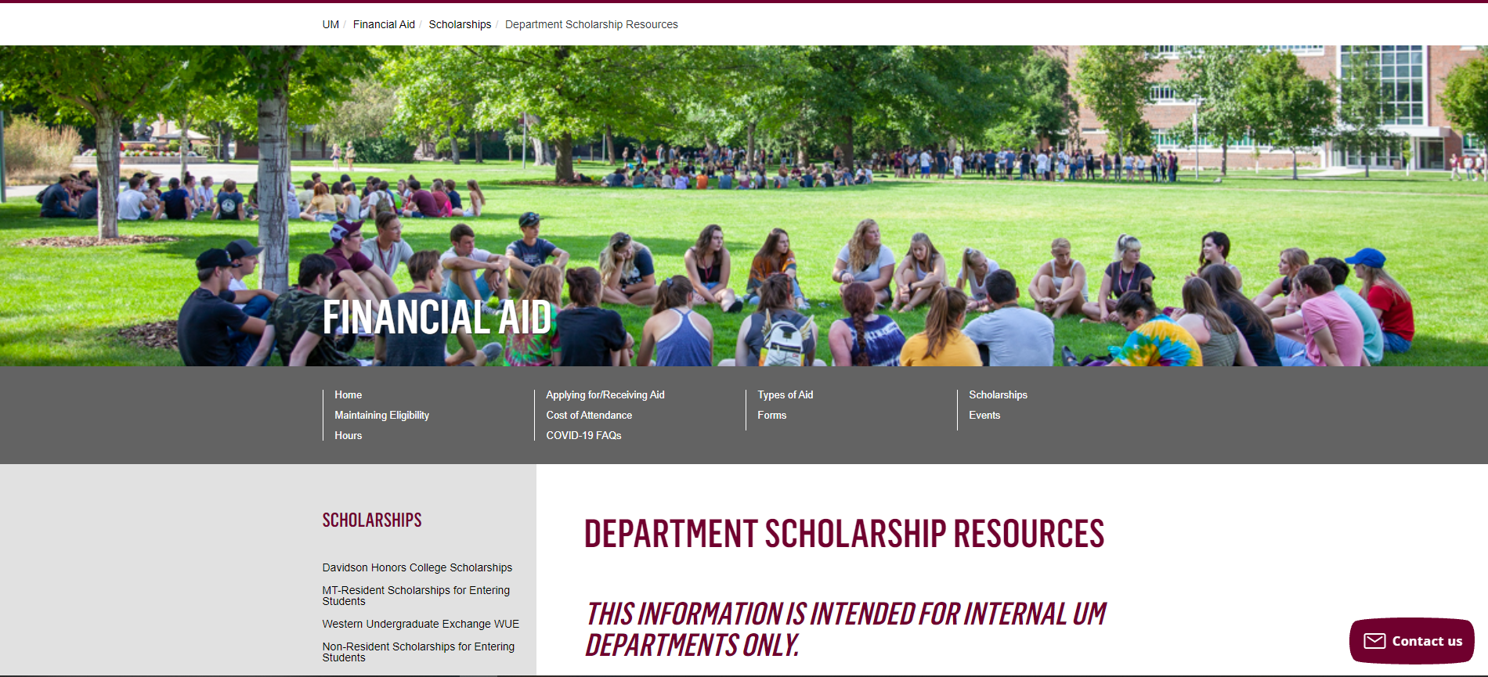
Department Scholarship Resource Webpage
Who is this for? ​
YOU! As a scholarship administrator/contact, these resources are for you, to use throughout the year as you go through your scholarship process.​
​
What can I find there? ​
Award Summary Sheet and Correction​
UM Portal Handouts/Instructions ​
Past Presentation Materials ​
Thank You letter information ​
FAO, UMF and Business Service Contact Information ​
​
How do I access this webpage?​
Please SAVE/Bookmark this link https://www.umt.edu/finaid/scholarships/department-use-resources.php. This link is “hidden” to reduce access from students.​

Slide 21
Questions?

Slide 22
Looks LIKE SOUNDS Like
Financial Aid Contacts | UM Foundation Contacts
Christina Peltier Financial Aid Evaluator II – Scholarship Manager (406) 243 - 4810 | Korla McAlpine Scholarship Administrator Korla.mcalpine@supportum.org (406) 243 - 4260
Department Scholarship Resources Webpage: https://www.umt.edu/finaid/scholarships/department-use-resources.php | Sarah Wade Manager of Fund Administration Sarah.wade@supportum.org (406) 243 - 5592
 | Nancy Randazzo Director of Gift and Fund Administration Nancy.Randazzo@supportum.org (406) 243 – 4739
 | Emily Shankle Donor Stewardship Manager Emily.shankle@supportum.org (406) 243 – 2506 Emily.shankle@supportum.org
Location: Aber Hall, 5th floor | Location: Gilkey Building, 2nd Floor . Our team is in office Monday-Tuesday, Working remotely Wednesday-Friday.
Financial Aid Office Email: fascholarships@mso.umt.edu (for scholarship department questions) | UM Foundation Email: umfawardsummarysheets@supportum.org (for scholarship department questions)
Business Services Contact
Barb Bybee (406) 243- 6261 Barb.bybee@mso.umt.edu

Slide 23
Thank you for joining us!
No June or July Scholarship Forums
We will be sending monthly communications
Mark your calendars for our August Scholarship Forum on August 5th at 11am
Have a wonderful summer!

