Slide 1



November Scholarship Forum
With the UM Foundation, Financial Aid and Barb Bybee (Business Services)

Slide 2

UM Foundation Information
2020-2021
Tracking/Reconciling
Use the Portal (if used to make awards), Scholarship Budget Tracking columns, UMDW and/or Banner to help track/reconcile scholarship funds.
Be sure ALL scholarships have disbursed!
  You may need to re-award! Now is a great time to do so!
Thank You Letters – Contact Emily Shankle
If you have student letters, please send to Emily Shankle, at thankyou@supportum.org.
  Please include full scholarship name or UMF Fund Number with copies. You can find the UMF Fund Number in BOX on the Scholarship Budget (excel) or Criteria (PDF).
UM Foundation Reports & Thank You Letters
We are gearing up to send out donor reports and Thank You Letters. Only if scholarships have disbursed will the student information show up.
~ Let’s show our donors the impact of their gifts!! ~
2021-2022
Scholarship Budgets and Criteria
Information will be sent beginning in January 2021
Korla/Sarah will reach out to those departments who have a preliminary scholarship budget meeting soon!
We will be using BOX and email to send information.
Please make sure your BOX communications are turned on.
UM Scholarship Portal
Have you thought about using the Portal to do any of the following?
  Collecting Applicants
  Reviewing Applicants
  Making Scholarship Awards
  Collecting Thank You Letters
  Now is the time to have your scholarship funds set up on the Portal.
Help US!
  Do you have new members to your scholarship team? Or new staff? Please send us the department name, staff name and email address ASAP!

Slide 3
Financial Aid Information
2020-2021
UM Scholarship Portal CLOSED for 2020-2021
Please do not make any awards for this award year on the Portal. Awards must be made using an Award Summary Sheet.
FALL ONLY Scholarship Deadline – November 13th
Last day to submit FALL only award summary Sheets, BOTH awarding and corrections sheets need be sent to the Financial Aid Office and UM Foundation.
Reminders:
Please send all Award Summary Sheets to fascholarships@mso.umt.edu and UMFawardsummarysheets@supportum.org. CC Barb Bybee to CORRECTION Award Summary sheets, barb.bybee@mso.umt.edu.
Do NOT send emails to faid@mso.umt.edu. Deviating from the proper email address may result in delayed processing.
2021-2022
New UM Scholarship Portal Cycle – Now Available!
Get Your Scholarships Ready!
  Review ALL scholarships
    New Scholarships
    Updated Scholarship criteria/description
    Auto-Match vs. Apply-To
  Review Description of scholarship – DO NOT Change/Edit – Only UMF can do so.
    Review qualification groups in the Qualification tab
    Add Start and End Dates
    Review Groups – Who should be included? Gather information on your committee(s).
    Please apply to Conditional Applications maintenance.
  Reminders:
  The Portal is used for awarding Full Year or Fall Only scholarships. No Spring ONLY awards.
  Some scholarships or funds may not be able to be awarded using the Portal.
  Scholarship Budgets will be updated on the Portal for each fund around January - March. DO NOT Change/Edit. Only UMF can do so.
UM Scholarship Departmental Resource Page
Please save/bookmark this link as a Favorite
https://www.umt.edu/finaid/scholarships/department-use-resources.php

Slide 4
Survey Questions

Slide 5
Question #1: Why we cannot have activity codes attached to student scholarships in UMDW?
Barb’s Answer: An Activity Code is solely used by the department to help administrators keep track of the expenses that needs the additional tag. Financial Aid and the Foundation do not use activity codes, it is a campus level administrative nuance. If you would like an activity code to be attached to the scholarship expense, you may do a JV to add the activity code through the U-Approve JV process.
When a new scholarship index is requested by the Foundation, I (Barb) create the index. The index is a short-cut for the accounting string – of a fund, organization code, and program code. An activity code is an additional piece of accounting information, but at the time of the request, I have no idea if an activity code is needed or if it should be consistently used on every award. I do not include activity codes for this reason, as it is not flexible.
Once the fund is created and index code assigned the next step in the process is to request a detail code that Financial Aid can use to apply the scholarship. The detail code uses the index and associated fund, org. code, program to post the expense of the award. Since there is no activity code associated with the index, the detail code will not include an activity code either. The index and detail code are hard coded into the Banner system, which is why Financial Aid cannot add an activity code at the time they post the award.

Slide 6
Question #2: Timeline/cut off dates for scholarships/award summary sheets.
FAO’s Answer: Through the scholarship portal, awards usually do not start flowing into our system (Banner) until late April and May. We begin processing Award Summary sheets around mid-May beginning of June for the upcoming year. It takes about 10 business days (2 weeks) to process the Award Summary sheets.
TIPS:
Don’t wait until the last minute to send your Award Summary Sheet.
  Submit early!
  Fall/Spring/Summer disbursement dates are scheduled in advanced and posted online. Use those dates to give yourself and financial aid enough time to process.

Slide 7
Question #3: How to know if you are over-awarding a student? How to fix that? How that fits into the timeline?
FAO’s Answer: Between mid-January and the 2nd week of March​ scholarship admins can send FAO an excel spread sheet with a list of student's names that you and your department is needing to determine if the student has need. After the second week of March FAO will no longer be able to review the excels for unmet need. If you have any questions you can contact Financial Aid at fascholarships@mso.umt.edu.
For over awards, once students aid has begun disbursing, FAO will reach out to departments to let them know if they need to reduce any of the student's aid that they have already received. Please note, the aid that is reduced is loans with minor exceptions to this. If you have any questions, please contact Financial Aid.
For department over awards where the department may have awarded one scholarship/award to two students, please use a CORRECTION Award Summary Sheet to retract one award. Another departmental general scholarship fund may need to be used to cover the other student scholarship, so the student is not penalized for an administrative error. For any new awards, please use the Award Summary Sheet and if possible, attach the CORRECTION and new award summary sheet together for ease of processing.
TIPS:
Review your unit/department scholarship timeline to ensure you can submit your questions and/or request early to the financial aid office.
In the department request, send full student name, UM ID# and how much of a scholarship you are anticipating awarding to each student in an excel.
Track and Reconcile scholarship awards throughout the year. Portal vs. Award Summary Sheet.

Slide 8
Question #4: How can we ensure enough time is given to Financial Aid for processing? How do we ensure accuracy?
FAO’s Answer: The best way to ensure that Award Summary sheets are processed in a timely manner is to make sure they are sent to the correct email addresses as well as within the dates that are given. Our processing timeline currently is 10 business days as our office sits on a rotation, between working at home and working in the physical office. This timeline can also change depending on how many Award Summary Sheet's we have received.
TIPS:
Be sure to include ALL award and student information on Award Summary Sheet.
Make sure ALL information is accurate. Example: UM ID #
Minimum Credits:
  System defaults most scholarships to full-time or 12 or more credits
  Graduate level students can be less than full-time, check credits and record on Award Summary Sheet as needed.
Don’t wait until the last minute to send Award Summary Sheet.
  Submit early!
Track and Reconcile scholarship awards! It takes a village! This note is included on every scholarship budget (excel).
  It is the departments’ SOLE responsibility to track recipient names, award amounts and available budget balances throughout the award cycle. This form can be downloaded to assist you with scholarship award tracking activity throughout the award cycle.

Slide 9
Question #4: What resources are available to graduate students? Where to lead students who need scholarships?
FAO’s Answer: There are many scholarship opportunities for Graduate students in the scholarship portal. Graduate student’s just need to fill out a general application that will then put them into the applicant pools for those opportunities. Graduate students should also work with their departments to see if the department has any Graduate Specific scholarships and how to apply for those.
TIPS:
Students can apply for Federal Student Aid by completing their Free Application for Federal Student Aid (FAFSA).
The Graduate School may know of other resources.
Financial Aid also has a list of scholarship links on their website https://www.umt.edu/finaid/scholarships/academic-department-scholarships/default.php

Slide 10
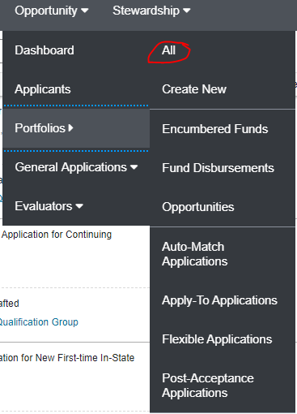
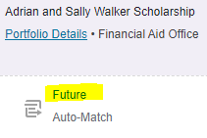
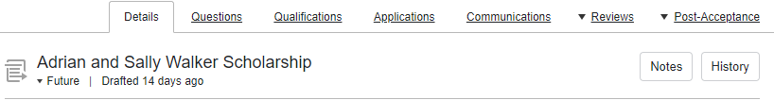
Question #5: How to update opportunities in the Portal?
FAO’s Answer: To access Opportunities go to “Opportunity“ → "Portfolios“ → All. This will show you a list of all the opportunities that you manage. To look at a specific Opportunity you will want to click on "Future" this will then take you into the details part of the scholarship opportunity. From here you can access the Questions tab and Qualifications tab.
TIPS:
Review ALL scholarships
  New Scholarships
  Auto-Match vs. Apply-To
  There is also a handout located on the Department Scholarship Resource webpage for this process as well.

Slide 11

Question #6: How do you change questions or scoring for reviewing?
FAO’s Answer: At this time, we will well not be discussing the reviewing aspects of the scholarship portal as this is something we will touch on in the December's meeting.

Slide 12
Other Questions?

Slide 13

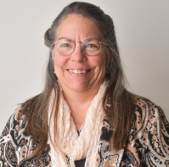
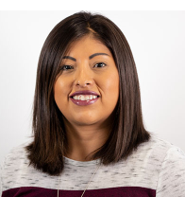
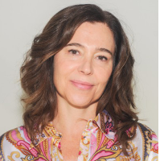
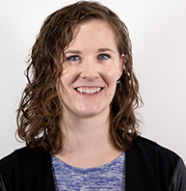

Contact Information
UM Foundation: | Financial Aid:
Korla McAlpine Scholarship Administrator (406) 243-4260 Korla.mcalpine@supportum.org | Shylar Wilson Financial Aid Evaluator (406) 243-5510
Sarah Wade Manager of Fund Administration (406) 243-5592 Sarah.wade@supportum.org | Christina Peltier Financial Aid Evaluator (406) 243-4810
Nancy Randazzo Director of Fund Administration (406) 243-4739 Nancy.randazzo@supportum.org | Ginger Lowry Associate Director of Customer Care (406) 243-6802
Emily Shankle Donor Stewardship Specialist (406) 243-2506 Emily.shankle@supportum.org
UM Foundation Email: UMFAwardsummarysheets@supportum.org | Financial Aid Office Email: fascholarships@mso.umt.edu
Office Location: Gilkey Building, 2nd Floor (Office is closed but if you need to get something to us, please let us know.) | Office Location: Lommasson Building, room 218
Business Services Contact: Barb Bybee (406) 243-2303 Barb.bybee@mso.umt.edu
UM Scholarship Departmental Resource Page
Please save/bookmark this link as a Favorite
https://www.umt.edu/finaid/scholarships/department-use-resources.php

Slide 14
Thank you for joining us!
December Scholarship Forum To Be Announced!

