Slide 1
Leveraging AI for Enhanced Efficiency
Applications in Higher Education

Slide 2
Agenda
Introduction to Generative AI
Opportunities and Applications
Case Study: Admissions
What is Prompt Engineering?
Group Activity
Information Security, Privacy, and Ethics
Guidelines for Leveraging Generative AI
Future Trends
Conclusion
Q&A

Slide 3
Artificial Intelligence, What is it?
AI is defined as “A system that shows behavior that could be interpreted as human intelligence.” - Doug Rose
AI thrives in an environment where there are defined rules and patterns that it can work with. This is where AI will seem the most “Intelligent”.
If you have used any of the following, you have used AI:
T-9 Texting, Google Translate, Hulu, Alexa etc.
Notes:
Artificial Intelligence is defined as “A system that shows behavior that could be interpreted as human intelligence.” and it thrives in an environment where there are defined rules and patterns.
Most of us have been using AI for the majority of our lives, it just wasn’t such a buzzword until GPT3 came out. Remember T-9 Texting? Remember the 90s? That’s AI. Using statistical patterns to predict the word you were trying to type.
Google Translate? Thank Georgetown-IBM in the 50’s. That’s Natural Language Processing, the first iteration of AI!
Hulu? Who do you think curates those “picked for you” categories? It’s not some person cross referencing the shows you watch with others that share similar traits. It’s a machine, its AI.
Now we have to ask ourselves though, are these really intelligent? John Searle had an interesting view on the topic.

Slide 4
Strong AI Vs. Weak AI
Strong AI is AI that acts exactly as a human would, think C-3PO, the Terminator or Commander Data. They exhibit emotions, real creativity, and can even have a sense of purpose.
Weak AI is AI that is confined to a narrow task, like when a system processes language into text or sorts all the pictures on your pc.
Examples of Weak AI include: Siri, Cortana, Bing, Netflix, and even ChatGPT.
Notes:
Let’s look at Siri, Siri listens to your input and then converts your language into something that the computer recognizes. Then, Siri, matches a response to what is in her database and outputs it back to you.
ChatGPT works the same way, as does most Generative AI. So there is no need to fear it, robots and AI taking over the world or brainwashing you are at least 10 years off.

Slide 5
Introduction to Generative AI
Generative AI refers to a type of artificial intelligence that has the ability to generate content that is, in many cases, indistinguishable from content created by humans. This AI can produce text, images, audio, or even video, often in response to a given input or prompt.
Generative AI operates by learning patterns and structures from large datasets and then using that knowledge to produce new content that fits within those learned patterns. It's a type of machine learning where the AI model learns to understand and mimic the characteristics of the data it has been trained on.

Slide 6
Generative AI Limitations
Quality and Coherence : Generative AI can sometimes produce content that is factually incorrect or incoherent.
Lack of Understanding: Generative models don't have true understanding of the text they generate. They generate responses based on statistical patterns rather than comprehension, which means they can't answer questions that require deep understanding or common-sense reasoning.
Biases: Generative AI can inadvertently perpetuate biases present in the training data.
Notes:
Quality and Coherence: Generative AI models like GPT-3 can sometimes produce content that is factually incorrect or incoherent. They generate text based on patterns in training data, and if the data contains errors or inconsistencies, the model may reproduce them.
Lack of Understanding: Generative models don't have true understanding of the text they generate. They generate responses based on statistical patterns rather than comprehension, which means they can't answer questions that require deep understanding or common-sense reasoning.
Biases: Generative AI can inadvertently perpetuate biases present in the training data. This can result in the generation of biased or discriminatory content. Efforts are ongoing to reduce bias, but it remains a challenge.
Safety and Privacy: In some cases, generative AI can generate harmful or inappropriate content. Ensuring the safety and ethical use of AI-generated text is a significant concern, especially in applications like content moderation.
Overgeneration: Generative models can be verbose and tend to over generate content. They may produce longer responses than necessary, which can affect readability and user experience.
Inconsistency: The same prompt given to a generative model may produce different responses at different times. While this can be useful for creativity, it can also result in inconsistent or contradictory answers.
Data Dependency: The quality of the generated text depends on the quality and diversity of the training data. Limited or biased training data can result in poor performance. ChatGPT3.5 for example only has data up to September 2021
8.Prompt Sensitivity: The way a prompt is framed can significantly impact the output. Crafting effective prompts requires skill and experimentation.

Slide 7
Generative AI Limitations
Safety and Privacy: In some cases, generative AI can generate harmful or inappropriate content. Ensuring the safety and ethical use of AI-generated text is a significant concern.
Inconsistency: The same prompt given to a generative model may produce different responses at different times. While this can be useful for creativity, it can also result in inconsistent or contradictory answers.
Overgeneration: Generative models can be verbose and tend to over generate content.
Notes:
Quality and Coherence: Generative AI models like GPT-3 can sometimes produce content that is factually incorrect or incoherent. They generate text based on patterns in training data, and if the data contains errors or inconsistencies, the model may reproduce them.
Lack of Understanding: Generative models don't have true understanding of the text they generate. They generate responses based on statistical patterns rather than comprehension, which means they can't answer questions that require deep understanding or common-sense reasoning.
Biases: Generative AI can inadvertently perpetuate biases present in the training data. This can result in the generation of biased or discriminatory content. Efforts are ongoing to reduce bias, but it remains a challenge.
Safety and Privacy: In some cases, generative AI can generate harmful or inappropriate content. Ensuring the safety and ethical use of AI-generated text is a significant concern, especially in applications like content moderation.
Overgeneration: Generative models can be verbose and tend to over generate content. They may produce longer responses than necessary, which can affect readability and user experience.
Inconsistency: The same prompt given to a generative model may produce different responses at different times. While this can be useful for creativity, it can also result in inconsistent or contradictory answers.
Data Dependency: The quality of the generated text depends on the quality and diversity of the training data. Limited or biased training data can result in poor performance. ChatGPT3.5 for example only has data up to September 2021
8.Prompt Sensitivity: The way a prompt is framed can significantly impact the output. Crafting effective prompts requires skill and experimentation.

Slide 8
Generative AI Limitations
Data Dependency: The quality of the generated text depends on the quality and diversity of the training data. Limited or biased training data can result in poor performance. ChatGPT3.5 for example only has data up to September 2021.
Prompt Sensitivity: The way a prompt is framed can significantly impact the output. Crafting effective prompts requires skill and experimentation.
Notes:
Quality and Coherence: Generative AI models like GPT-3 can sometimes produce content that is factually incorrect or incoherent. They generate text based on patterns in training data, and if the data contains errors or inconsistencies, the model may reproduce them.
Lack of Understanding: Generative models don't have true understanding of the text they generate. They generate responses based on statistical patterns rather than comprehension, which means they can't answer questions that require deep understanding or common-sense reasoning.
Biases: Generative AI can inadvertently perpetuate biases present in the training data. This can result in the generation of biased or discriminatory content. Efforts are ongoing to reduce bias, but it remains a challenge.
Safety and Privacy: In some cases, generative AI can generate harmful or inappropriate content. Ensuring the safety and ethical use of AI-generated text is a significant concern, especially in applications like content moderation.
Overgeneration: Generative models can be verbose and tend to over generate content. They may produce longer responses than necessary, which can affect readability and user experience.
Inconsistency: The same prompt given to a generative model may produce different responses at different times. While this can be useful for creativity, it can also result in inconsistent or contradictory answers.
Data Dependency: The quality of the generated text depends on the quality and diversity of the training data. Limited or biased training data can result in poor performance. ChatGPT3.5 for example only has data up to September 2021
8.Prompt Sensitivity: The way a prompt is framed can significantly impact the output. Crafting effective prompts requires skill and experimentation.

Slide 9
Identifying Opportunities for AI
Nature of the Task: What are you trying to generate?
Complexity of the Task: Does it need to be broken into segments?
Data Availability: How recent/prevalent is the data for what you are trying to do?
Ethical Considerations: Use ethical guidelines to avoid harmful or biased content.
Human Review/Monitoring: Human oversight is needed to ensure no errors or biases are present.
Scalability: Assess if the task can be handled efficiently with available computational resources.

Slide 10
Real-World Applications in Universities (Students)
Study and Homework Assistance:
Generating explanations and solutions for homework problems.
Providing study tips and summaries of course materials.
Offering virtual tutors for a wide range of subjects.
Explaining complex concepts and answering questions.
Creating exercises, quizzes, and pronunciation guides.
Helping students improve their essays, reports, and creative writing.
Personalized Learning Plans:
Analyzing students' performance data to recommend customized study plans.
Suggesting additional reading materials and resources.
Career Guidance:
Providing advice on choosing majors and career paths based on students' interests and skills.
Assisting in resume and cover letter writing.
Research Assistance:
Assisting in gathering preliminary research data and suggesting relevant sources.
Generating citations and bibliographies.
Language Translation:
Translating foreign language texts and documents for international students.
Supporting international exchange programs.
Time Management and Organization:
Creating personalized schedules and reminders for classes and assignments.
Offering productivity tips and techniques.
Notes:
Ask what they think students are using it for

Slide 11
Real-World Applications in Universities (Staff)
Content Generation:
Automating the creation of course materials, lecture notes, and assessments.
Generating content for university publications and marketing materials
Administrative Support:
Assisting in scheduling meetings, managing emails, and handling routine administrative tasks.
Answering frequently asked questions for staff and faculty.
Research Assistance:
Analyzing and summarizing research papers and articles.
Assisting in data analysis and visualization.
Admissions and Enrollment:
Managing inquiries from prospective students.
Automating admissions and enrollment processes.
Emergency Response and Communications:
Providing automated alerts and communication during campus emergencies.
Offering guidance on emergency protocols and procedures.
Student Support Services:
Providing automated responses to student inquiries related to registration, financial aid, and campus resources.
Offering career counseling and internship recommendations
Website and Social Media Management:
Generating content for university websites, blogs, and social media platforms.
Monitoring and responding to online engagement.
Grading and Assessment:
Assisting in grading assignments and exams.
Analyzing student performance data to identify areas for improvement.
Library and Information Services:
Assisting in information retrieval and research assistance for both faculty and students.
Automating library cataloging and resource recommendations.
Notes:
Ask what they currently use it for and/or what they think it can be used for

Slide 12
Case Study #1: Admissions
Elite University, a renowned higher education institution, has a highly competitive college admissions department that receives thousands of applications each year. To improve their efficiency and provide a better experience for applicants, Elite University decided to implement generative AI solutions. This case study details how the college admissions department leveraged generative AI to enhance their performance.

Slide 13
Challenges:
Application Processing: Reviewing and processing a large volume of applications was a time-consuming and labor-intensive task, often leading to bottlenecks and delays.
Essay Assessment: Assessing essays and personal statements for admissions required significant manual effort. It was difficult to ensure consistency and fairness in evaluations.
Applicant Support: Applicants often had questions about the application process, requirements, and deadlines. Providing timely and accurate responses to these inquiries was a challenge.

Slide 14
Solution:
Automated Application Screening:
  Integrated AI algorithms to automatically screen and categorize applications based on predefined criteria. This allowed the admissions team to prioritize applications that met minimum requirements.
  The generative AI system learned from historical admissions data to continuously refine its screening criteria.
AI-Enhanced Essay Assessment:
  Employed generative AI to assist in the assessment of essays and personal statements. The system provided initial evaluations, highlighting key strengths and areas for improvement.
  Admissions officers could use the AI-generated assessments as a starting point, saving time while ensuring a standardized review process.
AI-Powered Applicant Support:
  Implemented AI-powered chatbots on the university's admissions website and application portal. These chatbots answered applicant inquiries regarding deadlines, requirements, and procedures.
  Chatbots were trained using frequently asked questions and were designed to provide accurate and up-to-date information.
Notes:
What are some ways that we initially see that generative AI could help cut down on workload or time spent on tasks?
A:
PM: write emails, summarize transcripts, average planning times to get a more accurate representation of the life of the project
BA: write and edit user stories, generate reports/presentations or demos
Dev: write boilerplate code or generate an outline, explain a difficult concept or find an error, can go line-by-line to walk through a code snippet
QA: write unit tests, upgrade old unit tests, etc.

Slide 15
Results:
Faster Application Processing:
  Automated application screening reduced the time required to process applications, ensuring that qualified applicants progressed to the next stages more quickly.
Improved Essay Assessment:
  AI-assisted essay assessments provided consistent evaluations, reducing bias and ensuring fairness in the admissions process.
  Admissions officers had more time to focus on nuanced evaluations of applicant essays.
Enhanced Applicant Experience:
  AI-powered chatbots provided quick and accurate responses to applicant inquiries, improving the overall applicant experience.
Increased Efficiency:
  Admissions staff experienced increased efficiency as routine tasks were automated, allowing them to allocate more time to strategic decision-making.
Data-Driven Insights:
  The generative AI system collected and analyzed data on applicant behavior, providing valuable insights into the admissions process and applicant preferences.

Slide 16
What is Prompt Engineering?
Prompt engineering is the process of designing and crafting input prompts or queries to generative AI models to elicit desired outputs or responses. The choice of words, format, and context in the prompt can significantly influence the generated content.
How to structure prompts for desired outputs:
Be Clear and Specific
Specify the Format
Add Context
Use Examples
Control the Tone
Ask the Model to Think Step by Step
Use Keywords
Provide Constraints
Experiment
Iterate and Refine
Notes:
Be Clear and Specific:
Clearly state your request or question in the prompt. Avoid ambiguity to ensure the model understands your intent.
Specify the Format:
If you want a specific format for the response (e.g., a summary, list, or paragraph), mention it explicitly in the prompt.
Add Context:
Provide relevant context or background information to help the model understand the topic or task better.
Use Examples:
Include examples or precede the main request with illustrative sentences to guide the model's understanding.
Control the Tone:
Specify the tone or style you want for the response, whether it's formal, casual, persuasive, or informative.
Experiment:
Don't hesitate to experiment with different phrasings, structures, or prompt variations to find the most effective way to get the desired output.
Ask the Model to Think Step by Step:
For complex tasks, instruct the model to think step by step or provide reasoning for its answers. This can lead to more detailed and informative responses.
Use Keywords:
Include keywords related to the topic or task to guide the model's attention and focus.
Provide Constraints:
Set constraints or limitations if necessary. For instance, you can specify word limits, request the model not to include certain types of content, or ask for a specific viewpoint.
Iterate and Refine:
After generating a response, review it and, if needed, adjust the prompt or request clarification to get the desired outcome.

Slide 17
Prompt Engineering Examples
Task: Summarize a Report
  Ineffective Prompt: "Summarize this report."
  Effective Prompt: "Provide a concise summary of the key findings and overarching messages of the GLBA Audit Findings: [paste report here]. "
Task: Creative Writing
  Ineffective Prompt: "Write a story."
  Effective Prompt: "Create an engaging short story about a time traveler who finds themselves in a parallel universe where gravity behaves differently."
Task: Language Translation
  Ineffective Prompt: "Translate this sentence."
  Effective Prompt: "Translate the following English sentence into French: 'The quick brown fox jumps over the lazy dog.'"

Slide 18
Group Activity
We are going to test chatGPT’s effectiveness on some real-world scenarios.
Warm up: Consider what aspects of your work could be enhanced or made easier by using Generative AI.
Questions to ask yourself:
  what tasks are repetitive in my job?
  what kind of writing do you do that could be done by AI?
  what projects could you use help organizing or starting?
Notes:
Write a detailed email to the students about class registration and drop dates
Write a newsletter to students about essential student services here at the University that they may not be aware of
Write an advertisement for the University of Montana
Write an outline for a syllabus for [class]
Write policy surrounding responsible use of ChatGPT for a university
Write a rubric for grading college level Admissions essays
I do this one: Code a to-do list program in python, ask it to explain what it is doing line by line
Run it in the IDE
Tell them to all ask chatGPT to summarize their favorite movie
Ask them to have it summarize its summary

Slide 19
Group Activity
Now that we have thought of a few things that we can use generative AI for in our jobs, let’s practice! Try to get ChatGPT to perform some of the tasks you have thought of.
Some examples if you need somewhere to get started:
Write a newsletter to students about essential student services here at the University
Write a social media post about the University of Montana
Write a project plan/outline
Draft an email you normally have trouble starting
Notes:
Write a detailed email to the students about class registration and drop dates
Write a newsletter to students about essential student services here at the University that they may not be aware of
Write an advertisement for the University of Montana
Write an outline for a syllabus for [class]
Write policy surrounding responsible use of ChatGPT for a university
Write a rubric for grading college level Admissions essays

Slide 20
Information Security, Privacy, and Ethics
Do tools and platforms like ChatGPT present an inherent security risk?
  From their TOS: “Use of Content to Improve Services: We do not use Content that you provide to or receive from our API (“API Content”) to develop or improve our Services. We may use Content from Services other than our API (“Non-API Content”) to help develop and improve our Services.”
  OpenAI Recommends using fake names or pseudonyms when interacting with ChatGPT, and to avoid public wi-fi, instead using secured private networks.
Not all platforms follow the same or even similar guidelines
  “Copilot seamlessly integrates into Microsoft 365, inheriting your organization's security, compliance, and privacy policies, It utilizes advanced encryption, access control, and permissions to prevent data leakage and maintain compliance with security and privacy policies. Microsoft Copilot places a high emphasis on data security and privacy within Microsoft 365.” - Microsoft

Slide 21
University policies on data privacy
The University is bound to HIPAA and FERPA guidelines. There is a large crossover between FERPA and HIPAA and what data is considered to fall under which category depends heavily on what department you are employed under and what the relationship that department has to the University.
The easy answer is, if you think it might be HIPAA, or FERPA don’t use it!
Notes:
So! Just because we technically CAN use some student information, does that mean we should? Are we all aware of each and every student who has opted out of the University being able to use this information?

Slide 22
Ethical Concerns
Bias and Fairness: AI systems can inherit biases from the data they are trained on, potentially leading to discrimination in areas like admissions, hiring, or grading.
Privacy: AI may process and store sensitive student or faculty data, raising concerns about data security and privacy violations.
Transparency: The opacity of some AI algorithms makes it difficult to understand how decisions are reached. This lack of transparency can raise ethical questions about accountability and trust.

Slide 23
Ethical Concerns
Accountability: It can be challenging to assign responsibility when AI is used in decision-making processes. Determining who is accountable for AI-related outcomes or errors is an important ethical consideration.
Data Quality: Garbage in, garbage out: If AI systems are fed with poor-quality or biased data, the ethical integrity of the resulting decisions is compromised.
Consent: Collecting and using personal data for AI applications should involve informed consent. Universities must be transparent about data usage and give individuals the option to opt in or out.

Slide 24
Guidelines for Leveraging Generative AI
Understand the Technology
  Ensure that you and your team have a deep understanding of how generative AI works, its capabilities, and its limitations. This understanding is crucial for responsible use.
Data Ethics
  Use high-quality and diverse training data that is free from bias and sensitive information. Be aware of the potential biases in your training data and take steps to mitigate them.
Human Oversight
  Maintain human oversight and control over AI systems. Fact-check your data and avoid plagiarism.

Slide 25
Guidelines for Leveraging Generative AI
Accountability:
  Clearly define roles and responsibilities for AI development and deployment. Ensure accountability for the outcomes of AI systems, both positive and negative.
Education and Training:
  Provide training and guidelines to staff or users interacting with AI systems to promote responsible usage and ethical considerations.
Continual Monitoring and Evaluation:
  Continuously monitor the performance and impact of AI systems after deployment. Be prepared to make adjustments or take corrective actions as needed.

Slide 26
Tools, Platforms, and Software
ChatGPT – chatbot, text generator
Midjourney/Dall-E2 –text to art
Wisdolia – plugin, generate flash cards for any website, video, or PDF you are on.
RunwayML – Extreme video/picture editing.
Microsoft 365 copilot – brings AI across the entire Microsoft office suite
Eleven Labs – voice recognition. You speak to it, then you can feed it scripts and it will read them in your voice and cadence.
Synthesia – create a realistic avatar that can speak any script it is given.
Mixo/Sitekick – type a product idea and it creates a full website.
Tome – makes presentations from simple prompts.
Tableau’s Ask Data – ask questions, receive data visualizations as responses.
Notes:
Microsoft Copilot can generate first drafts in word, rewrite things or offer tips, it can generate entire powerpoint presentations off of simple prompts, it can analyze trends in excel, clear your inbox in outlook. Automate repetitive tasks etc.

Slide 27
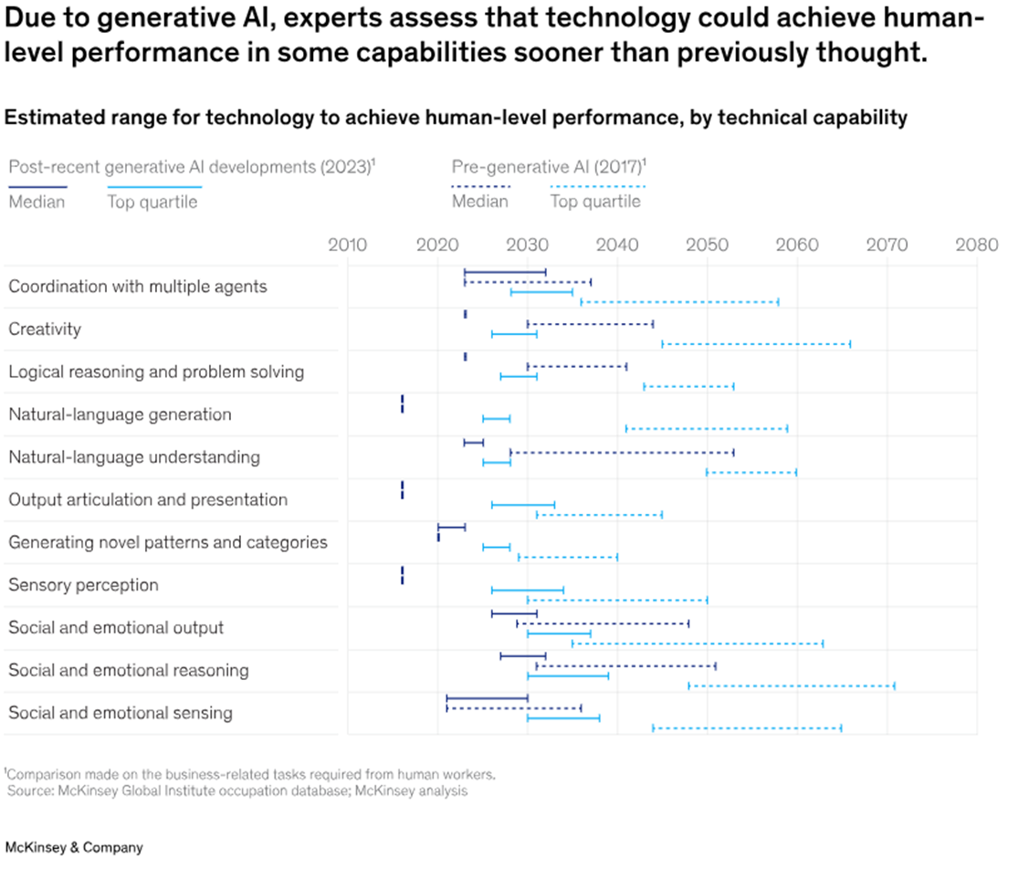
Future Trends
For most of the technical capabilities shown in this chart, gen AI will perform at a median level of human performance by the end of this decade. And its performance will compete with the top 25 percent of people completing any and all of these tasks before 2040. In some cases, that’s 40 years faster than experts previously thought.

Slide 28
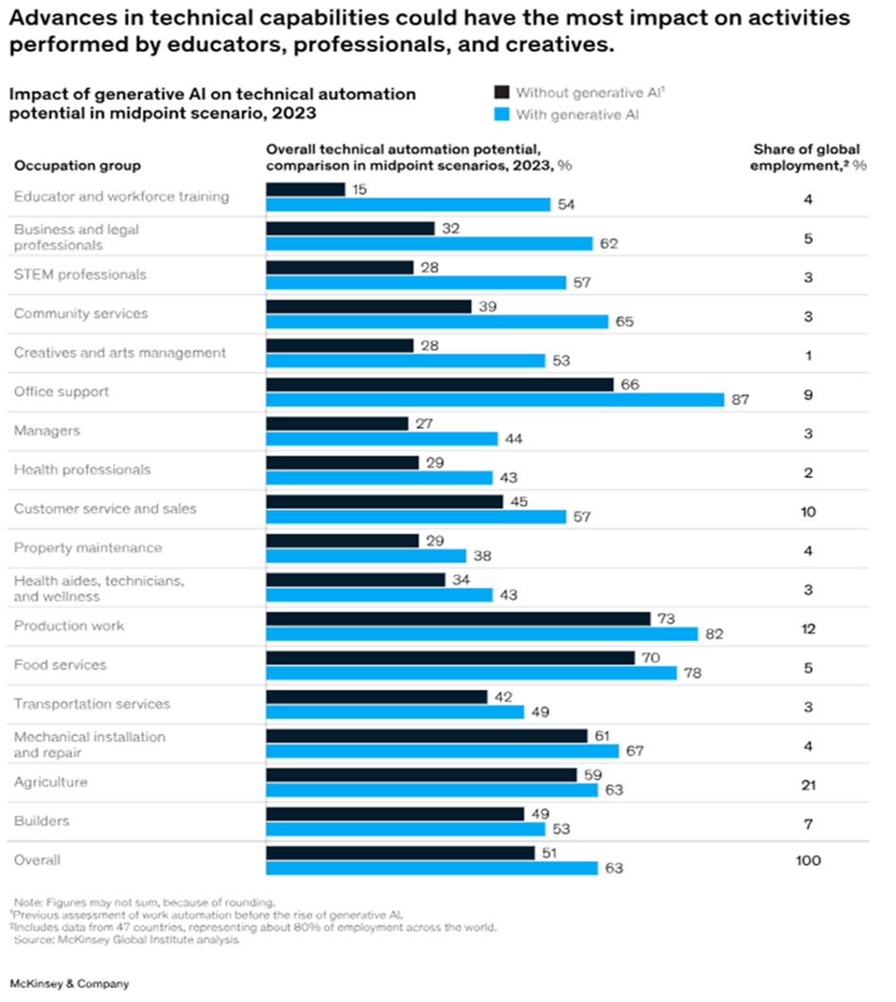
Future Trends
Previous waves of automation technology mostly affected physical work activities, but gen AI is likely to have the biggest impact on knowledge work—especially activities involving decision making and collaboration. Professionals in fields such as education, law, technology, and the arts are likely to see parts of their jobs automated sooner than previously expected. This is because of generative AI’s ability to predict patterns in natural language and use it dynamically.

Slide 29
Conclusion
AI is not going away, and learning how to use it appropriately is important. It is not coming for your job, but can make you much more productive.
Being mindful of how we use this new technology, and how we can shape our jobs with it will determine the future of its efficacy.
Through intentional exploration we can innovate in ways we have not dreamed of.
Common sense will prevail in most situations.

Slide 30
Q&A
Does anyone have any questions about what we have covered today?

Slide 31
Thank You!
I appreciate all of you taking the time to come learn with me today ☺
Please feel free to reach out to me with any other questions you may have, and stay tuned to OOLD for future Generative AI workshops!
Tanner Dodd, Sr. Auditor, Internal Audit Dept.
Tanner.Dodd@umt.edu
(406) 243-2553

