Slide 1
Understand and Manage Risks by Using Internal Controls
Presented by Jolene Crist and Ben Froemming

Slide 2

Intro/Background
Anta Coulibaly - Director of Internal Audit and Enterprise Risk
Jolene Crist - Internal Audit Manager
Ben Froemming - Senior Internal Auditor
Ben Eckert - Internal Audit Intern

Slide 3
UM’s Internal Audit Function
Personnel - Reporting
Board of Regents
OCHE
President
Anta Coulibaly
Director of Internal Audit and Enterprise Risk
Jolene Crist
Internal Audit Manager
(vacant)
Enterprise Risk Analyst
Ben Froemming
Senior Auditor
Ben Eckert
Intern
Notes:
Ben
First off you can see that we’re a pretty small department.
The primary thing to note here is that Internal Audit is able to maintain its independence by reporting directly to the Board of Regents, and only functionally to the President.

Slide 4

How are Internal Auditors different from External Auditors?
Internal Auditors
External Auditors
Review of financial reporting, operations, processes, internal control systems, risk management, and fraud assessment
IA’s focus is on continuous improvement
Review of financial statements or other compliance matters
EA’s focus is on fair reporting of financials or other compliance matters
Notes:
Jolene
Internal Auditors are typically employed by the entity they audit.
External Auditors are hired to complete audits/reviews.

Slide 5

UM’s Internal Audit Function
Committed to improving the University by maintaining a balance between:
  Scheduled audits
  External audit liaison
  Special projects
  Investigations
  Training services
  Our services focus on compliance, departmental performance, information technology, and financial related controls that help ensure the excellence and integrity of the University's operations.
Notes:
Ben
Special Projects are typically consulting engagements

Slide 6
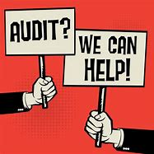
UM’s Internal Audit Function
The Internal Audit role is to examine the adequacy and effectiveness of University internal controls and make recommendations where control improvements are needed.
Internal Audit must remain independent and objective.
  We cannot have the primary responsibility for establishing or maintaining internal controls.
The effectiveness of the internal controls are enhanced through the reviews performed and recommendations made by Internal Audit.
Notes:
Jolene
1. Our role is to review UM’s internal controls and make recommendations where improvements may be needed.
2. We must remain independent and objective, therefore we cannot have the responsibility to create and maintain internal controls.
3. We can help enhance the effectiveness of internal controls through reviews and recommendation.

Slide 7

What do you think internal controls are?
Notes:
Ben
We would like to take a couple minutes to have a brief discussion to gauge where everyone is at and hopefully get some more audience engagement before getting into the lecture-y bits.
When you hear “Internal Control” what comes to mind?

Slide 8
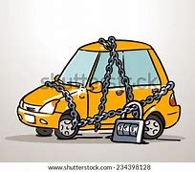

What are Internal Controls?
Everyday Examples:
Locking your home and vehicle
Keeping your ATM/debit card pin number separate from your card
Reconciling your checking account monthly
Setting up instant alerts for your debit/credit cards
Following a recipe to bake a cake
Notes:
Jolene
We all use internal controls in our everyday lives. (Read examples)
We do these things to help reduce the risk from occurring.
Locking our cars/homes: we are reducing the risk of theft
ATM: reducing the risk of unauthorized use
Reconciling: reducing the risk of overdrawing your account
Recipe: by following the step by step instructions, reducing the risk of flat cake/burnt cake…

Slide 9
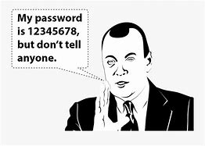
What are Internal Controls?
University Examples:
Computer passwords are changed periodically and are not written down and left by the computer
Authorizations required for certain activities (Travel authorizations)
Documented policies
Verifying charges on Procard statements against source documents (receipts, invoices, etc.)
Separation of duties
Notes:
Jolene

Slide 10
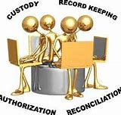
Common Internal Control Principles
Establish responsibility
  Assign each task to only one employee
Segregate duties
  Do not make one employee responsible for all parts of the process
Restrict access
  Do not provide access to systems, information, assets, etc. unless it is truly needed to complete assigned responsibilities
Document procedures and transactions
  Prepare documents to show activities have occurred
Independently verify
  Check the work of others
Notes:
Ben
Establish responsibility and accountability
Segregate duties within reason – we’ll expand on that when we talk about the cost/benefit analysis of internal controls later on.

Slide 11

Why are internal controls important?
Notes:
Ben
Try to get audience to throw out a few ideas before proceeding to next slide and answering the question

Slide 12
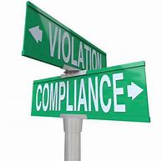
Why Internal Controls?
Internal controls MUST be an integral part of UM’s financial and business policies and procedures.
Internal controls consist of all the measures taken by the University for the purpose of:
  Protecting its resources against waste, fraud, and inefficiency
  Ensuring accuracy/reliability in accounting and operating data
  Securing compliance with University policies and procedures
  Evaluating the level of performance in all University units
Notes:
Jolene

Slide 13
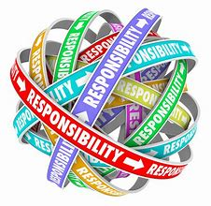
Who is Responsible?
Board of Regents is ultimately responsible but they must delegate that responsibility down to the President who then delegates responsibilities throughout the University.
The Deans/Directors/Chairs have oversight responsibility for internal controls within their units.
Managers and supervisory personnel have responsibility for executing control policies and procedures at the detail level within their specific unit.
Everyone - Each individual within a unit should be cognizant of proper internal control procedures associated with their specific job responsibilities.
Notes:
Ben
After reading first paragraph – Although the Board of Regents is ultimately responsible, it would be unfeasible for them to monitor controls at every individuals level.
Likewise, since supervisory personnel are responsible for oversight they are partially accountable for breakdowns of internal controls within their department.

Slide 14
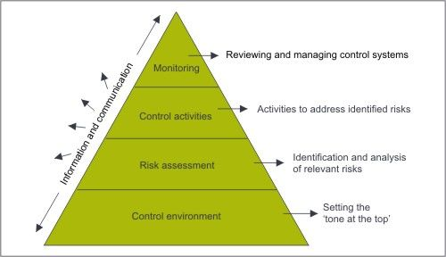
Five Elements of Internal Control
Notes:
Jolene
Internal control systems operate at different levels of effectiveness.
These five elements together can help create an effective internal control system:
Control Environment- Setting the tone at the top
Risk Assessment- Identification and analysis of relevant risks
Control Activities- Activities to address identified risks
Monitoring- Reviewing and managing control systems
Information and Communication- occurs throughout all the elements
Tie this into the title by directly stating that these are, in a way, the steps that should be followed in order to ‘create’ an effective control environment.

Slide 15
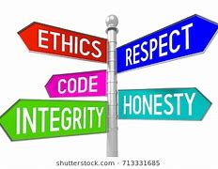
1. Control Environment
The control environment, as established by the company, sets the tone and influences the control consciousness of its people.
Leaders of each department, area, or activity establish a local control environment.
Control environment factors include:
  Integrity and ethical values
  The commitment to competence
  Leadership philosophy and operating style
  The way management assigns authority/responsibility and organizes/develops its people
Notes:
Ben
If your supervisor seems to not care much about being compliant with policies – why should you? This can result in a lot of mistakes being made when employees are executing their duties, and also be someone’s rationale when committing fraud.

Slide 16


2. Risk Assessment
The process of identifying and analyzing risk is an ongoing process and is a critical component of an effective internal control system.
After risks have been identified, they must be evaluated.
Attention must be focused on risks, at all levels, and necessary actions must be taken to manage.
Notes:
Jolene
1. A risk assessment is a systematic process that identifies, analyzes and controls risks that could negatively impact an entity’s ability to conduct business.
Identifying and analyzing risks is an on-going process.
2. After risks have been identified, they must be evaluated.
3. Attention must be given to risks at all levels and we must take action to manage those risks.

Slide 17

3. Control Activities
Control activities are the policies and procedures that help ensure management directives are carried out.
Control activities occur throughout the organization, at all levels, and in all functions. They include a range of activities such as:
  Approvals/Authorizations
  Security of assets
  Segregation of duties
  Verifications
  Reconciliations
  Reviews of operating performance
Control activities usually involve two elements:
  A policy establishing what should be done
  Procedures to effect the policy
Notes:
Ben
Something to keep in mind that seems common on campus is the use of informal policies and undocumented procedures – and these can be much less effective than if they were formalized and accurately documented

Slide 18


Control Activities- 5 Types of Controls
  Preventative Controls:
    Pre-approvals
    Authorized Signers
    System access controls
    Segregation of duties
    Employee training
    Physical security controls
  Detective Controls:
    Physical inventories
    Reconciliations
    Performance reviews
    Monthly transaction reconciliations
Notes:
Jolene
Preventative controls are designed to prevent errors and irregularities by helping to identify and address problems before they happen.- “first line of defense”
Pre-approvals: Uapprove, supervisor signature
Authorized Signers:
Access Controls: Banner access, log-in credentials, Passwords, physical controls over assets, such as door locks
Segregation of duties: Procard payments and redistributions
Detective controls are designed to detect errors or irregularities that may have occurred.

Slide 19



Control Activities- 5 Types of Controls
Directive Controls:
Policies and procedures
Training
Job descriptions
Organizational structure
  Corrective Controls:
    Updating or creating new policies or procedures
    Software patches or modifications
    Error communication and reporting
Compensating Controls:
Close supervision for improper segregation of duties
Email encryption
Notes:
Ben
Directive controls are designed to direct actions to ensure a particular outcome is achieved.
Corrective controls are designed to correct errors or irregularities that have been detected.
Compensating controls are used to compensate for controls that are otherwise lacking- intended to be temporary.
All of these types of controls have their own unique benefits and none of them are always objectively better than the other, it all sort of just depends on the risk that you’re intending to mitigate.

Slide 20
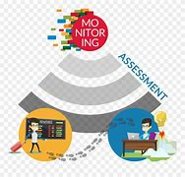
4. Monitoring
Internal control systems need to be monitored.
Need to assess the quality of the internal control system's performance over time.
The scope and frequency of separate evaluations depend primarily on an assessment of risks and the effectiveness of ongoing monitoring procedures.
Internal control deficiencies should be reported upstream, with serious matters reported immediately to top administration and governing boards.
Notes:
Jolene
Monitoring assures that proper control activities are being implemented and used during day-to-day operations. Monitoring should be on-going and be regularly reviewed to verify that internal controls are functioning properly and identify any opportunities for improvement. (covers bullet 1 & 2)

Slide 21

5. Information and Communication
Pertinent information must be identified, captured, and communicated in a form and time frame that enables people to carry out their responsibilities.
They must understand their own role in the internal control system as well as how individual activities relate to the work of others.
All personnel must receive a clear message from top management that control responsibilities must be taken seriously.
Effective communication must occur in a broad sense, flowing down, across, and up the organization.
Notes:
Ben
All this is to say that anybody can identify risks regardless of their position, and they can identify weaknesses in the control system that’s being used. Someone down in the weeds with a complicated process may have a much clearer perspective than their supervisor, and the supervisor should be receptive to their subordinate’s feedback.

Slide 22

You are the Financial Manager for a department and frequently make purchases on your ProCard. In order to maintain an effective control environment, you have your administrative assistant complete reconciliations and submit redistributions from the ProCard clearing account after they have verified the purchases with the receipts you have provided to them.
Unfortunately, your admin assistant is the only other person in your office and has just put in their two-week notice. At the current pay rate, you believe you will be unable to backfill for several months.
What should you do?
Notes:
Jolene
Very open ended – Maybe that’s a good thing?
Should give the audience ~5 minutes to throw out ideas or get in small groups to discuss

Slide 23

Case Study #2
You’re a supervisor for IT and you’re unable to find an adequate candidate to fill your computer support specialist position.
You have a work-study student that seems interested in performing some of the support specialist’s duties, but would need to have several permissions granted in order to do so (administrator credentials, GrizCard door access, etc.).
What could go wrong – What are the risks?
What controls already exist, and what are your options for mitigating those risks?
Notes:
Ben

Slide 24
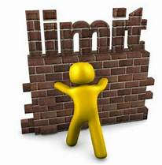
Internal Control Limitations
There is no such thing as a perfect control system
  Often why Internal Audit says, “It depends!”
Staff size limitations may obstruct efforts to properly segregate duties, which requires the implementation of compensating controls to ensure that objectives are achieved.
A constraint in any system is the element of human error, misunderstandings, fatigue, and stress.
Encourage employees to take earned vacation time in order to improve operations through cross-training while enabling employees to overcome or avoid stress and fatigue.
Notes:
Jolene
Bullet #2: Additional controls that can be added when segregation of duties does not exist:
-Supervisory reviews
-Independent reviews
-Reconciliations
-Exception reporting, irregularities are reviewed and signed off by management
-Transaction log is maintained to provide a record of all transactions processed whether it’s logged manually or automatically

Slide 25
Internal Control Limitations
The cost of implementing a specific control should not exceed the expected benefit of the control.
  Sometimes there are no out-of-pocket costs to establish an adequate control.
  A realignment of duty assignments may be all that is necessary to accomplish the objective.
  In analyzing the pertinent costs and benefits, managers also need to consider the possible ramifications for the University at-large.
Notes:
Ben
Example: IT setting a limit on the number of minutes for the screen to lock
Another example would be that you wouldn’t want to require supervisor approval for everything that’s done in your department; sure it could reduce the risk of mistakes being made, but it would require a lot of time and effort that could be better spent elsewhere.

Slide 26

Internal Control Limitations
Internal controls should reduce the risks associated with undetected errors or irregularities, but designing and establishing effective internal controls is not always a simple task and cannot always be accomplished through a short set of quick fixes.
Notes:
Jolene

Slide 27
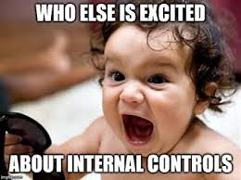

Slide 28

Questions?
Notes:
Mention that there are only 5 spots left for the Lunch and Learn. Sign up is first come, first serve.

