Slide 1



HAZARD COMMUNICATION & GHS
Environmental Health & Risk Management

Slide 2

GHS
Globally Harmonized System of Classification & Labeling of Chemicals
Notes:
The Globally Harmonized System of Classification and Labeling of Chemicals or GHS is an internationally agreed-upon system, created by the United Nations. It is designed to replace the various classification and labeling standards used in different countries by using consistent criteria for classification and labeling on a global level.

Slide 3
GHS
A system for standardizing and harmonizing the classification and labeling of chemicals
Defines health, physical and environmental hazards of chemicals
Communicates hazard information, as well as protective measures, on labels and Safety Data Sheets (SDS).

Slide 4
Current Systems
Differences in systems within different countries and within different regulatory agencies within the same government leads to inconsistent protection for those potentially exposed to the chemicals as well as creating extensive regulatory burdens on companies producing chemicals
Notes:
Notes: In the United States (U.S.) there are requirements for classification and labelling of chemicals for the Consumer Product Safety Commission, the Department of Transportation, the Environmental Protection Agency, and the Occupational Safety and Health Administration.

Slide 5
GHS
The GHS itself is not a regulation or a standard
Establishes agreed hazard classification and communication provisions with explanatory information on how to apply the system
Notes:
GHS A set of criteria and provisions that can be incorporated into existing systems, or used to develop new systems.

Slide 6
Why Was GHS Developed?
To provide sound management of chemicals that includes a system through which chemical hazards are identified and communicated to all who are potentially exposed
Notes:
Notes: The widespread use of chemicals has resulted in the development of sector-specific regulations (transport, production, workplace, agriculture, trade, and consumer products).

Slide 7
International Mandate
Adopted in the 1992 United Nations Conference on Environment and Development (UNCED), often called the "Earth Summit".
It was recognized that an internationally harmonized approach to classification and labeling would provide the foundation for all countries to develop comprehensive national programs to ensure the safe use of chemicals.
Notes:
UNCED issued a mandate calling for development of GHS.

Slide 8
GHS History
GHS formally adopted by the UN Committee of Experts - The Transport of Dangerous Goods and GHS in December 2002
OSHA ANPR on GHS 2006
OSHA NPRM on GHS 2009
Notes:
ANPR - Advanced Notice of Proposed Rulemaking; NPRM – Notice of Proposed Rulemaking

Slide 9
GHS History
OSHA revised the Hazard Communication Standard, aligning it with the GHS March 26, 2012
Rule effective 60 days after publication in the Federal Register
Estimated to prevent 43 fatalities and 521 injuries & illnesses annually

Slide 10
Implementation
Employers must complete all training regarding new label elements and SDS format by Dec 1, 2013
Requiring compliance with all provisions for preparation of new labels and SDS by June 1, 2015

Slide 11
Implementation
Distributors can’t ship containers unless they have a GHS label by Dec 1, 2015
Employers given an additional year, June 1, 2016 to update their Hazard Communication programs or any other workplace signs, if applicable

Slide 12
Application of GHS
Enhance the protection of human health and the environment by providing an internationally comprehensible system
Provide a recognized framework to develop regulations for those countries without existing systems
Facilitate international trade in chemicals whose hazards have been identified on an international basis
Reduce the need for testing and evaluation against multiple classification systems

Slide 13
Overall Benefits of GHS
To ensure that employers, employees and the public are provided with adequate, practical, reliable and comprehensible information on the hazards of chemicals, so that they can take effective preventive and protective measure for their health and safety

Slide 14
Benefits to Workers/Public
Improved safety for workers and others through consistent and simplified communications on chemical hazards and practices to follow for safe handling and use,
Greater awareness of hazards, resulting in safer use of chemicals in the workplace and in the home

Slide 15
GHS & Existing Regulations
The specific hazard criteria, classification processes, label elements and SDS requirements within an existing regulation will need to be modified to be consistent with the harmonized elements of the GHS
ALL existing hazard communication systems will need to be changed in order to apply the GHS
Notes:
Notes: For example, in the U.S. EPA and OSHA would be expected to require hazard pictograms/symbols on labels.

Slide 16
Classification
Classification is the starting point for hazard communication
Involves the identification of the hazard(s) of a chemical or mixture by assigning a category of hazard/danger using defined criteria
Notes:
Chemicals classified based on the type, the degree and the severity of the hazard it poses. Manufacturers under the revised HCS are required to re-evaluate chemicals according to the new criteria to make sure they are classified . For physical hazards, new criteria are generally consistent with current DOT requirements, so this classification should already be done.

Slide 17
Hazard Classes
16 classes of physical hazards
10 classes of health hazards
3 classes of environmental hazards
Notes:
Hazard classes are subdivided into categories of hazard. Example Carcinognicity: 1 – known or presumed human carcinogen; 2 – suspected human carcinogen.

Slide 18
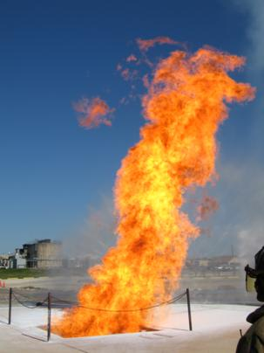
GHS Physical Hazards
Explosives
Flammable Gases
Flammable Aerosols
Oxidizing Gases
Gases Under Pressure
Flammable Liquids
Flammable Solids
Self-Reactive Substances
Pyrophoric Liquids
Pyrophoric Solids
Self-Heating Substances
Substances which, in contact with water emit flammable gases
Oxidizing Liquids
Oxidizing Solids
Organic Peroxides
Corrosive to Metals

Slide 19
GHS Health Hazards
Acute Toxicity
Skin Corrosion/Irritation
Serious Eye Damage/Eye Irritation
Respiratory or Skin Sensitization
Germ Cell Mutagenicity
Carcinogenicity
Reproductive Toxicology
Target Organ Systemic Toxicity - Single Exposure
Target Organ Systemic Toxicity - Repeated Exposure
Aspiration Toxicity

Slide 20

GHS Environmental Hazards
Hazardous to the Aquatic Environment
Acute aquatic toxicity
Chronic aquatic toxicity
Bioaccumulation potential
Rapid degradability

Slide 21
GHS Hazard Communication
Once a chemical has been classified, the hazard(s) must be communicated to target audiences
Labels and Safety Data Sheets are the main tools for chemical hazard communication

Slide 22
GHS Label Elements
Product Identifier
Signal Word (Danger, Warning)
Hazard Statement (for each hazard class and category)
Pictogram(s)
Precautionary Statement (for each hazard class and category)
Name, Address and Tele. # of chemical manufacturer
Notes:
UN markings are required for outer packagings.

Slide 23
Signal Words
"Danger" or "Warning" are used to emphasize hazards and indicate the relative level of severity of the hazard, assigned to a GHS hazard class and category.
"Danger" for the more severe hazards
"Warning" for the less severe hazards.
Notes:
Little perceived difference between Warning and Caution, so Caution was not adopted.

Slide 24
Hazard Statements
Hazard statements are standardized and assigned phrases that describe the hazard(s) as determined by hazard classification

Slide 25
Hazard Statement Examples
“Causes eye irritation”
“Toxic if inhaled”
“Flammable aerosol”
“May cause cancer”
“May cause respiratory irritation”
“Harmful to aquatic life”
“Contains gas under pressure; may explode if heated”
Notes:
Hazard Statements are standard phrases assigned to a hazard class and category that concisely describe the nature of the hazard.
25

Slide 26
Symbols/Pictograms
Convey health, physical and environmental hazard information, assigned to a GHS hazard class and category.
The GHS symbols have been incorporated into pictograms for use on the GHS label
Pictograms will have a black symbol on a white background with a red diamond frame
Notes:
Pictograms serve to attract attention to the hazard warnings. One pictogram may be used to represent several hazards within a class.

Slide 27

Health Hazard
Carcinogen
Mutagenicity
Reproductive Toxicity
Respiratory Sensitizer
Target Organ Toxicity
Aspiration Toxicity

Slide 28

Environment
Aquatic toxicity

Slide 29

Exclamation Mark
Irritant (skin and eye)
Skin Sensitizer
Acute Toxicity
Narcotic Effects
Respiratory Tract Irritant
Hazardous to Ozone Layer (Non-Mandatory)

Slide 30

Skull & Crossbones
Acute toxicity (fatal or toxic)
Notes:
Some of the pictograms included in the final rule are already widely recognized by a general audience.

Slide 31

Gas Cylinder
Gases Under Pressure

Slide 32

Corrosion
Skin Corrosion/Burns
Eye Damage
Corrosive to Metals

Slide 33

Exploding Bomb
Explosives
Self-Reactives
Organic Peroxides

Slide 34

Flame Over Circle
Oxidizers

Slide 35

Flame
Flammables
Pyrophorics
Self-Heating
Emits Flammable Gas
Self-Reactives
Organic Peroxides

Slide 36
Physical Hazard Pictograms

Slide 37
Health Hazard Pictograms

Slide 38
Precautionary Statements
Precautionary Statements are standardized explanations of the measures to be taken to minimize or prevent adverse effects
Prevention
Response
Storage
Disposal
Notes:
Precautionary statements have been codified (numbered) but they are not considered formally harmonized. So different language can be used for the precautionary statements. Precautionary statements are not harmonized like the hazard statements are. May be considered harmonized in the future, but OSHA has required them as mandatory.

Slide 39
Precautionary Statement Examples
Prevention
“Wear protective gloves”
Response
“If inhaled remove person to fresh air”
Storage
“Store in well ventilated place”
Disposal
“Waste must be disposed of in accordance with federal, state and local environmental
control regulations”

Slide 40
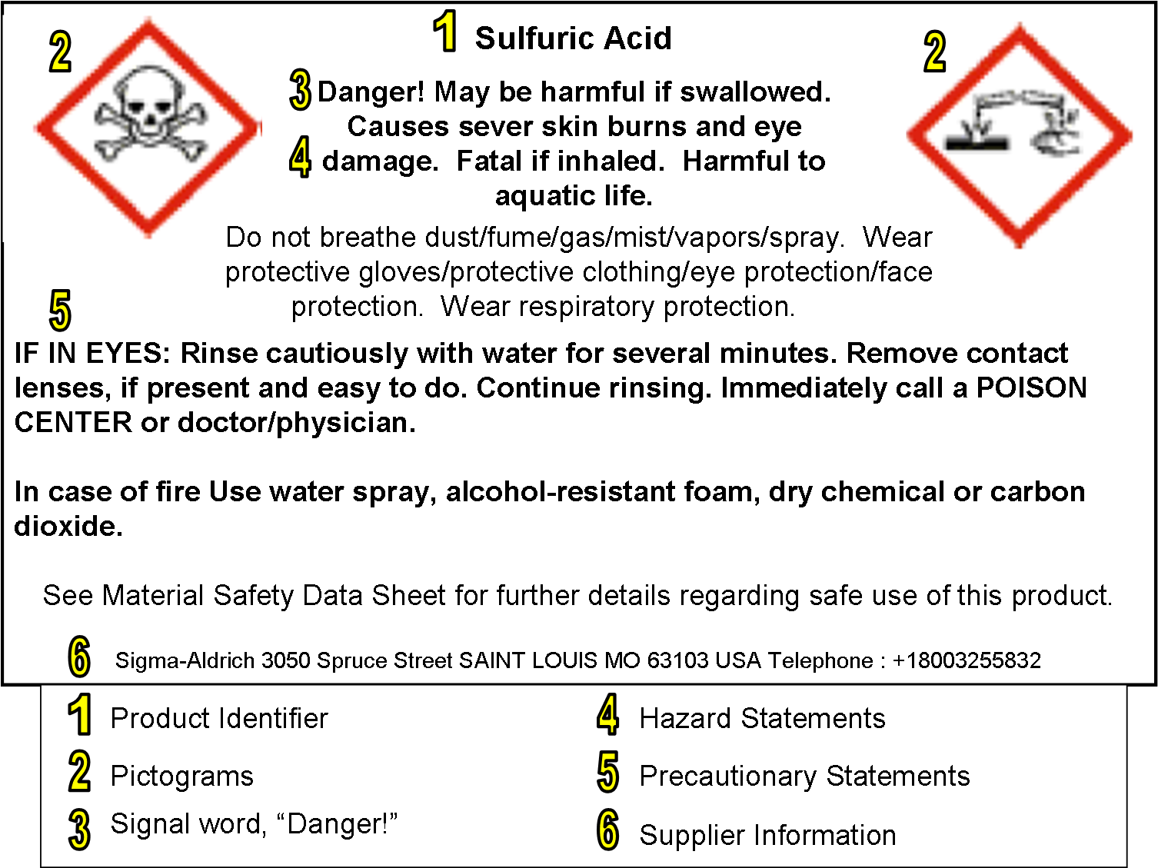
Label Example

Slide 41
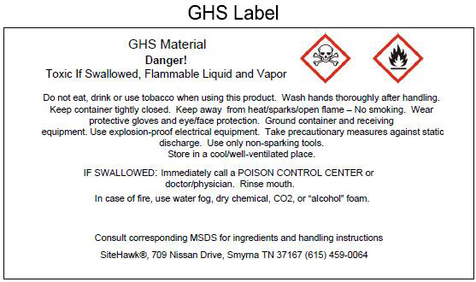
Label Example

Slide 42
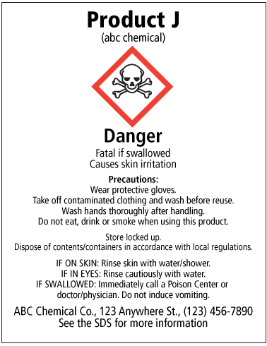
Label Example
Notes:
The current standard allows employers to continue to use systems such as NFPA, HMIS. The information supplied must be consistent with the revised HCS

Slide 43
Secondary Containers
Employers must ensure that each container of hazardous chemicals in the workplace is labeled, tagged, or marked with either the information specified under (i) through (v) for labels on shipped containers

Slide 44
Secondary Containers
(i) Product identifier;
(ii) Signal word;
(iii) Hazard statement(s);
(iv) Pictogram(s);
(v) Precautionary statement(s);
OR

Slide 45
Secondary Containers
Product identifier and words, pictures, symbols, or combination thereof, which provide at least general information regarding the hazards of the chemicals, and which, in conjunction with the other information immediately available to employees under the hazard communication program, will provide employees with the specific information regarding the physical and health hazards of the hazardous chemical.
Notes:
NFPA hazard diamonds or HMIS labels can be used to indicate the appropriate hazard warnings.

Slide 46
MSDS’s
Information that is currently required on a MSDS:
Identity used on the label
Physical & chemical characteristics
Physical hazards
Health hazards
Primary routes of entry
Exposure limits
Carcinogenic information
Safe handling
Control measures (PPE)
Emergency & First Aid procedures
Date of preparation
Chemical mfg. contact info
Notes:
MSDS’s have been changed to Safety Data Sheets.

Slide 47
Safety Data Sheets (SDS)
1. Identification of the substance or mixture and of the supplier
2. Hazards identification
3. Composition/information on ingredients
4. First aid measures
5. Firefighting measures
Accidental release measures
7. Handling and storage
8. Exposure controls/personal protection
Notes:
Chemical Mfg. and importers following ANSI Z400.1 for safety data sheets should already have the appropriate format so will only be required to make small modifications. Items of primary interest to exposed employees and emergency responders are presented at the beginning of the SDS; more technical information is presented in the later sections.

Slide 48
Safety Data Sheets (SDS)
9. Physical and chemical properties
10. Stability and reactivity
11. Toxicological information
12. Ecological information
13. Disposal considerations
14. Transport information
15. Regulatory information
16. Other information including information on preparation and revision of the SDS

Slide 49
Section 1 – Substance & Supplier Identification
Identifies the chemical on the SDS as well as the recommended uses. It also provides the essential contact information of the supplier:
Product identifier used on the label and any other common names or synonyms by which the substance is known.
Name, address, phone number of the manufacturer, importer, or other responsible party, and emergency phone number.

Slide 50
Section 2- Hazards Identification
Identifies the hazards of the chemical presented on the SDS and the appropriate warning information associated with those hazards:
The hazard classification of the chemical
Signal word.
Hazard statement(s).
Pictograms
Precautionary statement(s)
Description of any hazards not otherwise classified

Slide 51
Section 3 – Composition/Information on Ingredients
Identifies the ingredient(s) contained in the product. This section includes information on substances, mixtures, and all chemicals where a trade secret is claimed:
Chemical name
Common name and synonyms
For mixtures, the chemical name and concentration (i.e., exact percentage) of all ingredients which are classified as health hazards
Chemical Abstracts Service (CAS) number and other unique identifiers.

Slide 52
Section 4 – First Aid Measures
Describes the initial care that should be given by untrained responders to an individual who has been exposed to the chemical:
Necessary first-aid instructions by relevant routes of exposure (inhalation, skin and eye contact, and ingestion).
Description of the most important symptoms or effects, and any symptoms that are acute or delayed.
Recommendations for immediate medical care and special treatment needed, when necessary.

Slide 53
Section 5 – Fire Fighting Measures
Provides recommendations for fighting a fire caused by the chemical:
Recommendations of suitable extinguishing equipment, and information about extinguishing equipment that is not appropriate for a particular situation.
Advice on specific hazards that develop from the chemical during the fire, such as any hazardous combustion products created when the chemical burns.
Recommendations on special protective equipment or precautions for firefighters.

Slide 54
Section 6 – Accidental Release Measures
Provides recommendations on the appropriate response to spills, leaks, or releases, including containment and cleanup practices to prevent or minimize exposure to people, properties, or the environment:
Use of personal precautions and protective equipment
Emergency procedures, and appropriate protective clothing
Methods and materials used for containment
Cleanup procedures (e.g., appropriate techniques for neutralization, decontamination, cleaning or vacuuming; adsorbent materials; and/or equipment required for containment/clean up)

Slide 55
Section 7 – Handling & Storage
Provides guidance on the safe handling practices and conditions for safe storage of chemicals:
Precautions for safe handling, including recommendations for handling incompatible chemicals, minimizing the release of the chemical into the environment, and providing advice on general hygiene practices (e.g., eating, drinking, and smoking in work areas is prohibited)
Recommendations on the conditions for safe storage, including any incompatibilities

Slide 56
Section 8 – Exposure Controls/Personal Protection
Indicates the exposure limits, engineering controls, and personal protective measures that can be used to minimize worker exposure:
OSHA Permissible Exposure Limits (PELs), American Conference of Governmental Industrial Hygienists (ACGIH) Threshold Limit Values (TLVs), and any other exposure limit used or recommended by the chemical manufacturer
Appropriate engineering controls
Recommendations for personal protective measures to prevent illness or injury from exposure to chemicals
Any special requirements for PPE, protective clothing or respirators

Slide 57
Section 9 – Physical & Chemical Properties
Identifies physical and chemical properties associated with the substance or mixture including but not limited to the following:
Appearance (physical state, color, etc.)
Upper/lower flammability or explosive limits
Odor
Vapor pressure
Vapor density
pH
Flash point

Slide 58
Section 10 – Stability & Reactivity
Describes the reactivity hazards of the chemical and the chemical stability information:
Description of the specific test data for the chemical(s)
Indication of whether the chemical is stable or unstable under normal ambient temperature and conditions while in storage and being handled
List of all conditions that should be avoided and all classes of incompatible materials with which the chemical could react to produce a hazardous situation.

Slide 59
Section 11 – Toxicological Information
Identifies toxicological and health effects information or indicates that such data are not available:
Information on the likely routes of exposure
Description of the delayed, immediate, or chronic effects from short- and long-term exposure
The numerical measures of toxicity (e.g., acute toxicity estimates such as the LD50 (median lethal dose))
Description of the symptoms
Indication of whether the chemical is listed in the National Toxicology Program (NTP), International Agency for Research on Cancer (IARC) Monographs or found to be a potential carcinogen by OSHA

Slide 60
Section 12 – Ecological Information
Provides information to evaluate the environmental impact of the chemical(s) if it were released to the environment:
Data from toxicity tests performed on aquatic organisms
Whether there is a potential for the chemical to persist and degrade in the environment
Results of tests of bioaccumulation potential
The potential for a substance to move from the soil to the groundwater
Other adverse effects
Notes:
Effects on plants and animals, ultimate environmental disposition. OSHA will not enforce the content of sections 12-15 because they concern matters handled by other agencies.

Slide 61
Section 13 – Disposal Considerations
Provides guidance on proper disposal practices, recycling or reclamation of the chemical(s) or its container, and safe handling practices:
Description of appropriate disposal containers to use.
Recommendations of appropriate disposal methods to employ.
Description of the physical and chemical properties that may affect disposal activities.
Language discouraging sewage disposal.
Any special precautions for landfills or incineration activities

Slide 62
Section 14 – Transport Information
Provides guidance on classification information for shipping and transporting of hazardous chemical(s) by road, air, rail, or sea:
UN number
UN proper shipping name
Transport hazard class(es)
Packing group number
Any special precautions which an employee should be aware of or needs to comply with, in connection with transport or conveyance either within or outside their premises

Slide 63
Section 15 – Regulatory information
Identifies the safety, health, and environmental regulations specific for the product that is not indicated anywhere else on the SDS
Any national and/or regional regulatory information of the chemical or mixtures (including any OSHA, Department of Transportation, Environmental Protection Agency, or Consumer Product Safety Commission regulations)
Notes:
Classification under federal, state and international regulations. EU risk and safety phrases.

Slide 64
Section 16 - Other information
Indicates when the SDS was prepared or when the last known revision was made. Other useful information also may be included here
Notes:
In preparing an SDS, the chemical mfg. when they become aware of any significant information regarding the hazards of a chemical, or ways to protect against the hazard, this new info must be added to the SDS within 3 months.; they get 6 months to update labels.

