Slide 1
Navigate: Appointment Campaigns
Training for Faculty

Slide 2
Appointment Campaigns
Appointment Campaigns are designed to select a specific cohort of students encouraging them to schedule an appointment.
Campaign and availability must match Location and services.
Add Students
Add Nudges and Success Message.
We will define our students using a saved search, student list. If neither of those are in use the advanced search will open.
Nudges are messages sent to the student as a reminder that the student needs to schedule an appointment. Success message is sent after a student schedules an appointment.
Appointment Campaigns are the most common approach to scheduling with students.
Define the Campaign.
Add Staff To Campaign
Confirm and Send
Define your campaign. This is where we will select care unit, location, services and course or reason for campaigns
Here we will add organizers to the appointment campaign. You must include yourself and if role permissions are such, we can add more staff to help field the appointment campaign and help with advising students
Review your campaign details, students, staff and your nudges and success messages. Once you have confirmed your details. Send your campaign out.
Outlook Calendar sync must be enabled for appointment campaigns.

Slide 3
Where to Find Campaigns
Appointment Campaigns can be found under the campaign's logo.
After we click campaigns, we are taken to the next page where we can select five different campaigns.
We will focus on appointment campaigns. This is where we can create a cohort of students that we can send out targeted messaging to schedule appointments with an advisor.
From the short video we can see when we click “ Add New” under appointment campaign the steps to creating a campaign will populate.

Slide 4
Define Campaign
Campaign Name: Campaign name will be visible to the creator and anyone with permissions to view campaigns. Students will not be able to view the name.
Instructions or Notes: These are for the student when they open the campaign. Keep this short and descriptive.
Care Unit: Select your appropriate Care unit
Location: This is the same location used for your availability
Service: The service this campaign is going to be students for.
Appointment Limit: How many appointments would you like the student to schedule.
Appointment Length: Set the length you would like each appointment
Slots Per Time: Appointments can be a single person or groups
Staff/Recipient Reminders: Here we can choose to send campaign notifications via text or email
Scheduling Window: We can set a range of dates that you would like students to schedule in. These dates will when you would like your appointments to happen.
If you are going to include other staff, they must have availability that matches the appointment campaign.

Slide 5
Adding Students To a Campaign
We can select students from saved searches action menu.
Saved Lists
From the list's menu, we can select a previously uploaded list. Select the list, then from the action's menu select “appointment campaign”.
There are three ways we can select students for an appointment campaign.
My Students Only
Saved Searched Items
The Final way to add students to your campaign is adding all your assigned students. When we don’t choose a saved search or launch an appointment campaign through a saved list. We can use “my students only”.

Slide 6
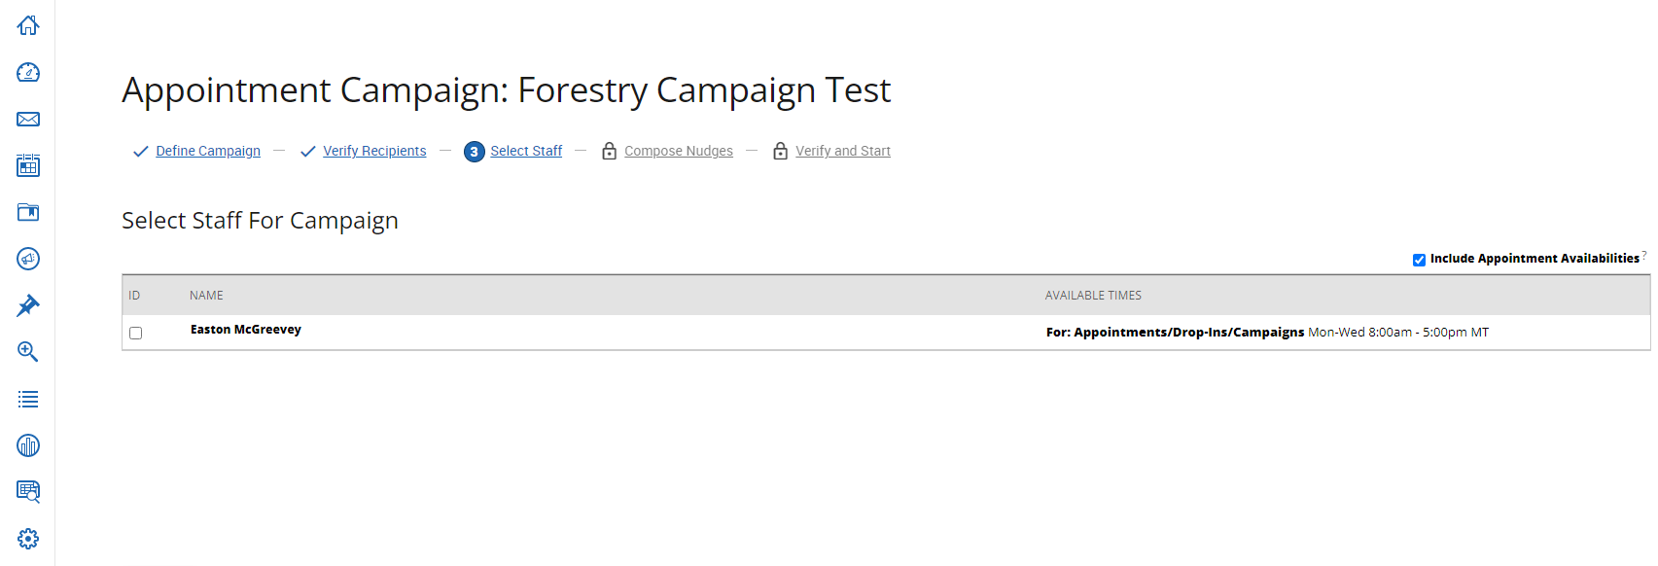
Select Staff
The third step in creating an Appointment Campaign is the selection of staff. Here we can see that I have populated as a staff member. I have available times for this campaigns.
Include Appointment Availabilities: This checkbox is used to distinguish which type of availability you want students too schedule with. If the checkbox is marked, students will be ablet to schedule any appointment type; appointments, drop-in or Campaigns. This means if you have different availabilities students will be able to schedule with all three.
If you have setup a single availability just for campaigns and only want students to use that availability type, you would un-check the box. This means students will only be able to schedule on a specific date and time you have setup for your appointment campaigns.
Once you have selected yourself and any other staff member that would populate just like me in the screenshot. Press the continue button and we will start to build out Nudges and Success messages.

Slide 7
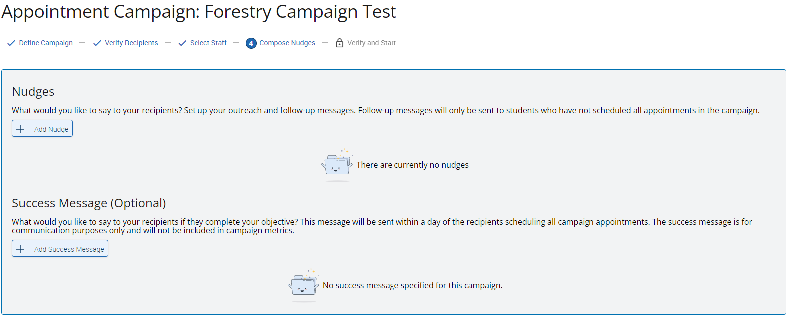
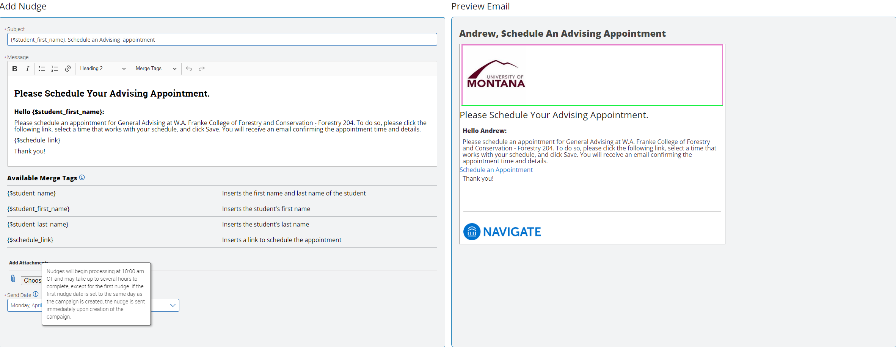
Nudges
The Fourth step in your appointment campaign is setting up nudges and success messages (optional).
In the bottom screenshot is where we can edit the nudge message. We can edit the subject, body, add attachments, and even change merge tags.
Merge Tags grab specialized content that can be added to your subject line or the body of the message. We currently only use four total merge tags.
There is only one major rule for merge tags. You should never delete the “Schedule Link” merge tag.
Once you have your subject line and the body of your message is complete, we can add attachments below and even select the date you would like to send out the nudge.
We also get a preview email to the right which will show you exactly what your email is going to look like for students.

Slide 8
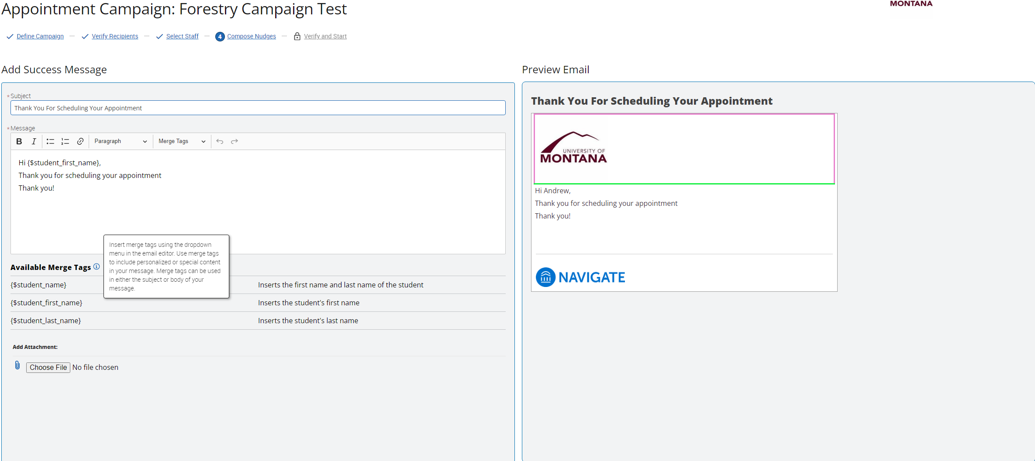
Success Message
Like the nudge message, success messages are not sent out before the appointment campaigns starts. Success messages are sent after the student has scheduled an appointment through the appointment campaign.
We can edit the subject and body of the message using merge tags as well.
Add attachments is also a feature just like nudge message.
A preview of the email is to the right.
The Success Message is for communication purposes only.

Slide 9
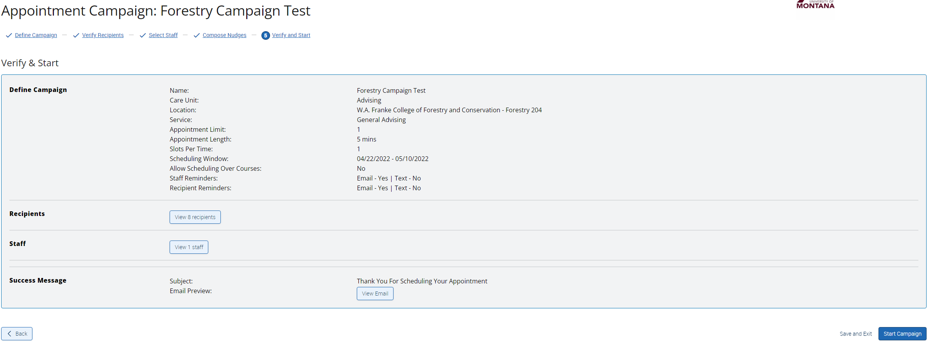
Confirm and Send
After we have completed steps 1-4, we now can verify and start the campaign
Review your campaign definition, recipients, staff selection, and your personalized messages.
Once you have confirmed all above details, launch the campaign.

Slide 10
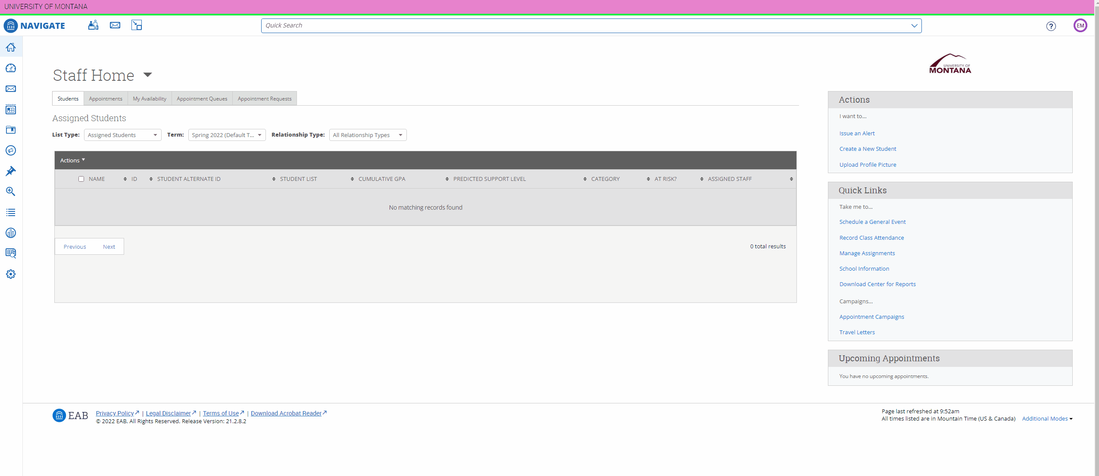
Review our Campaign
Once we have started our appointment campaign, we can now view statistics about our appointment campaign.
As shown in the short video we can access all our old and new campaigns and view participation percentages, appointments made and even students who have yet made an appointment.
This page also allows us to edit our campaign, delete the campaign and even export student lists.

Slide 11
You have finished the lesson!
Questions on content?
Suggestions for improvements?
Any other thoughts?
For all of these, please email us at osstech@mso.umt.edu.
We would love to hear from you!

