Slide 1
Navigate: Appointment summaries
Training for Faculty

Slide 2
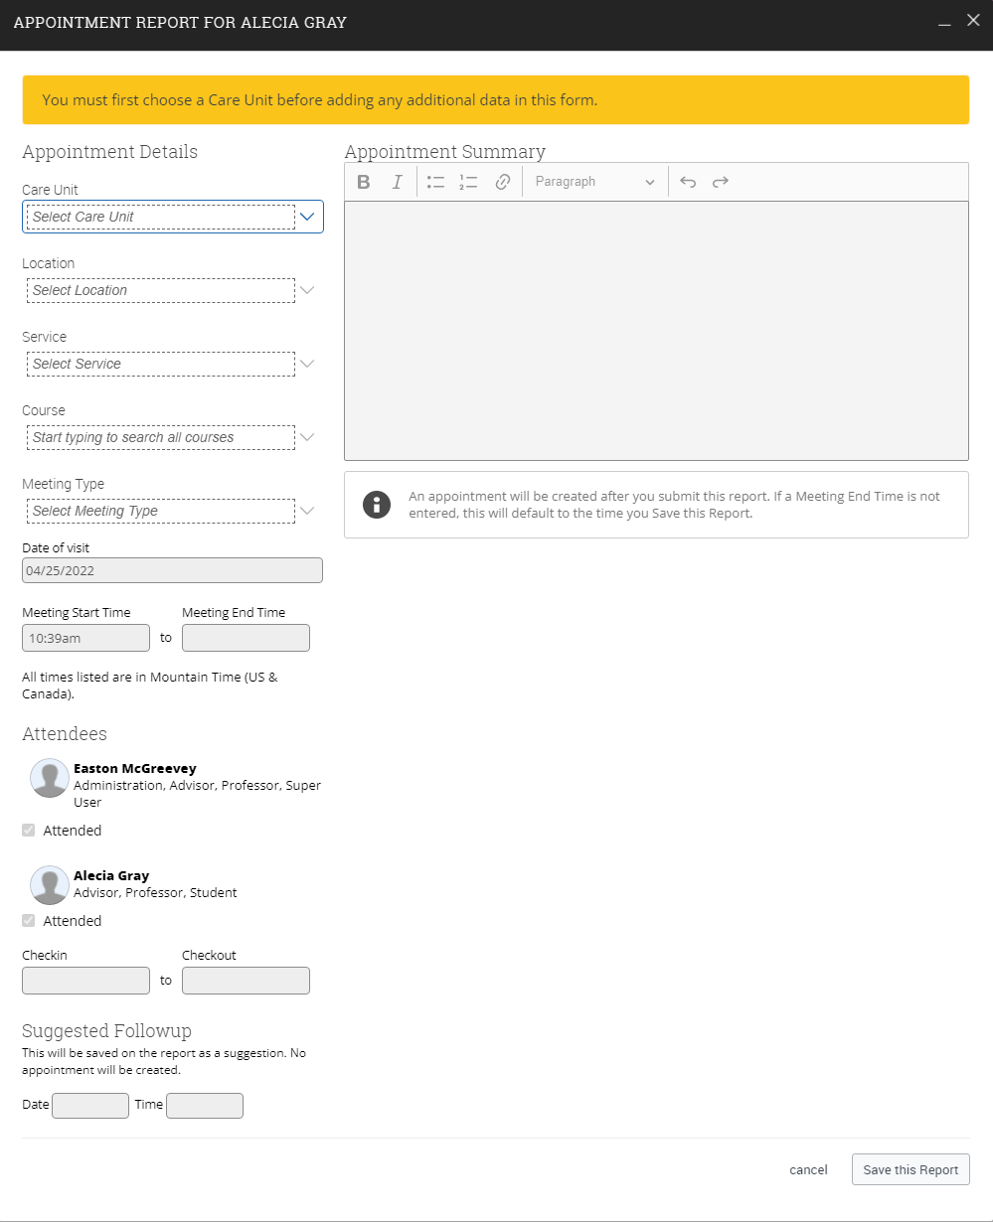
Appointment Summaries
Appointment summaries allow us to dictate and document an appointment that you had with a student after an appointment.
Appointment summaries are created and stored in the Staff homepage, student profile and can also be found using the reporting tool.
Appointment Summaries are used by faculty and staff to record the interaction with the student during there scheduled appointment
Appointment Summaries can be made from drop-ins, appointments or whether the student was a no-show
Appointment Summaries can be made visible based on care unit.
Appointment summaries can also be made on behalf of other users.

Slide 3
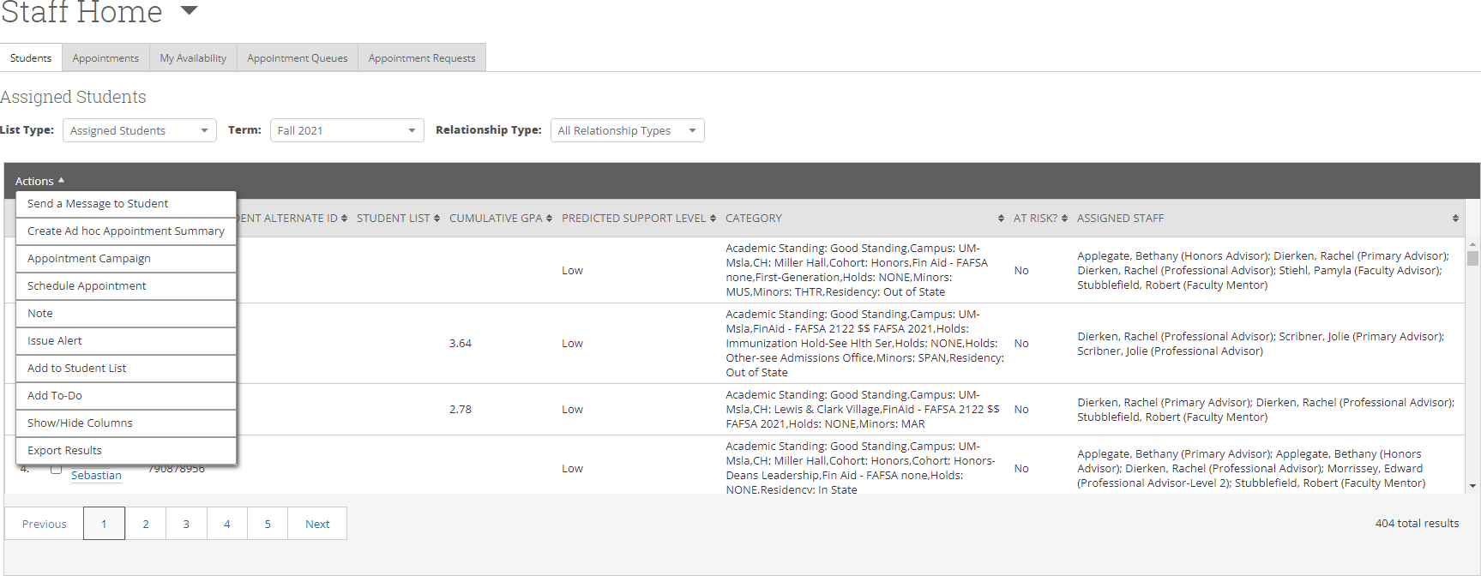
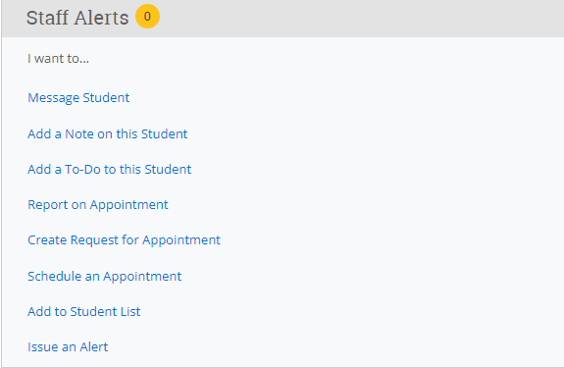
Creating appointment summaries (ad-hoc)
When Creating Ad-Hoc appointment summaries there a few different ways we can do this. We can access our student list, select an assigned student. Using the actions menu, we select “create Ad hoc appointment summary”.
Another way to create an Ad-hoc appointment summary is viewing the student’s profile. When the student's profile is pulled up, we have a couple options on the right hand of the screen. The Ad-hoc selection “report on appointment” this will create an Ad-hoc appointment summary.
These two options will create an ad-hoc appointment summary and will add the appointment to your calendar in the past, for record keeping.
It is also very important to have your outlook synced up, Navigate will create past appointments appear on your calendar which is vital for Appointment summary reports.

Slide 4
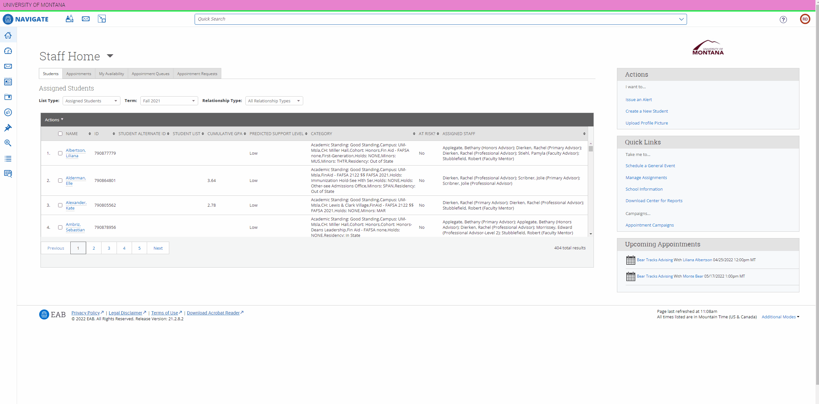
Creating appointment summaries (scheduled)
The easiest way to create appointment summaries is from your staff appointments tab. We can select recent appointments and using our actions menu create an appointment summary.
It is important to try and create appointment summaries from recent appointments rather than ad-hoc. This ensures that the appointment summary report is tied to that specific appointment.
It is very important that Appointment summaries must be at least five minutes long. Anything less than five minutes will result in an error.
Appointment Summaries can also be made from your recent appointments tab below upcoming appointments using the actions menu as well just like the video.
It is very import to understand that all appointment summaries are apart of the student's official record
Appointment summaries cannot be marked private

Slide 5
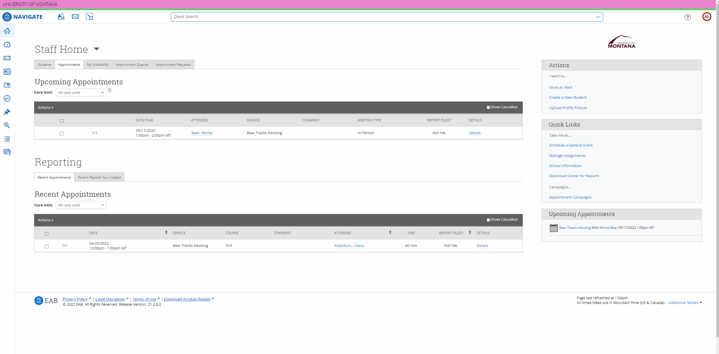
Creating Appointment summaries (no-show)
To mark a student as a no show, find your recent appointments tab under your appointments.
Select the student that did not show up, using the actions menu select “no show”. This will pull up an appointment report with the student's name uncheck in the bottom of the report.
Marking a student as a no show will still add an appointment summary.

Slide 6
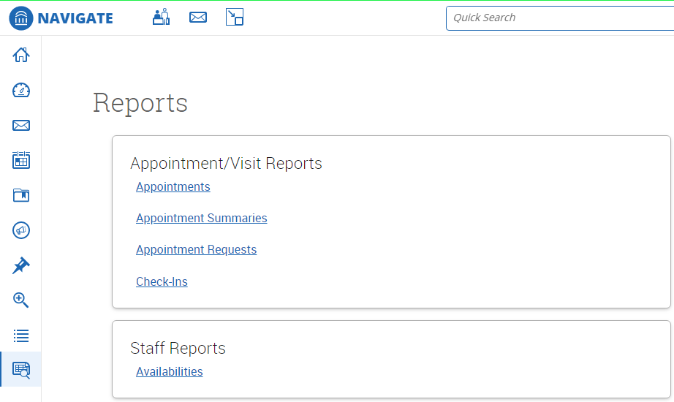
Appointment reporting
All appointment summaries are stored, and we can view them either daily or at the end of the year.
Utilizing the reporting tool in Navigate we can get a full list of all our appointments and appointment request.
The data in an appointments report is care-unit specific.
Each report allows for customization of date ranges, care units, services and more. Let’s take a look.

Slide 7
Appointment reports
When we generate a new appointment report we are taken to new screen. At the top are Activity features. Activity Features; Time Frame, meeting type, care unit, location filter and service filter. This allows us to narrow our search down to an exact type of cohort you're looking for.
We also have checkboxes at the bottom too further our narrowing of our searches. Including cancelled appointments and no-shows.
Much like advanced search in Navigate we are given the same unique search abilities when creating our appointment reports.
Student Filters allow us to define a specific cohort or even look for an individual student to see their appointment history. We can even filter by just our students assigned to us using the check boxes down below student filters.

Slide 8
Appointment reports cont.
When we finally define our cohort or students we want to view. We are given a list of students. From here we are given details about each appointment.
Each appointment is in one line and outlines every aspect of the appointment. From the advisor, length of appointment, too even why the student scheduled the appointment. This report will even show advising comments.

Slide 9
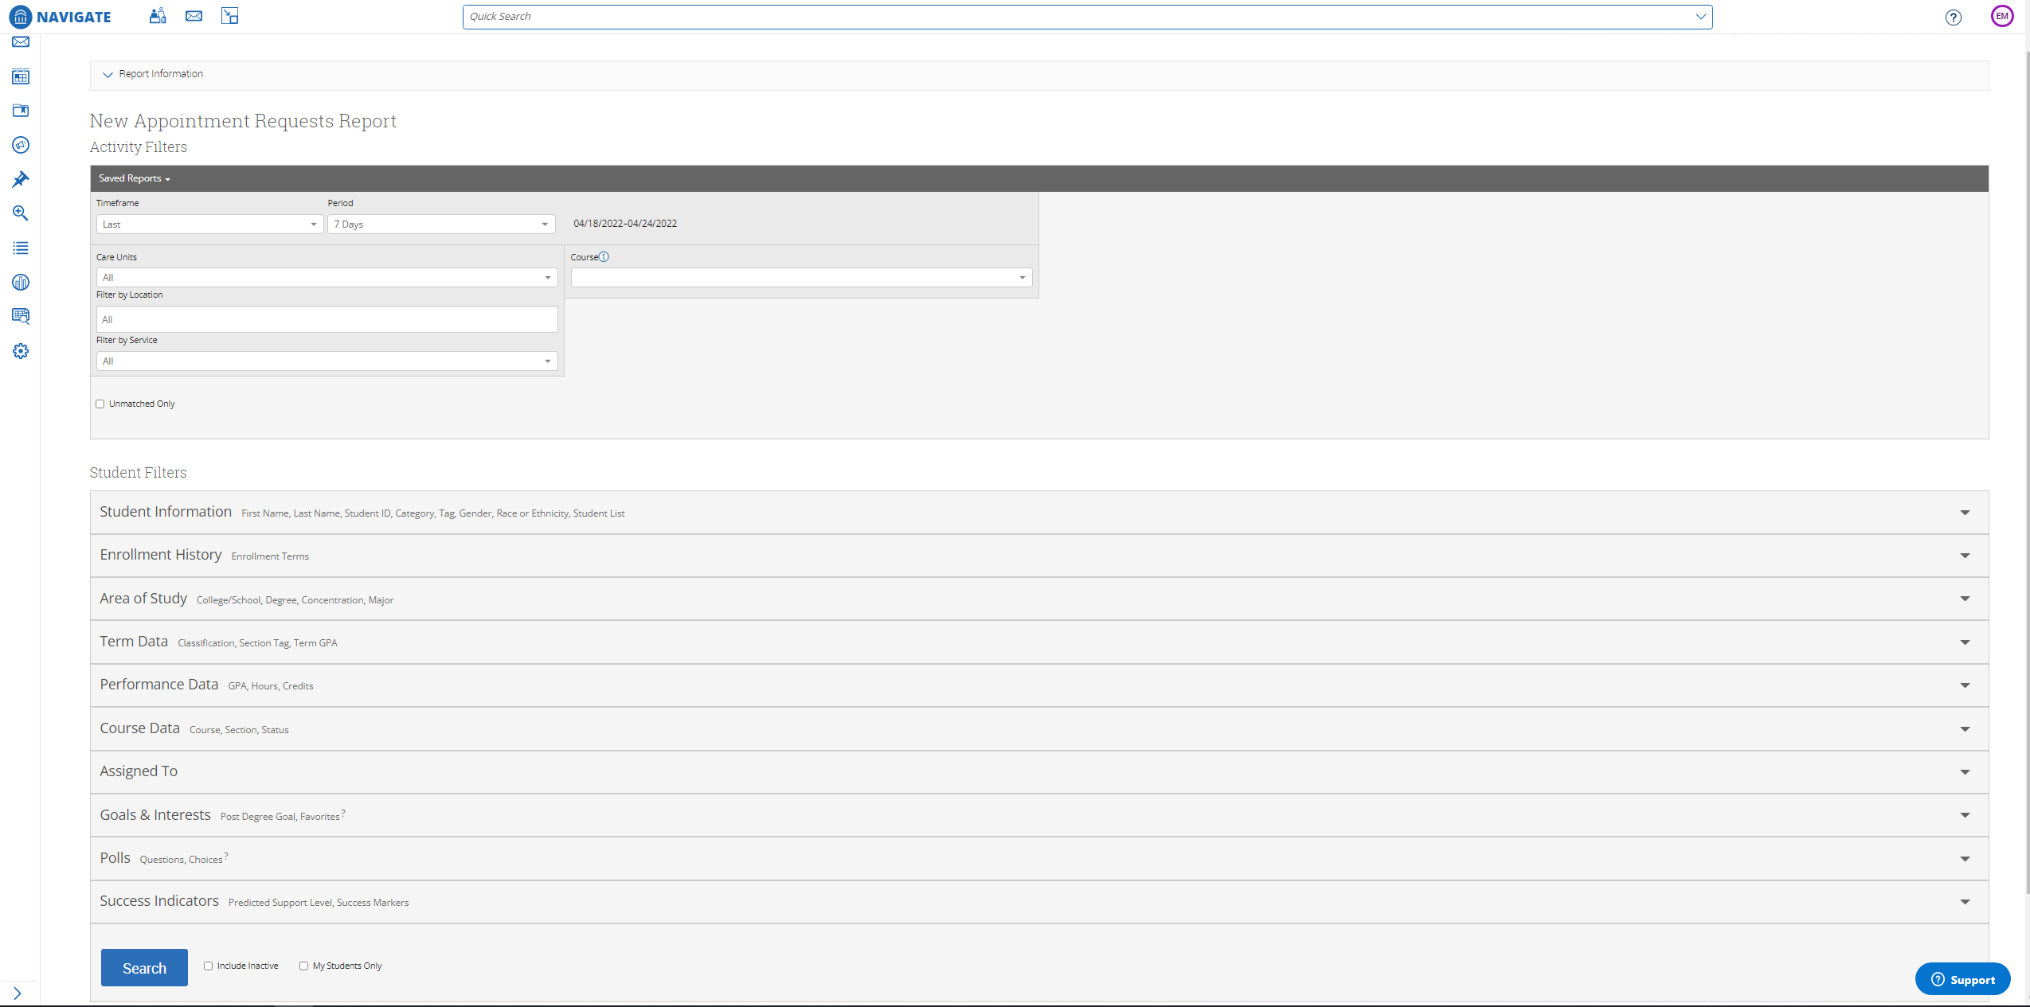
Appointment request report
Like our appointments report we can use the appointment request report to find students who have requested appointments with advisor or faculty mentors.
Each report will appear like the appointments report in the previous slide. Each report has a general theme that Navigate follows.
Each report also has an action menu that we can use to create Ad-hoc campaigns or even export to excel!
Lets take a look on the next slide.

Slide 10
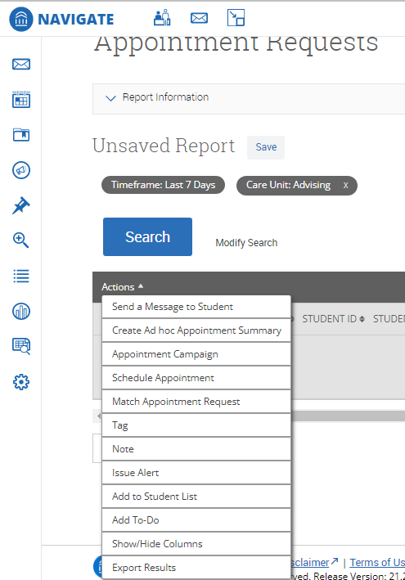
Reports Action menu
The actions menu associated with each report allows for users to utilize each report to message students or even export files to excel if need be.
We can even create an appointment campaign from the list that we created using filters.
The only thing in the actions menu that is not enabled across Navigate currently at the UM campus is the action item “To-Do’s”.
When viewing a report, if there is too much information, we can also edit the file using the Show/Hide columns.

Slide 11
You have finished the lesson!
Questions on content?
Suggestions for improvements?
Any other thoughts?
For all of these, please email us at osstech@mso.umt.edu.
We would love to hear from you!

