Slide 1
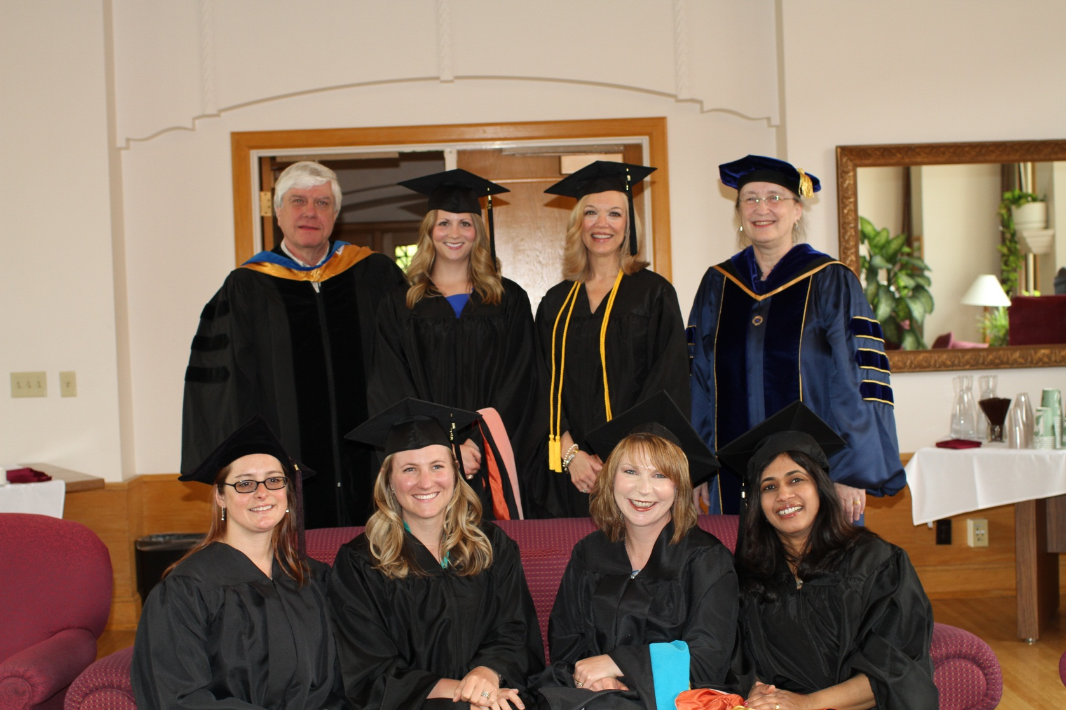
2013
Graduation Ceremony
Back Row: Dr. Craig Molgaard, Carly Borth, Gin Graham, Dr. Amanda Golbeck
Front Row: Kathryn Fox, Tracie Weiss, Janell Porter, Ushakumari Valappil

Slide 2
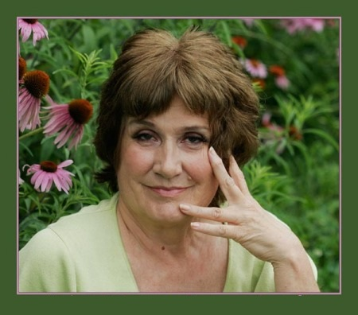
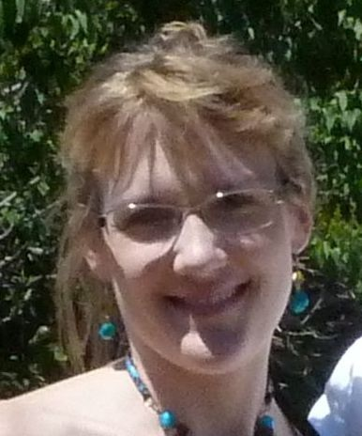
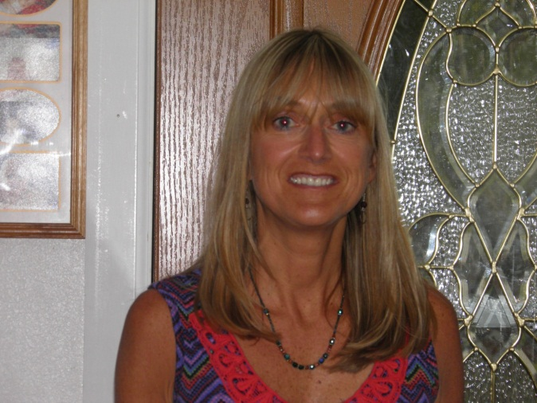
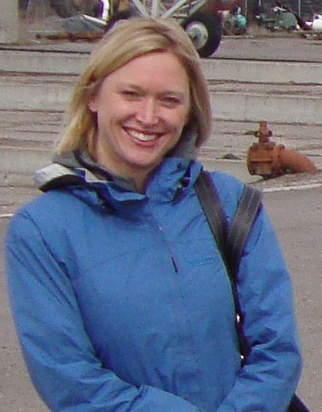
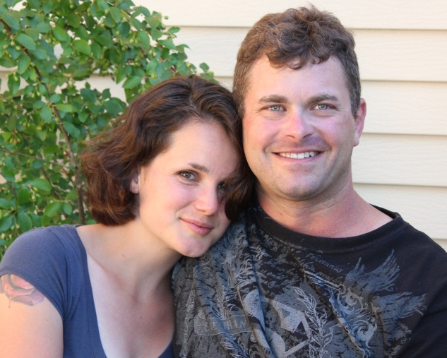
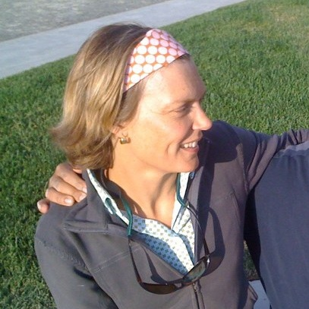
2013
Graduates
Not Pictured: Marcia Dias, Dana Fejes, Deborah Gibson, Saskia Jacobson, Jennifer Just, Heidi Lasher

Slide 3
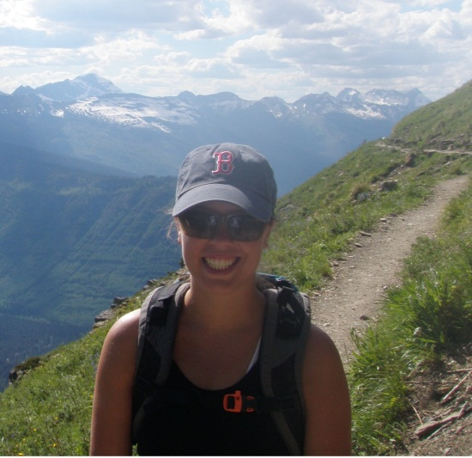
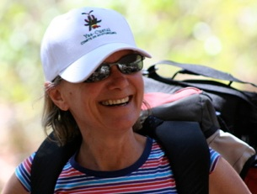
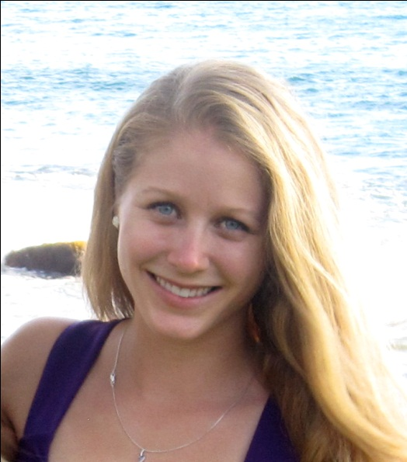
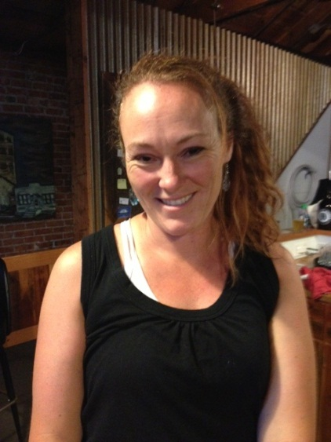
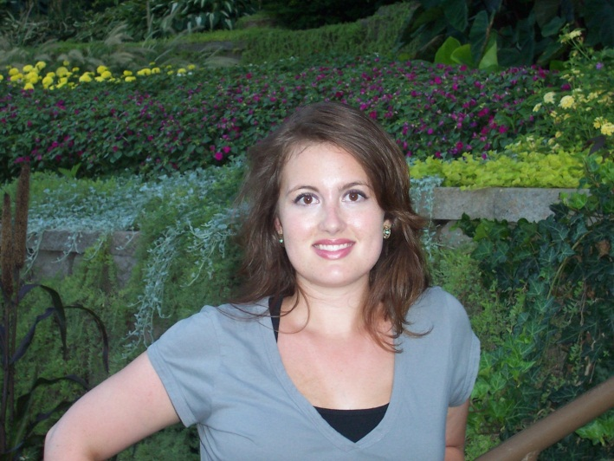
2013
Graduates
Not Pictured: Druanne Prescott, Silvia Puliti, Ashley Rice, Blair Snyder, Margaret Springer

Slide 4
2013
Graduates

Slide 5
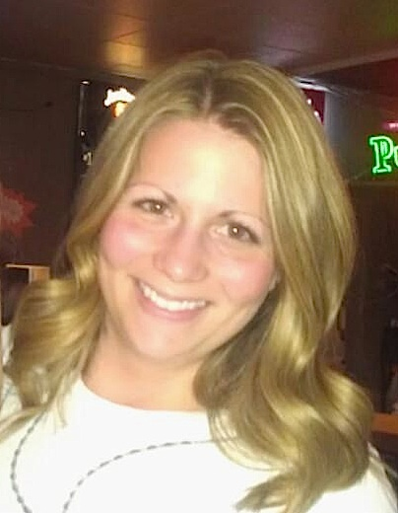
Carly Borth
MPH
05/18/2013

Slide 6
Marcia Dias
CPH
05/18/2013

Slide 7
Dana Fejes
MPH
05/18/2013

Slide 8
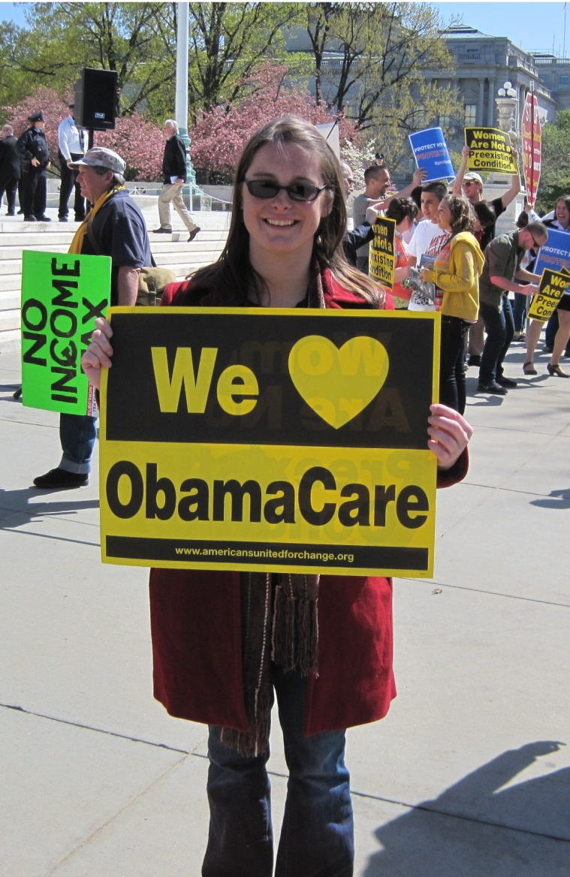
Kathryn Fox
MPH
05/18/2013

Slide 9
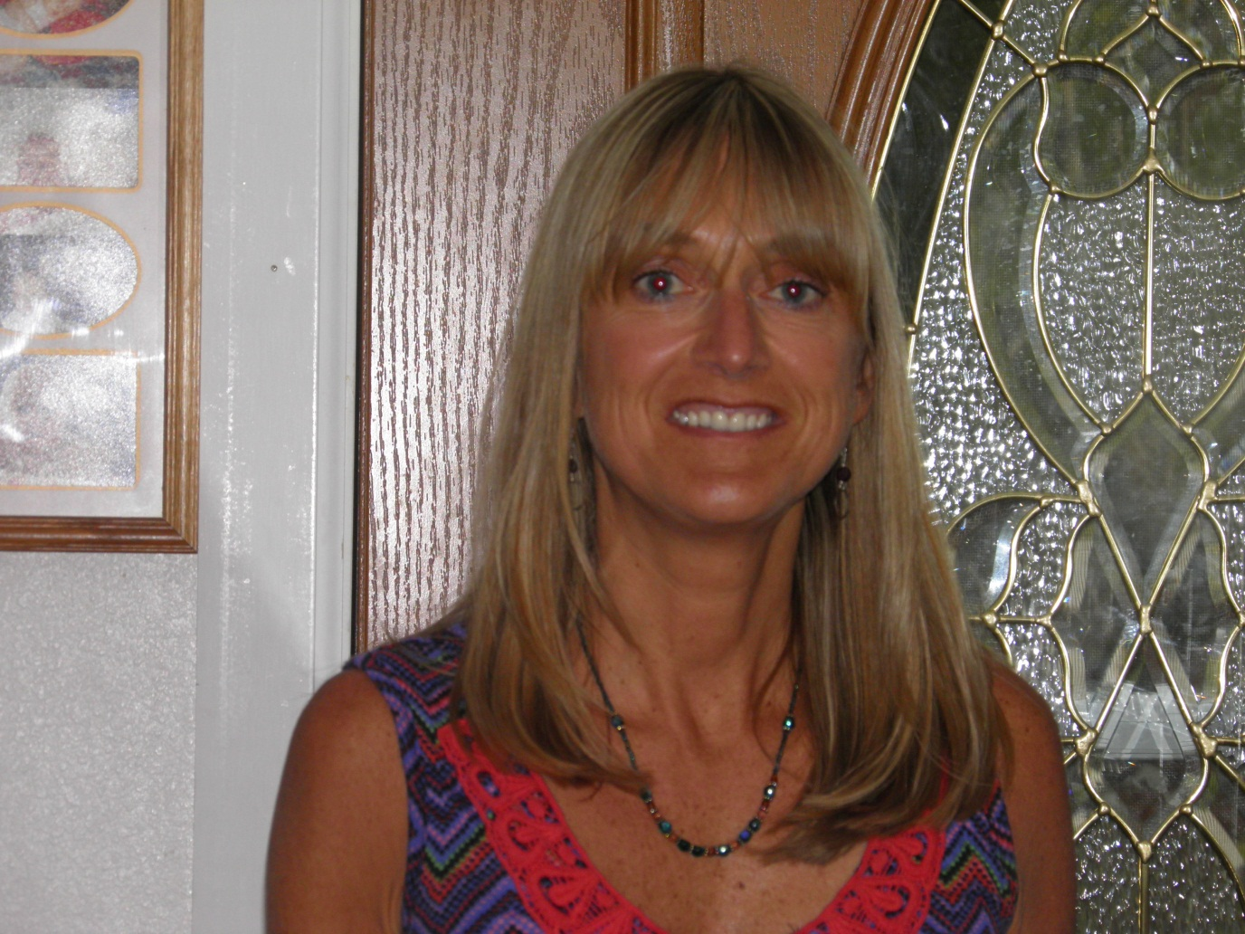
Deborah Gibson
MPH
05/18/2013

Slide 10
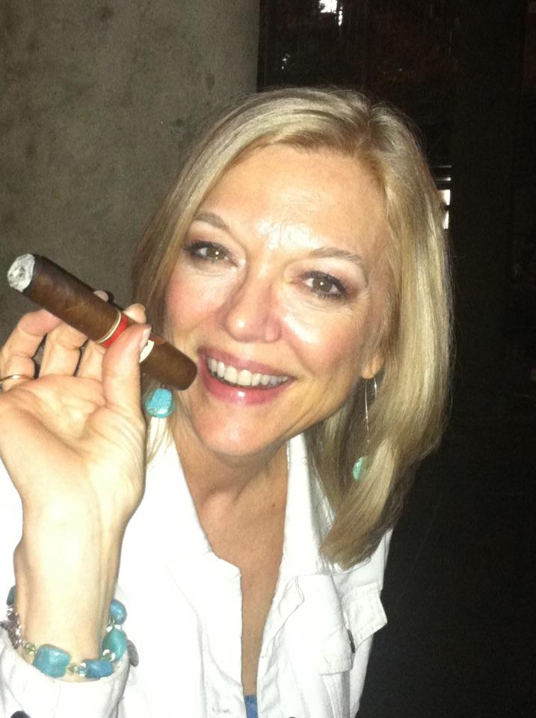
Gin Graham
CPH
05/18/2013

Slide 11
Saskia Jacobson
MPH
05/18/2013

Slide 12

Jennifer Just
CPH
05/18/2013

Slide 13
Heidi Lasher
CPH
05/18/2013

Slide 14
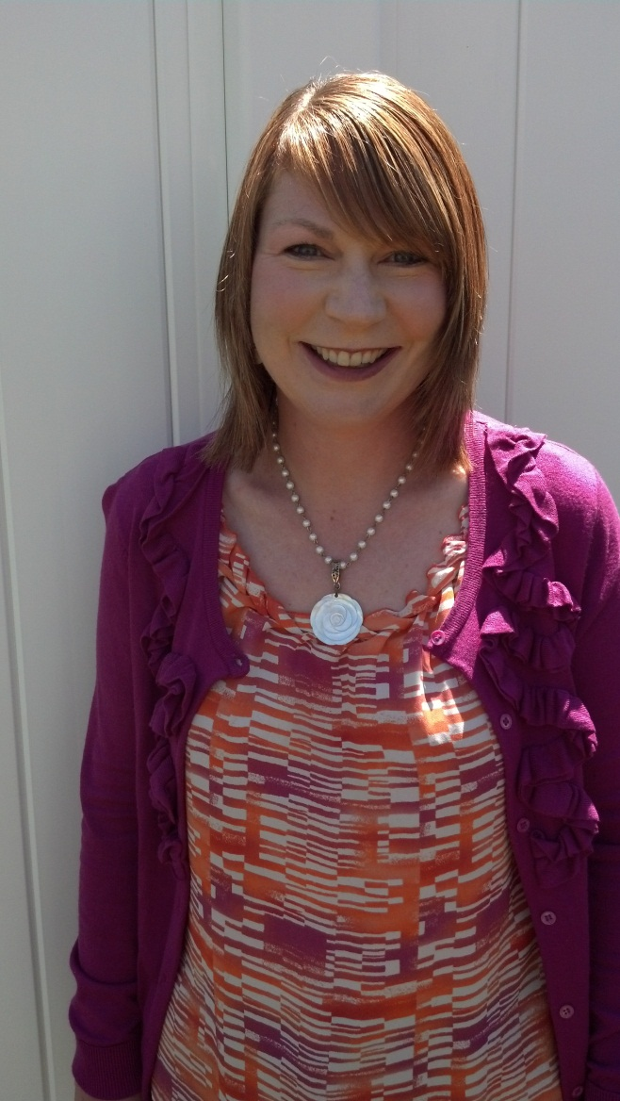
Janell Porter
MPH
05/18/2013

Slide 15

Druanne Prescott
MPH
05/18/2013

Slide 16
Silvia Puliti
MPH
05/18/2013

Slide 17
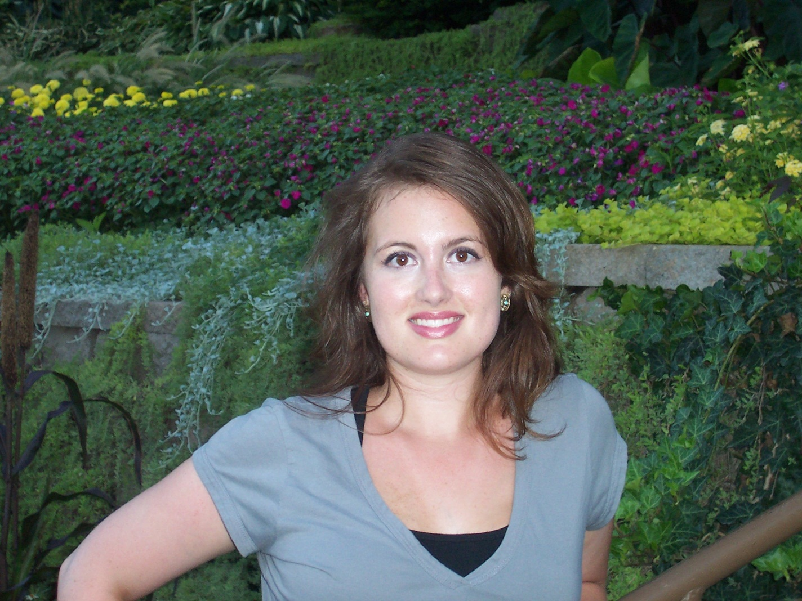
Ashley Rice
CPH
05/18/2013

Slide 18
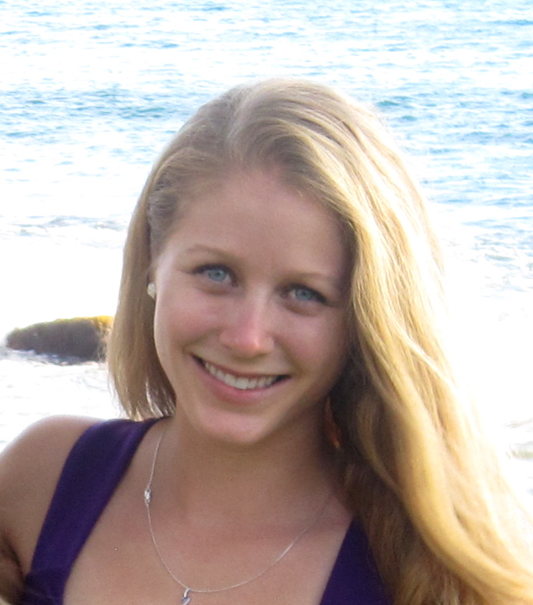
Blair Snyder
CPH
05/18/2013

Slide 19
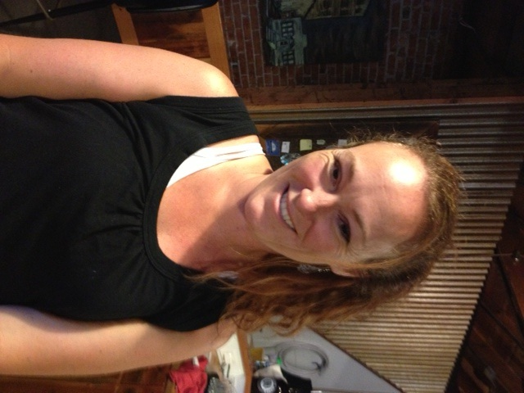
Margaret Springer
CPH
05/18/2013

Slide 20
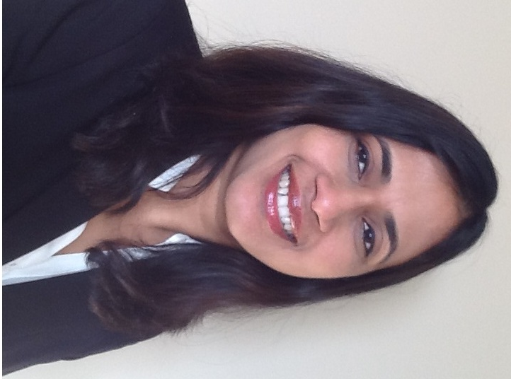
Ushakumari Valappil
MPH
05/18/2013

Slide 21
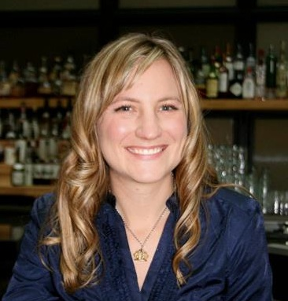
Tracie Weiss
MPH
05/18/2013

