Slide 1
Graduation 2015
School of Public and Community Health Sciences

Slide 2
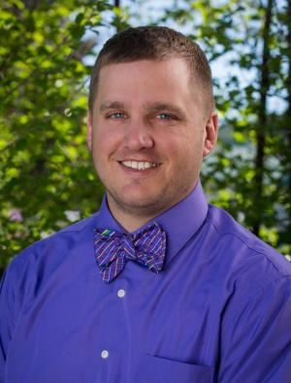
Edward Amberg
MPH

Slide 3

Samantha Birch
MPH

Slide 4
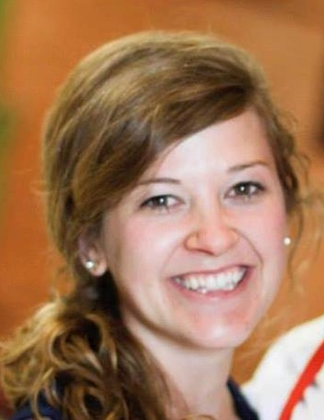
Megan Broekemeier
MPH

Slide 5
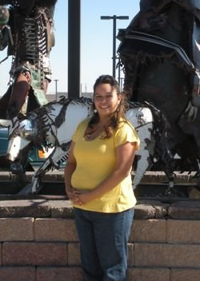
Cicily Bull Calf
CPH

Slide 6
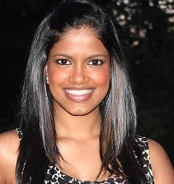
Karishma Chainani
CPH

Slide 7
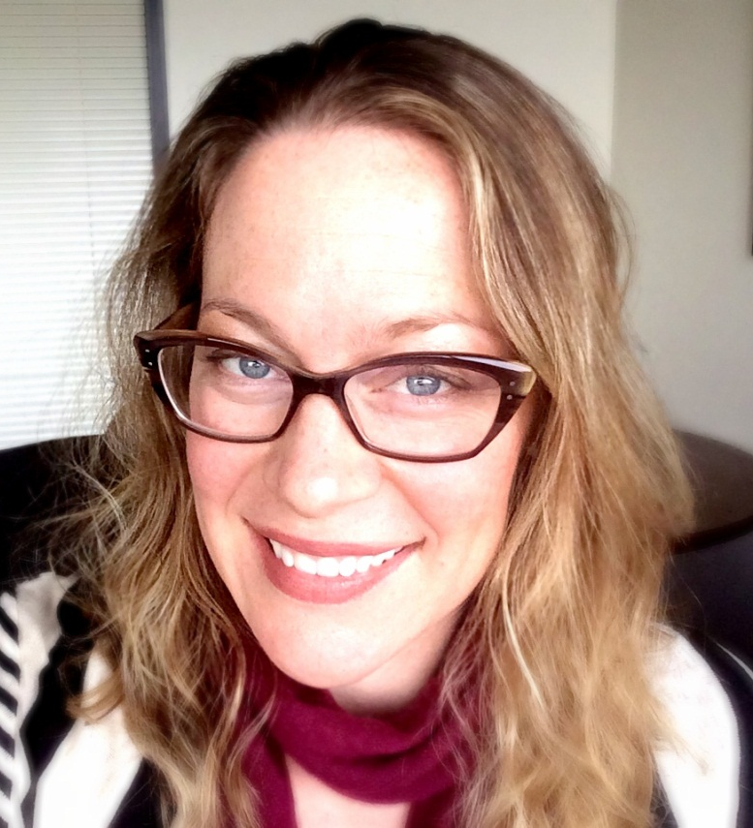
Erin Friedman
MPH

Slide 8
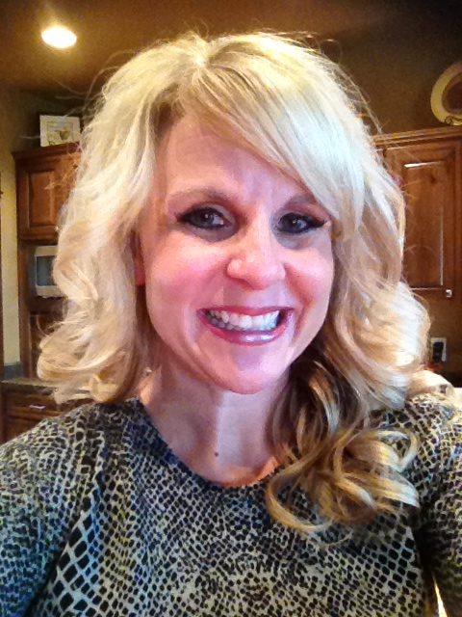
Molly Hale
CPH

Slide 9
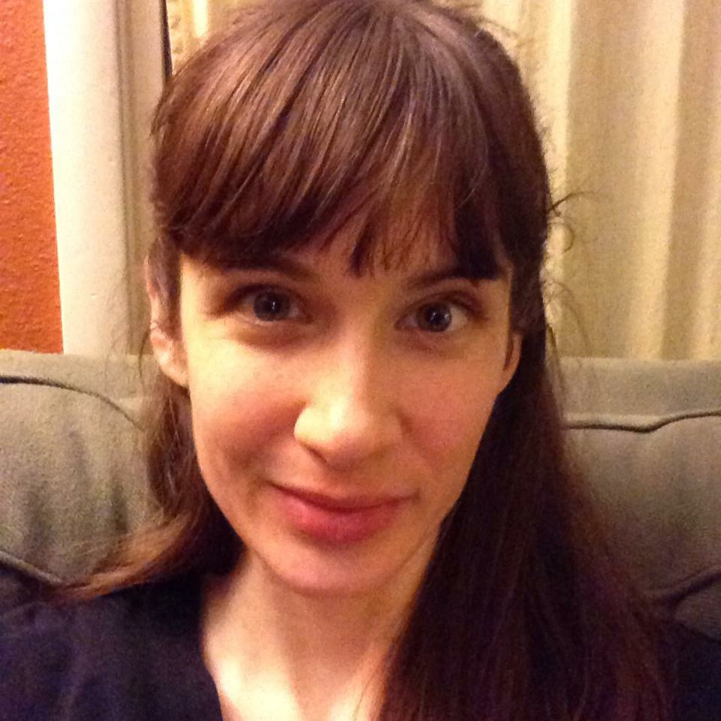
Cara Hiebert
CPH

Slide 10
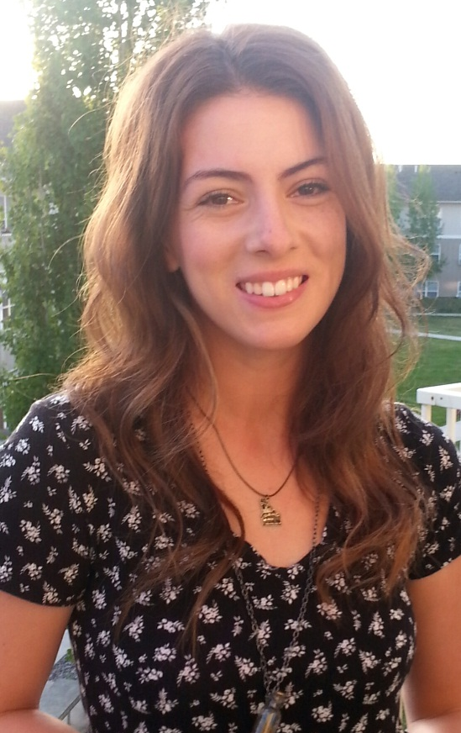
Emilee Kottcamp-Allen
MPH

Slide 11
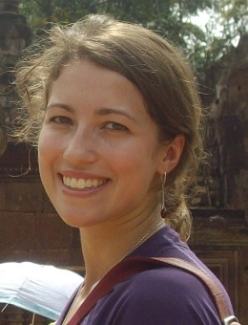
Stephanie Lackey
CPH

Slide 12
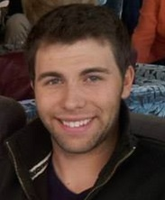
Justin Martin-Whitlock
CPH

Slide 13
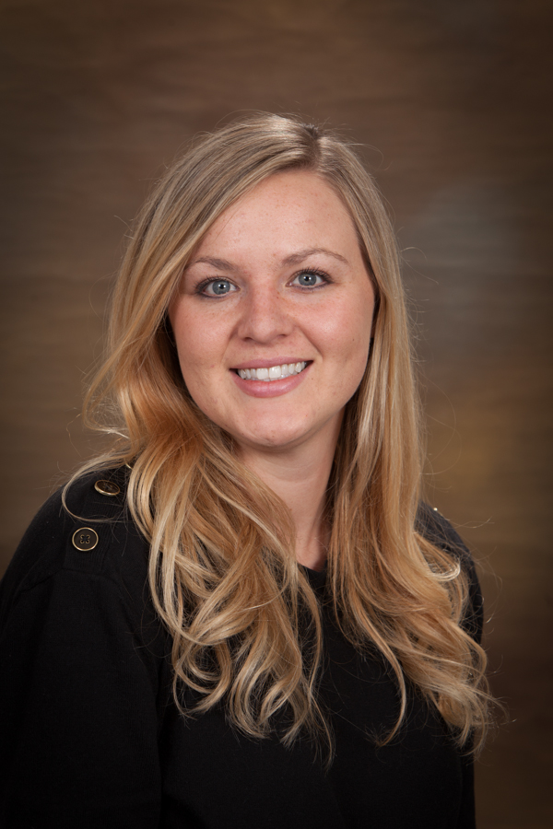
Kaitlen McDonald
CPH

Slide 14
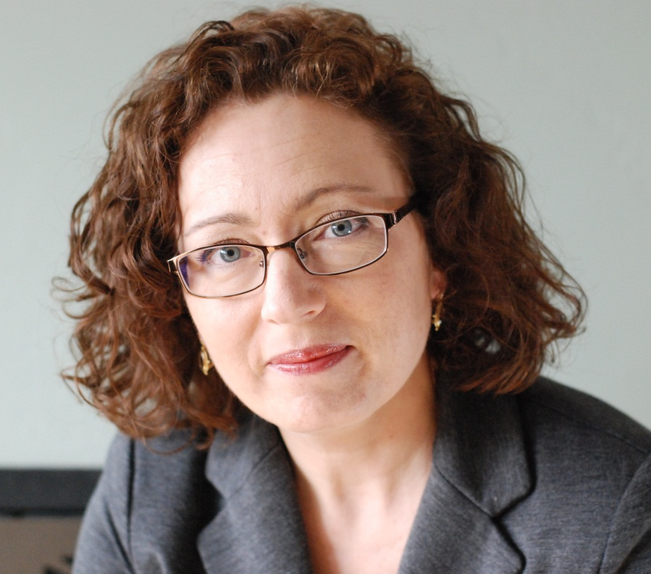
Emily River
CPH

Slide 15

Helen Russette
MPH

Slide 16
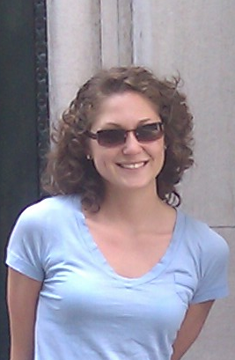
Rhainnon Simon
MPH

Slide 17
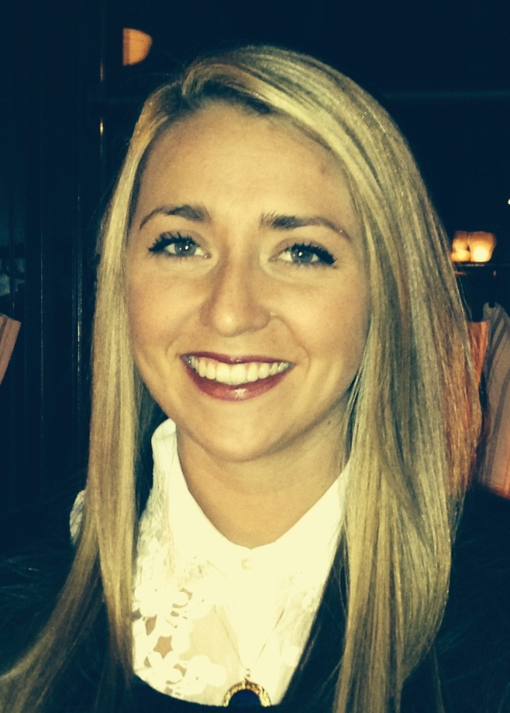
Erika Strehl
MPH

Slide 18

Jane Van de Grift
CPH

