Slide 1
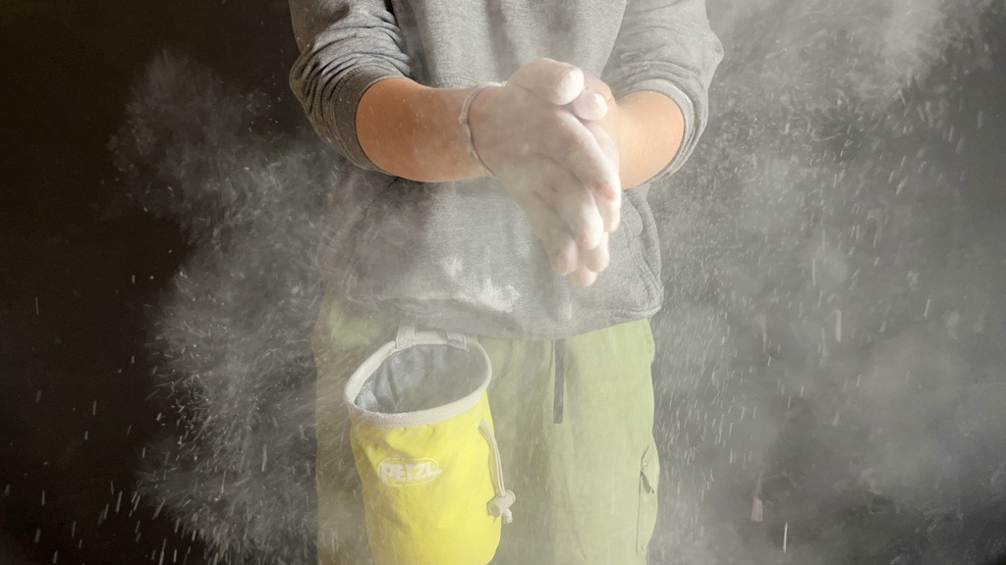
Particulate matter 2.5 levels in a climbing gym on Set Day vs a normal day
By Claire Lane
Capital High School, Honors Biology 1, Mrs. Urban

Slide 2
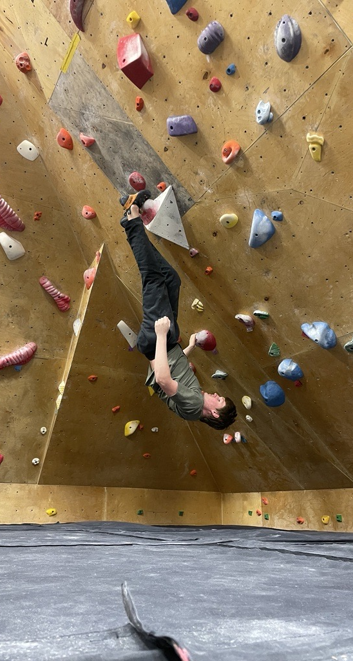
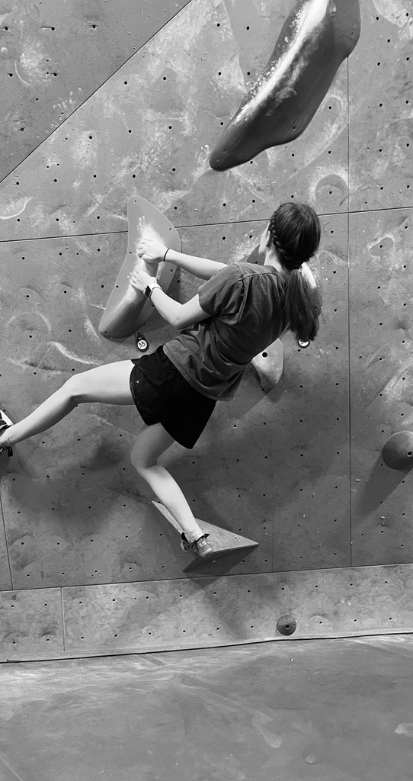
Question
Does the particulate matter (PM) 2.5 level vary in a climbing gym on Set Day, the busiest day of the week, vs a normal day?
Hypothesis
If its set day, then the PM2.5 levels will be higher, because there are more climber in the gym on that day, so more chalk is used, causing the PM2.5 level to rise.

Slide 3
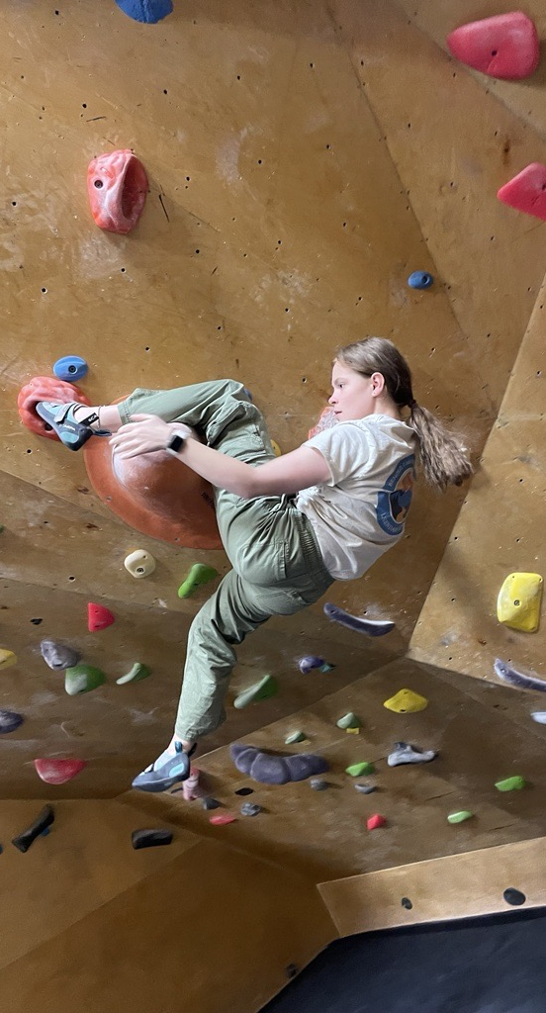
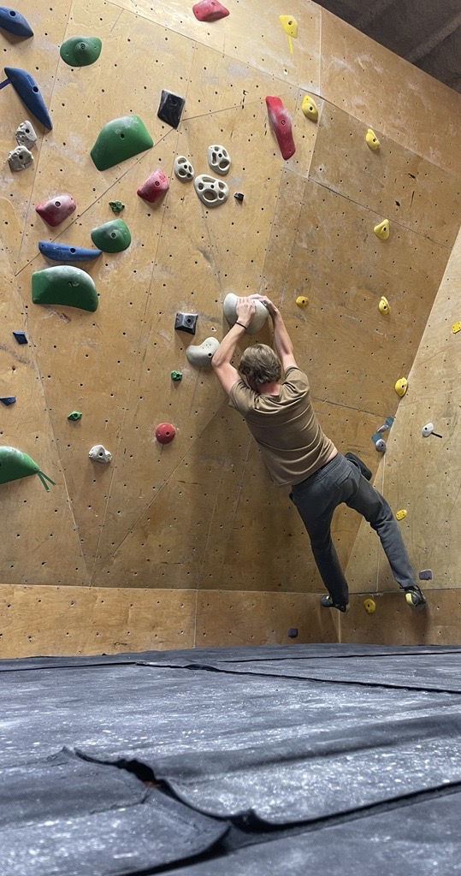
Background
Main pollutant in climbing gym is magnesium carbonate (chalk)
Chalk is non-toxic but will aggravate preexisting breathing conditions
Filter systems in climbing gym help the air quality of the building
I have friends and fellow climbers who have asthma or other breathing conditions.
Go climb on set day, or Normal day?
Notes:
In a climbing gym the most prominent pollutant will be magnesium carbonate, which is just chalk. Climbers use this to dry out their hands in order better grip the climbing holds, so often it's floating in the air. The purpose of this experiment was to see if particulate matter level would change on Set Day vs a normal day. Set day is the busiest day of the week, because new climbs have been put up on the wall so everyone wants to try the new routs. Thank fully climbing chalk is non-toxic so it cant cause things such as cancer but it can aggravate preexisting conditions like asthma. While many climbing gyms, including mine, have filter systems to help the air quality of the building, it's in no way fool proof. I have friends and fellow climbers who have asthma or other breathing conditions. So, I wanted to see if they should go on set day, which admittedly is the best day of the week to climb, and potentially risk their health, or on a regular day to better protect their lungs.

Slide 4
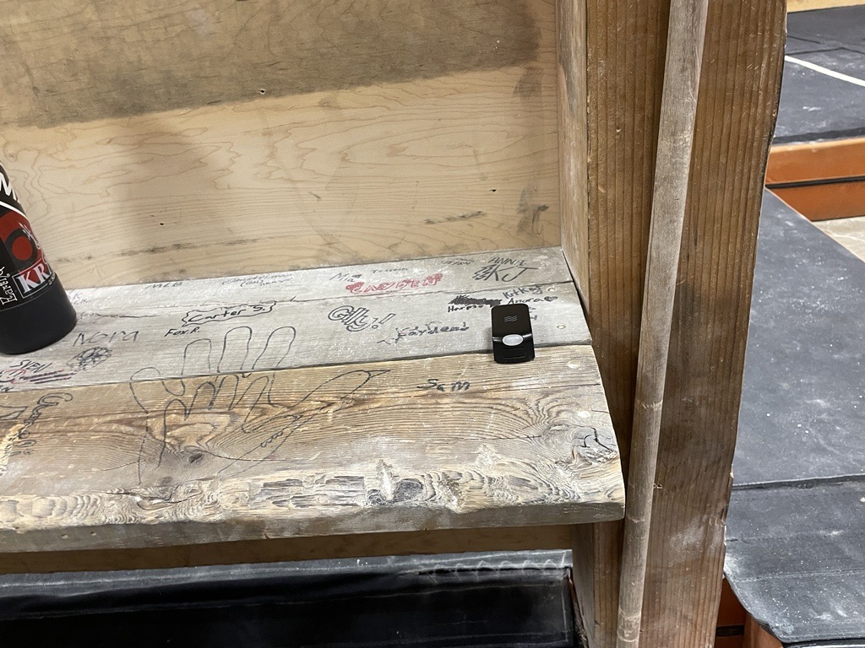
Materials, Procedure, and Variables
Independent Variable – What day it is (set day or normal)
Dependent Variable – level of PM2.5 inside climbing gym
Control – Level of PM2.5 on a normal day
Materials
Wynd senser
Climbing gym
Procedure
Take air quality outside gym for 10 min (5 in from door, sitting on ground against wall).
Put senser about 15 feet in front of wall that had been newly Set (where the most people are).
Have the senser get data every second, set it on the mat or bench and let it run for 10 min; once time is up let sit for 10 min (repeat process a total of 3 times).
Move senser outside (make sure your hands and senser don’t have chalk on them) and repeat step one.
Repeat steps 1-4 again at the same climbing gym on a day besides set day (make sure there is no special events on that day).

Slide 5
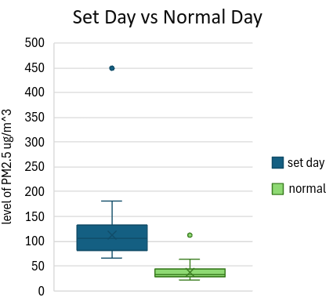
Results:
The level of PM2.5 outside the climbing gym was between 20 and 30 ug/m³, on both days, showing the variations seen below are only in the climbing gym.
On the Set Day vs Normal Day graph, we can see that on Set Day the level of PM2.5 is higher than on a normal day
The red line is what the EPA recommends as your daily average intake of PM2.5
.

Slide 6
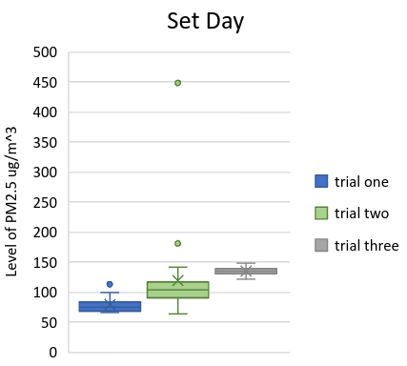
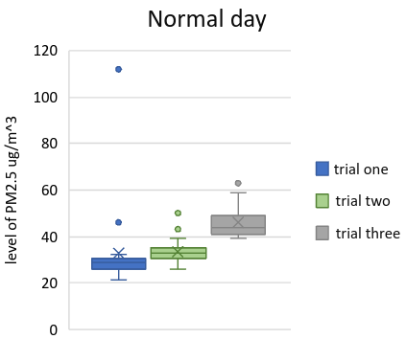
Results
As it gets later in the day, the more PM2.5 level is higher. The red line is the EPA average again. My control (Normal day) is still slightly above the average the EPA recommends but that was taken at the end of the day so most of the day is below what is recommended. Again, showing just how high the PM2.5 level is on set day.

Slide 7
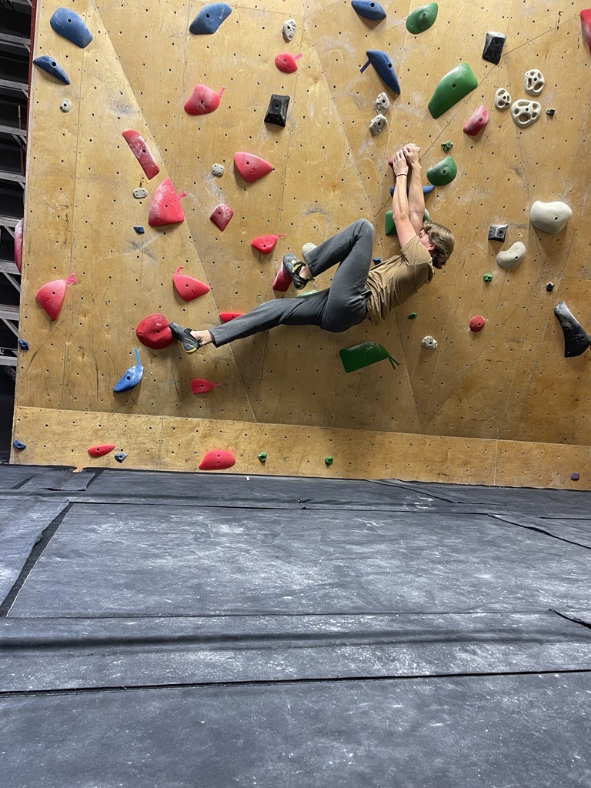
Places of Error, Improvements and Limitations
I was only able to go to the gym for 2-3 hours at the end of the day : Leave the sensor at the gym all day
I only had the sensor for three days : More trials
One of the three days I had the sensor it stopped working so I only have 2 days' worth of data
The senser was only getting the level of PM2.5 in one spot, which isn't accurate as to what the climber is breathing in while on the wall : Attach the sensor to climber

Slide 8
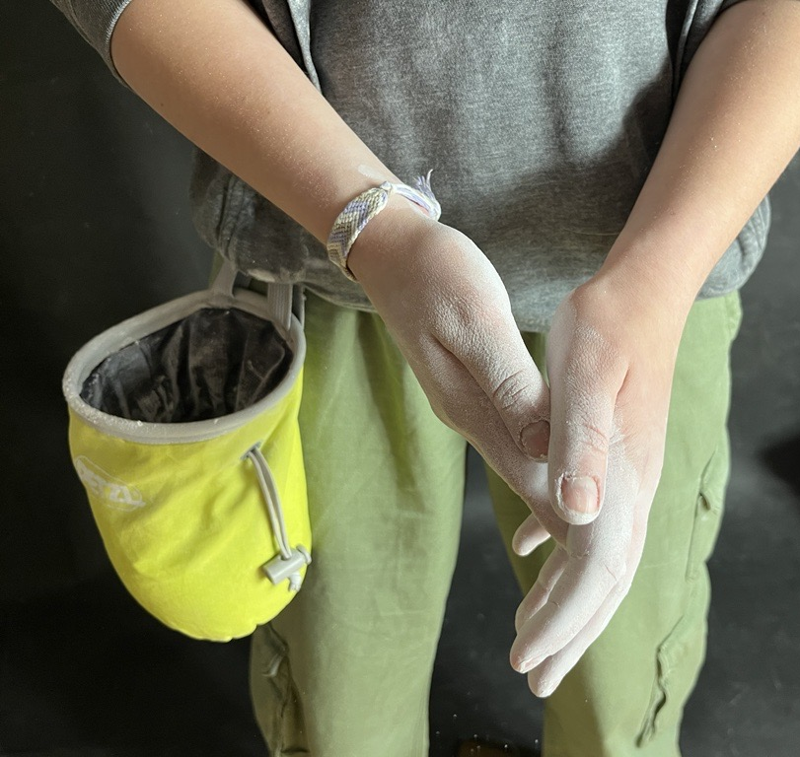
Conclusion
My hypothesis was supported by the data I gathered. As seen by the graphs on Set Day the amount of PM2.5 in the air is higher than on a normal day (which is still above what the EPA says. Which is in 24 hours one should not inhale more than 35.0 ug/m³, and a person's annual daily average should be 9.0 ug/m³, or below. ). The higher level on Set Day is most likely due to the amount of people in the gym being higher on those days, so more chalk will be used.
Notes:
Conclusion - My hypothesis was supported by the data I gathered. As seen by the data, on Set Day the amount of PM2.5 in the air is significantly higher than on a normal day (which is still above the daily average you should be breathing). The higher level on Set Day is most likely because the amount of people in the gym is higher on those days, so more chalk will be used.
Next steps - Our climbing gym does have an air filter, but it is on the celling, so going forward we may want to have one or two filters on the ground to ensure the chalk that is settling on the ground is getting filtered out. Also, if you have a breathing condition, I recommend that you start climbing earlier in the day and not on set day.

Slide 9
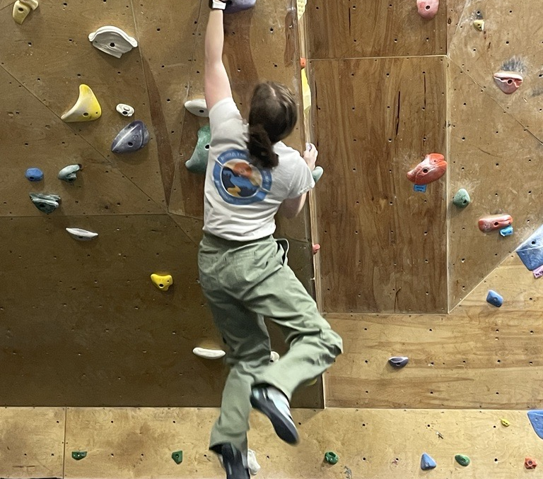

Next Steps
The Climbing Gym
Our climbing gym does have an air filter, but it is on the celling, so going forward we may want to have one or two filters on the ground to ensure the chalk that is settling on the ground is getting filtered out. Also, if you have a breathing condition, I recommend that you start climbing earlier in the day and not on set day.
The Experiment
I want to run more trials, attach the senser to climbers and different level of climbers. As well as see if the time of year is a factor.

Slide 10
References
Ashley, Amanda. “Chalk Dust: Mitigation & Source Control.” Chalk Dust: Mitigation & Source Control - Climbing Wall Association, 10 June 2019, www.cwapro.org/blog/chalk-dust-mitigation-and-source-control#.
Revised Air Quality Standards for Particle ..., www.epa.gov/sites/default/files/2016-04/documents/2012_aqi_factsheet.pdf. Accessed 1 May 2024.
Weinbruch S;Dirsch T;Kandler K;Ebert M;Heimburger G;Hohenwarter F; “Reducing Dust Exposure in Indoor Climbing Gyms.” Journal of Environmental Monitoring : JEM, U.S. National Library of Medicine, pubmed.ncbi.nlm.nih.gov/22767051/. Accessed 2 May 2024.
“Dust Exposure in Indoor Climbing Facilities.” DUST EXPOSURE IN INDOOR CLIMBING FACILITIES, Berkeley B ALMAND-HUNTER, Joanna GORDON, Nick MASSON, Michael P HANNIGAN and Shelly L MILLER, asac.nl/wp-content/uploads/2020/02/DUST-EXPOSURE-IN-INDOOR-CLIMBING-FACILITIES.pdf. Accessed 9 May 2024.

