Slide 1

Scholarship Universe Training
Stewardship Process,
Fund Reconciliation,
& Looking Ahead
Notes:
---

Slide 2
Agenda
Stewardship Process and Expectation for Upcoming Cycle 2026-2027
  Brief Q/A Regarding Stewardship Process
Fund Reconciliation and Correction Process
  Upcoming Deadlines Explained
Moving into Summer SU Phase 2
End on Q/A

Slide 3
Stewardship Process Moving Forward
Scholarship Universe has an automatic “Thank You Letter” template and software—we have worked closely with the UM Foundation, who have been amazing partners in this process, to create the prompts that students will see when they are awarded a scholarship.
Explore student view in upcoming slides, and turn time over to Foundation from there to dive deeper into how they plan to manage the stewardship process
If you have any questions regarding the stewardship process, we will share contact information with the UM Foundation stewardship team moving forward if you need to set up a meeting to discuss any concerns regarding stewardship for your area.
Note: All stewardship efforts/thank you letter collection will be managed by the Foundation at this time. This is the expectation for all departments on campus, and the goal is to have all campus departments compliant with this policy in the future.

Slide 4
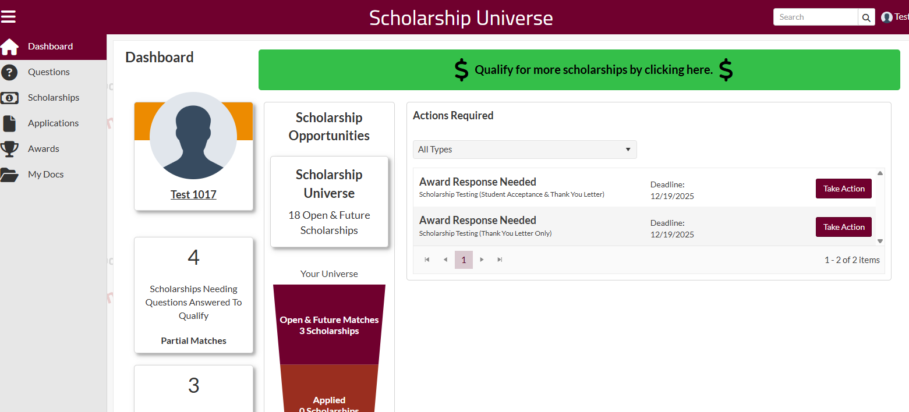
Student Thank You Experience in SU
Login to Dashboard
Toggle to “Awards”
Review “Action Items”
Fill out Scholarship Thank You Letter template prompts

Slide 5
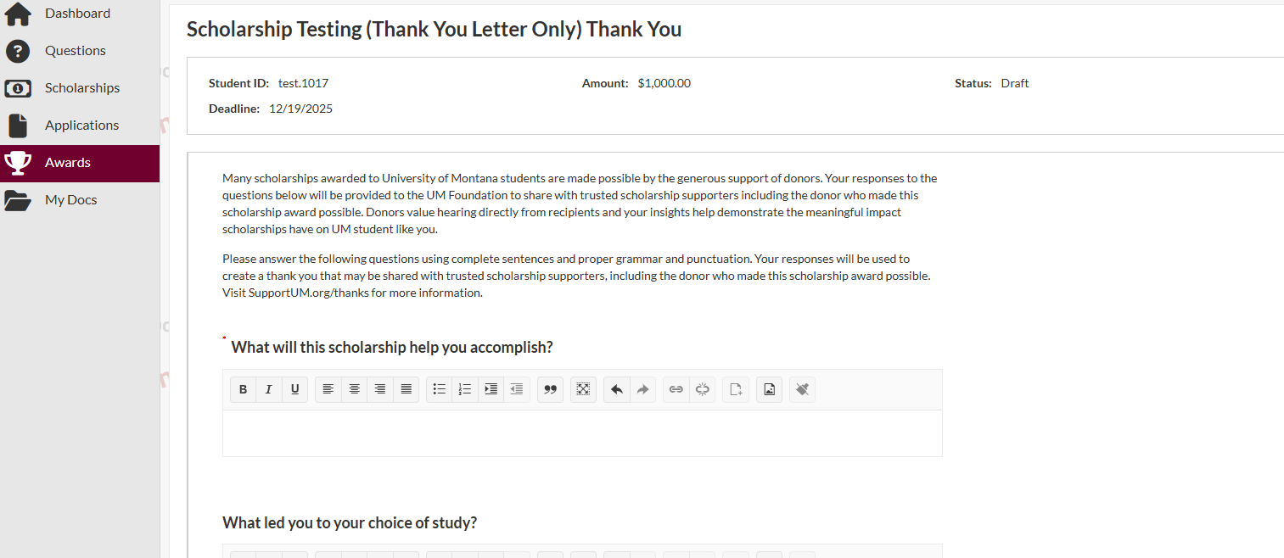
Student Thank You Experience in SU Cont’d
What will this scholarship help you accomplish?
What led you to your choice of study?
What accomplishments would you like to highlight from your time at UM, including academic achievements, internships, study abroad or other experiences?
What are you looking forward to accomplishing at UM and in your future career/profession?
What would you like to say to the donors who support scholarships for UM students?
Please enter your name, if you are willing to share it with scholarship supporters, or you can write “Grateful UM student” if you prefer not to share your name.

Slide 6
All awards in SU will have deadline of August 1
Students will receive reminders before deadline
SFS will waive requirement by 8/1/26 so accounts are not affected
Student Deadlines & Reminder Communication

Slide 7
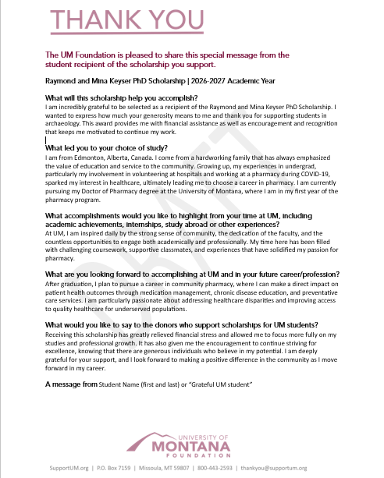

Thank-You Letters to Donors
If you have any questions about student thank you, please contact Jenise Amestoy at jenise.amestoy@supportum.org.
Notes:
UM Foundation will download thank-you letter content and mail to appropriate scholarship supporters

Slide 8
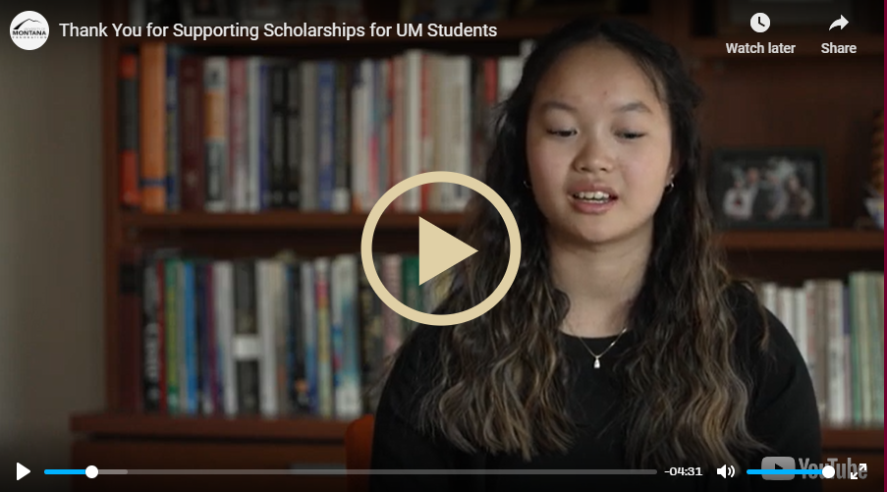
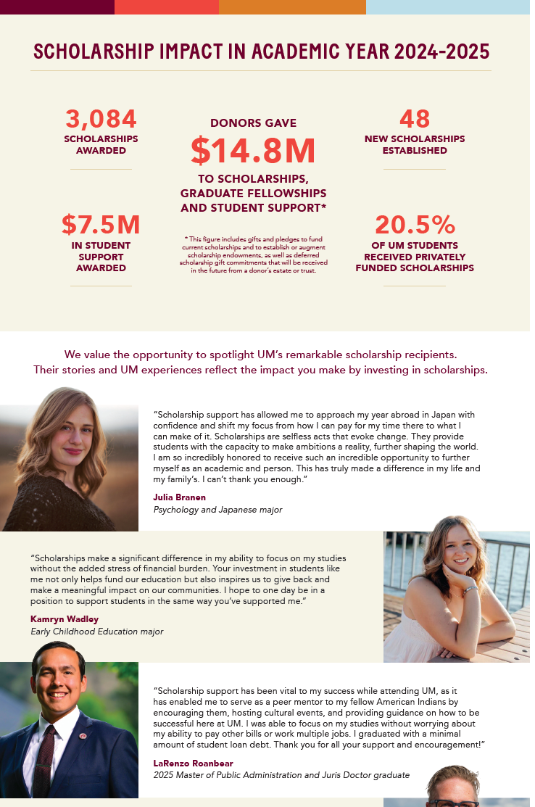
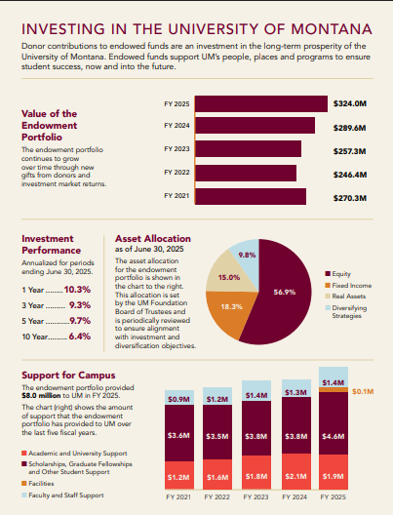
UM Foundation Scholarship Impact Communications
SPRING | Video
FALL | Mailing
WINTER | Endowment Report
Notes:
https://supportum.org/outreach/stewardship/scholarship-impact.php and https://www.supportum.org/newsandinformation/financial-statements/fy25umfoundationendowmentreport.pdf

Slide 9
Fund Reconciliation & Corrections in SU
Notes:
https://umt.scholarshipuniverse.com/school/award

Slide 10
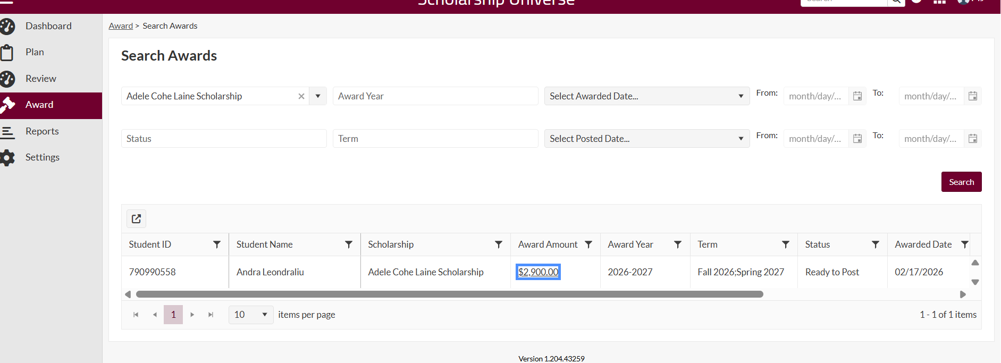
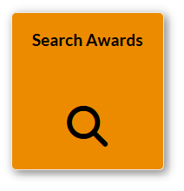
How to make award corrections
Toggle to Award Tab,
Go to “Search Awards” Box
Click Award Amount
Adjust award accordingly, include comment/date of adjustment
From here, Banner will pull back award, budget should re-appear in SU and you can reallocate funds

Slide 11
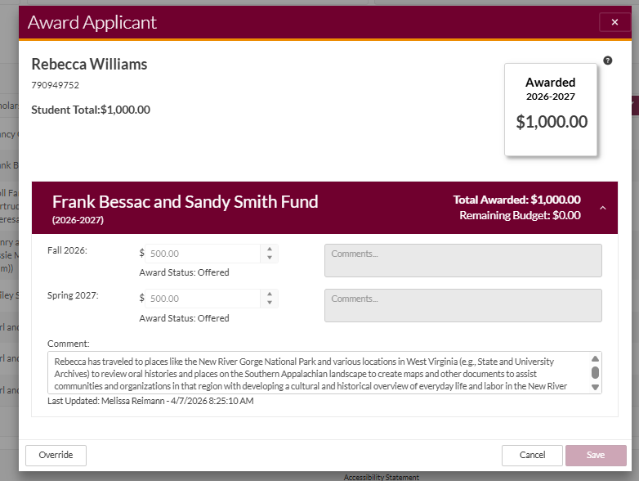
How to make award corrections part II
Select “award amount” for this window to pop up. You will need to then hit the “override” button, and leave and updated comment as to why you are changing the award. You can keep original comment, and insert update after original.
Once saved, this SHOULD go and post to banner or pull award back from banner.
This will need to be clicked in order to update award

Slide 12
Award Summary Sheets & Correction Sheets
We are trying to move away from these!! If your funds can be tracked within the portal, we would like to put them into the portal.
We will not be posting AWSS and CAWSS for FY 26-27, rather please reach out if you see that a fund is not in Scholarship Universe, and we can either add it or send you these sheets as needed,
Currently working on loading programmatic funds into the Universe by Mid May, and set up as direct awards (auto-match) so you can continue to award these with the flexibility .
We won’t be getting rid of these, but also only want to use them as needed.
Notes:
If you have programmatic funds that are in use—please reach out so we can continue to get these loaded into the Universe!

Slide 13
AWARDING DEADLINE BREAKDOWN
2025-2026 AWARDS
These MUST be in by April 1. We will not process any 2025-2026 awards sent after this point,.
If you have sent an AWSS by April 1, your awards will be processed.
2026-2027AWARDS
Goal to award all your scholarship funds by April 1.
Please, let us know if you have funding you are holding onto for Spring.
Earlier awards = more success overall
Notes:
2025-2026 Awards- as we are too close to Fiscal Year end to continue to accept awards in this fund cycle, and it is too heavy of a work load to manage/room for too much error
More flexible, but we are trying to set students up for success with payment deadline. Earlier awarding helps avoid beginning of semester chaos, also help students choose or STAY at UM

Slide 14
What’s Next?
Summer Meetings: I will be reaching out to meet with each area on campus to continue to refine SU awarding process.
Great time for application adjustments, criteria questions, adding funds to SU that aren’t there, or adding an external application system that you use into SU. Having everything in one place helps A LOT
Start thinking about which of your funds may not need an application, lessen burden for students.

