Slide 1

APRIL Scholarship Forum
With the Financial Aid Office, UM Foundation and Business Services
April 5th, 2024
Notes:
Raven presents
Complete.

Slide 2

February Scholarship Forum Recap
Topics covered in the last Forum:
Summer 2024 Awarding
UM Box - UNIT / DEPT Scholarship Folders
UM Scholarship Portal and FAFSA Updates for the 2024 – 2025 Academic Year
Notes:
Raven presents
24-25 Fafsa updates
24-25 Award offers
Reviewer and reference login update
Reviewer groups and rubrics
How to offer awards via the Portal

Slide 3


Academic Year Timeline & Monthly To Do List
Notes:
Raven Presents:
Complete.

Slide 4
2023 - 2024 Academic year timeline
April 1st – Was the last day to submit 2023-2024 Spring only and regular Full year awards​.
  Exceptions for graduation awards or awards that are dependent on end of term/year criteria.
All final 2023 – 2024 awards must be made using an award summary sheet
  Complete reconciliation of all funds. ​
    UM Scholarship funds should have a $0 fund balance at fiscal year-end. ​
    You can view your fund balance in Banner in FGITBSR (you will need the fund number) and in UMDW in the "General" tab > Trial Balance
May 3rd – Last day of regular classes.
May 6th – May 10th – Final Exams
May 11th - Spring Commencement
Wrapping up reconciliation of all funds.
Reconciliation of funds should be complete.
June is the end of Fiscal Year. Business Services and FAO will be working on completing any fiscal year end items at this time.
April
May
June
Notes:
Raven Presents:
Complete.

Slide 5
2024 - 2025 Academic year timeline
Continue awarding for Summer 2024 and academic year 2024-2025.
Continue awarding for Summer 2024 and academic year 2024-2025.
May 20th – Classes begin for 10-week summer session and 5-week summer session I.
May 27th – Memorial day – No classes, offices closed
June 1st – All 2024-2025 awards must be made by this date.
June 21st – Last Day of Classes for 5-week Summer Session I
June 24th – Classes Begin for 5-week Summer Session II
April
May
June
Notes:
Raven Presents:
Add any updates for 24-25 need- based scholarship awarding.

Slide 6



UM Foundation Reminders and Updates
Scholarship Budget Updates​
The Foundation continues to make 2024-2025 revisions/updates to scholarship budgets, please be sure your Box notifications are turned on, so you receive notice.
Reminders: ​
  For Department Funds, administrators, please review your 2023-2024 budgets and expenditures to inform UMF (Korla) on what you would like to budget for the 2024-2025 academic year.​
  The Foundation updates scholarship budgets in Box as money is received, processed, and reviewed. Please allow a few business days once money is received. ​
If you have scholarship budget questions or updates, please contact our Scholarship Administrator, Korla McAlpine at korla.mcalpine@supportum.org.
A message from our Stewardship team:
Please find the new version the UM Foundation Scholarship Thank You Letter template at https://www.supportum.org/scholarship-letters/default.php under the “Writing Your Letter” header.
Students can email completed thank you letters to the UM Foundation at thankyou@supportum.org for the remainder of the 2023-24 academic year, unless they were instructed differently.
Please contact the UM Foundation before you publish this content so we can ensure that the information about donors is accurate and up-to-date. We are always happy to help verify this information.
  Please contact the UM Foundation if you have any questions about scholarship donor stewardship at thankyou@supportum.org.
Scholarship Department Administration Musts:
  Administer scholarships in accordance with UM and UMF policies, procedures, and protocol.
  Make every effort to fully utilize all scholarship funds.
  Award through a consistent, documented process, in a fair and equitable manner.
  Adhere to documented criteria and donor intent.
  Verify “Financial Need” through the Financial Aid Office or via the Scholarship Portal.
  Pay directly to the students’ accounts to assist with expenses related to the students’ incurred costs.
If you are unable to find a student who meets the criteria, please contact the Foundation-Scholarship Team. Please do not contact the donor(s) to request an exception.
Scholarship Administrator Contact Email Listserv
Please send the Foundation and Financial Aid Office any new contacts (and their info including their umontana employee email address) who are assisting with Scholarship Administration in your unit/department or program.
Please contact the Foundation for Scholarship Budget or Criteria questions.
Notes:
Raven Presents:
Stewardship Updates - Ask Makaya if she would like to be included.

Slide 7

SUMMER 2024 SCHOLARSHIP AWARDING REVIEW
Submitting Summer Award Summary Sheets
Requests for Summer 2024 AWSS should be sent to the UM Foundation email (umfawardsummarysheets@supportum.org).
Please follow the instructions below to submit your Summer 2024 Award Summary Sheet:
Fill out ALL information asked on the Summer 2024 Award Summary Sheet.
Review fund and student information to ensure ALL information is accurate.
Collect the signature of your dean, director, or other specified “responsible party” who can approve awards. If you are unable to collect a signature, please be sure the specified “responsible party” can include the Summer Award Summary Sheet attachment with their email approval.
Send the Summer Award Summary Sheet attachment (that includes the signature) by email to the Financial Aid Office for processing fascholarships@mso.umt.edu AND CC the Foundation umfawardsummarysheets@supportum.org.
The email SUBJECT LINE should include: SUMMER 2024 Award Summary Sheet – Dept/Unit Name.
For Foundation Scholarship funds, please confirm the following:
Check your scholarship box folder to review budget amounts AND criteria
Check if you have already submitted a 2024-2025 AWSS
Check if you have already offered a scholarship in the Portal
Additional Information:
For Scholarships, the 2024-2025 AY budgets includes summer awards (if any)
Disbursements in Banner or UMDW will not display until a week or two prior to the first day of the semester, therefore, it is important to track how you are awarding scholarships.
For Foundation Programmatic funds, confirm the following:
Check that you have a sufficient cash balance in the fund
  Review your accounting report or discuss with your fiscal administrator
Check the funds’ purpose/criteria
Key Take Aways
Summer awards cannot be made in the Portal.
By submitting your Summer Award Summary Sheet you acknowledge the above has been reviewed AND your department will be responsible for any over-awards made.
Please send Summer 2024 AWSS separately, do not mix with new 2024-2025 awards.
Notes:
Raven Presents:
Complete.

Slide 8
Financial aid office updates and reminders
2023 - 2024
​
2024 - 2025
​
Scholarship Portal Update:​
  All final 2023-2024 awards were due April 1st. Questions? Contact fascholarships@mso.umt.edu
  AWSS and CAWSS for 2023-2024 will no longer be available on the Department Scholarship Resources webpage after April 12th 2024. If you are needing one of these after this date please reach out to Financial Aid.
Award Summary Sheets for the 2024-2025 year will be available at the end of May.
Please make scholarship awards via the Scholarship Portal in the meantime.
If your scholarship is not in the Portal please reach out to fascholarships@mso.umt.edu and we can work with you.
Scholarship Portal and Reviewer Update:
We have seen a record high with submitted general applications for the 2024-2025 year. Due to this Reviewers WILL be seeing HIGHER numbers of applications to review.
Remember to check qualifications in each of your opportunities to match criteria provided by the UM Foundation.
Please make sure to login and add open and close dates. (This must be done every year after cycle management)
Opportunity Administrator Request Form
If you need to request access for an individual to be an Opportunity Administrator in the Scholarship Portal. Please have your Dean/Director fill out the following webform. https://www.umt.edu/finaid/scholarships/opportunity-admin-request.php
A link to this form has been added to the Department Resources Webpage.
Please make sure to include the individuals’ NetID as this will allow us to grant them access.
Reminder: Please allow at least 10 business days for processing.
Notes:
FAO Presents
Ask for updates, information may change before forum regarding “early April” FAFSA Deadline
Add reminder about close dates? They will need to be later bc awarding is delayed.
Add FAO Update about now 24-25 AWSS until June 1?

Slide 9
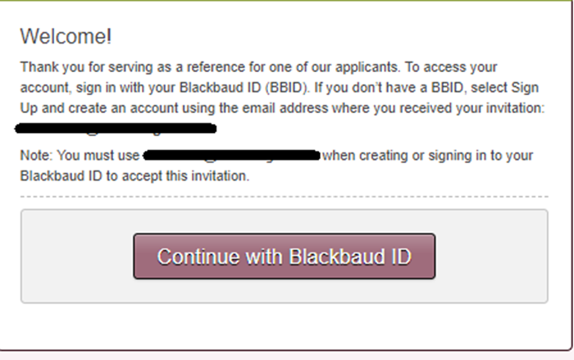
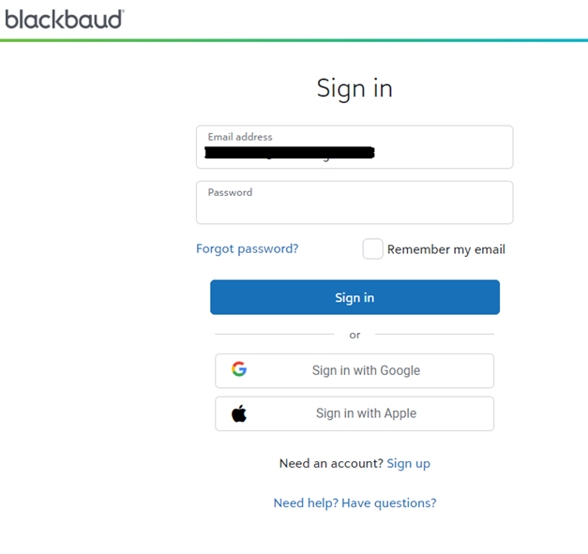
Reviewer and Reference login
Blackbaud Award Management which houses the University of Montana Scholarship Portal has begun enforcing the use of Multi-Factor Authentication sign-on.
If a student has requested that you be a reference or you have been assigned to a review group you will receive an email with a link to login to the Scholarship Portal.
Once you click on the link you will be brought to a webpage with a button “Continue with Blackbaud ID”. Click this button and it will bring you to the Blackbaud website to login through their MFA.
Please note: As of March 1st 2024, all References and Reviewers are required to set up a Blackbaud ID (Multi-Factor Authentication). You will be brought to this page if it is your first time logging in as a Reference or Reviewer, with the new Multi-Factor Authentication, you will click on the button “Continue with Blackbaud ID”. It will bring you to a new page.
If it is your first time here you will click on Sign up. If you have already created your account, you will continue logging in with the password you set up. Once you log in and approve the Multi-Factor authentication it should log you directly into the Scholarship Portal to view the applications you’ve been asked to review.
If you have any questions regarding how to login or if you do not see any opportunities to review please reach out to the Financial Aid office at fascholarships@mso.umt.edu.
Notes:
FAO Presents:
Update?
Address Wendys question - Do all of our faculty reviewers really need to set up a multi-factor authentication? I know for sure that we will have a few faculty members who are not willing to do this. Do we need to then remove them from our scholarship committees?

Slide 10

2024 – 2025 Fafsa Reminder
Notification from Department of Education
The U.S. Department of Education has begun to slowly release FAFSA data to campuses nationwide.
  Impact on Scholarship Portal:
  Due to the slow roll out of this FAFSA information will not be available in the Scholarship Portal until Mid-April.
  Consequently, need-based scholarships will initially reflect 0 applications until FAFSA information is received.
  Awarding Scholarships:
  Despite the delay, departments retain the ability to award scholarships not contingent on FAFSA information.
  Departments are encouraged to proceed with reviewing and awarding scholarships not reliant on need-based criteria.
Deadline Reminder:
June 1st remains the deadline for awarding scholarships for the 2024-2025 academic year.
Notes:
FAO Presents:
May need to be updated since it is early April.

Slide 11

UM Scholarship Portal
TOPICS:
How to Decline Awards in the Portal
How to View Student Thank You Letters in the Portal
Post-Acceptance End Date

Slide 12

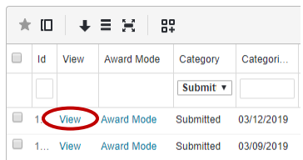
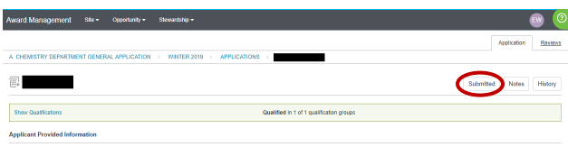
Declining/Canceling A Scholarship Award In the Portal
See online handout for more in-depth graphics and info > How to Cancel or Decline Awards in the Scholarship Portal
Steps:
Locate the applicant by opportunity
Opportunity > Portfolios > All > Click on Applications
Click on “View”
3. Click on “Submitted”
Notes:
FAO Presents
Complete

Slide 13
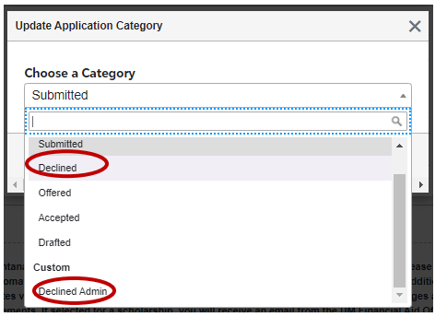
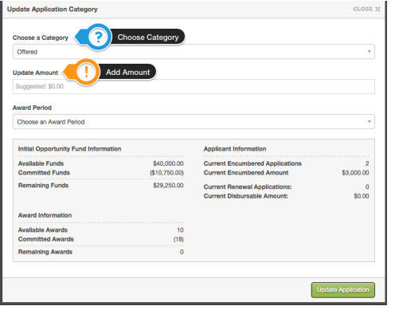
Declining/Canceling A Scholarship Award In the Portal CONT.
Continued Steps:
4. Update Category to “Declined” or
“Declined Admin”
> Update Application Category
box will appear, click
“Update Application”.
Please note, the system will take a few minutes to process and update.
Last STEP: Submit a Correction Award Summary Sheet
Reminder: A Correction Awards Summary sheet is still needed even if the student is no longer attending.
Notes:
FAO Presents
Complete.

Slide 14

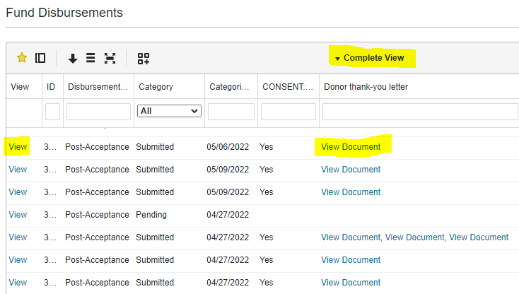
How to: view student thank you letters on the Portal
There are two options to view student thank you letters on the Scholarship Portal:
First Option > If you want to review all thank you letters for your unit/department:
Opportunity > Portfolios > Fund Disbursements > Complete View or Select Custom View
You can move columns around and save the information
you want to see first by creating a custom view.
​Click on “View” under View column, OR
“View Document” under Donor thank-you letter column.
Using “View” will show you the recipients' responses
and link to the thank you letter.
Using “View Document” will download the document.

Slide 15
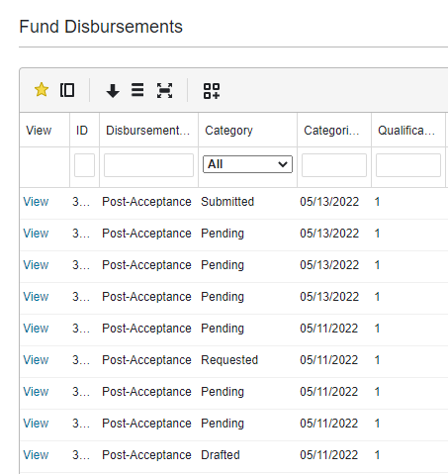
How to: view student thank you letters on the Portal CONT.
Fund Disbursements > Category Status:
Pending = Award offer has been extended to the applicant, but they have not “accepted” or “declined” the offer.
Requested = Award offer has been “accepted”, but the applicant has not yet completed their “Post-Acceptance”.
*Drafted = Applicant started to respond to the “Post-Acceptance” but has not yet completed it.
*Submitted = Post-Acceptance is complete.
*Awarded = Financial Aid has reviewed the award.
*This does not hold up the award from being transmitted to the student’s financial profile (Banner).

Slide 16
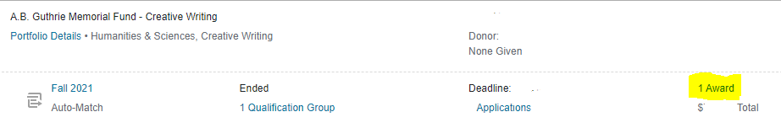
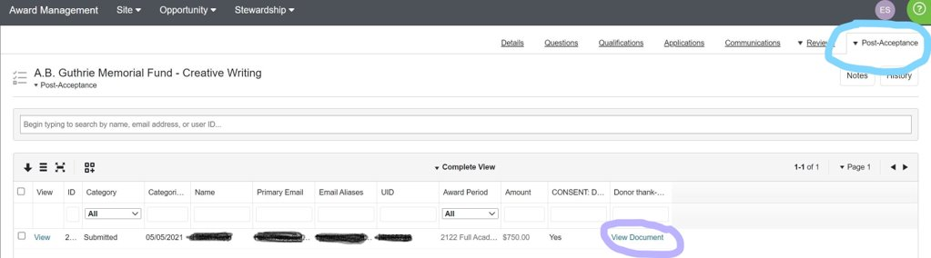
How to: view student thank you letters on the Portal CONT.
Second Option > If you want to view thank you letters for a specific scholarship:
Opportunity > Portfolios > All > Click on Award

Slide 17
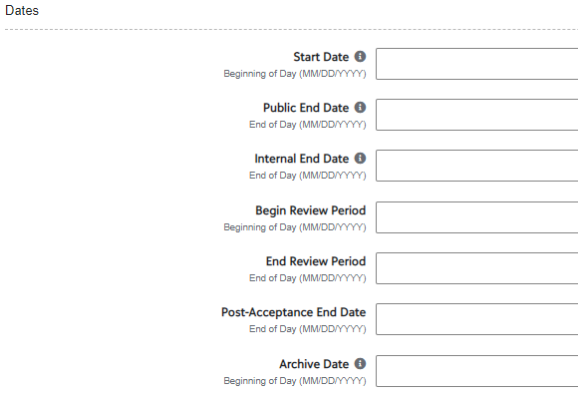
Post-Acceptance End Date
The “Post- Acceptance End Date” field is located in the funds Opportunity under the “Dates” section.
If a date is added to the “Post – Acceptance End Date” field students will not be able to answer any Post- Acceptance Questions or upload their Thank you Letters to the Portal.
This may cause confusion for students, as they may try to upload and won't be able to complete the Post Acceptance requirements.
Details Tab - Opportunity

Slide 18

Questions?
Notes:
Raven Presents
Complete.

Slide 19

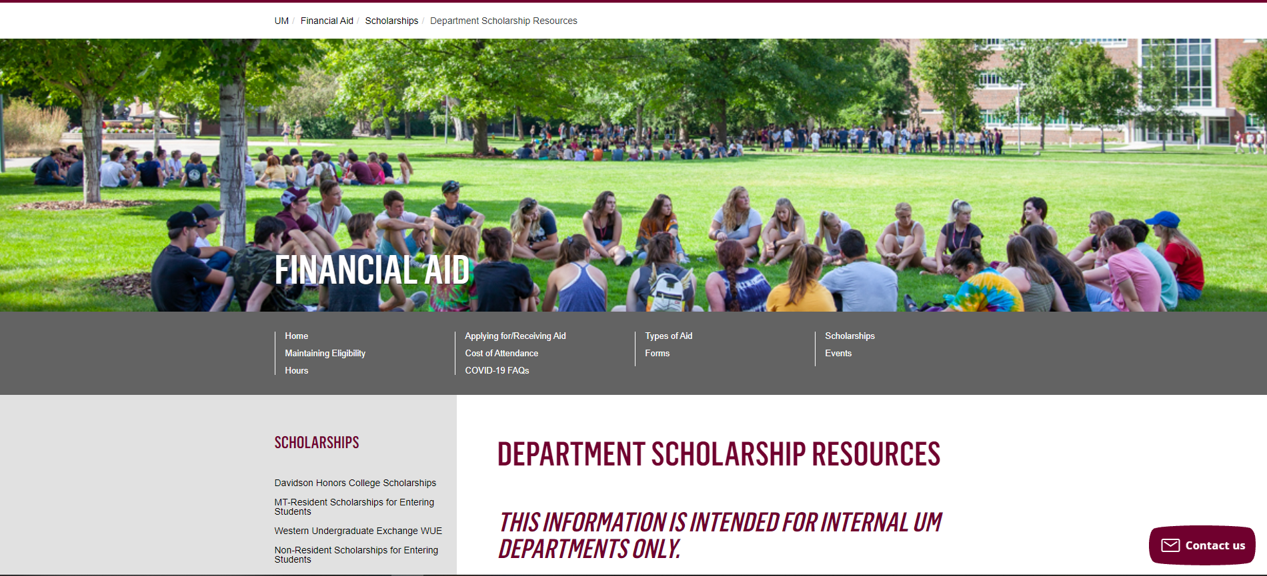
Department Scholarship Resource Webpage
Who is this for? ​
YOU! As a scholarship administrator/contact, these resources are for you, to use throughout the year as you go through your scholarship process.​
​
What can I find there? ​
Portal Administrator Request Form
Award Summary Sheet and Correction​
UM Portal Handouts/Instructions ​
Past Presentation Materials ​
Thank You letter information ​
FAO, UMF and Business Services Contact Information ​
How do I access this webpage?​
Please SAVE/Bookmark this link https://www.umt.edu/finaid/scholarships/department-use-resources.php. This link is “hidden” to reduce access from students.​
​
Notes:
Raven Presents:
Complete.

Slide 20


Looks LIKE SOUNDS Like
Financial Aid Contacts | UM Foundation Contacts
Christina Peltier Financial Aid Specialist II- Scholarship Manager (406)243-4810 | Korla McAlpine Scholarship Administrator Korla.mcalpine@supportum.org (406) 243-4260
 | Sarah Wade Assistant Director of Fund Administration Sarah.wade@supportum.org (406) 243-5592
 | Nancy Randazzo Director of Gift and Fund Administration Nancy.Randazzo@supportum.org (406) 243-4739
Department Scholarship Resources Webpage: https://www.umt.edu/finaid/scholarships/department-use-resources.php | Leana Schelvan Senior Director of Donor Relations and Stewardship leana.schelvan@supportum.org (406)243-6208
To contact the Financial Aid Office main line please call (406) 243-5373 | Raven Clark Fund Administration Coordinator raven.clark@supportum.org (406)243-2407
Location: Aber Hall, 5th floor | Location: Gilkey Building, 2nd Floor. Our team is in office Monday-Tuesday, working remotely Wednesday-Friday.
Financial Aid Office Email: fascholarships@mso.umt.edu (Use to submit award summary/award summary correction sheets and any award questions) | UM Foundation Email: umfawardsummarysheets@supportum.org (for scholarship department questions)
Business Services Contact
Barb Bybee (406) 243-6261 Barb.bybee@mso.umt.edu
Notes:
Raven Presents:
Complete.

Slide 21

Thank you for joining!
Please note we will not be hosting Scholarship Forums in May, June, or July. ​​
Stay tuned for monthly communications that will include important ​scholarship information and dates of upcoming forums.
Notes:
Raven Presents:
Complete.

