Slide 1

December Scholarship Forum
With the Financial Aid Office, UM Foundation and Business Services
December 8th, 2023
Notes:
Raven presents
Complete.

Slide 2

October Scholarship Forum Recap
Topics covered in the last Forum:
Tracking and Reconciling
UM Foundation FAQ
Notes:
Raven presents
Complete.

Slide 3
Financial aid office updates and reminders
2023 - 2024
​
Scholarship Awarding Deadlines:​
December 1st: Last day to submit 2023-2024 Fall only awards via an award summary sheet.
April 1st – Last day to submit 2023-2024 Spring only and regular Full year awards​
Scholarship Portal Update:​
No more awarding on the Portal​
Use the Award Summary Sheets (AWSS) to make awards.​
Opportunity Administrator Request Form
If you need to request access for an individual to be an Opportunity Administrator in the Scholarship Portal. Please have your Dean/Director fill out the following webform. https://www.umt.edu/finaid/scholarships/opportunity-admin-request.php
A link to this form has been added to the Department Resources Webpage.
Please make sure to include the individuals’ NetID as this will allow us to grant them access.
2024 - 2025
​
Remember to check qualifications in each of your opportunities to match criteria provided by the UM Foundation.
Please make sure to login and add open and close dates. (This must be done every year after cycle management)
Note: 2024-2025 FAFSA will go live by December 31, 2023.
Do you have a student looking for an award?
If so, please direct them to Cyberbear to view their Registration Bill for Spring 2024. Students will want to view UM pay bill.
Reminder: Please allow at least 10 business days for processing. The Financial Aid Office is currently shorthanded.
Notes:
FAO Presents
Ask FAO for additions.

Slide 4


UM Foundation Reminders and Updates
Scholarship Department Administration Musts:
  Administer scholarships in accordance with UM and UMF policies, procedures, and protocol.
  Make every effort to fully utilize all scholarship funds.
  Award through a consistent, documented process, in a fair and equitable manner.
  Adhere to documented criteria and donor intent.
  Verify “Financial Need” through the Financial Aid Office or via the Scholarship Portal.
  Pay directly to the students’ accounts to assist with expenses related to the students’ incurred costs.
If you are unable to find a student who meets the criteria, please contact the Foundation-Scholarship Team. Please do not contact the donor(s) to request an exception.
A message from our Stewardship team:
If your unit plans to publish content regarding privately funded scholarships, please consult with the UM Foundation to ensure donors are appropriately featured and/or informed. Your partnership helps the UM Foundation honor formal media and stewardship agreements with generous supporters who invest in scholarships.
Please instruct students to email thank you letters to thankyou@supportum.org for the remainder of the 2023-2024 academic year, unless otherwise instructed.
If you have any questions or would like an email Template for Requesting a Thank You Letter from a Student, please contact Emily Shankle, Donor Stewardship Manager at Emily.shankle@supportum.org.
Scholarship Department Administration Recommendations:
  Track how awards are made (AWSS v. Portal).
  Reconcile throughout the year to ensure students receive funds and to promote fund utilization.
    Tip: Reconcile after the 15th class day and set a calendar reminder.
  Annually review your degree programs and what’s available, to ensure the Scholarship Portal is accurate.
2024 - 2025
Scholarship Budget and Criteria Report Updates
*New Modified Look* - Budget and Criteria are now combined in an Excel spreadsheet. We will discuss further in upcoming slide.
We are reviewing, gathering, and distributing budget and criteria information now. Distribution will wrap up in March.
Revisions will begin once all main units/departments have received their initial budgets.
For units/departments we meet annually with to discuss budget/criteria reports, please be on the lookout for an email invite in the coming weeks.
Scholarship Administrator Contact Email Listserv
Please send the Foundation and Financial Aid Office any new contacts (and their info including their umontana employee email address) who are assisting with Scholarship Administration in your unit/department or program
Please contact the Foundation for Scholarship Budget or Criteria questions.
Notes:
Raven Presents:
Complete.

Slide 5

Academic Year Timeline & Monthly To Do List
Notes:
Raven Presents:
Complete

Slide 6
2023 - 2024 Academic year timeline
December 1st – Last day to submit 2023-2024 Fall Only scholarship awards.
December 4th – Spring 2024 – Registration Bills will be available via CyberBear at 1 pm.
  Tip: Direct students to their Registration Bill view and not the Account Summary View, to view scholarships credits.
Reconcile your 2023-2024 scholarship budgets against what had paid/disbursed to ensure students have received payment. ​
December 8th – Last day of Regular Classes​
December 11th – 15th – Final Exams​
December 15th – Fall Commencement
January 15th – Offices Closed in observation of Martin Luther King, Jr. Day
January 18th – Spring Semester Classes Begin and Spring 2024 Registration Payment Deadline (late fee applies after this date)
February 7th – Spring 2024 Final Payment Deadline to Avoid Cancellation of Classes
Departments, track and reconcile 2023—2024 awarded students.
  Check disbursements after SPRING census date. In addition, make re-awards.
  February 19th – Presidents’ Day – No classes, Offices closed
December
January
February
Notes:
FAO Presents:
Complete

Slide 7

2024-2025 UM Foundation Scholarship Budget/Criteria Report and Guide review
Notes:
Raven Presents:
Complete

Slide 8
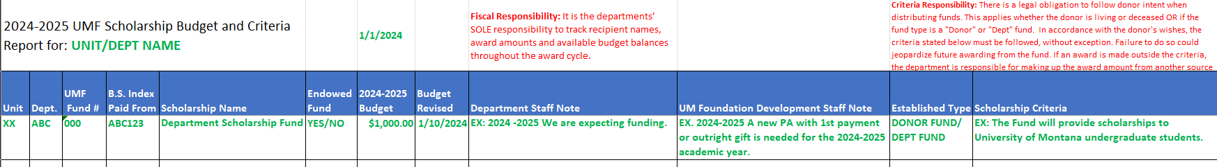
Navigating the UMF Scholarship Budget and Criteria Excel
NEW! Combined Scholarship Budget and Criteria Report
This year we have combined the budget and criteria report, so all Foundation scholarship information is contained in one Excel spreadsheet.
Understanding Your Scholarship Budget and Criteria Report
The Scholarship Budget and Criteria Report includes the following information:
Unit
Department
UMF Fund Number – UM Foundation’s fund number that uniquely correlates to “B.S. Index Paid From” issued code.
B.S. Index Paid From – UM’s Index Code number that uniquely correlates to “UMF Fund Number” (campus/Business Services issued code)
Scholarship Name
*Endowed Fund – If fund is endowed, a “Yes” will be marked in the column.
If Fund is a “Term Endowment”, the field will say, “Term” rather than “Endowed”.
2024-2025 Budget – $ Amount
Budget Revised – Date will be added if a change in the budget occurs.
Department Notes – Notes for the department contact(s) to review prior to making awards.
Development Staff Notes – Notes for UM Foundation Development Staff to review.
*Newly added* Established Type – “Donor Fund v. Dept Fund”
*Newly added* Scholarship Criteria, now included in the Scholarship Budget report (excel)
You may download the report and wrap the text.
Notes:
Raven Presents
Complete.

Slide 9
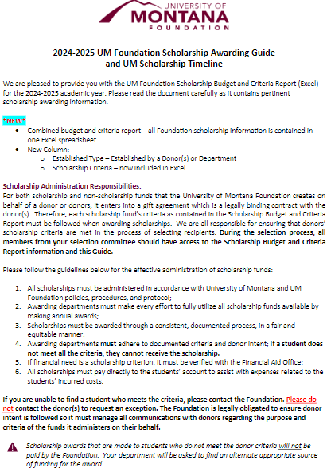
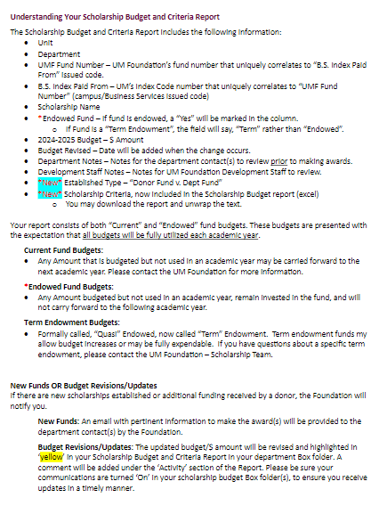
Navigating the UMF Scholarship Budget and Criteria PDF Guide
Highlights
Each Scholarship Box folder will contain a copy of this Guide
Combined the Budget and Criteria reports into ONE Excel.
New columns:
  Established Type – Donor v. Department (DEPT)
  Scholarship Criteria
Scholarship Administration Responsibilities
How to use the Scholarship Budget and Criteria Report
The difference between a Current, Endowed, or Term Fund (Quasi).
What you need to know about General Scholarship Funds.
Basic information regarding the Scholarship Billing Process between the Foundation and UM Business Services Office.
UM Scholarship Timeline
Notes:
Raven Presents
Complete.

Slide 10

New Scholarship Cycle
2024 - 2025
Notes:
Raven Presents
Complete.

Slide 11

Benefits to Using the Scholarship Portal
No more hardcopy applications!
  Collecting or tracking pieces of student application materials. (i.e., essay, transcript, letter of recommendation, etc.)
Provides student access and consideration to scholarships across various disciplines or interests.
Data provided in the Portal is “archived”
  This means you can view and download information from the past, just by a few clicks.
Reduce or eliminate the number of Award Summary Sheets that are filled out.
  Student information needed is collected in the Portal. (i.e., Name, UM ID#, Major, Class, Hometown, State, Award amount, etc.)
Scholarship Committee Review
  Groups can be set up to review specific scholarships.
  Groups can create a scoring rubric or questions for the committee to respond to.
  Using review groups in the Portal is optional.
Awarding Communications to Students
  Offer Email and Offer Reminder Email communications.
Collection of Student Thank You letters
  Post-Acceptance Email and banner communication to students.
  Collect students' consent.
  Students can submit thank you letter.
Portal Awards Flow to Banner (student profile).
Access to viewing the students’ scholarship acceptance and post-acceptance progress of completion.
Notes:
FAO Presents:
Complete.

Slide 12


how does the Portal Work For Students?
Tip!
Encourage students to check the Portal throughout the year, and of course their UM Student email account.
Who can apply?
  New, continuing, returning, and transfer students attending Missoula College (or Bitterroot College), and Mountain Campus.
What is needed to apply?
  Students will need their Net ID to login. If a student does not know their Net ID, they can use Net ID Lookup, https://user.umt.edu/netidlookup/ for further assistance.
When can students apply?
  After the student is fully admitted.
  Beginning November 1st for the new cycle
  Students should apply each year
Where do students apply? https://umt.academicworks.com/users/sign_in
  Link also available at umt.edu/finaid, click on Scholarships → UM Scholarship Portal
How do they apply?
  Students will need to complete their General Application
    Students will be asked questions and to self-report information. Please encourage students to answer all questions, however only the (*) ones are required.
    Additional information such as GPA, UM ID#, Major, Minor, etc. will be collected from their student record in Banner. Students will not see that information.
  If applicable, students may need to complete a Conditional Application
    Students who have a major, minor, or answered accordingly to a question from the General Application, may be asked to complete a Conditional Application.
      Students will be asked questions, to self-report information, upload additional letters of recommendation, etc. for further consideration for their units' scholarship application process.
  In addition, students may submit or answer supplemental items by clicking on "Apply" to scholarship opportunities that are set up as an "Apply-To" type.
    Students can review a list of scholarships by clicking on “Opportunities” after they complete their General Application.
Reminders
Student’s will not be able to see any “Auto-Matched" opportunities they are considered for.
Notes:
FAO Presents:
Complete.

Slide 13
Reviewing Opportunities in the Portal
Reminder
Changes to UM Scholarship Portal Administration
Effective beginning with the 2024-2025 scholarship cycle, the UM Foundation will no longer create “Qualification Groups” when adding new scholarship funds (“Portfolios”) to the Portal. The Foundation will add basic scholarship fund information including the name, description and budget information. The Financial Aid Office will work with scholarship administrators across campus in the transition of managing qualifications in the Portal within their respective areas.
The UM Foundation will continue to assist with the collection of Student Thank You Letters on the Portal and will continue to audit awards made to ensure recipient selection is in accordance with donor intent. Should you have questions regarding the interpretation of donor criteria, please continue to work with the UM Foundation.
Scholarship Portal – Get Started
Need access to the Portal? Send your request via online form found on the Department Scholarship Resources webpage.
Portal handouts are available to view online at the Department Scholarship Resources webpage.
Criteria for Foundation funds can be found in your Box folder. There is a legal obligation to follow donor set criteria. Please do not deviate. Questions, contact the UM Foundation – Scholarship Team.
Scholarship Portal Don’ts
DO NOT change or add language in the Description box for Foundation funds.
DO NOT enter an archive date. The opportunities are archived automatically through Cycle Management. If you enter this, it can cause issues in having the scholarship roll to the next year.
DO NOT enter budgets. The UM Foundation will update the award amount information once a budget has been determined.
DO NOT remove requirements or require additional items that are not specified in the criteria.
  Examples: Transcripts, essays, letters of recommendation, GPA level.
  Reminder: You can filter and sort applicants in the Applicant View prior to reviewer groups members viewing.
DO NOT change the communications language. These are set the same for everyone. If you need to provide a student with additional information you will need to email them separately.
Notes:
FAO Presents
Complete.

Slide 14
Scholarship Portal Checklist
*Review Portal users in your department. Does anyone need access? Or can be removed? ^Review list of scholarship funds: Are all funds listed in the Portal? Check your degree programs that are offered. Are there new degree programs in your department (majors, minors, concentrations, etc.) that need to be added to your qualifications? *Check Portal Qualifications for each opportunity. Based on the criteria report, are the qualification or questions properly added? Please do not add additional requirements that are not specified in the criteria. Examples: Transcripts, essays, letter of recommendations, etc. *Check Conditional Application questions. You must have at least one required question. | Determine how you will alert students of available scholarships and how to apply. *Determine committee members and set up Reviewer Groups. *Add Start/End Dates to begin collecting applications. You can add reviewer start and end dates at the same time. *After dates are entered, check applicant pools. Are the proper students filtering in each opportunity? *Determine if you need a custom view to look at applicants by opportunity. *Review How To Offer Awards to Applicants handout via the Department Scholarship Resources. ^Check the selected recipient meets the full criteria. Track and Reconcile awards. *Other resources available on the Department Scholarship Resources webpage.
* Questions should be directed to the Financial Aid Office – Scholarship Team. ^ Questions should be directed to the Foundation – Scholarship Team.
Notes:
FAO Presents:
Complete.

Slide 15

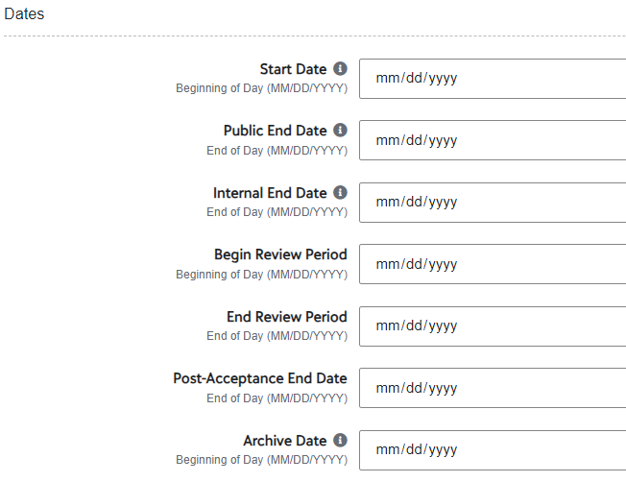
  How to add Start and End Dates at the Opportunity Level
Opportunity Portfolios ALL​
​
If no date has been entered, the default is “Future”, click on “Future”.​
Start Date – If left blank, the opportunity will be closed for applicants. You can back date to “November 1st” even if it past that date when you add in the Portal. ​​
Public End Date – The deadline date that is visible to applicants. After this date, the opportunity will no longer be published.​​
Internal End Date – The deadline date for matching applications to the opportunity. Only qualified applications that were submitted prior to/on this date will match to the opportunity. Applicant answers submitted after this date will not be reflected on the opportunity applications.​​
Begin Review Period and End Review Period Dates – You may add when you open, however, please be sure you have updated your committee members and it is recommended the Begin Review Period is a week or so after the End Date. The time between will allow you to review your applicant pool and organize your list for your review committee whether you are using the Review functionality in the Portal or not.
Tip! For more information on adding start and end dates and other Portal Opportunity setup tips checkout the Opportunity Set Up handout on the Department Scholarship Resources webpage.
Notes:
FAO Presents

Slide 16
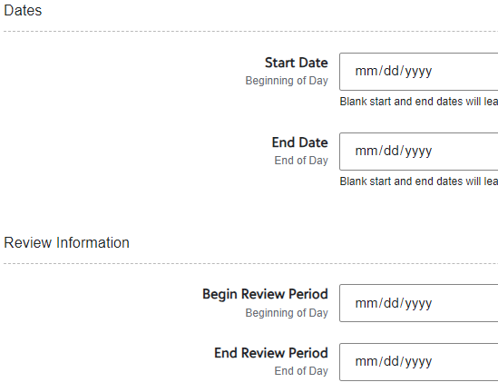
  How to add Start and End Dates at the Conditional Level
Opportunity General Applications Conditional​
​
Click on “Conditional Application Details” ​
​
Start Date – If left blank, the conditional application will be closed for applicants. You can back date to “November 1st” even if it past that date when you add in the Portal. ​​
End Date – The last date the conditional application will accept applications.​
Begin Review Period and End Review Period Dates
Recommendations:​
Update your committee members and reviewer group.​
Set review period a week or so after the End Date. The time will allow you to review your applicant pool and organize your list for your review committee whether you are using the Review functionality in the Portal or not.
Notes:
FAO Presents
Complete.

Slide 17
Questions?
Notes:
Raven Presents
Complete.

Slide 18

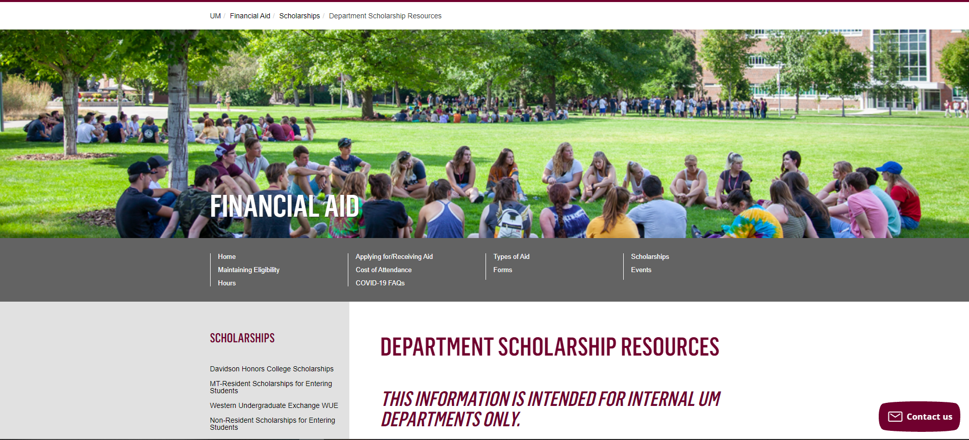
Department Scholarship Resource Webpage
Who is this for? ​
YOU! As a scholarship administrator/contact, these resources are for you, to use throughout the year as you go through your scholarship process.​
​
What can I find there? ​
Portal Administrator Request Form
Award Summary Sheet and Correction​
UM Portal Handouts/Instructions ​
Past Presentation Materials ​
Thank You letter information ​
FAO, UMF and Business Service Contact Information ​
How do I access this webpage?​
Please SAVE/Bookmark this link https://www.umt.edu/finaid/scholarships/department-use-resources.php. This link is “hidden” to reduce access from students.​
​
Notes:
Raven Presents:
Complete.

Slide 19


Looks LIKE SOUNDS Like
Financial Aid Contacts | UM Foundation Contacts
Christina Peltier Financial Aid Specialist II- Scholarship Manager (406)243-4810 | Korla McAlpine Scholarship Administrator Korla.mcalpine@supportum.org (406) 243-4260
Nicole Krause Financial Aid Specialist I (406) 243-5373 | Sarah Wade Assistant Director of Fund Administration Sarah.wade@supportum.org (406) 243-5592
Ethan Kurtz Financial Aid Specialist I (406) 243-5373 | Nancy Randazzo Director of Gift and Fund Administration Nancy.Randazzo@supportum.org (406) 243-4739
Department Scholarship Resources Webpage: https://www.umt.edu/finaid/scholarships/department-use-resources.php | Emily Shankle Donor Stewardship Manager Emily.shankle@supportum.org (406) 243-2506
To contact the Financial Aid Office main line please call (406) 243-5373 | Raven Clark Fund Administration Coordinator raven.clark@supportum.org (406)243-2407
Location: Aber Hall, 5th floor | Location: Gilkey Building, 2nd Floor. Our team is in office Monday-Tuesday, working remotely Wednesday-Friday.
Financial Aid Office Email: fascholarships@mso.umt.edu (Use to submit award summary/award summary correction sheets and any award questions) | UM Foundation Email: umfawardsummarysheets@supportum.org (for scholarship department questions)
Business Services Contact
Barb Bybee (406) 243-6261 Barb.bybee@mso.umt.edu
Notes:
Raven Presents:
Complete.

Slide 20

Thank you for joining!
Stay tuned for monthly communications that will include important scholarship information and dates of upcoming forums.
Reminder! If you have a scholarship contact change, please email the Foundation and Financial Aid Office.
Notes:
Raven Presents
Complete.

