Slide 1

February Scholarship Forum
With the Financial Aid Office, UM Foundation and Business Services
February 9th, 2024
Notes:
Raven presents
Complete.

Slide 2

December Scholarship Forum Recap
Topics covered in the last Forum:
Navigating the UMF Scholarship Budget and Criteria Excel
New Scholarship Cycle​
2024 – 2025
Scholarship Portal Checklist
Notes:
Raven presents
Benefits to Using the Scholarship Portal
how does the Portal Work For Students?
Reviewing Opportunities in the Portal
How to add Start and End Dates at the Opportunity& Conditional Level

Slide 3

Academic Year Timeline & Monthly To Do List
Notes:
Raven Presents:
Complete.

Slide 4
2023 - 2024 Academic year timeline
Departments, track and reconcile 2023—2024 awarded students.
  Check disbursements after SPRING census date. In addition, make re-awards.
  February 19th – Presidents’ Day – No classes, Offices closed
Departments should continue reviewing previously awarded students and make re-awards.
March 1st – Priority deadline for General Scholarships via the Scholarship Portal.
March 18th – March 22nd – Spring Break, No Classes.
April 1st – Last day to submit 2023-2024 Spring only and regular Full year awards​
All final 2023 – 2024 awards must be made using an award summary sheet
February
March
April
Notes:
Raven Presents:
Complete.

Slide 5



UM Foundation Reminders and Updates
Tracking and Reconciling:
  The 15th class day has now passed, which means it is a good time to review scholarship funds and disbursements to ensure students have received awards.​
A message from our Stewardship team:
NEW! The UM Foundation provides a thank you letter template that students can use when writing their thank you letters to the donor who supported the scholarship award they received. We have updated the design of this template. Please find the new version the UM Foundation Scholarship Thank You Letters webpage at https://www.supportum.org/scholarship-letters/default.php under the “Writing Your Letter” header.
Students can email completed thank you letters to the UM Foundation at thankyou@supportum.org for the remainder of the 2023-24 academic year, unless they were instructed differently.
We are grateful that many units include information about scholarships and scholarship donors on your websites or in other publications. Please contact the UM Foundation before you publish this content so we can ensure that the information about donors is accurate and up-to-date. We are always happy to help verify this information. You can email our team at thankyou@supportum.org.
  Update: Emily Shankle has moved into a new role at the UM Foundation and will no longer be managing scholarship stewardship. If you have any questions about student thank you letters or stewarding scholarship donors, please contact Leana Schelvan, Senior Director of Donor Relations and Stewardship at leana.schelvan@supportum.org
Scholarship Department Administration Musts:
  Administer scholarships in accordance with UM and UMF policies, procedures, and protocol.
  Make every effort to fully utilize all scholarship funds.
  Award through a consistent, documented process, in a fair and equitable manner.
  Adhere to documented criteria and donor intent.
  Verify “Financial Need” through the Financial Aid Office or via the Scholarship Portal.
  Pay directly to the students’ accounts to assist with expenses related to the students’ incurred costs.
If you are unable to find a student who meets the criteria, please contact the Foundation-Scholarship Team. Please do not contact the donor(s) to request an exception.
Scholarship Administrator Contact Email Listserv
Please send the Foundation and Financial Aid Office any new contacts (and their info including their umontana employee email address) who are assisting with Scholarship Administration in your unit/department or program
Please contact the Foundation for Scholarship Budget or Criteria questions.
Notes:
Raven Presents:
Complete.

Slide 6
Financial aid office updates and reminders
2023 - 2024
​
Scholarship Awarding Deadlines:​
April 1st – Last day to submit 2023-2024 Spring only and regular Full year awards​
Scholarship Portal Update:​
Awarding for the 23-24 AY is no longer available on the Portal.
Use the Award Summary Sheets (AWSS) to make awards.​
Opportunity Administrator Request Form
If you need to request access for an individual to be an Opportunity Administrator in the Scholarship Portal. Please have your Dean/Director fill out the following webform. https://www.umt.edu/finaid/scholarships/opportunity-admin-request.php
A link to this form has been added to the Department Resources Webpage.
Please make sure to include the individuals’ NetID as this will allow us to grant them access.
2024 - 2025
​
PLEASE NOTE: Due to the delay of the FAFSA launch as well as the Department of Education not releasing the information to any campuses, no FAFSA information will be loaded into the Scholarship Portal until Mid-March/ Early April.
  This means that need-based scholarships will reflect 0 applications until we receive this information from the Department of Education.
June 1st – All 2024-2025 awards must be made by this date.
Remember to check qualifications in each of your opportunities to match criteria provided by the UM Foundation.
Please make sure to login and add open and close dates. (This must be done every year after cycle management)
Reminder: Please allow at least 10 business days for processing. The Financial Aid Office is currently shorthanded.
Notes:
FAO Presents
Complete.

Slide 7

Summer 2024 Awarding
Notes:
Raven Presents:
Complete

Slide 8
SUMMER 2024 SCHOLARSHIP AWARDING​
Summer 2024 Award Summary Sheets (AWSS)
Summer awards cannot be made in the Portal
ALL requests for a Summer AWSS will need to be sent to the UM Foundation (umfawardsummarysheets@supportum.org).
Summer Award Summary sheets can begin being sent out on March 1st
Reminders for Administrators
For Foundation Scholarship funds, please confirm the following:
Check your scholarship box folder to review budget amounts AND criteria
Check if you have already submitted a 2024-2025 AWSS
Check if you have already offered a scholarship in the Portal
Additional Information:
For Scholarships, the 2024-2025 AY budgets includes summer awards (if any)
Disbursements in Banner or UMDW will not display until a week or two prior to the first day of the semester, therefore, it is important to track how you are awarding scholarships.
For Foundation Programmatic funds, confirm the following:
Check that you have a sufficient cash balance in the fund
  Review your accounting report or discuss with your fiscal administrator
Check the funds’ purpose/criteria
IF AN OVER-AWARD IS MADE
It is the departments’ SOLE responsibility to track recipient names, award amounts and available budget balances throughout the award cycle. The department will be responsible for covering over-awards made by the unit/department or program.
Notes:
Raven Presents:
Complete.

Slide 9
SUMMER 2024 SCHOLARSHIP AWARDING​
Submitting Summer Award Summary Sheets
Please follow the instructions below to submit your Summer 2024 Award Summary Sheet:
Fill out ALL information asked on the Summer 2024 Award Summary Sheet.
Review fund and student information to ensure ALL information is accurate.
Collect the signature of your dean, director, or other specified “responsible party” who can approve awards. If you are unable to collect a signature, please be sure the dean, director, or other specified “responsible party” can include the Summer Award Summary Sheet attachment with their email approval.
Send the Summer Award Summary Sheet attachment (that includes the signature) by email to the Financial Aid Office for processing fascholarships@mso.umt.edu AND CC the Foundation umfawardsummarysheets@supportum.org.
The email SUBJECT LINE should include: SUMMER 2024 Award Summary Sheet – Dept/Unit Name.
Key Take Aways
Send Summer AWSS request to the Foundation (umfawardsummarysheets@supportum.org).
By submitting your Summer Award Summary Sheet you acknowledge the above has been reviewed AND your department will be responsible for any over-awards made.
Please send Summer 2024 AWSS separately, do not mix with late year end/spring 2023-2024 OR new 2024-2025 awards.
Notes:
Raven Presents:
Complete.

Slide 10
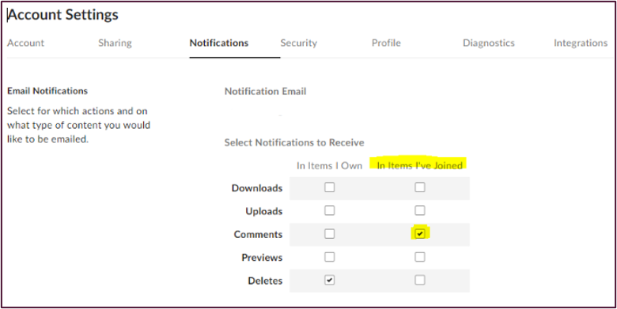
UM BoX - UNIT / DEPT Scholarship Folders
Your unit/departments Box Folder contains a budget and criteria report for the current academic year along with a guide to assist you throughout the awarding process.
Scholarship Budget and Criteria Report Updates
*New Modified Look* - Budgets and Criteria are now combined in an Excel spreadsheet.
All initial budget reports have been distributed and we are working on revisions
Scholarship Budget Revisions
Revisions have begun. If there is funding available in your general scholarship funds (unrestricted), we will update this month.
Please check that your Box communications are turned “on”. This is important because Box will send you a communication/notification when budgets are updated.
Budget revisions/updates will be highlighted in “yellow” with date in scholarship budget excel spreadsheet.​
The Scholarship Portal will be updated until the Portal closes for 2024-2025.
Tips:
We recommend each unit/dept have a designated person with access to the Box folder who can distribute the scholarship criteria to the scholarship committee members.
  This is to ensure that faculty understand the criteria before making their selections or recommendations.
If you download a copy of your budget and criteria report, make sure that all revisions and updates are reflected on your copy before it is distributed to your scholarship committee.
Notes:
Raven Presents:
Complete.

Slide 11

UM Scholarship Portal and FAFSA Updates for the 2024 – 2025 Academic Year
Notes:
Raven Presents
Complete.

Slide 12
2024 – 2025 Fafsa
The 2024-2025 FAFSA’s went live for a soft opening on December 31st, 2023. With the FAFSA going live campuses were excited to be able to begin receiving the FAFSA information.
Unfortunately, all Financial Aid offices across the nation received a notification from the Department of Education that they were pushing back when FAFSA information would be available to campuses until mid-March/early-April.
We understand the frustrations that this is causing departments especially with need-based scholarships. We will continue to communicate any updates that we receive to departments.
Notes:
FAO Presents:
Complete.

Slide 13
2024 - 2025 Award Offers
With the delay in the 2024 -2025 FAFSA, it is in turn causing a delay on our ability to send out 2024 - 2025 award offers to students. Though we understand the frustration with this there are some positives. This would be the first time in years that departmental non-need-based scholarships can be included in the award offers to student’s along with federal aid. In normal years, award offers go out in December, not allowing institutional scholarships to show on the student’s initial award offer.
Departments still have the ability to award the majority of their scholarships prior to the University of Montana receiving the 2024 - 2025 FAFSA. Departments can continue to move forward with reviewing and awarding all scholarship opportunities that are not contingent on need.
At this time June 1st is still the deadline to have 2024 - 2025 scholarships awarded by.
Notes:
FAO Presents:
Complete.

Slide 14
Reviewer and Reference login update
Blackbaud Award Management which houses the University of Montana Scholarship Portal has begun enforcing the use of Multi-Factor Authentication sign-on. This was fully enforced by them on January 23rd, 2024.
Reviewers and References have always logged in via an email instead of a NetID, which means these will have to be set up BBID with MFA or they will not be able to sign in to the University of Montana Scholarship Portal as a Reference or Reviewer. We understand the frustration this may cause, especially for UM employees.
We are still working on coming up with a solution that will allow UM Employee emails to link to the same Single Sign On (SSO) that UM already uses when logging in with their NetID. Unfortunately, we do not have this capability at this time.
Notes:
FAO Presents:
Complete.

Slide 15
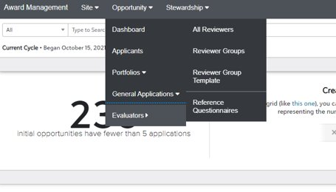
Quick overview:
Reviewer Groups and Rubrics
Notable features
Reviewers can use a "Rubric" to rate each student's qualifications
Each Reviewer can go into the Portal and review applicants at their leisure during the Review Period
What are Review Groups?
A feature in the Portal that allows administrators to assign your department Scholarship Committee members to review and select recipients for opportunities/scholarships
If your department already has functional Reviewer Groups set up, you can add various review settings in each opportunity
On each opportunity, you can make the following adjustments for your reviewing process:
Hide Applicant Name – if you would like a more unbiased review
Opportunity Reviewer Note – administrators may enter any notes specific to the opportunity that the review group would need to see
Begin Review Period – administrators will need to enter dates for the reviewers to complete their process
* Please email fascholarships@mso.umt.edu to create or update Reviewer Groups!
In your email, please provide the following information:
  Number of Reviewer Groups needed
  Names of all Reviewers (members of your Scholarship Committee) and their role
  Rubric ideas
  Which opportunities the groups(s) will be assigned to
Notes:
FAO Presents:
Complete.

Slide 16
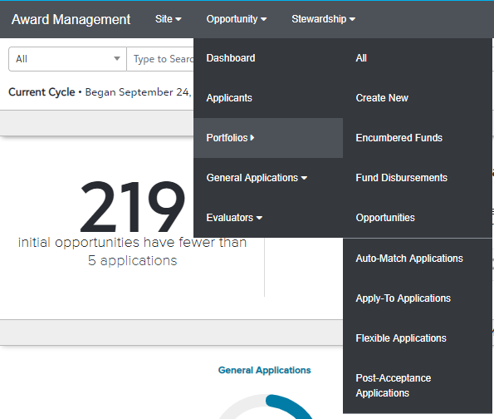
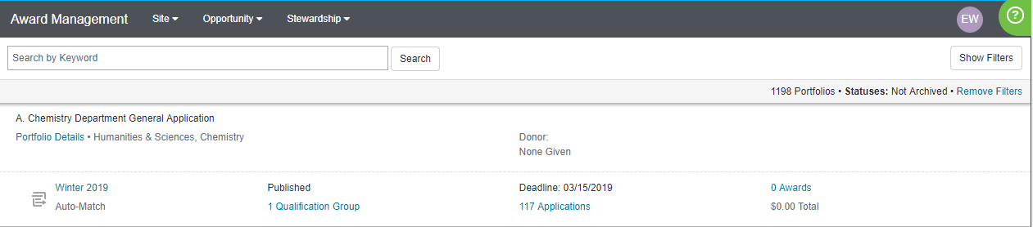
HOW TO OFFER SCHOLARSHIPS TO STUDENTS VIA THE SCHOLARSHIP PORTAL
Extending a Single Award Offer
1. While logged in as an opportunity administrator, go to the Opportunity section and select the Portfolios menu's "All" page and locate the desired opportunity.
1a. Click on the season time stamp to open the opportunity.
Notes:
FAO Presents:
Complete.

Slide 17

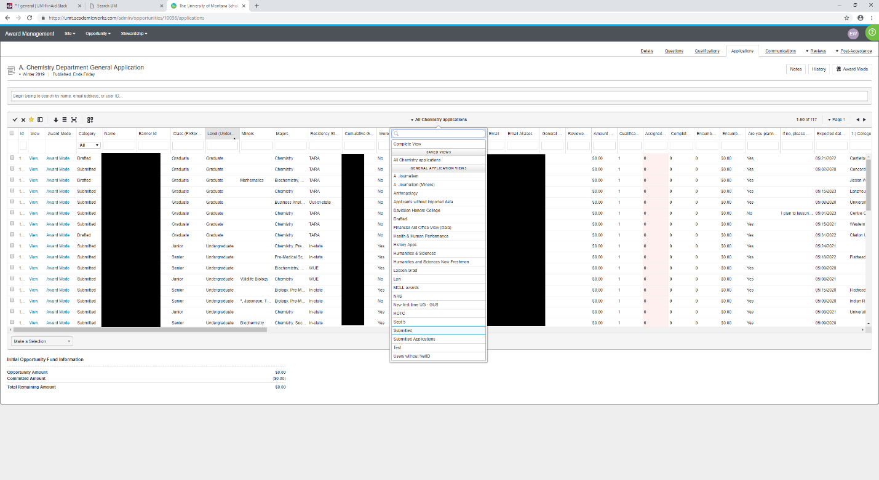
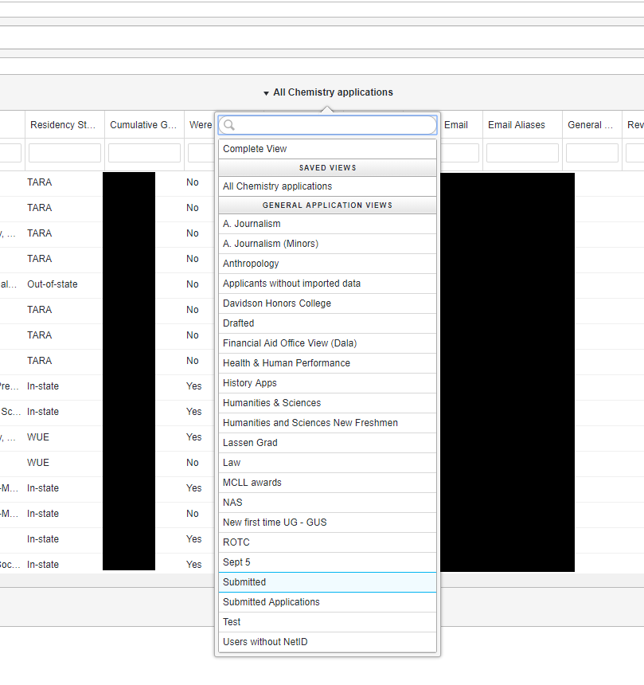
2. Next, click on the opportunity's Applications tab and a grid of all applications for the opportunity should appear.
2a. To ensure you are looking at submitted applications only, hover over the view function in the middle of the screen and select “Submitted”
Notes:
FAO Presents:
Complete.

Slide 18
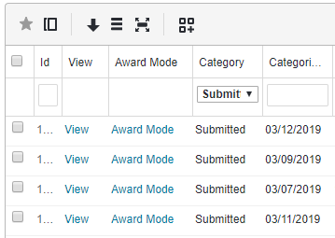
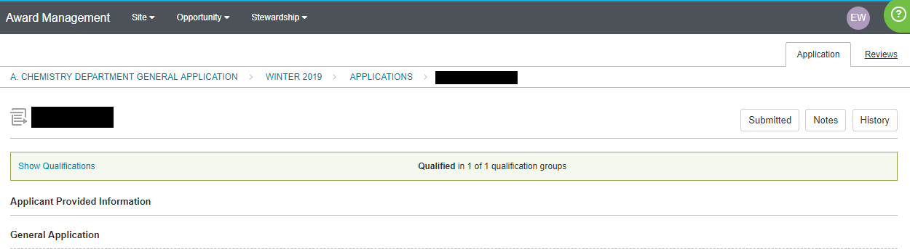
3. To locate the applicant(s) to whom you wish to make an offer and click the “View” link for that applicant. You may be interested in the values for Reviewer Score and Qualification Points columns, or in filtering the grid to locate particular applicants.
4. The page that opens up will display the user's application for that particular opportunity. You should see a button on the right side of the window that displays the current status or category of the application.
Notes:
FAO Presents:
Complete.

Slide 19
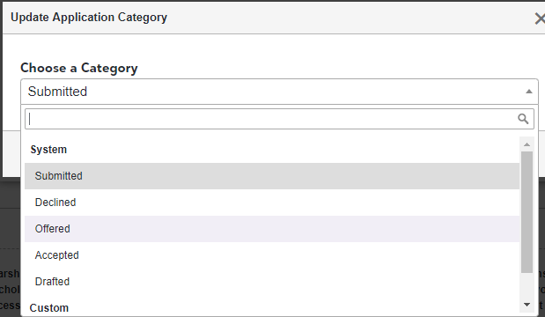
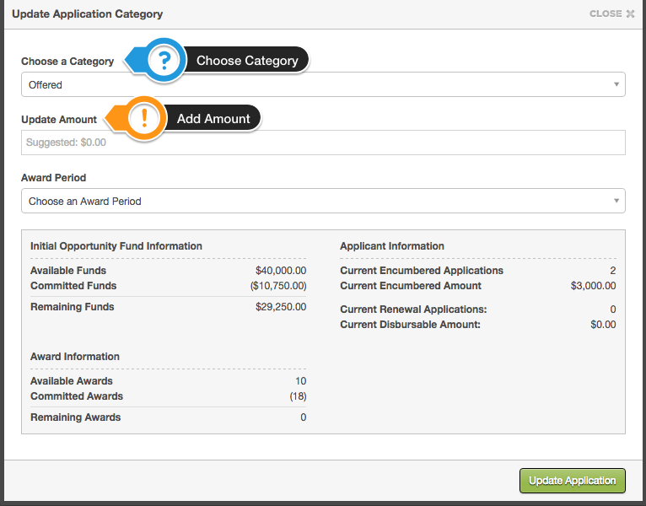
4a. Click on the category (i.e. Submitted) button to launch the category updating screen. When you select the "Offered" category from the drop-down menu, additional awarding information will appear. You may wish to review this information before making your decision:
4b. After selecting “Offered” category, an “update application category” box will display.
Notes:
FAO Presents:
Complete.

Slide 20
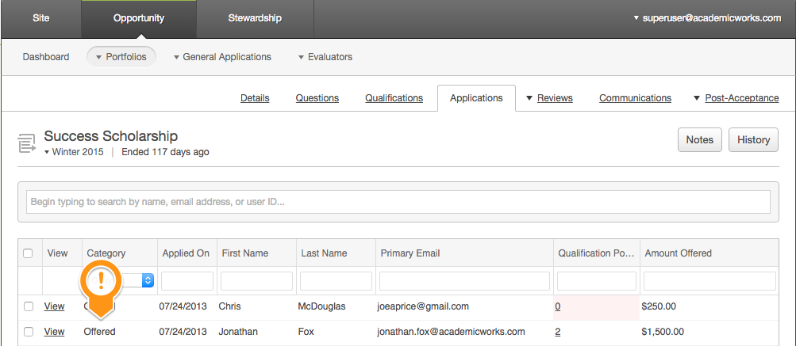
5. The category updating box will close and, in a few moments, the award offer will be extended to the applicant. After waiting a few moments, you may check the opportunity's Applications tab to confirm the award offer.
Note:
If you would like to print out a copy of these instructions, they can be found here on the Department Resources Page.
Notes:
FAO Presents:
Complete.

Slide 21

Questions?
Notes:
Raven Presents
Complete.

Slide 22

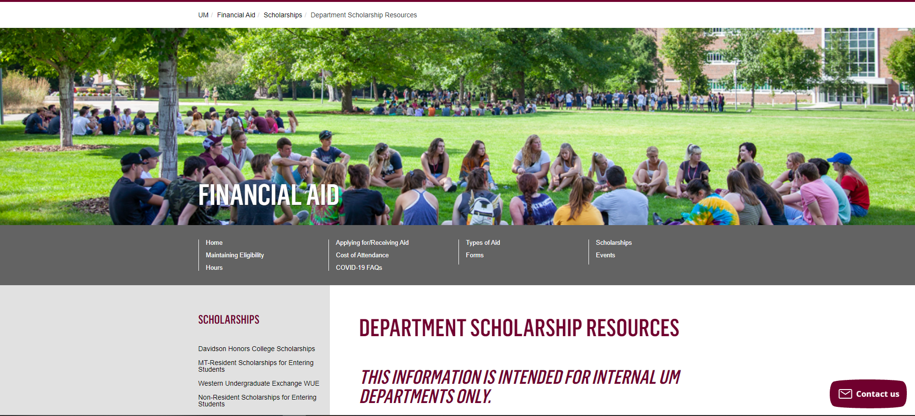
Department Scholarship Resource Webpage
Who is this for? ​
YOU! As a scholarship administrator/contact, these resources are for you, to use throughout the year as you go through your scholarship process.​
​
What can I find there? ​
Portal Administrator Request Form
Award Summary Sheet and Correction​
UM Portal Handouts/Instructions ​
Past Presentation Materials ​
Thank You letter information ​
FAO, UMF and Business Service Contact Information ​
How do I access this webpage?​
Please SAVE/Bookmark this link https://www.umt.edu/finaid/scholarships/department-use-resources.php. This link is “hidden” to reduce access from students.​
​
Notes:
Raven Presents:
Complete.

Slide 23


Looks LIKE SOUNDS Like
Financial Aid Contacts | UM Foundation Contacts
Christina Peltier Financial Aid Specialist II- Scholarship Manager (406)243-4810 | Korla McAlpine Scholarship Administrator Korla.mcalpine@supportum.org (406) 243-4260
Ethan Kurtz Financial Aid Specialist I (406) 243-5373 | Sarah Wade Assistant Director of Fund Administration Sarah.wade@supportum.org (406) 243-5592
 | Nancy Randazzo Director of Gift and Fund Administration Nancy.Randazzo@supportum.org (406) 243-4739
Department Scholarship Resources Webpage: https://www.umt.edu/finaid/scholarships/department-use-resources.php | Leana Schelvan Senior Director of Donor Relations and Stewardship leana.schelvan@supportum.org (406)243-6208
To contact the Financial Aid Office main line please call (406) 243-5373 | Raven Clark Fund Administration Coordinator raven.clark@supportum.org (406)243-2407
Location: Aber Hall, 5th floor | Location: Gilkey Building, 2nd Floor. Our team is in office Monday-Tuesday, working remotely Wednesday-Friday.
Financial Aid Office Email: fascholarships@mso.umt.edu (Use to submit award summary/award summary correction sheets and any award questions) | UM Foundation Email: umfawardsummarysheets@supportum.org (for scholarship department questions)
Business Services Contact
Barb Bybee (406) 243-6261 Barb.bybee@mso.umt.edu
Notes:
Raven Presents:
Complete.

Slide 24

Thank you for joining!
Stay tuned for monthly communications that will include important scholarship information and dates of upcoming forums.
Reminder! If you have a scholarship contact change, please email the Foundation and Financial Aid Office.
Notes:
Raven Presents:
Complete.

