Slide 1

January Scholarship Forum
With the Financial Aid Office, UM Foundation, and Business Services.
January 24, 2025
Notes:
Raven presents
Complete.

Slide 2
Financial aid office updates and reminders
2024 - 2025
​
Opportunity Administrator Request Form
If you need to request access for an individual to be an Opportunity Administrator in the Scholarship Portal. Please have your Dean/Director fill out the following web form. https://www.umt.edu/finaid/scholarships/opportunity-admin-request.php
A link to this form has been added to the Department Resources page.
Please make sure to include the individuals’ NetID as this will allow us to grant them access.
Scholarship Awarding Deadlines:​
April 1st – Last day to submit 2024-2025 Spring only and regular Full year awards
  Please be advised that any submissions received after this deadline will not be processed unless prior approval has been given.
Scholarship Portal Update:​
Awarding for the 24-25 AY is no longer available on the Portal.
Use the Award Summary Sheets (AWSS) to make awards.​
2025 - 2026
​
June 1st – All 2025-2026 awards must be made by this date.
Remember to check qualifications in each of your opportunities to match criteria provided by the UM Foundation.
Please make sure to login and add open and close dates. (This must be done every year after cycle management)
Reminder: Please allow at least 10 business days for processing. The Financial Aid Office is currently shorthanded.
Notes:
FAO Presents
Complete

Slide 3


UM Foundation Reminders and Updates
2025-2026 Scholarship Budget and Criteria Reports
Wrapping Up Budget/Criteria Report Distribution | We are at the tail end of distributing budget reports. If your department would like to meet with the UMF Scholarship team to go over your budgets, please contact us.
UM Box → UM Foundation Scholarship SharePoint Site Migration| All Foundation scholarship materials were migrated to UMF SharePoint in July and August.
Users that should have access to SharePoint: Administrative support, Fiscal/Budget Analysts, Chairs, Directors and Deans
  Scholarship committee members should be given a copy of the report before selections are made to ensure selected recipients meet the criteria.
If you're having trouble finding the email invitation with the link to access the SharePoint site, search "UM Foundation Scholarships" in your inbox, or contact the UMF Scholarship Team for further assistance.
A message from our Stewardship team:
The Microsoft Forms questionnaire used to create student thank you letters has been discontinued. Please direct students to send a completed thank you letter to thankyou@supportum.org.
Writing tips for thank-you letters can be found at www.SupportUM.org/thanks.
Blayne Shelton is the UM Foundation’s Donor Relations and Stewardship Specialist. He will be implementing all strategic activities of scholarship donor stewardship, including processing, and distributing UM student thank-you letters. He looks forward to working with all scholarship administrators on campus. Please contact Blayne directly at Blayne.shelton@supportum.org with any questions about student thank you letters or scholarship donor contacts.
Scholarship Budget and Criteria Reminders
All pertains to all funds.
Awarding departments must make every effort to fully utilize all scholarship funds available.
Please track and reconcile awards to prevent over-awards OR identify unawarded funds
Awarding departments and selection committees must adhere to documented criteria and donor intent​. There is a legal obligation to follow donor intent, whether the donor is living or deceased.
If Financial Need is a scholarship criterion, it must be verified with the Financial Aid Office​ or via the Scholarship Portal.
Scholarship awards that are made to students who do not meet donor criteria will not be paid by the Foundation. Your department will be asked to find an alternate appropriate source of funding for the award​
Scholarship Administrator Contact Email Listserv
Please send the Foundation and Financial Aid Office any new contacts (and their info including their umontana employee email address) who are assisting with Scholarship Administration in your unit/department or program
Reminder | If you are unable to find a student who meets the criteria, please contact the Foundation. Please do not contact the donor(s) to request an exception. The Foundation must manage all communications with donors regarding the purpose and criteria of the funds UM administers.
Notes:
Raven Presents:
Complete.

Slide 4
Academic year timeline
& Monthly to Do List
Processing Times:​​
Please keep in mind that the Financial Aid Office is shorthanded currently, processing times are taking at least 10 business days.
Any remaining awards for the 2024-2025 academic year must be made using an Award Summary Sheet. Email to fascholarships@mso.umt.edu and umfawardsummarysheets@supportum.org.
To download a copy of the 2024-2025 AY Award Summary Sheet or Correction Sheet please visit the Department Resources Website.
Students can submit thank you letters to thankyou@supportum.org. Contact Blayne Shelton, UM Foundation - Donor Relations and Stewardship Specialist at (blayne.shelton@supportum.org) if you have any questions.
March 1st – Priority deadline for General Scholarships via the Scholarship Portal. ​
Please ensure your Scholarship Committee is properly set up with the Scholarship Portal if they plan to use it to review scholarships.
Departments should continue reviewing previously awarded students and make re-awards.​
March 17^{th -} March 21st – Spring Break – No classes.
February 17th – Presidents’ Day – No classes, Offices closed.
Departments, track and reconcile 2024—2025 awarded students. ​
  Check disbursements after the SPRING census date. In addition, make re-awards.
January
February
March
Notes:
FAO presents
Update Dates.

Slide 5

New Scholarship Cycle
2025 - 2026
Notes:
Raven Presents
Complete.

Slide 6

Benefits to Using the Scholarship Portal
No more hardcopy applications!
  Collecting or tracking pieces of student application materials. (i.e., essay, transcript, letter of recommendation, etc.)
Provides student access and consideration to scholarships across various disciplines or interests.
Data provided in the Portal is “archived”
  This means you can view and download information from the past, just by a few clicks.
Reduce or eliminate the number of Award Summary Sheets that are filled out.
  Student information needed is collected in the Portal. (i.e., Name, UM ID#, Major, Class, Hometown, State, Award amount, etc.)
Scholarship Committee Review
  Groups can be set up to review specific scholarships.
  Groups can create a scoring rubric or questions for the committee to respond to.
  Using review groups in the Portal is optional.
Awarding Communications to Students
  Offer Email and Offer Reminder Email communications.
Collection of Student Thank You letters
  Post-acceptance email and communication to students.
  Collect students’ consent.
  Students can submit a thank you letter.
Portal Awards Flow to Banner (student profile).
Access to viewing the students’ scholarship acceptance and post-acceptance progress of completion.
Notes:
FAO Presents:
Complete

Slide 7


how does the Portal Work For Students?
Tip!
Encourage students to check the Portal throughout the year, and of course their UM Student email account.
Who can apply?
  New, continuing, returning, and transfer students attending Missoula College (or Bitterroot College), and Mountain Campus.
What is needed to apply?
  Students will need their Net ID to login. If a student does not know their Net ID, they can use Net ID Lookup, https://user.umt.edu/netidlookup/ for further assistance.
When can students apply?
  After the student is fully admitted.
  Beginning November 1st for the new cycle
  Students should apply each year
  Students should also file their FAFSA each year
Where do students apply? https://umt.academicworks.com/users/sign_in
  Link also available at umt.edu/finaid, click on Scholarships → UM Scholarship Portal
How do they apply?
  Students will need to complete their General Application
    Students will be asked questions and to self-report information. Please encourage students to answer all questions, however only the (*) ones are required.
    Additional information such as GPA, UM ID#, Major, Minor, etc. will be collected from their student record in Banner. Students will not see that information.
  If applicable, students may need to complete a Conditional Application
    Students who have a major, minor, or answered accordingly to a question from the General Application, may be asked to complete a Conditional Application.
      Students will be asked questions, to self-report information, upload additional letters of recommendation, etc. for further consideration for their units' scholarship application process.
  In addition, students may submit or answer supplemental items by clicking on "Apply" to scholarship opportunities that are set up as an "Apply-To" type.
    Students can review a list of scholarships by clicking on “Opportunities” after they complete their General Application.
Reminders
Student’s will not be able to see any “Auto-Matched" opportunities they are considered for.
Notes:
FAO Presents:
Complete

Slide 8
Reviewing Opportunities in the Portal
Reminder | Changes to Qualification Build Out
Effective last cycle (2024-2025), the UM Foundation has discontinued entering “Qualification Groups” when adding new scholarship funds (“Portfolios”) to the Portal. The Foundation will continue to add basic scholarship fund information including the name, description, and budget information.
This means if you are unsure how to build out qualifications, please consult with the Financial Aid Office.
If you are searching for an active scholarship and do not see it listed in the Portal, please contact the UM Foundation – Scholarship Team.
The UM Foundation will continue to assist with the collection of Student Thank You Letters on the Portal and will continue to audit awards made to ensure recipient selection is following donor intent. Should you have questions regarding the interpretation of donor criteria, please consult with the UM Foundation – Scholarship Team.
Scholarship Portal – Get Started
Need access to the Portal? Send your request via online form found on the Department Scholarship Resources webpage.
Portal handouts are available to view online at the Department Scholarship Resources webpage.
Criteria for Foundation funds can be found in your SharePoint folder. There is a legal obligation to follow donor set criteria. Please do not deviate. Questions, contact the UM Foundation – Scholarship Team.
Scholarship Portal Don’ts
DO NOT change or add language in the Description box for Foundation funds.
DO NOT enter an archive date. The opportunities are archived automatically through Cycle Management. If you enter this, it can cause issues in having the scholarship roll to the next year.
DO NOT enter budgets. The UM Foundation will update the award amount information once a budget has been determined.
DO NOT remove requirements or require additional items that are not specified in the criteria.
  Examples: Transcripts, essays, letters of recommendation, GPA level.
  Reminder: You can filter and sort applicants in the Applicant View prior to reviewer groups members viewing.
DO NOT change the communications language. These are set the same for everyone. If you need to provide a student with additional information you will need to email them separately.
Notes:
FAO Presents
Complete

Slide 9

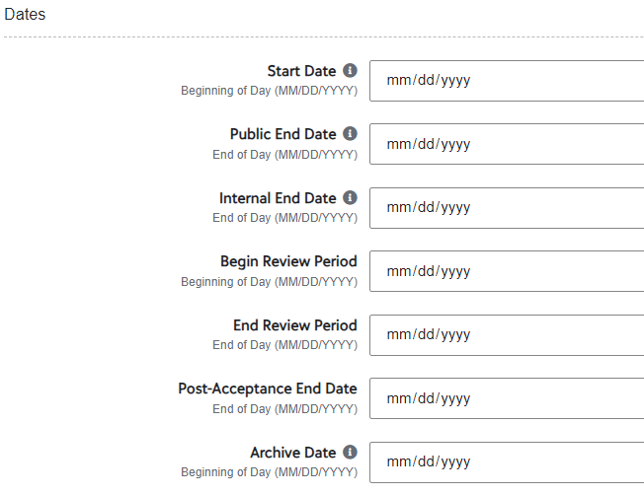
  How to add Start and End Dates at the Opportunity Level
Opportunity Portfolios ALL​
If no date has been entered, the default is “Future”, click on “Future”.​
Start Date – If left blank, the opportunity will be closed for applicants. You can backdate to “November 1st” even if it is past that date when you add it to the Portal. ​​
Public End Date – The deadline date that is visible to applicants. After this date, the opportunity will no longer be published.​​
Internal End Date – The deadline date for matching applications to the opportunity. Only qualified applications that were submitted before/on this date will be matched to the opportunity. Applicant answers submitted after this date will not be reflected in the opportunity applications.​​
Begin Review Period and End Review Period Dates – You may add when you open, however, please be sure you have updated your committee members, and it is recommended the Begin Review Period is a week or so after the End Date. The time between will allow you to review your applicant pool and organize your list for your review committee whether you are using the Review functionality in the Portal or not.
Post-Acceptance End Date – If you add a date in this field, students will no longer be able to submit a thank you letter once the date has passed. We do not recommend adding a date.
Archive Date – DO NOT add date, this field will be populated when the Financial Aid Office completes Cycle Management.
Please Note – Many scholarships for University of Montana students are made possible through the generous support of donors. The UM Foundation keeps donors informed throughout the year by sending impact videos, reports, and student thank-you letters. While students are encouraged to send thank-you letters, the UM Foundation does not require them for scholarship disbursement. Scholarships will be awarded regardless of whether a thank-you letter is submitted.
Tip! For more information on adding start and end dates and other Portal Opportunity setup tips checkout the Opportunity Set Up handout on the Department Scholarship Resources webpage.
Notes:
FAO Presents
Raven – Maybe Stewardship can chime in that TY letters are not required???

Slide 10
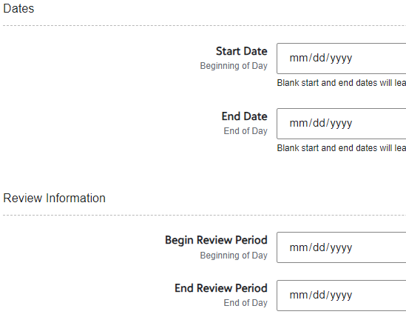
  How to add Start and End Dates at the Conditional Level
Opportunity General Applications Conditional​
Click on “Conditional Application Details” ​
Start Date – If left blank, the conditional application will be closed for applicants. You can backdate to “November 1st” even if it is past that date when you add it to the Portal. ​​
End Date – The last date the conditional application will accept applications.​
Begin Review Period and End Review Period Dates
Recommendations:​
Update your committee members and reviewer group.​
Set a review period a week or so after the End Date. The time will allow you to review your applicant pool and organize your list for your review committee whether you are using the Review functionality in the Portal or not.
Notes:
FAO Presents
Complete.

Slide 11
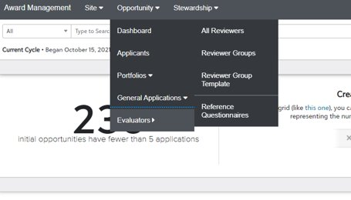
Quick overview:
Reviewer Groups and Rubrics
What are Reviewer Groups?
A feature in the Portal that allows administrators to assign your department Scholarship Committee members to review and select recipients for opportunities/scholarships
Notable features
Reviewers can use a "Rubric" to rate each student's qualifications
Each Reviewer can go into the Portal and review applicants at their leisure during the Review Period
Do you have an existing reviewer group?
You can add various review settings in each opportunity. You can make the following adjustments:
Hide Applicant Name – if you would like a more unbiased review
Opportunity Reviewer Note – administrators may enter any notes specific to the opportunity that the review group would need to see
Begin Review Period – administrators will need to enter dates for the reviewers to complete their process
How to Create or Modify a Reviewer Group
Please email fascholarships@mso.umt.edu
In your email, please provide the following information:
  Number of Reviewer Groups needed
  Names of all Reviewers (members of your Scholarship Committee) and their role
  Rubric ideas
  Which opportunities the groups(s) will be assigned to
Notes:
FAO Presents:
Complete.

Slide 12
Scholarship Portal Checklist
*Review Portal users in your department. Does anyone need access? Or can be removed? ^Review list of scholarship funds: Are all funds listed in the Portal? Check your degree programs that are offered. Are there new degree programs in your department (majors, minors, concentrations, etc.) that need to be added to your qualifications? *Check Portal Qualifications for each opportunity. Based on the criteria report, are the qualification or questions properly added? Please do not add additional requirements that are not specified in the criteria. Examples: Transcripts, essays, letter of recommendations, etc. *Check Conditional Application questions. You must have at least one required question. | Determine how you will alert students of available scholarships and how to apply. *Determine committee members and set up Reviewer Groups. *Add Start/End Dates to begin collecting applications. You can add reviewer start and end dates at the same time. *After dates are entered, check applicant pools. Are the proper students filtering in each opportunity? *Determine if you need a custom view to look at applicants by opportunity. *Review How To Offer Awards to Applicants handout via the Department Scholarship Resources. ^Check the selected recipient meets the full criteria. Track and Reconcile awards. *Other resources available on the Department Scholarship Resources webpage.
* Questions should be directed to the Financial Aid Office – Scholarship Team. ^ Questions should be directed to the Foundation – Scholarship Team.
Notes:
FAO Presents:
Complete

Slide 13

Questions?
Notes:
Raven Presents:
Complete.

Slide 14

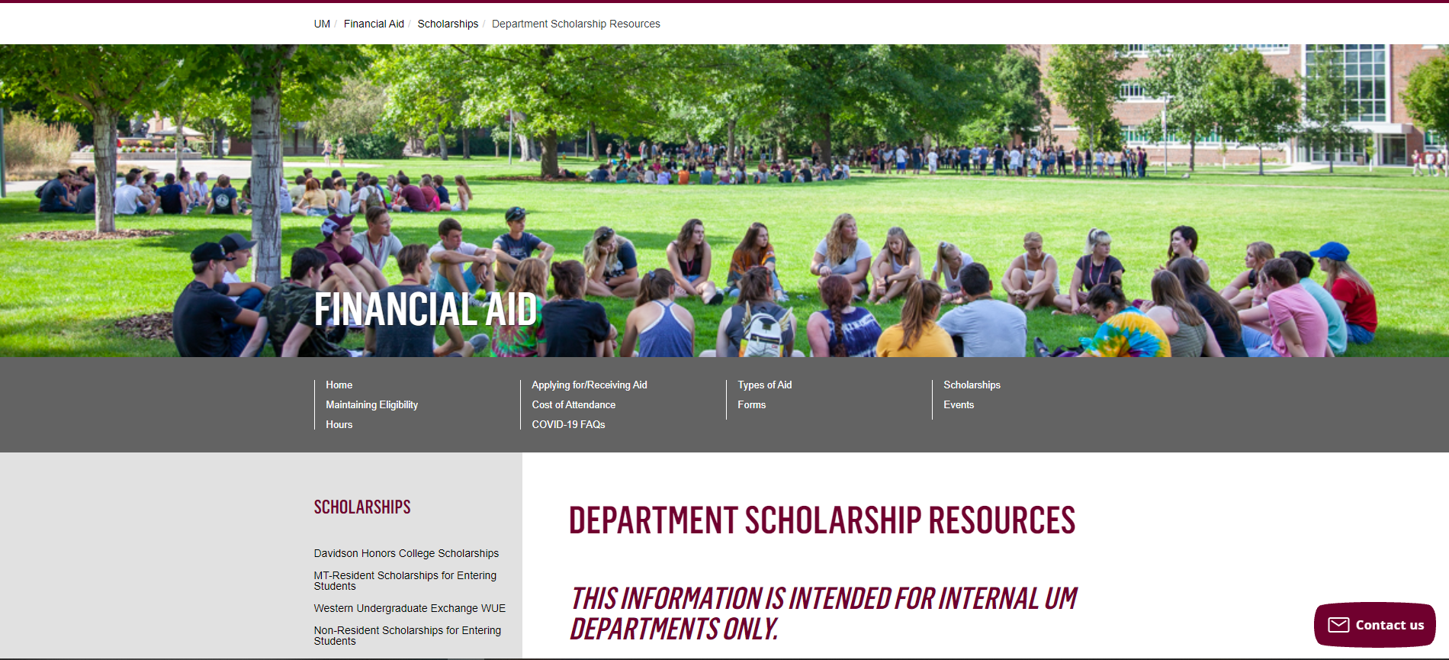
Department Scholarship Resource Webpage
Who is this for? ​
YOU! As a scholarship administrator/contact, these resources are for you, to use throughout the year as you go through your scholarship process.​
​
What can I find there? ​
Portal Administrator Request Form
Award Summary Sheet and Correction​
UM Portal Handouts/Instructions ​
Past Presentation Materials ​
Thank You letter information ​
FAO, UMF and Business Service Contact Information ​
How do I access this webpage?​
Please SAVE/Bookmark this link https://www.umt.edu/finaid/scholarships/department-use-resources.php. This link is “hidden” to reduce access from students.​
​
Notes:
Raven Presents:
Complete.

Slide 15


Looks LIKE SOUNDS Like
Financial Aid Contacts | UM Foundation Contacts
Ginger Lowry Interim Director ginger.lowry@mso.umt.edu (406)243-5373 | Sarah Wade Assistant Director of Fund Administration Sarah.wade@supportum.org (406) 243-7460
 | Nancy Randazzo Senior Director of Gift and Fund Administration Nancy.Randazzo@supportum.org (406) 243-7440
Department Scholarship Resources Webpage: https://www.umt.edu/finaid/scholarships/department-use-resources.php | Raven Clark Senior Fund Administrator raven.clark@supportum.org (406) 243-7416
To contact the Financial Aid Office main line please call (406) 243-5373 | Blayne Shelton Donor Relations and Stewardship Specialist blayne.shelton@supportum.org (406) 243-7425
Location: Aber Hall, 5th floor | Location: Gilkey Building, 2nd Floor.
Financial Aid Office Email: fascholarships@mso.umt.edu (Use to submit award summary/award summary correction sheets and any award questions) | UM Foundation Email: umfawardsummarysheets@supportum.org (for scholarship department questions)
Business Services Contact
Barb Bybee (406) 243-6261 Barb.bybee@mso.umt.edu
Notes:
Raven Presents:
Add Ethan?

Slide 16






Thank you for joining!
Next Upcoming Forum: Friday, April 4 at 11 am via Teams
Stay tuned for future communications that will include important
scholarship information and deadlines.
Notes:
Raven Presents:
Complete.

