Slide 1

Scholarship Universe Training
Awarding Pt.2:
Making and Managing Awards
Notes:
---

Slide 2
Agenda
Review Training Schedule/Where to find training materials
Review Last Training Session
Live SU Demo of Awarding a Scholarship and Award Management Features
End on Q/A

Slide 3
January Trainings
Session 1: Deeper dive into Navigating SU, where things are, what functions exist and where to find them.
Session 2: Pt 1 of Awarding: Reporting and Data Export Features
Session 3: Pt 2 of Awarding: Entering Awards, Award Tracking, Award Management
Session 4: Training Wrap Up, Scholarship Best Practices, Awarding Deadlines, and what to expect looking forward.

Slide 4
Review
Review Process: Batch Application Review vs Review Pools and how to tackle each approach
Difference between Oversight Administrator, Support Administrator and Reviewer and where to access each
When will budgets be released/show up in my funds?
Why do I not see certain funds?
What does the “draft” status mean for a certain fund?

Slide 5
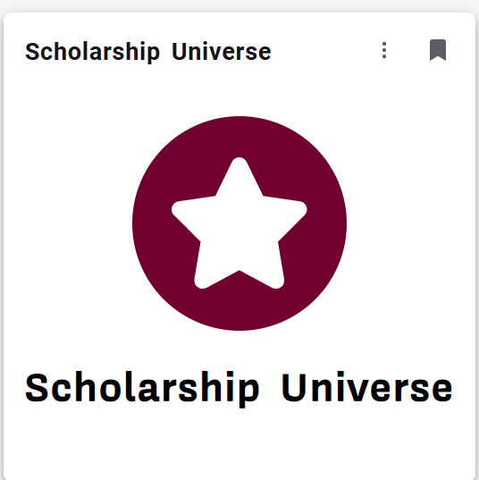
Scholarship Universe Tour:
Awarding Scholarships
Scholarship Universe Awarding

Slide 6
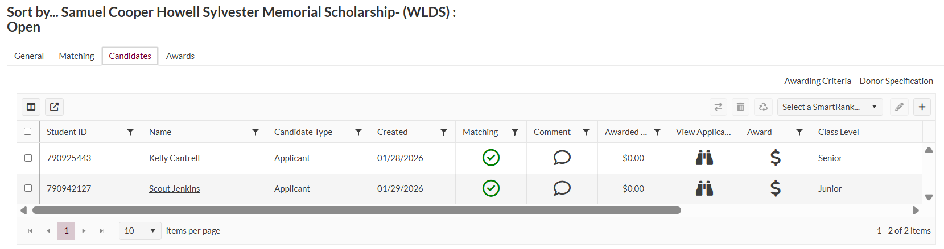
Awarding in Scholarship
View
After you have reviewed all candidates you can begin awarding.
Once you pull up your list of scholarship view, you can find the “Candidate View” and list of candidates matched to your scholarship
Take a moment to refer to the “awarding criteria” button to ensure that your candidates meet the criteria and preferences outlined by donors, and click the $ in the award column

Slide 7
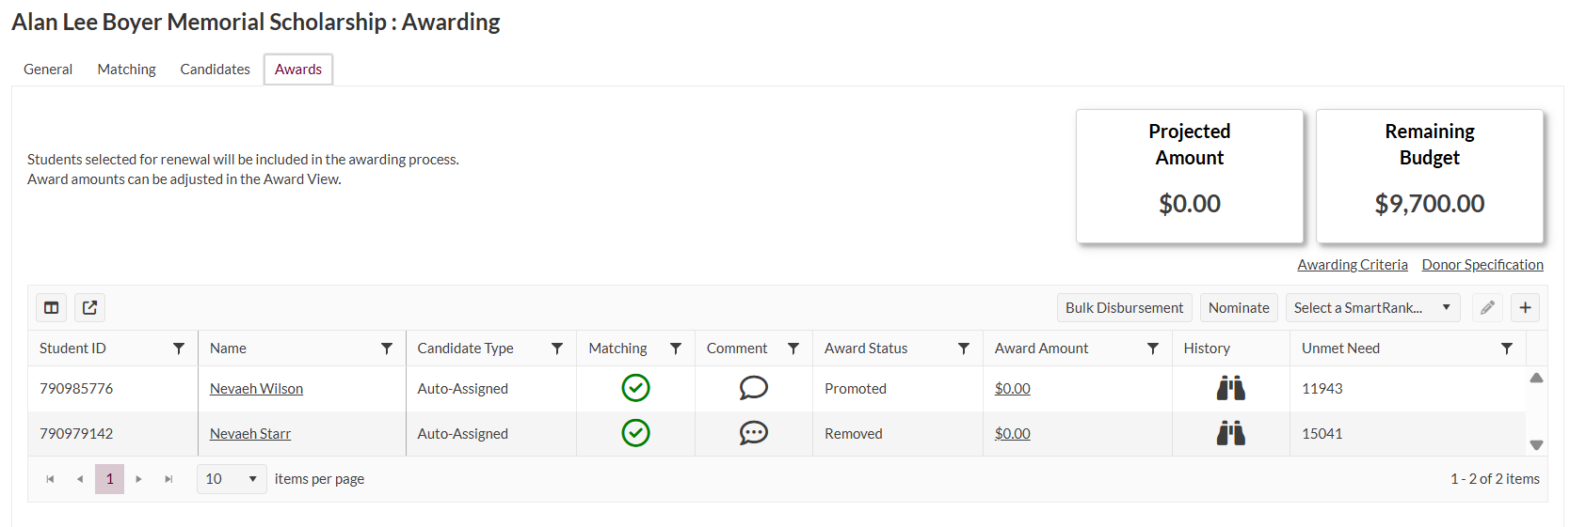
Awarding Cont’d
Once you click the $ sign in the candidates tab, you will see your candidates promoted to this “awards” tab.
Here you will assign “award amount” in the award amount column with the option to award fall, spring, or full year awards.
You will also have the ability to leave comments on your awards and track the remaining budget or your scholarships.
Notes:
Please note, this page will help you track awards. However, unlike what I said in my video, all departments will continue to track their own budgets and reconcile funds.

Slide 8
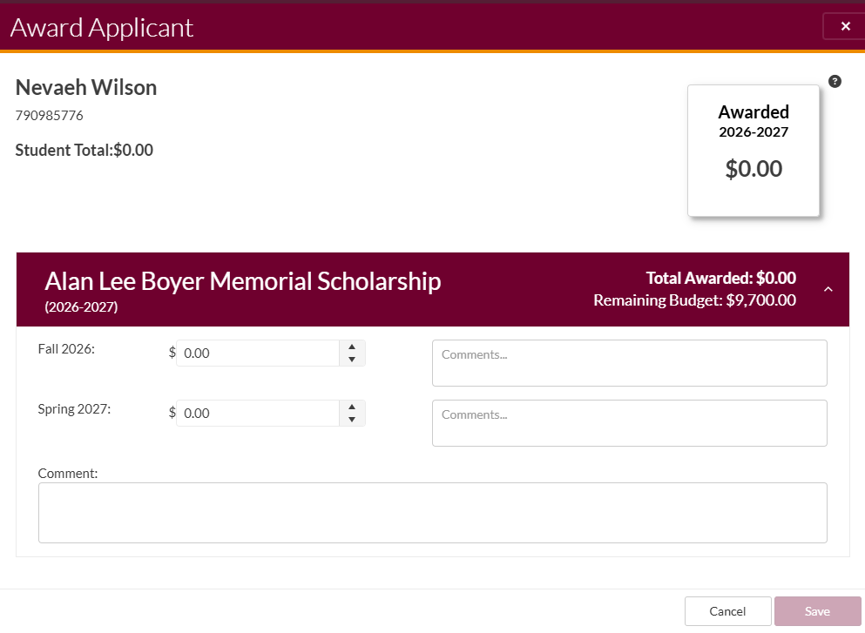
Award Amount Icon
Once you click on the award amount icon, this is the screen you will be brought to officially make and award the scholarship.

Slide 9
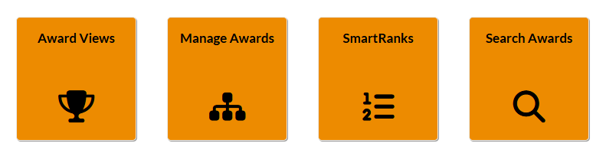
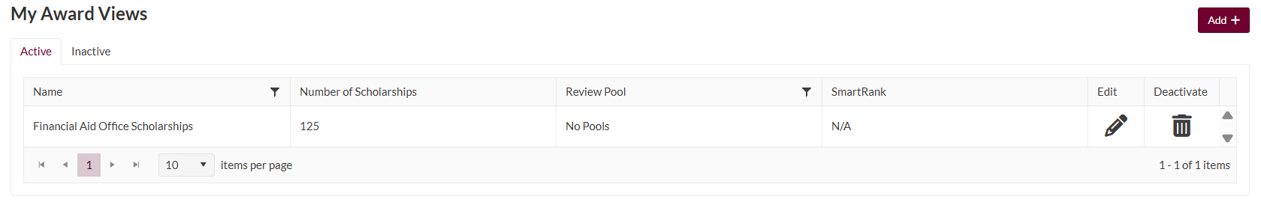
Awarding Management
Views Option
In your “awarding tab” you can open your “award views” icon and manage all of your awards in one place rather than drilling into awarding at the scholarship level.
Please note, this function will only be availble to all after March 1, when applications are closed, and after awards have been reviewed/ready to award

Slide 10
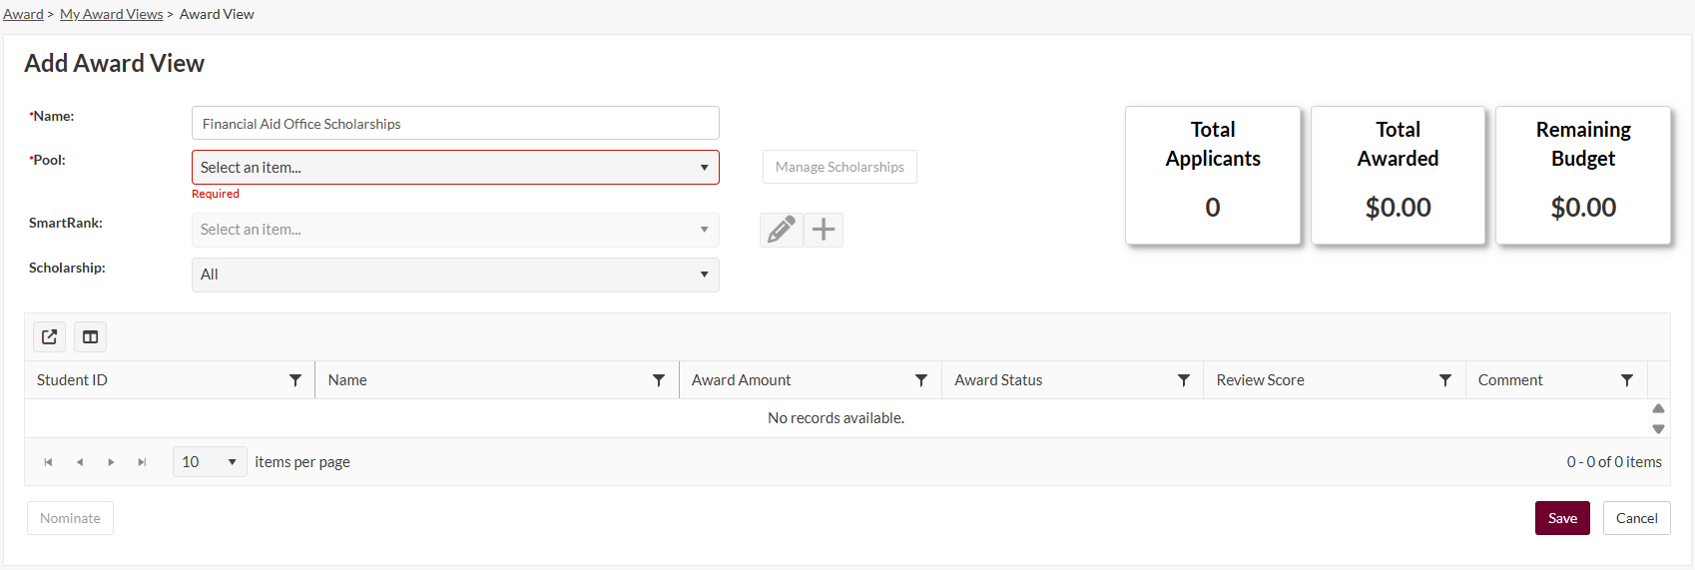
Award Views
Once you drill into “award views” you will be brought to this page.
Here you will fill out the name of your scholarships, select associated review pools if that is applicable (or just select no pools)
From here, you will be prompted to select all the associated scholarships you want to see in this view

Slide 11
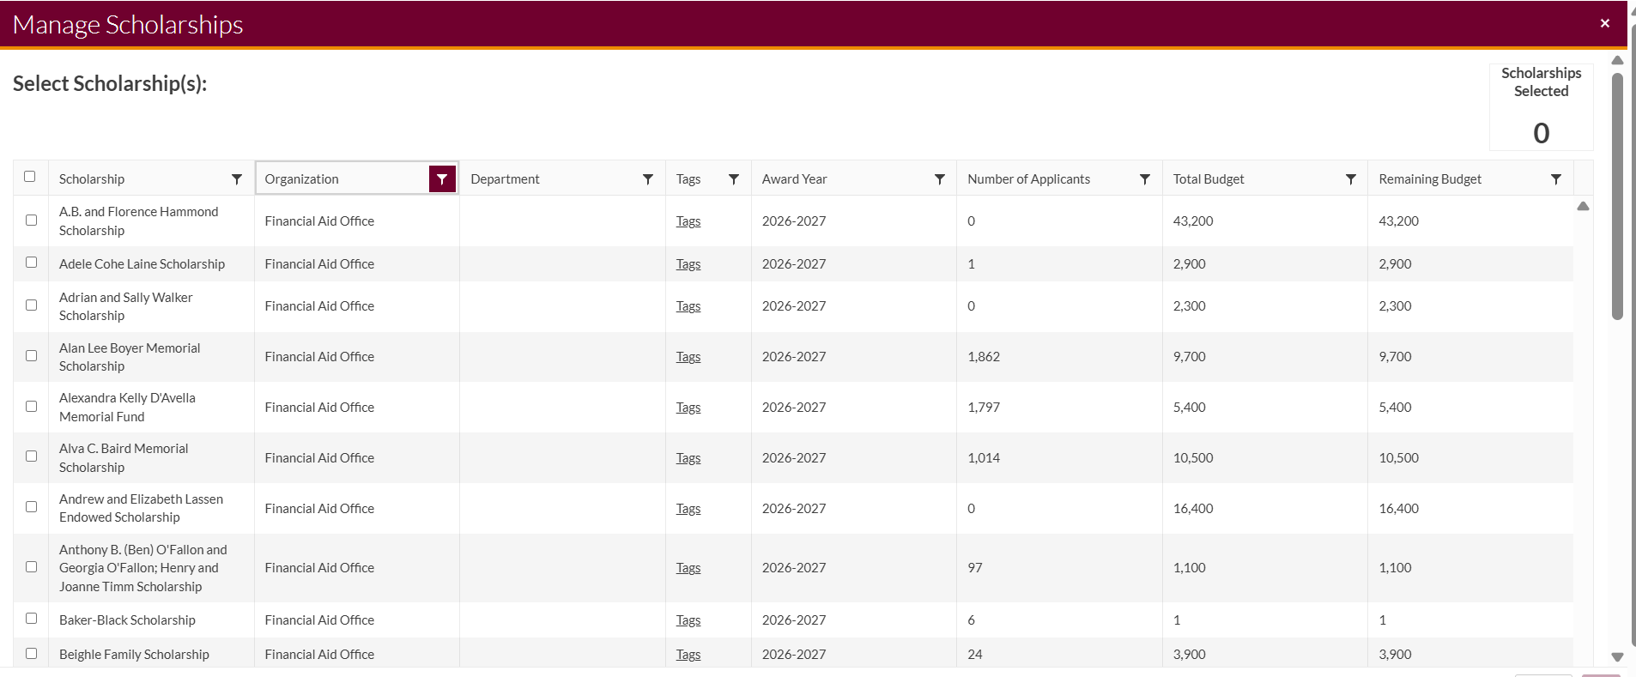
Award Views Cont’d
Once you fill out the previous page, you will be brought to this scholarship view page.
I can see all scholarships, so I filtered by only financial aid scholarships.

Slide 12
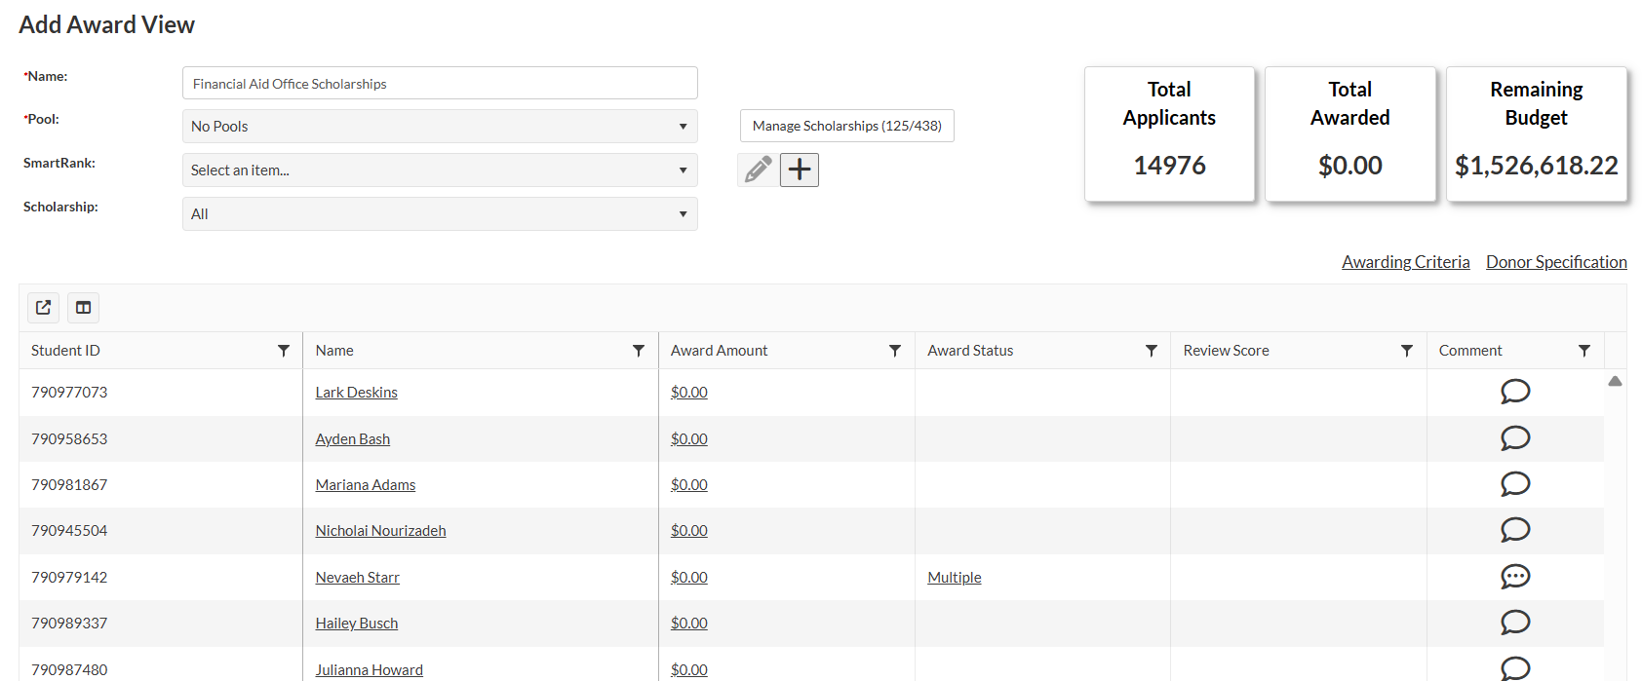
Award Views Cont’d
This dropdown allows me to select one scholarship at a time
Once I select all scholarships I want to manage, I am given this view with all of my scholarships, compiled budgets, candidates, etc.
I can manage this by filtering through each scholarship, to make sure I am awarding candidates that are matching only to the associated scholarship

Slide 13
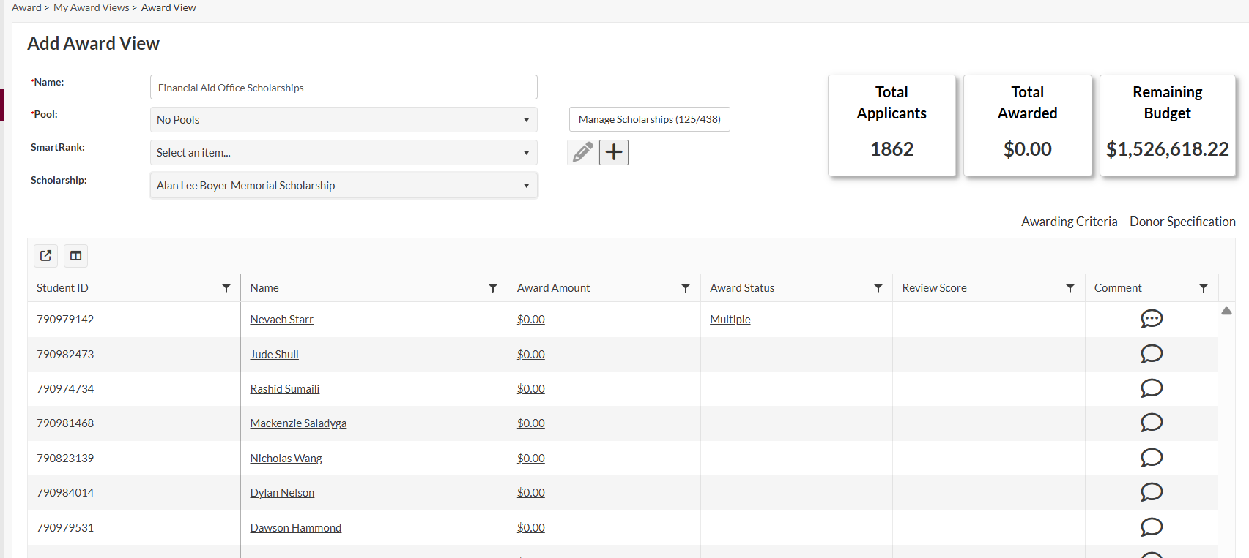
Award View cont’d
This view allows me to award, or just see my applicant pool, and review score per applicant if you have review pools.
Similarly to the scholarship view, I can make awards in this view too

Slide 14
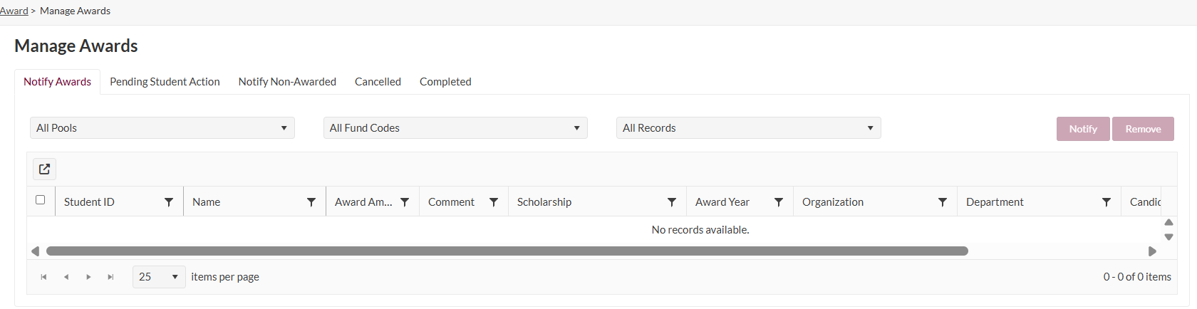
Manage Awards
Once you make awards, you can toggle to the “manage awards” vantage point, wether you can see funds, completed, cancelled, and all other awards that you have made for your scholarships

Slide 15
Meeting Q/A Summary
In the old Portal, we used to have specialized communications that went out to recipients when they were awarded. Will that still be available?
Nope! All awarding communication will come from the FAO office. Any special communications regarding scholarships will need to come directly from your email to students. In fact, we do ask that you refrain from communicating out to students about awards until eligibility has been verified.
If a student is selected for an award, but then does not end up enrolling for whatever reason, will that show up in SU as being rejected or unused, etc?
Similarly to the old portal, you will need to manage this. This will not be visible in SU until you remove the award. The enrollment status of a student is not visible here. However! You should be able to adjust awards, eliminating the need for AWSS! Yay!
Will Spring Only awards be able to be done in SU (instead of having to only use an AWSS)
You can designate funds to be “Spring Only,” but only the students who applied by Mar 1 will be available for applying to these scholarships, unless we set up a cycle for those spring funds, which we have the capacity for, but ultimately remains up to campus leadership.
If a scholarship does not have any applications by March 1st, can the deadline be extended, and what is the process to do that??
If a scholarship has no applicants, please set up a meeting with us, and we can create another cycle for those funds/brainstorm strategies to get those funds awarded.

