Slide 1

Scholarship Universe Training
Training Series Wrap Up:
Best Practices, Awarding Deadlines, & Looking Forward
Notes:
---

Slide 2
Agenda
Review option 1 and 2 for Review Process
Awarding Deadlines/Philosophy
Communications to Students Receiving Awards
Scholarship Best Practices
End on Q/A

Slide 3
January Trainings
Session 1: Deeper dive into Navigating SU, where things are, what functions exist and where to find them.
Session 2: Pt 1 of Awarding: Reporting and Data Export Features
Session 3: Pt 2 of Awarding: Entering Awards, Award Tracking, Award Management
Session 4: Training Wrap Up, Scholarship Best Practices, Awarding Deadlines, and what to expect looking forward.

Slide 4
Review
Review Process: Batch Application Review vs Review Pools and how to tackle each approach
Are there more options? This is what we did before, how do we best incorporate this new system?
Review pools just comes with scoring, we can make that a very simple process, but it is a central part of review pool functionality
How do I set up appt to make review pools?

Slide 5
AWARDING DEADLINES
All awards April 1 and list of “Spring Award” funds
Why do we want this? Drew
Exceptions? Yes, but only if granted special permissions
What do we do after March 1 for awards with no applicants? Demo in SU for reporting on scholarship matching by MJ
Notes:
Matched but not applied report – do some marketing to those students
Applicants in progress
Two week extension

Slide 6
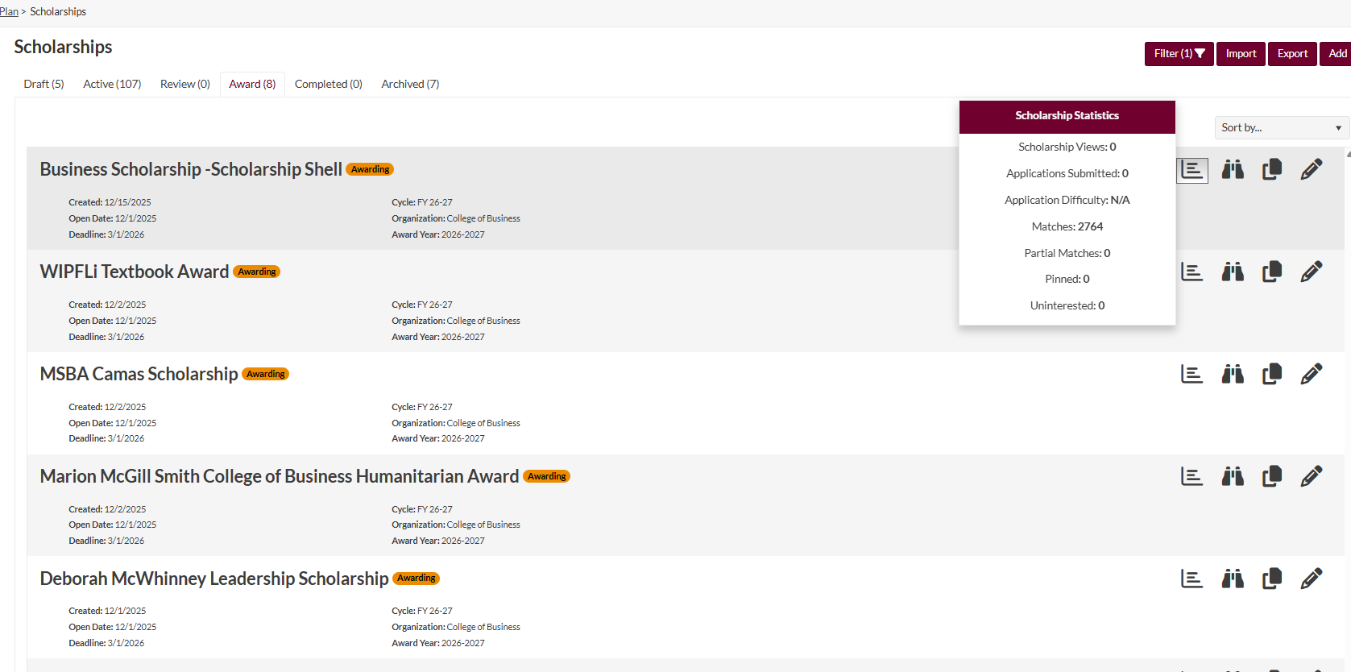
Scholarship Reporting
If you look at this “report” button, you can pull stats on your scholarships. Here you can see the matches, partial matches, views, etc on your scholarships.

Slide 7
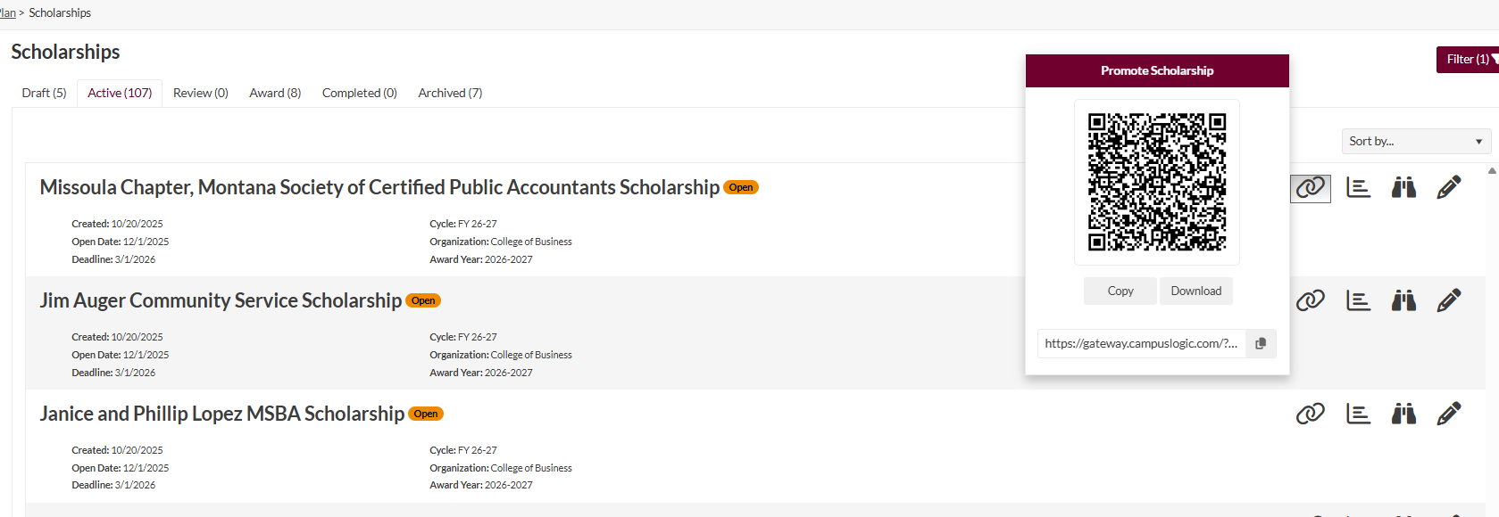
Promoting Scholarships
In addition to the “report” feature, you have this “promote” feature that you can utilize for your scholarships to send out to potential candidates for your scholarship. Especially those who have low candidate counts

Slide 8
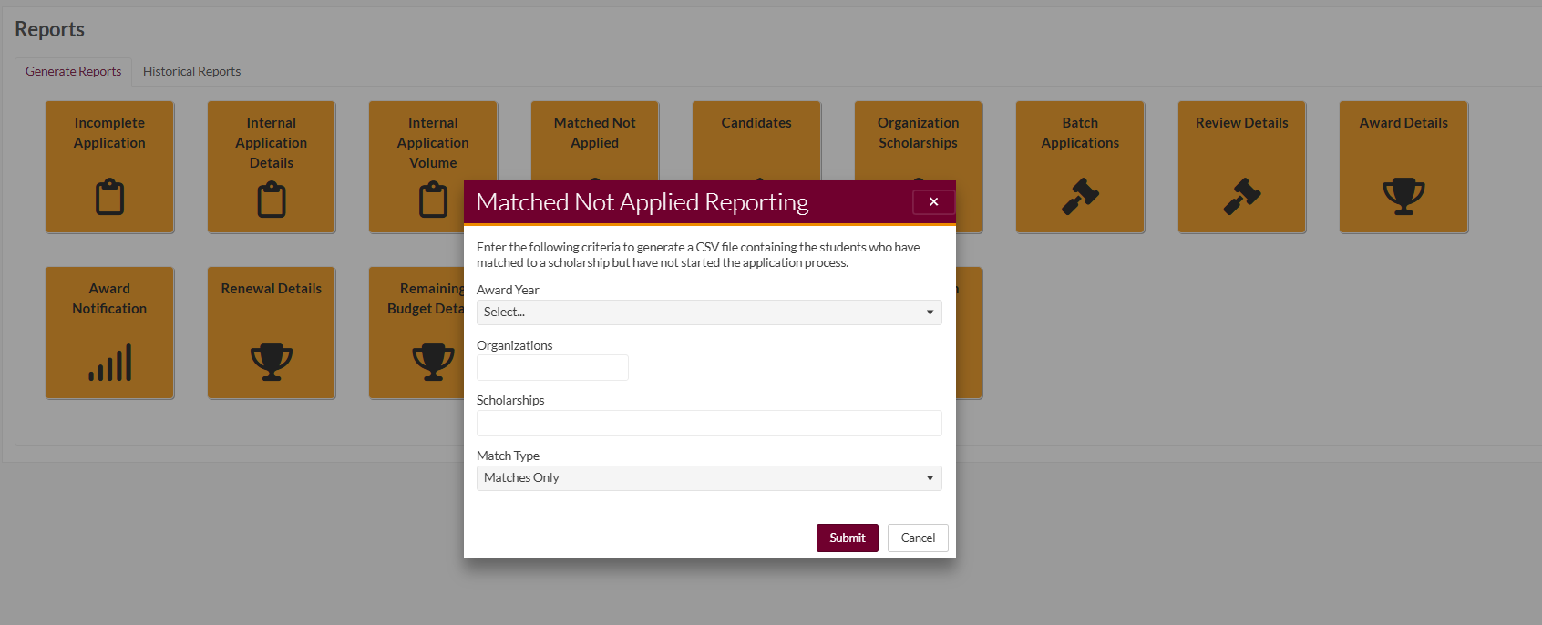
Matched, Not Applied Report
Once you identify what scholarships you want to pull data on, you can select the scholarships you are trying to promote, to find students who have matched to your scholarships and not applied, or who are partial matches or both. This will give you a sense of who might be a potential candidate for your scholarships!

Slide 9
Communication to Students
FAO will be confirming eligibility for each award
  Meeting requirements
  Room in budget for the award
Don’t communicate until we confirm eligibility
  This is to ensure that we don’t communicate awards to ineligible students

Slide 10
Scholarship Best Practices/Strategies
Goal is to promote enrollment: recruitment or retention
Filling the need gap
Coordinating with other awards – spread the love
Whittling your list down – don’t be too linear

Slide 11
What’s Next?
Office Hours: TIME TBD—for now schedule anything on my calendar, and I will carve out specific times for office hours
One more training date on Fund Reconciliation, Stewardship Process—TBD Date/Time
Beyond that, I will meet with Departments 1:1 before next cycle to check in, and improve for next cycle
Overall goal: Make awarding/applying as easy and accessible for students while also remaining within the lines of donor criteria.

