Slide 1

Scholarship Universe Training
Awarding Pt.1:
Reports & Data Exports
Notes:
---

Slide 2
Agenda
Review Training Schedule/Where to find training materials
Review Awarding options A. & B.
Live SU Demo of a Batch Application Report and Candidate Report
Enter into fund and discuss Candidate Tab/Info Being Pulled from SU into reports
End on Q/A

Slide 3
January Trainings
Session 1: Deeper dive into Navigating SU, where things are, what functions exist and where to find them.
Session 2: Pt 1 of Awarding: Reporting and Data Export Features
Session 3: Pt 2 of Awarding: Entering Awards, Award Tracking, Award Management
Session 4: Training Wrap Up, Scholarship Best Practices, Awarding Deadlines, and what to expect looking forward.

Slide 4
Awarding Options
Continuous awarding-use batch application report, give to committees, finish award process in Scholarship Universe
Create review pools within scholarship Universe—If this is your route, please set up a time to meet with me (a bit more complex)
Notes:
I went over option A in our training, and option B will be for departments who have historically used the portal to create “review pools” to delegate the scholarship review process to other colleagues and faculty.
IF you are a department who does need training on how to create and manage review pools, please reach out to me and set up a meeting so we can train you on creating and managing review pools.

Slide 5
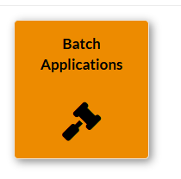
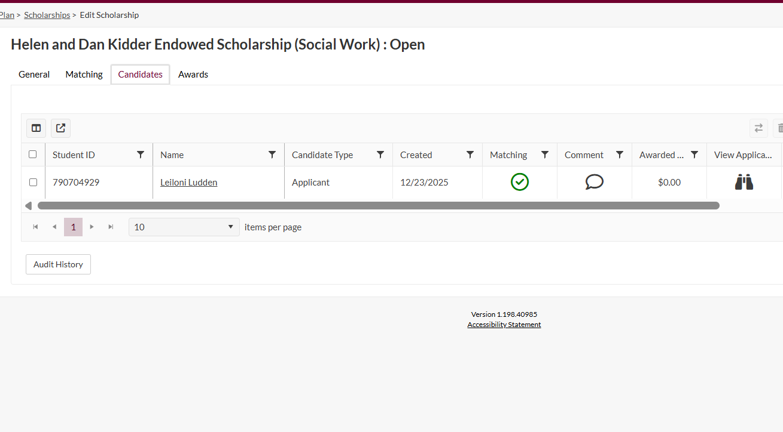
Reviewing Candidates in Scholarship Universe
This is where you can view a candidate’s associated application within the scholarship view
If you have several scholarships, you can pull a report of all scholarships associated with a given application, and all candidates who qualifiy for each scholarship.
This report will pull all candidates, their applications, and the scholarships they specifically qualify for
Notes:
For your department, there are two ways to go about reviewing candidates and their applications for a specific scholarship.
Users can manually drill into each scholarship within the SU platform, and view each candidate’s application within each scholarship
Users can pull a “batch application” report with a comprehensive view of each candidate, their answers to each question

Slide 6
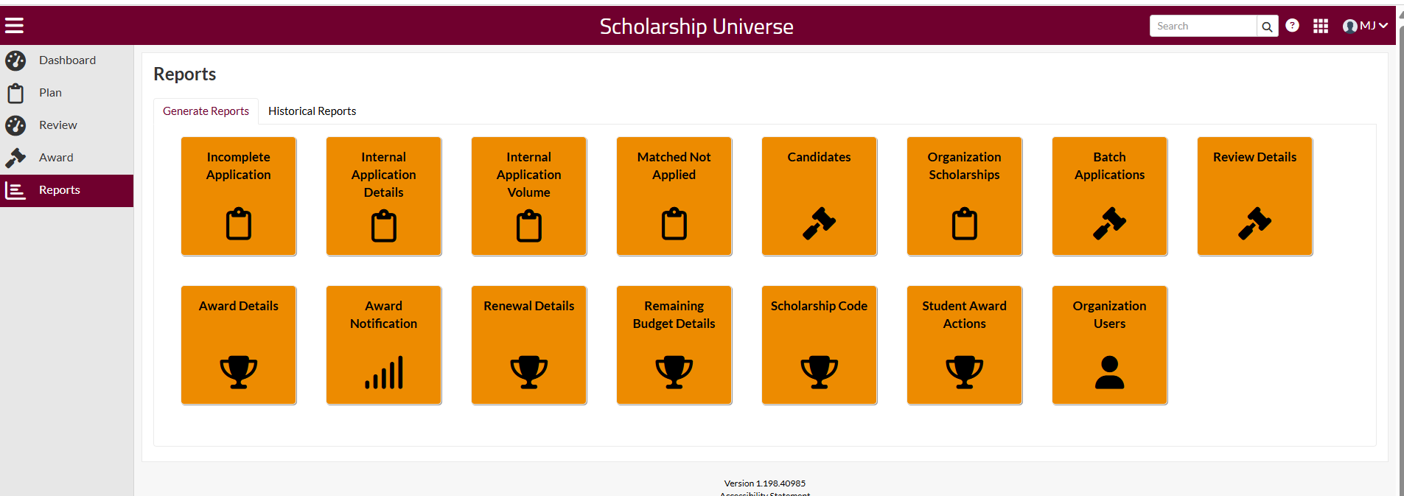
Pulling Batch Application Report
This is where you will go to pull your ‘batch applicant’ report
Toggle over to this tab on your dashboard to access various reports
Go to your “reports” tab on your profile. Reminder only Oversight Admins have this functionality available to them, so if you need this function, please request access
Toggle over to the Batch Application Report

Slide 7
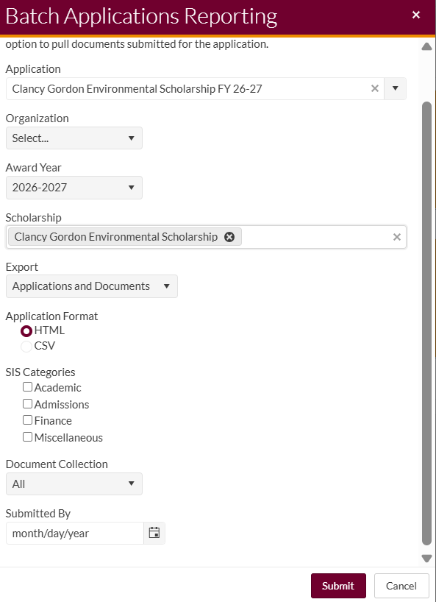
This is where you will select the application you are seeking to pull data from
This is where you will select award year
This is where you will select all scholarships that you want data pulled from that are associated with your selected application above
This is where you will select the view type..HTML view comes with additional SIS categories to add, (which is data we are pulling from Banner into SU) where the CSV file does not come with this extra info
Step 1: Requesting the Report
This is where you can specify if you want attachments included ie letters of references, essay uploads, etc
Notes:
When you click on the “Batch Applications” icon, you can see this pop up, that you will be prompted to fill out. Only the arrow indicators are required info to include when pulling this report. Again, this report will generate a mass file of the candidates associated with this applications, so viewers can review and score student applications. This report might be helpful if you are trying to share your applicants’ work with a review committee.

Slide 8
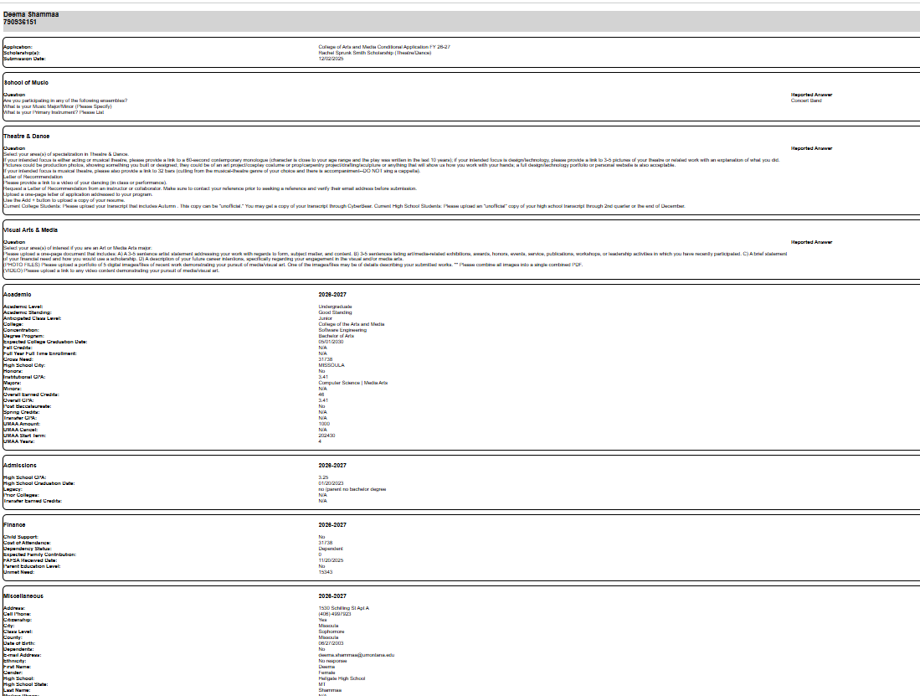
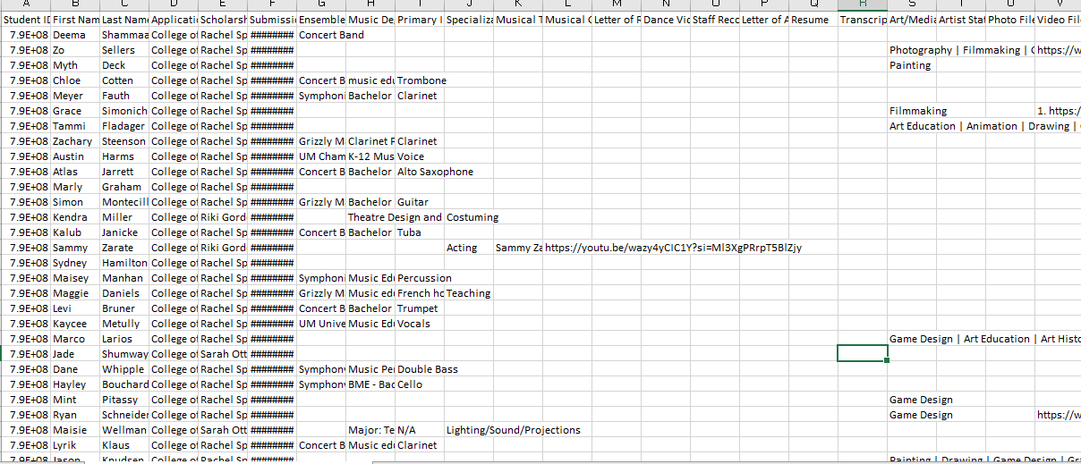
Batch Application Format
HTML VIEW
CSV VIEW
CSV File only has application questions and applicant answers
This is where extra SIS data can be pulled in HTML View
Notes:
When determining what format to view your candidate’s applications in, please know that documents associated with applications (ie LORs, Document Uploads, Essay Uploads, Transcripts, or any other attachments connected to the application will also be emailed to you in a separate file.
CSV view is a bit easier to track each student as all data and info is in one page for each applicant.

Slide 9
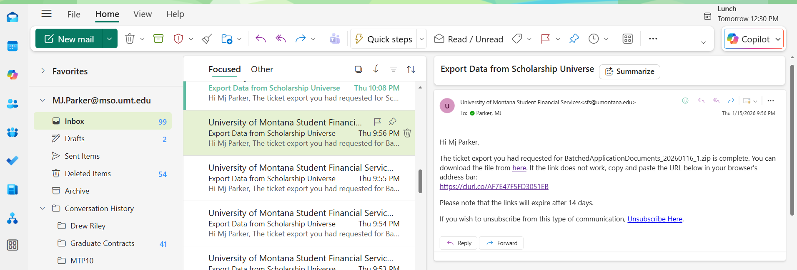
Step 2: Submitting your request– Check inbox
Once you fill out the batch application request screen you will get an email with the data format you chose, and an email with the applicant’s associated documents. This is what the email will look like
Notes:
This is what the report email will look like when you generate the “batch application” report. You will receive two different emails.
Email 1: Includes either the HTML report or CSV report, depending on what you chose,
Email 2: Includes associated documents with the applicants’ applications. Here you will find any uploads like letters of rec, transcripts, resumes, essay uploads, etc. The documents associated with the application will correlate directly to an application question.

Slide 10
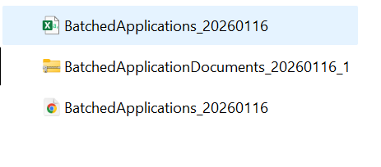
Step 3: Download reports to computer
Download view
1. CSV File
2. Zip File with application documents
3. HTML File
Notes:
Once you download the batch application report, this is the view you should have from your desktop/downloads tab

Slide 11
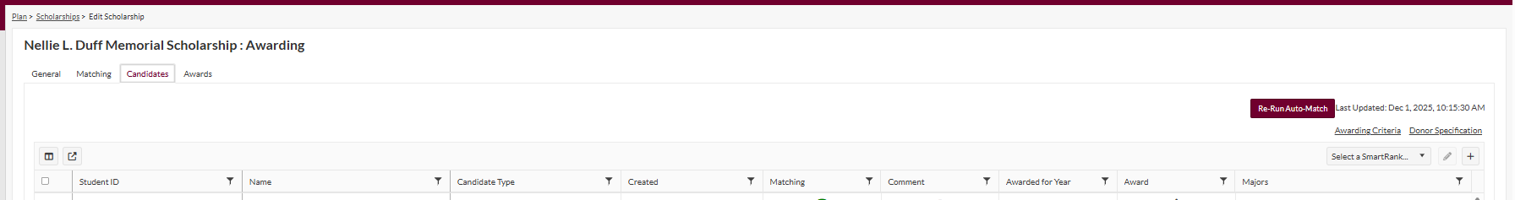
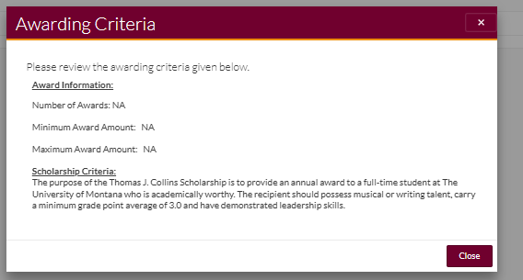
Candidate Tab Functions
Awarding Criteria
Column Manager
Awarding Criteria Paragraph
Column Manager Tool
Export Candidate List
Notes:
When you come into an individual scholarship, you can toggle to your “candidate tab” to see the list of candidates per scholarship.
Before you run the report, be sure to click on the “Awarding Criteria” button in the top Right corner. This will give you a clear picture on what the criteria is, and if you need to add any preferential filters to sort through lists. You will do this through the “column manager” tool.
Once you have added your filters through column manager, you can run the candidate report.

Slide 12
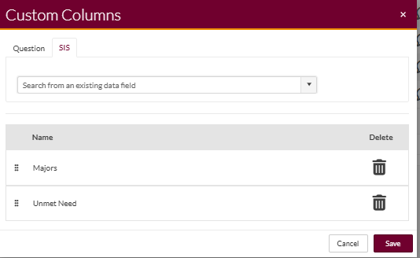
Column Manager Tab
SIS Tab
Question Tab
Notes:
This is the column manager pop up once you click that tool. If you focus on the “SIS” portion of this report, you will be able to add any SIS data that is pulled into banner—this will allow you to pull information like hometown, unmet need, highschool, GPA, etc, so you can better filter through your candidates, and make sure they are the best fits for your awards
The “question” column allows you to pull any question from Scholarship Universe (matching or essay) and pull the student’s answers to that question. This can also be helpful when narrowing down candidates and selections.

Slide 13
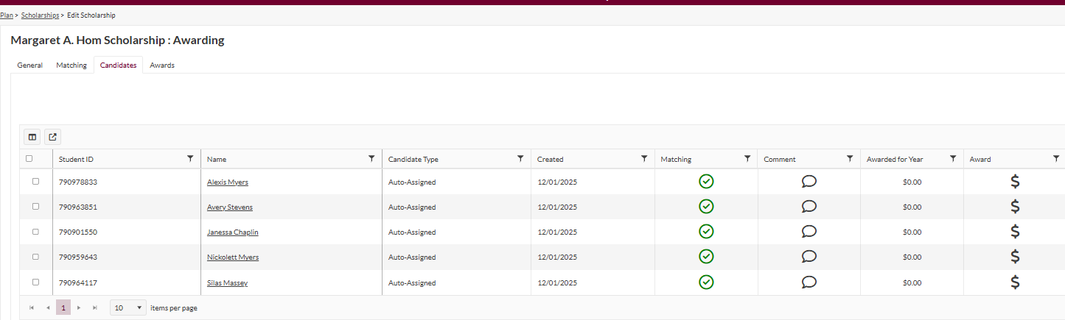
When you pull up an individual scholarship view, you can generate a report of each candidate that has qualified for a scholarship using this export feature
Candidate Report

Slide 14
Meeting Q/A Summary
Would you recommend faculty scholarship committees review applicant materials by reports or review on scholarship universe?
The approach that I have taught in this training is the batch application review, just because it requires that less people learn the system for this first cycle. I think in the future we will want to revisit review pools, but for this first year, with deadlines approaching, this might be the simplest approach. However, if you are a department that absolutely needs review pools, please set up a meeting with me, and our consultant and I can meet with you and show you how that function works in SU!
Who or where do you request oversight permissions? ?
You will use the same “Scholarship Administrator” link to request access to updated roles. As of now, you have the ability to also include that you need “oversight”, “Support”, or “Reviewer” roles in SU. Also, if you had reviewers in the previous portal those have NOT been added to the portal. You will need to request those once you have set up a meeting and trained on how reviewers function in the portal.
I don't have the ability to select HTML as a report option?
If you do not have that functionality in your batch application report, chances are you do not have candidates who have applied for that scholarship yet.
If a scholarship does not have any applications by March 1st, can the deadline be extended, and what is the process to do that??
If a scholarship has no applicants, please set up a meeting with us, and we can create another cycle for those funds/brainstorm strategies to get those funds awarded.

