Slide 1

Scholarship Universe Training Series
Navigating SU
Notes:
---

Slide 2
Agenda
Review Training Schedule for Jan
Review Roles/Descriptions
Live SU Demo with all functions
End on Q/A

Slide 3
January Trainings
Session 1: Deeper dive into Navigating SU, where things are, what functions exist and where to find them.
Session 2: Reporting and Data Export Features/ Pt 1 of Awarding
Session 3: Pt 2 of Awarding
Session 4: Training Wrap Up, Scholarship Best Practices, Awarding Deadlines, and what to expect looking forward.

Slide 4
Role | Description
Scholarship Viewer | All administrators currently have this access, it allows you to view the scholarship opportunities within your assigned scopes
Candidate Manager | All administrators currently have this access, it allows you to view the students who have matched to you respective scholarships.
Review Manager | No staff currently have this access. This access allows your designated Scholarship Admin team to create review pools so that your team can effectively review the candidate pools for each scholarship. You also have access to special reports to have a more comprehensive data view to share with your review pools of scholarship candidate data. We recommend designating one or two staff members to manage this role within your scholarship team.
Award Manager | No staff currently have this access. This access allows an administrator to actually award students once the committee has decided on candidates for each scholarship. This staff will add scholarship amounts to students, and manage award status, outstanding tasks, and redirecting awards if students withdraw, etc. This staff will also have the ability to pull different reports related to award management.
Reviewer | No staff currently have this access. This access will be relevant for your scholarship review committee, which will be set up by the Review Manager. As a reviewer, you can participate in the review process with this role. This might be for faculty who are apart of review committees
Help Desk | No staff currently have this access. This access requires special permission from FAO office, as it allows staff to search any student, and you can see student data, progress on applications, matches, partial matches, etc
Admin | All SU administrative access only given to FAO at this time
Support Administrator Roles
Oversight Administrator Roles
Review Team Role
FAO Roles
Notes:
Depending on your level of involvement in the Scholarship Process, administrators can request access according to these different functions.
Administrators can request role through the Scholarship Administrator Request button on the department resources webpage.
Department Resources link- https://www.umt.edu/finaid/scholarships/department-use-resources.php

Slide 5
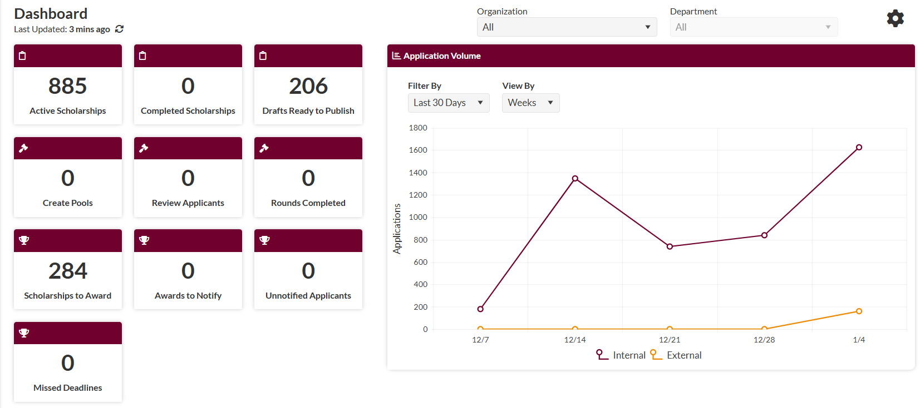
Dashboard View
Row 1- Scholarship Viewer access: user can see scholarship opportunities within their scope
Row 2-Review Manager Access: user can see review pool management overview
Row 3- Award Manager Access: user can
Notes:
Each access level has different portal view functions in the dashboard.
Row 1- Support Administrator functionality
Row 2 and 3- Oversight Admin functionality
Review Applicants Icon- Reviewer funcitionality

Slide 6
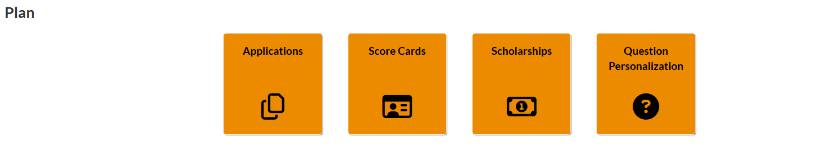
Plan Tab
Application icon- user can use this to find and view the applications associated with department opportunities
Score Cards- user can use if they manage review pools and want to know scoring of their opportunities
Scholarships icon- user can use this tab to access all the opportunities associated with their scope
Question personalization- not necessary, but this adds a view of all the matching questions in SU
Notes:
Overall objectives with new scholarship platform: user-friendly site navigation, sticking to donor criteria, and removing any questions that are not reflected in donor criteria contract when students apply for scholarships—we will do this in phases.

Slide 7
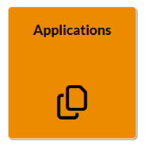
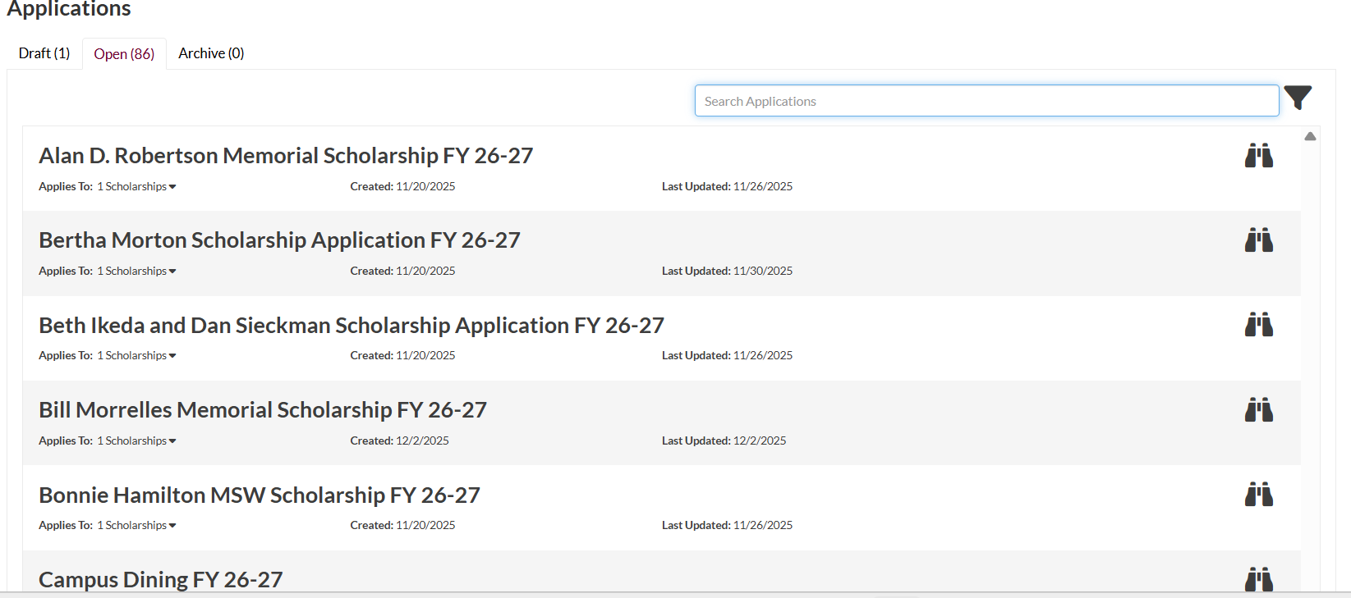
Application Icon
Users can search applications using this search bar
Users can open and view application using goggle icon
If a user clicks on the application icon, they will find this view
All application edits will be made by the FAO, administrators no longer have ability to edit scholarship applications.
Applications should not add any questions that are not found in fund specific criteria
Notes:
Due to time constraints with launching new portal, applications for FY 26-27 have been published, (as reflective of the old system as possible) so there are no updates that can be made for the 26-27 Fund cycle.
Moving forward, the FAO office will collaborate with each department to edit applications as needed to make scholarship process as accessible/painless as possible for both students and administrators in 1:1 meetings with Scholarship Team.

Slide 8
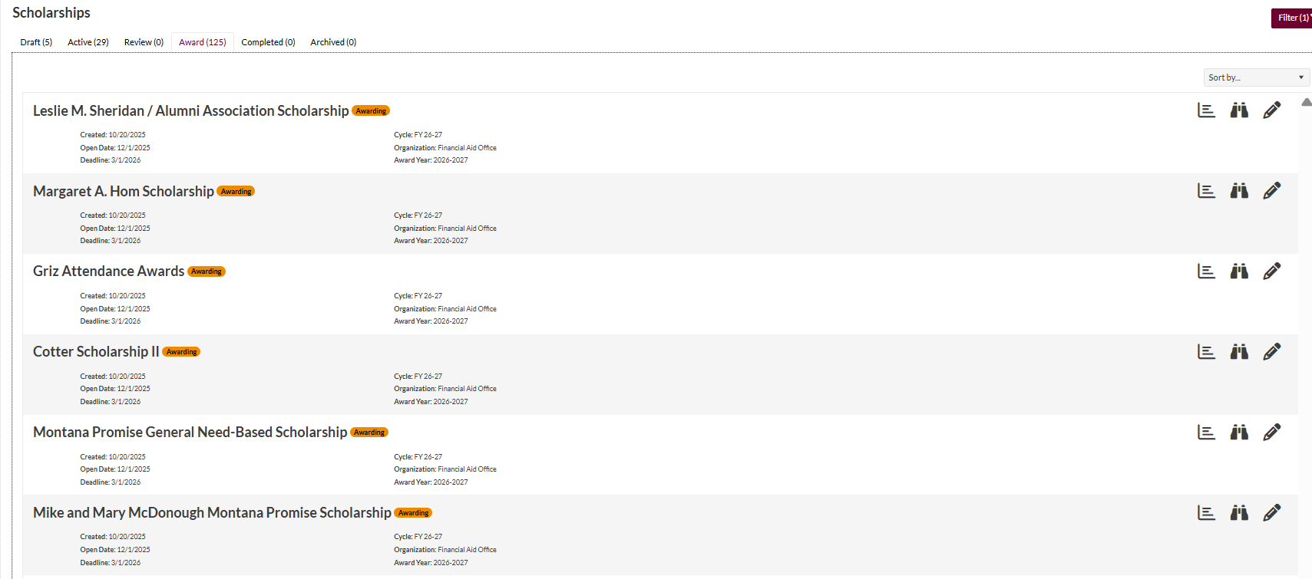
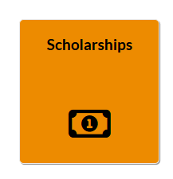
Fund phases: draft, active, review, award, complete, archived
Users can see into their fund and award an individual fund by clicking on this pencil icon
Scholarships Icon
If a user clicks on the scholarships icon, they will find this view of all the funds within their scopes
All fund edits will be made by the FAO and UMT Foundation. Administrators can only “view” their opportunity set up
Top row shows user where fund is at in scholarship process
Notes:
Draft funds are funds that are not yet published, or able to be viewed by students. This means FAO office has not finished setting up and publishing your fund, but that the fund will be available for the given award cycle (FY 26-27)
Funds in the “Award Phase” are ready to award
Funds in the “Completed Phase” have been awarded.

Slide 9
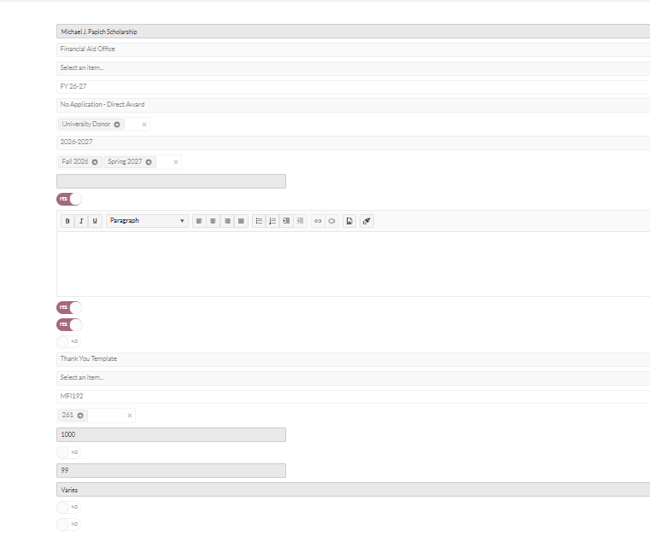
Individual Scholarship View
Fund Name
Fund Department Association
Application tied to fund
General Fund Tab: this includes name of scholarship, department, application tied to scholarship, fund code, budget, award criteria, etc
Fund Budget
Notes:
All admins will have the capacity to go into their scopes, and see this fund view for their funds.
All budgets will be released and input into funds following the same timeline as previous years. If budgets is reflecting $1, this will mean that budget has not been updated.

Slide 10
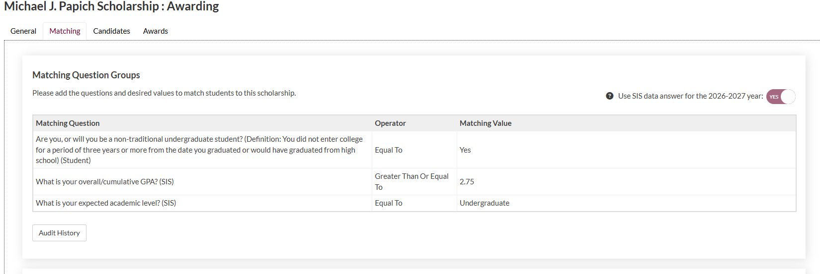
Individual Scholarship
View
Matching Fund Tab: this includes the specific matching questions tied to each scholarship. This criteria was determined based on donor contract with UM Foundation
Notes:
We are partnering with UM Foundation in this matching process. Together, we have tried to include all matching criteria as specified by the donor. If you notice that there should be certain criteria included with your fund, keep a list of your funds, changes that need to be made, and send that list to MJ Parker at mj.parker@umt.edu...we can also set up a 1:1 meeting to discuss any issues.

Slide 11
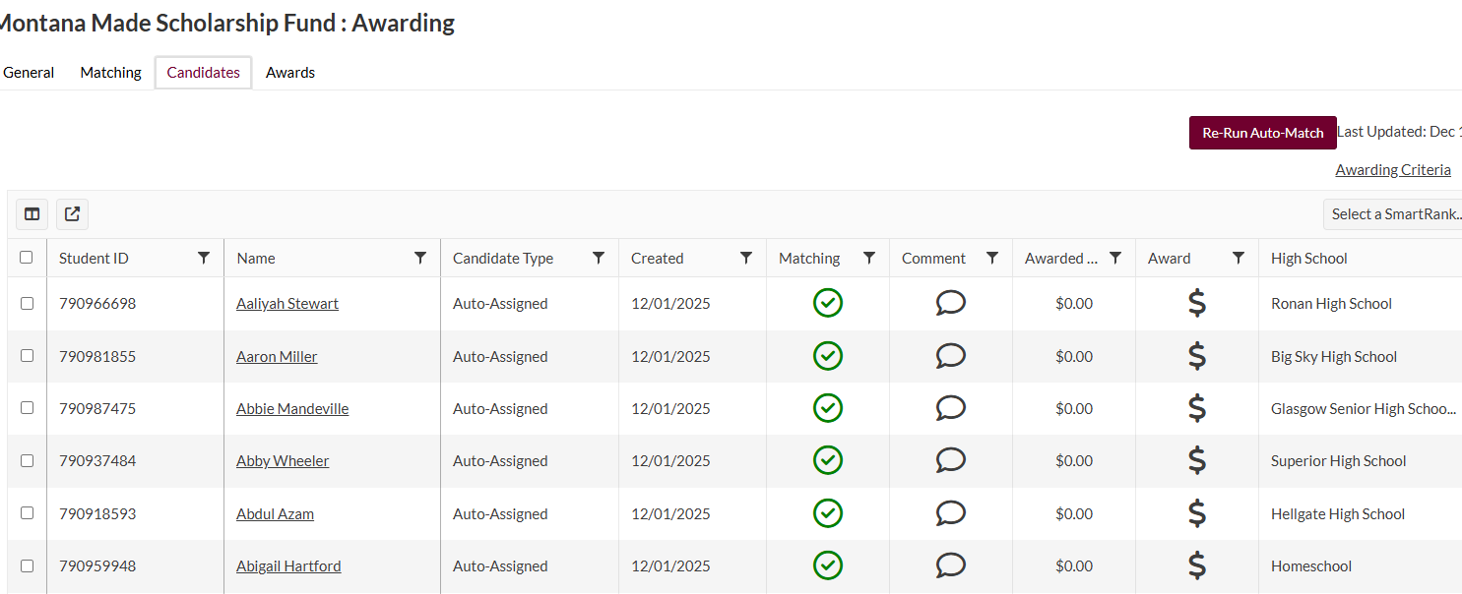
Individual Scholarship View
Candidate Fund Tab: this includes all candidates who have matched to a specific fund…SU has the capacity to pull reports on this information, or users can drill into a specific fund for this info
Awarding Criteria tab will show you all the criteria from donors including preferences, min, and max awards
Column Manager Tool
Notes:
Candidate view allows you to sort through your candidate pool.
You can use Column Manager Tool to add filters to your candidate pool to sort through them ie: unmet need, UMAA, WUE, High School sort, etc, to make award selection process easier.
Awarding Criteria Tab allows you to pull up all the donor intent for your awards to ensure that you are meeting all preference criteria outlined for your scholarship.

Slide 12
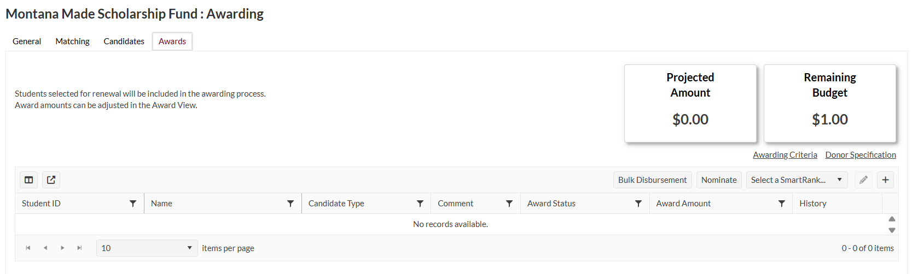
Individual Scholarship
View
Award Tab: this functionality is only available for the Award Manager. You can make and awards here, see a general overview of how much has been awarded, and keep a historical record of who is awarded to each fund each cycle moving forward.
Notes:
While this capacity exists on the individual fund level, it also exists within the “Awarding Tab” on an Award Manager’s Dashboard

Slide 13
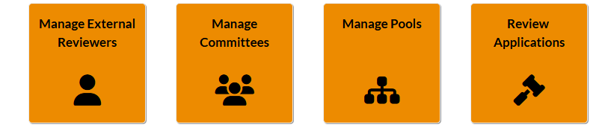
Review Tab
Manage External Reviewers icon- Allows Review Manager to invite someone outside of UMT staff to join a scholarship review committee
Manage Committees icon- Allows Review Manager to create and manage review committees for their scholarships, so committee can log in, and score candidates based on criteria
Manage Pools icon- Allows Review Manager to create relevant scholarship pools for all scholarships that a certain committee will review so that review committee can review all scholarships/candidates in one setting
Review Applications– A reviewer tab, for reviewers on review committees to hop on and review candidate pools. Reviewer access is all that is needed to access this particular icon
Notes:
Review tab is managed by Review Manager, and Reviewer only has access to “Review Applications”—FAO Office recommends “Oversight Admin” if you need access to this functionality in SU.

Slide 14
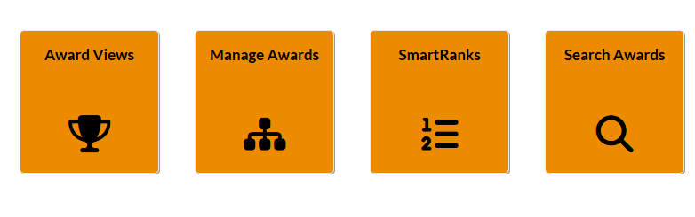
Award Tab
Award Views icon- Allows oversight admin to award all scholarships in one place, rather than having to drill into each individual scholarship to award
Manage Awards icon- Allows users to see an overview of all students they have awarded, outstanding student tasks, whether or not a student cancelled the award, and all of the associated info with the fund that a student was awarded
Smart Ranks icon- Allows user to give weight to certain criteria when a review pool goes to score scholarship candidates
Search Awards- Allows user to search through all awards and the statuses of awards. Staff can see here if an award was removed from a student, to determine reconciliatory efforts for funds
Notes:
Award Tab is only accessible to Award Manager (Oversight Admin Role)

Slide 15
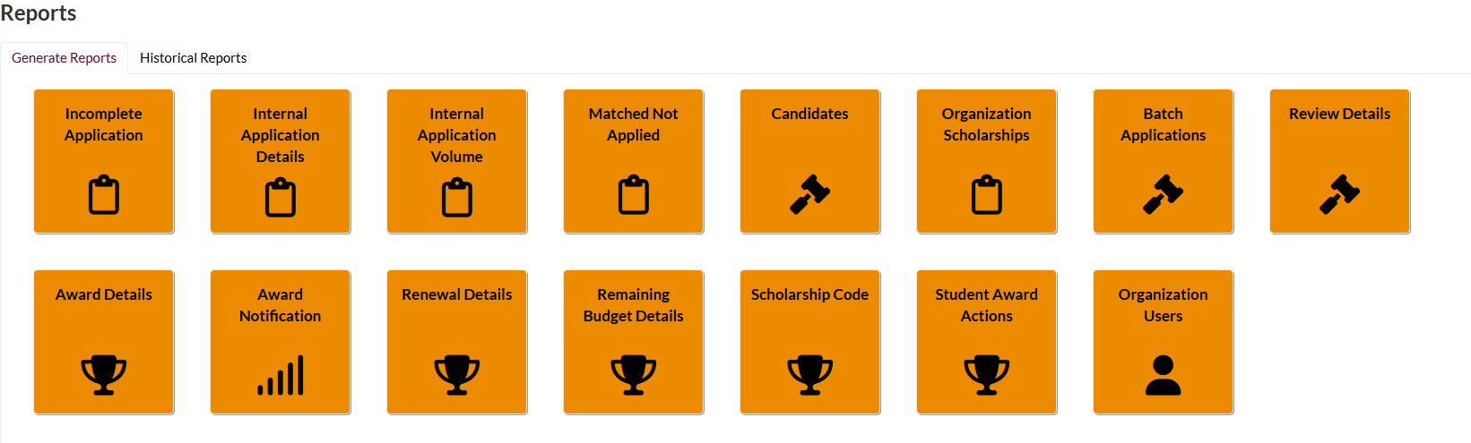
Reports Tab
Incomplete Application Report -Allows oversight admin to pull report on all students with incomplete applications associated with certain funds
Internal Application Details- Allows users to pull report on data related to how many students filled out an application tied to funds
Matched not applied- Allows user to pull report on candidates who matched to scholarships, but didn’t apply
Batch Applications- Allows users to pull report on all scholarships associated with application tied to funds, and matching candidates. Most admins will want to share this report with with their review pools
Award Reports- Will go over in future trainings
Notes:
Reports tabs access can vary depending on what type of access you have.
Oversight Admins will be the ones who have access to all of these reports

Slide 16
Meeting Q/A Summary
Can we reopen an application if it was submitted and the student is requesting an opportunity to enter additional information?
The application cycle for students is open from Dec.1- Mar. 1. Even if a student submits an application, they have the ability to make edits throughout that entire cycle to their answers and applications.
Do we contact the fascholarships email to assign roles?
You will use the same “Scholarship Administrator” link to request access to updated roles. As of now,
Will the administrator be able to change the scholarship application deadline?
Our overall Application timeline this year for SU is 12/1/25- 3/1/26. If you as a department want to encourage students to apply sooner, we welcome that. The cycle just will not close until 3/1/26. Meaning, students will be able to apply up until that point. That said, administrators will be able to make awards throughout this entire cycle period. We have awarding set up so that you could award today if desired. You can prioritize students who apply sooner.
Will we be able to make edits to the applications in Scholarship Universe?
The FAO office has set up every application according to its original form, unless the question in the previous application is now a matching question. Because the application is now live and published, we have limited ability to make edits to applications during this fund cycle. I will be meeting with each department before the next cycle to gather any changes in applications for the next cycle.
Can the timeline/cycle for certain Scholarship be changed?
The Scholarship Universe portal does have this capacity, however departments will need to reach out and request special permissions for certain scholarships to be on a different cycle.

